Slide 1
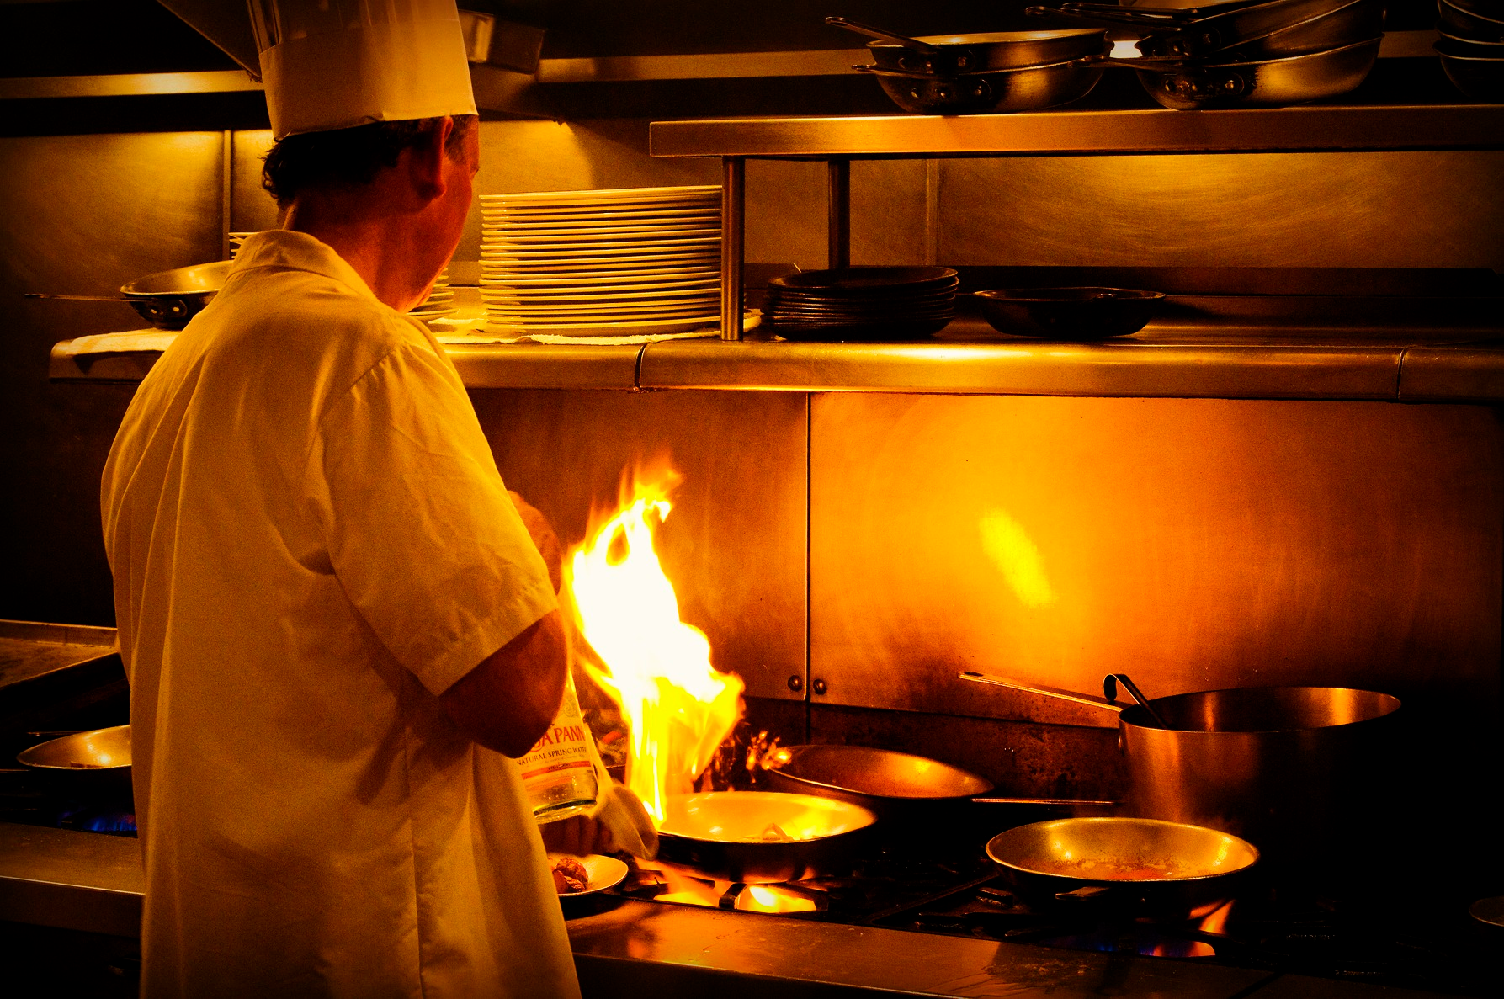
YOU ARE
getting
THAT 5
star review
(c) HOT HOPKINS KITCHEN
Notes:
- hello everyone welcome to the hot hopkins kitchen!
- introduce, formerly
- do you want to hear a story? Yes!
- wade and I heard about this lab that ap bio kids loved where eminems.
- we could one up that
- your our special guests today and we're going to tour of what makes our resteraunt special

Slide 2
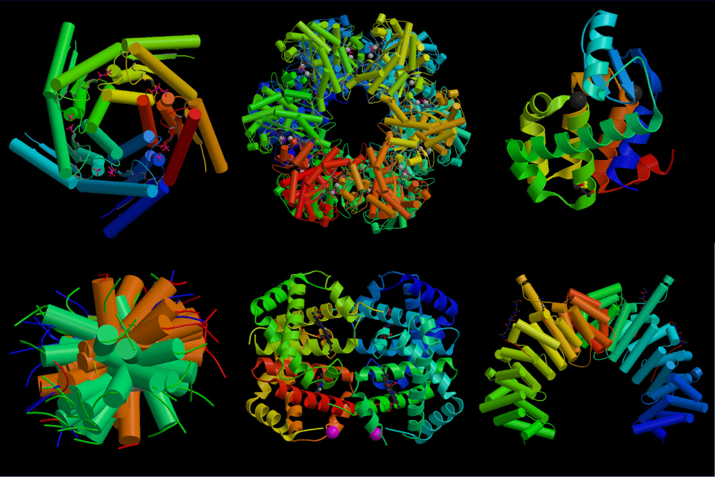
PROTEIN
Notes:
When I say protein I know
Bruh
How much of our dry mass is protein? 75%
So its kind of important we understand this and to do this we're going to take a look at the egg
What is the most common protein in egg?
Albumin
Show → 50% of that. %50 of the blood plasma too
Let's talk about some properties of albumin

Slide 3

BROTEIN!

Slide 4

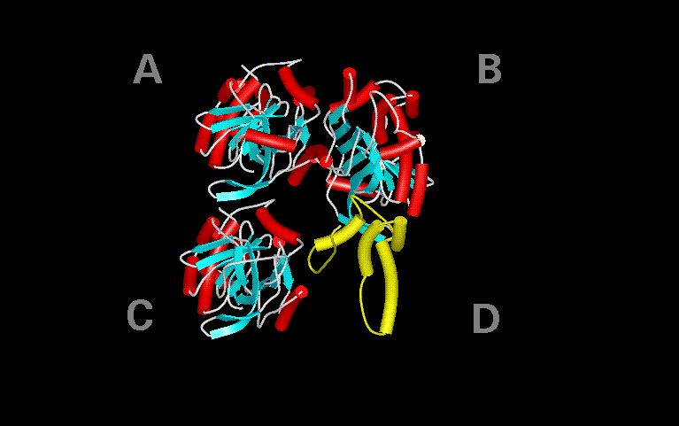
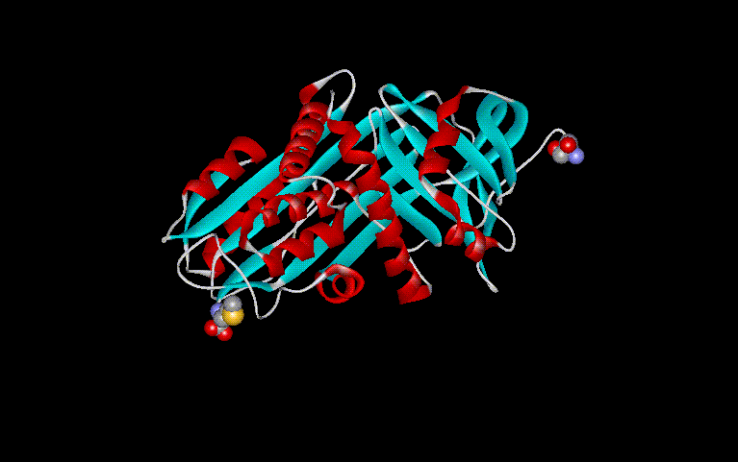
PRIMARY
SECONDARY
LYSINE-GLYCINE-VALINE-CYSTEINE
-ARGININE-GLUTAMINE-CYSTEINE
-SERINE-SERINE-GLYCINE-VALINE
-LYSINE-GLYCINE-VALINE-CYSTEINE
-HISTIDINE-GLUTAMINE-TYROSINE
-PROLINE-SERINE-GLYCINE-PROLINE
-SERINE-CYSTEIN-GLYCINE-VALINE
TERTIARY
QUATERNARY
Notes:
As you know, Four levels of structure
This is albumin (4)
I want sara to disrupt this beautiful structure
What can he do?
Demo:
Acid
Whisking
cooking

Slide 5
DENATURATION
Notes:
Eggs aren't that interesting
Lets move to something that'll get us real $
These babies
What are a few ways of cooking meat?
Marinade usually has an acidic component to it. Why?
This tenderizes the meat.
Hopefully we' can see the difference

Slide 6
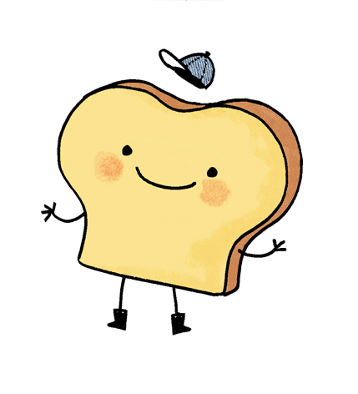
Notes:
While that's marinating let's ask a different question.
Why does toast brown?
Why doesn't random object brown when I put that into a toaster and come out nice and crispy?

Slide 7
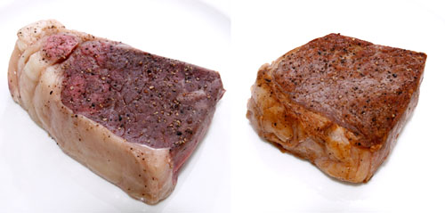
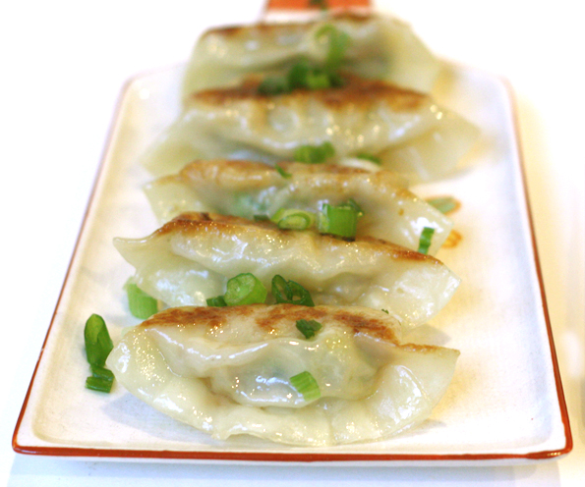
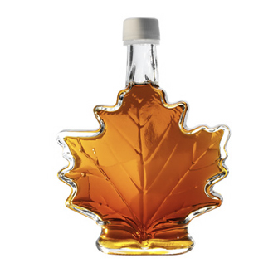
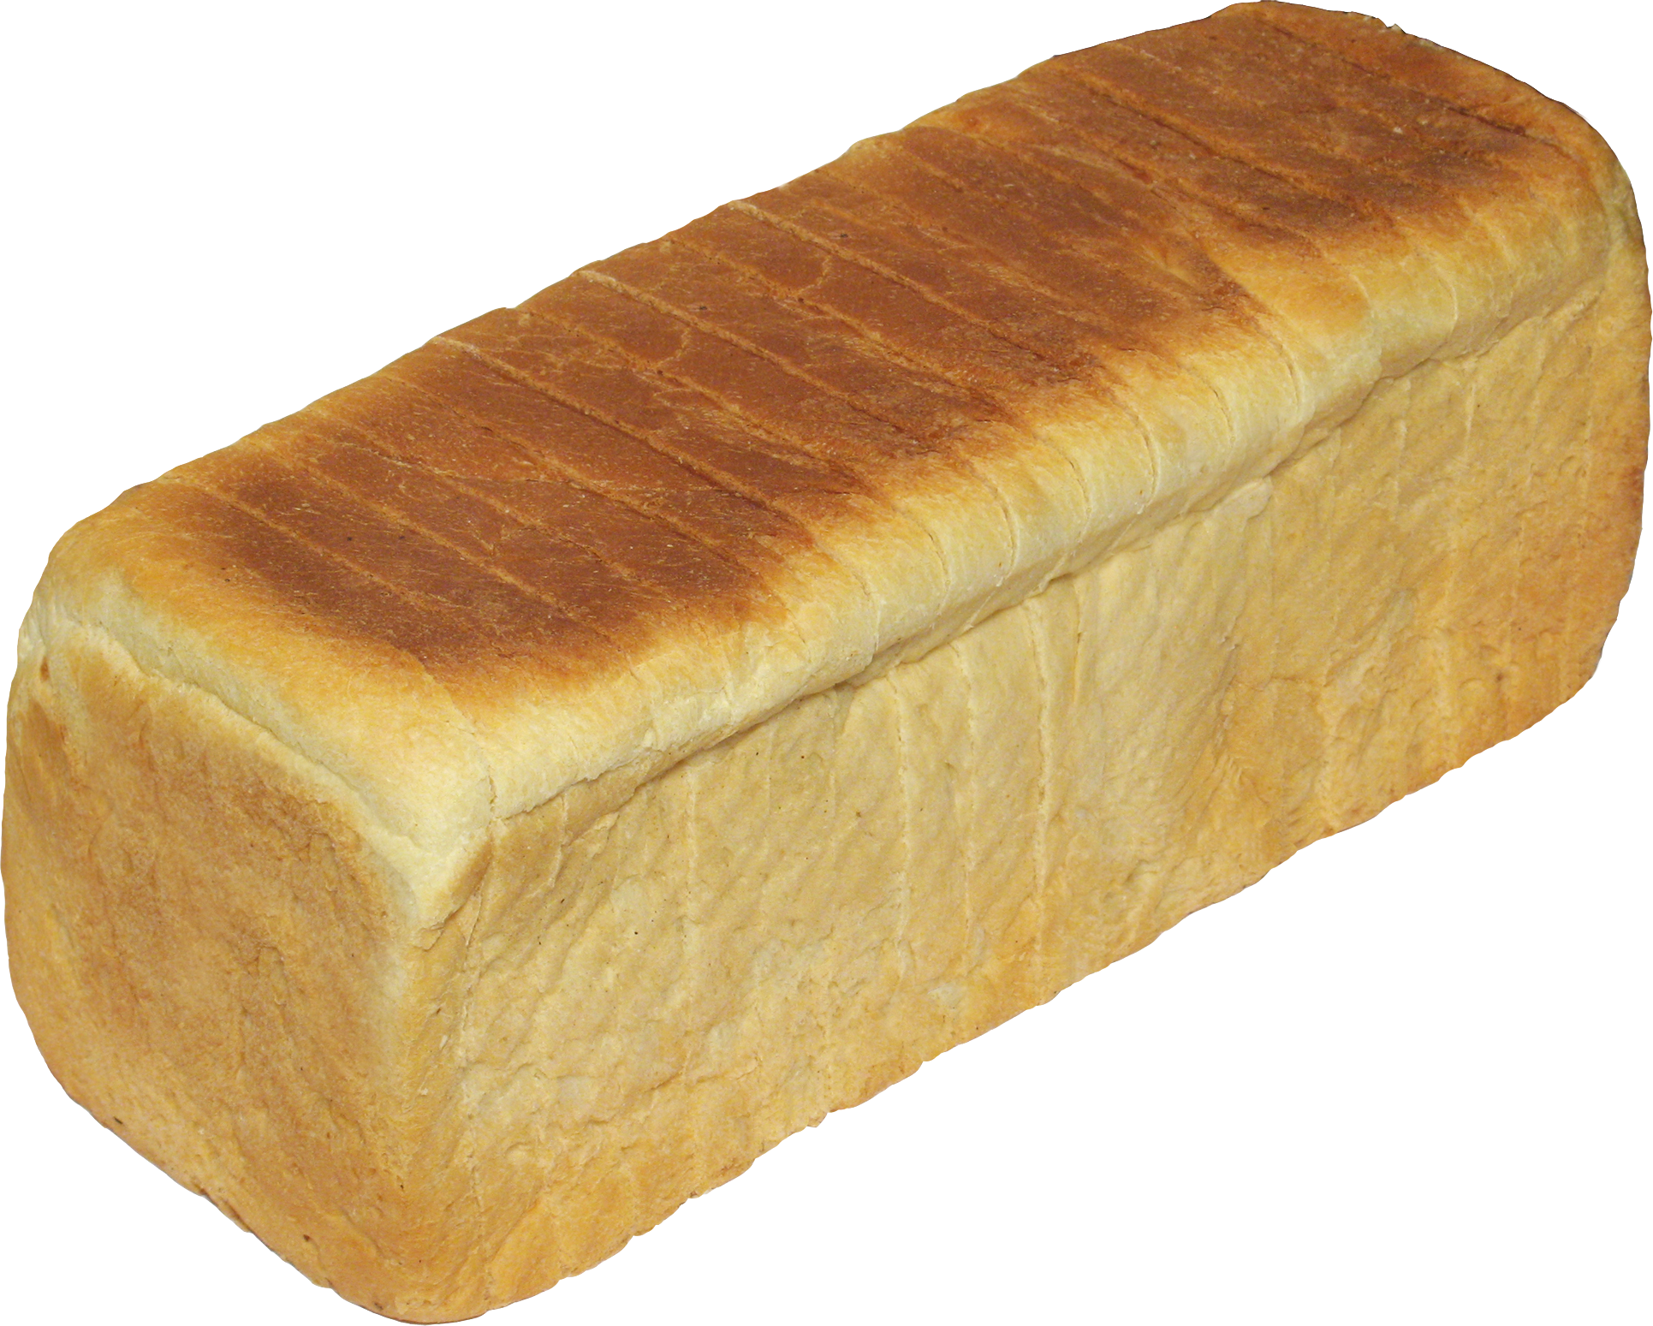
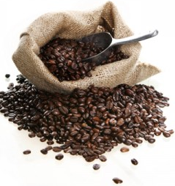
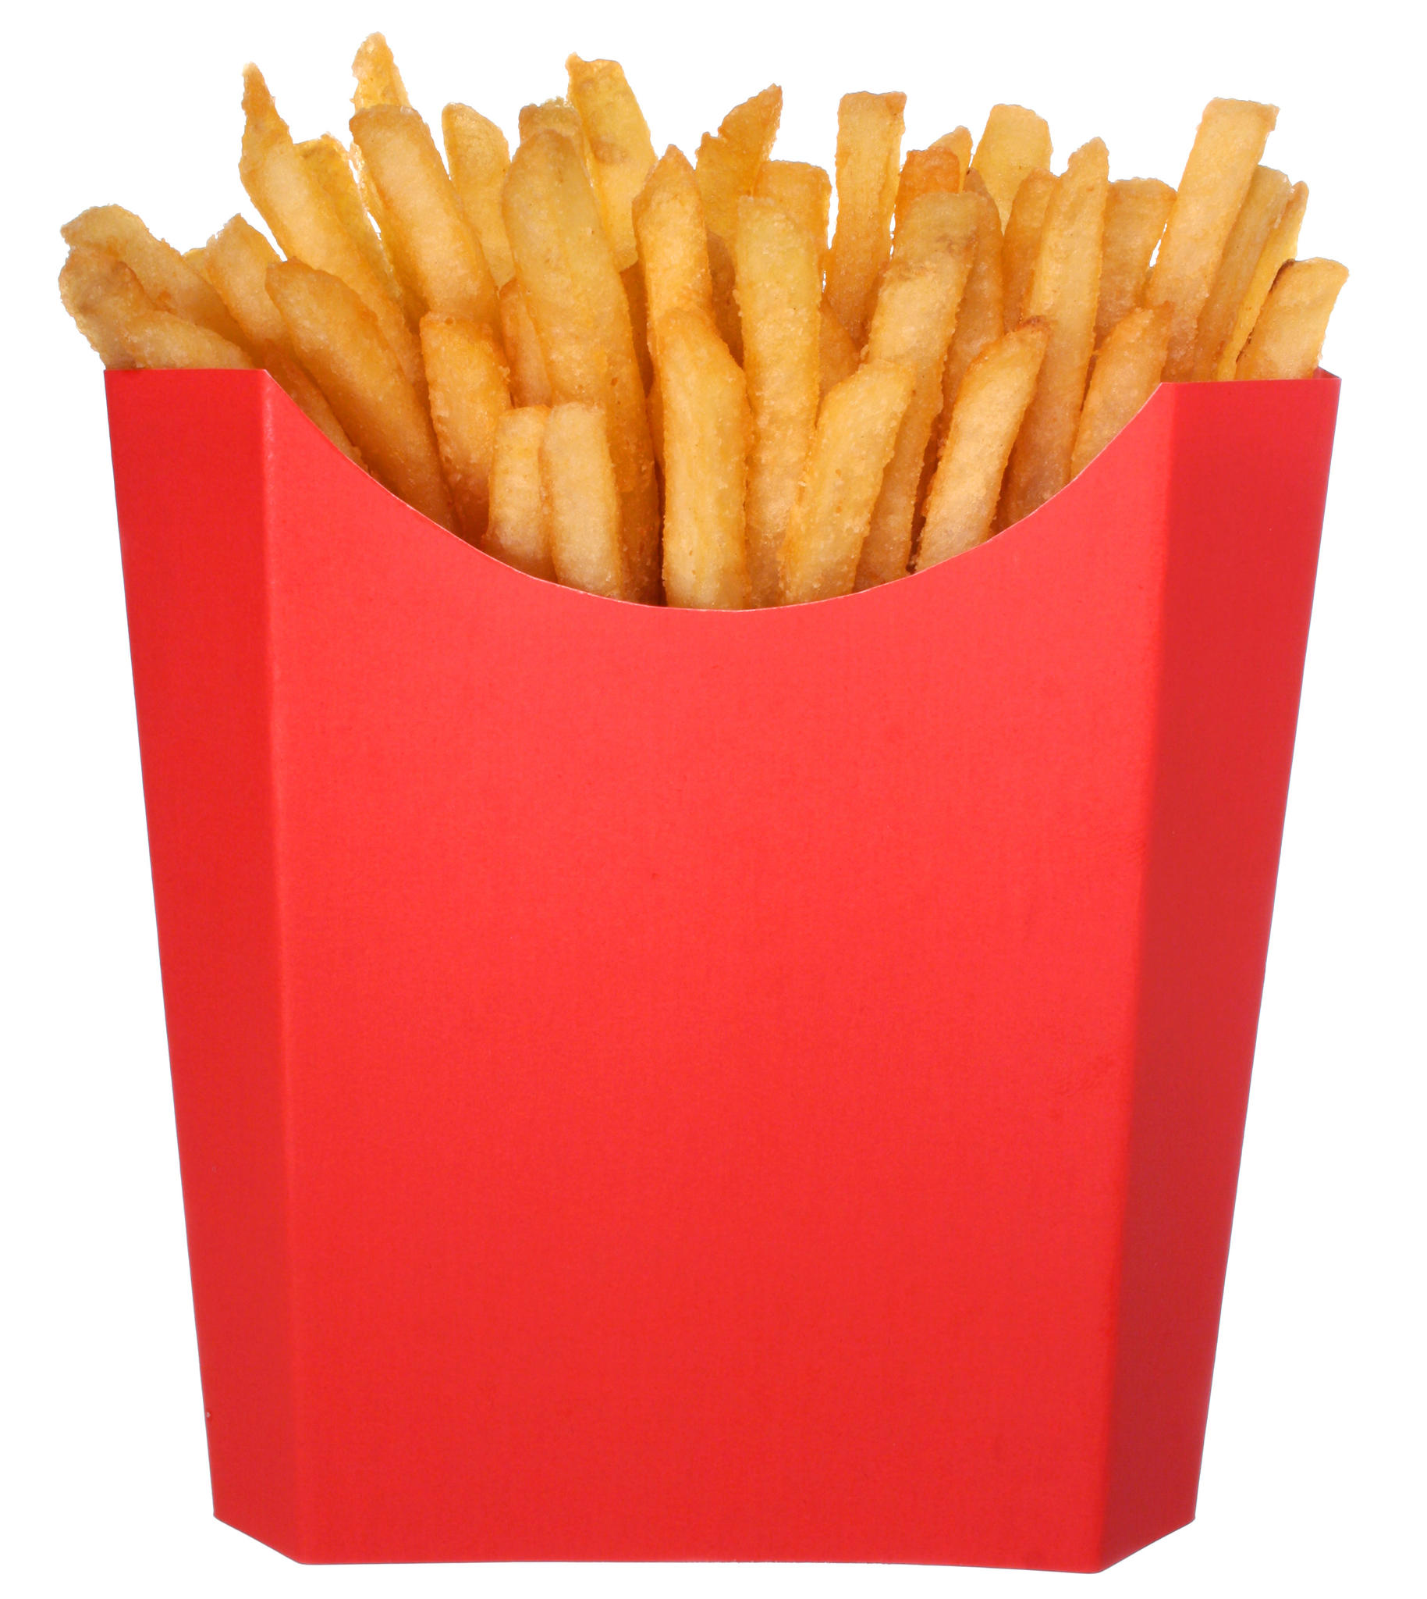
MAILLARD RXNs
Notes:
While that's marinating let's ask a different question.
Why does toast brown?
Why doesn't random object brown when I put that into a toaster and come out nice and crispy?

Slide 8
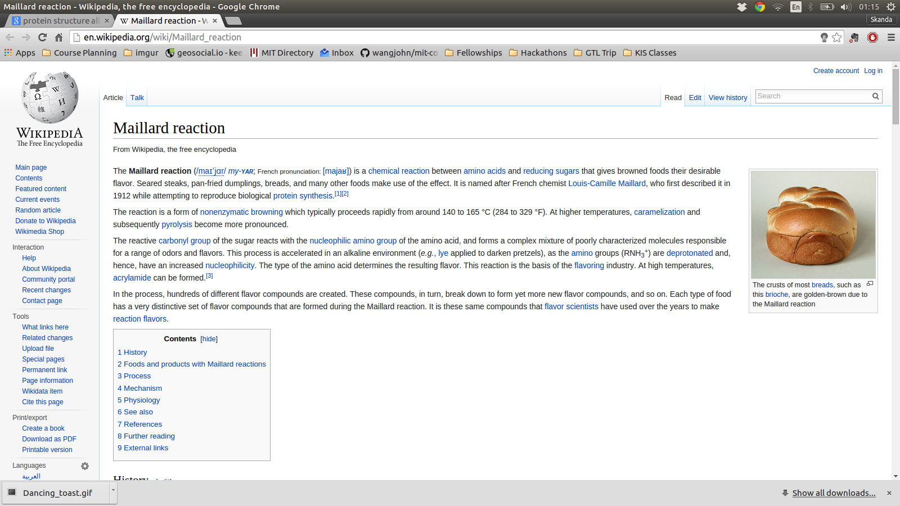
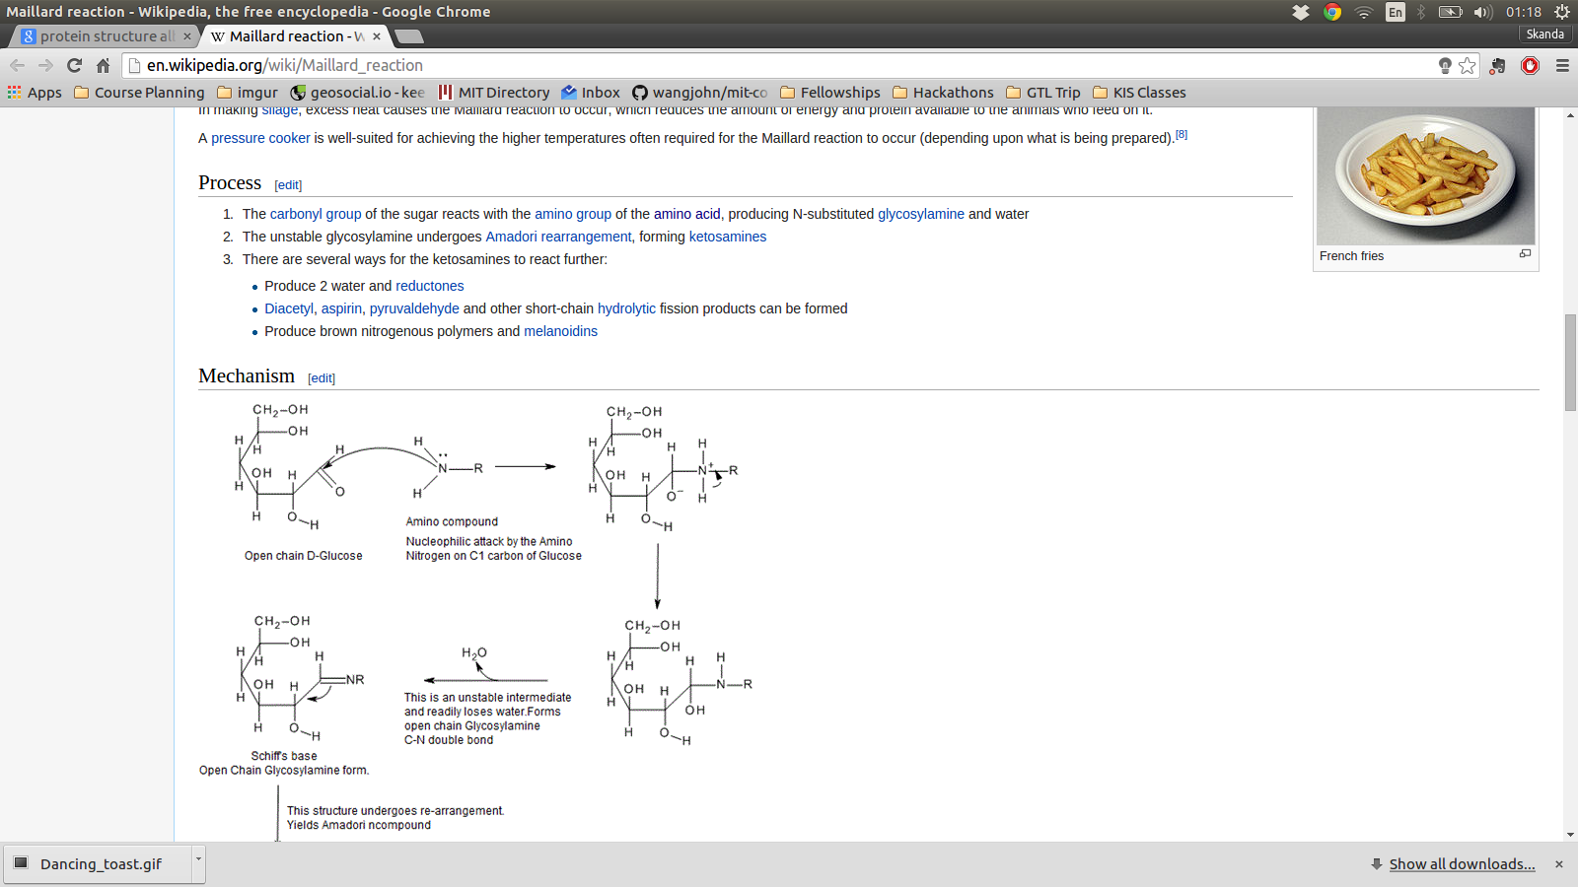
FUNCTIONAL GROUP REVIEW TIME
...
Notes:
While that's marinating let's ask a different question.
Why does toast brown?
Why doesn't random object brown when I put that into a toaster and come out nice and crispy?

Slide 9
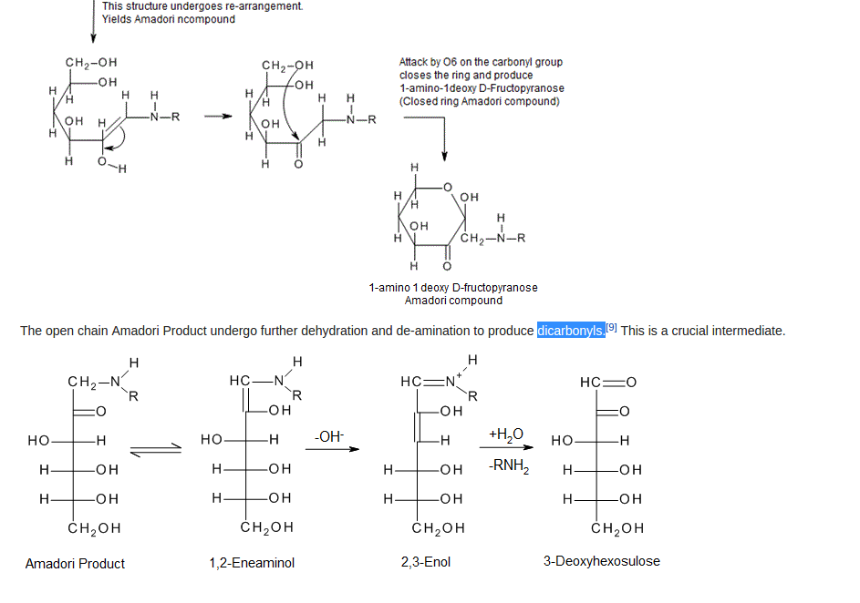
FUNCTIONAL GROUP REVIEW TIME
Notes:
While that's marinating let's ask a different question.
Why does toast brown?
Why doesn't random object brown when I put that into a toaster and come out nice and crispy?

Slide 10
IMPORTANT THINGS FOR NOW
REACTANTS?
PRODUCTS?
Notes:
What do these reactions require?
What do these reactions not require?
Sugar and butter →
Sugar and milk →
Caramel is 1D
Dulce de leche

Slide 11
BUT I GOT NO PROTEIN, BRAH...
Notes:
While that's marinating let's ask a different question.
Why does toast brown?
Why doesn't random object brown when I put that into a toaster and come out nice and crispy?

Slide 12
CARMELIZATION
Notes:
While that's marinating let's ask a different question.
Why does toast brown?
Why doesn't random object brown when I put that into a toaster and come out nice and crispy?

Slide 13
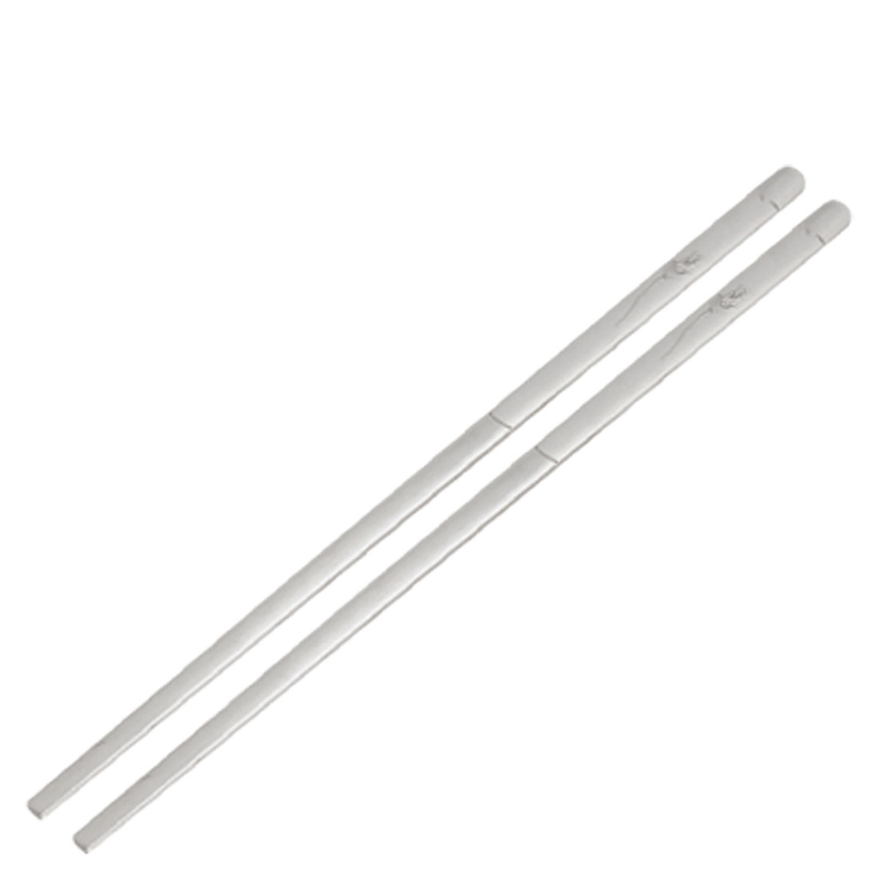
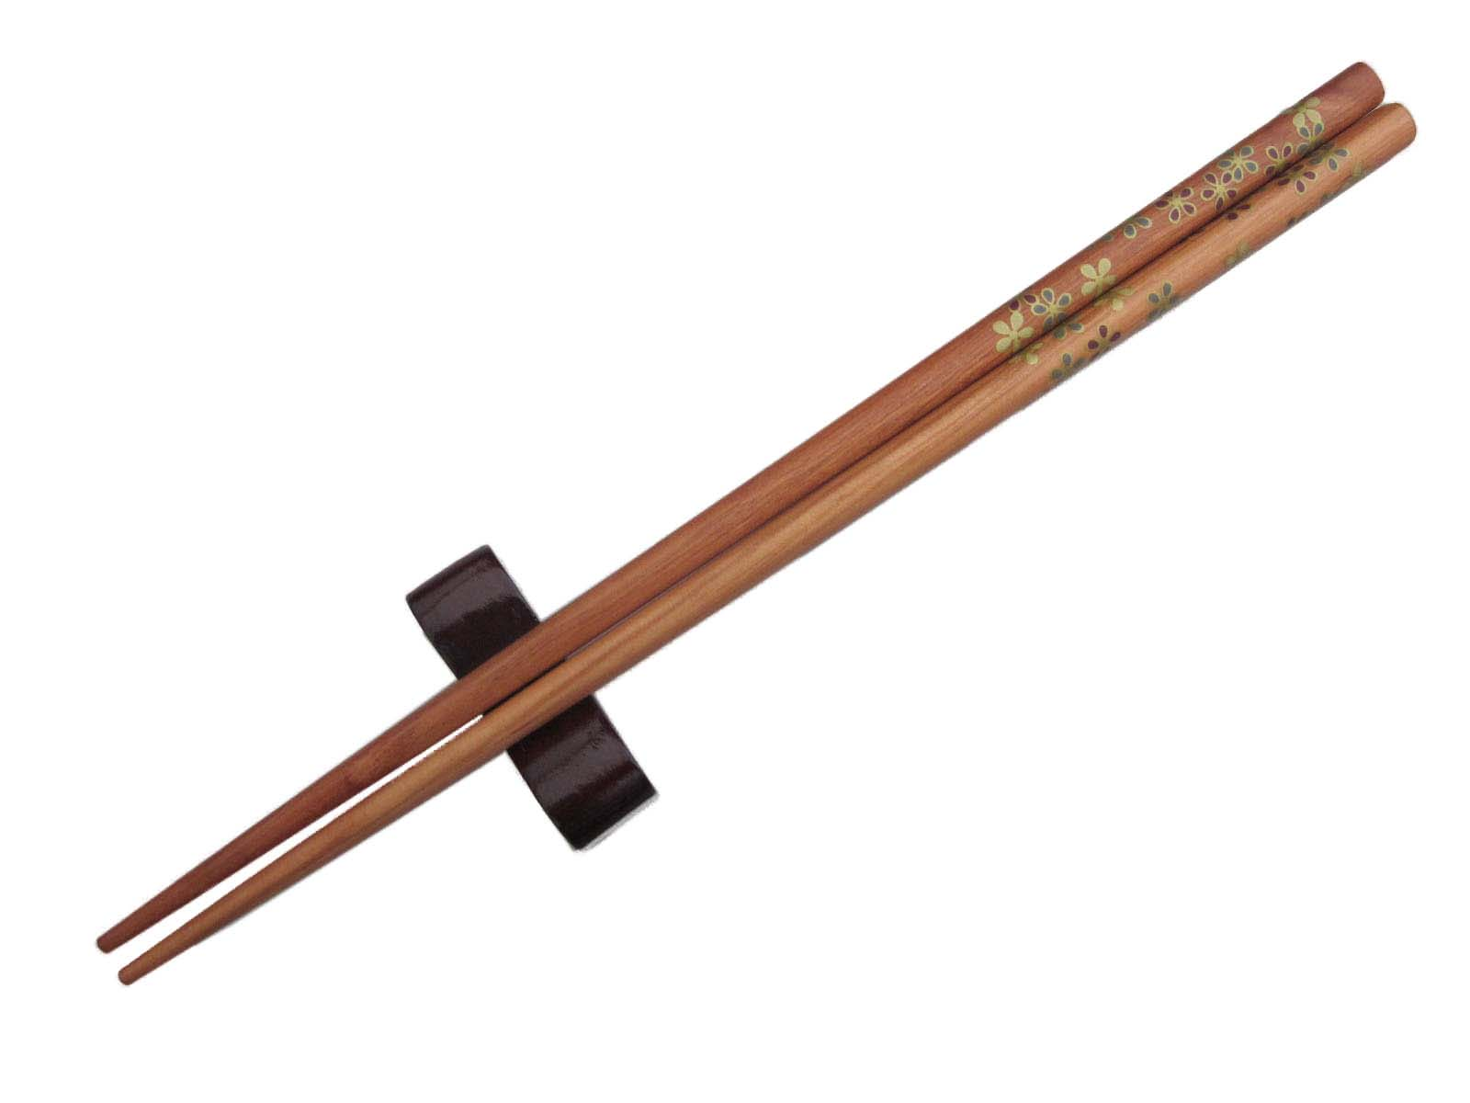
Notes:
While that's marinating let's ask a different question.
Why does toast brown?
Why doesn't random object brown when I put that into a toaster and come out nice and crispy?

Slide 14
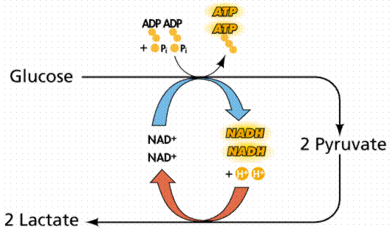
Notes:
While that's marinating let's ask a different question.
Why does toast brown?
Why doesn't random object brown when I put that into a toaster and come out nice and crispy?

Slide 15
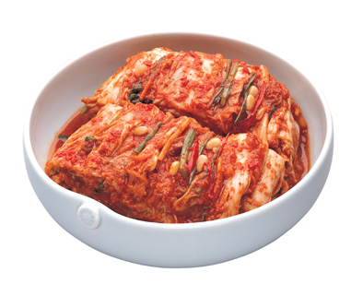
BATTLE OF THE KIMCHIs
MY pH beats your pH!
Notes:
While that's marinating let's ask a different question.
Why does toast brown?
Why doesn't random object brown when I put that into a toaster and come out nice and crispy?

