Slide 1

CHESSTRONICS CYBERSECURITY

Slide 2
RESOURCES FOR KIDS
https://www.esafety.gov.au/kids (K-5)
https://www.youtube.com/watch?v=PR0c-gJ20kA&list=PL9ooVrP1hQOGPQVeapGsJCktzIO4DtI4_&index=41
EDUREKA Videos
Phishing target

Slide 3
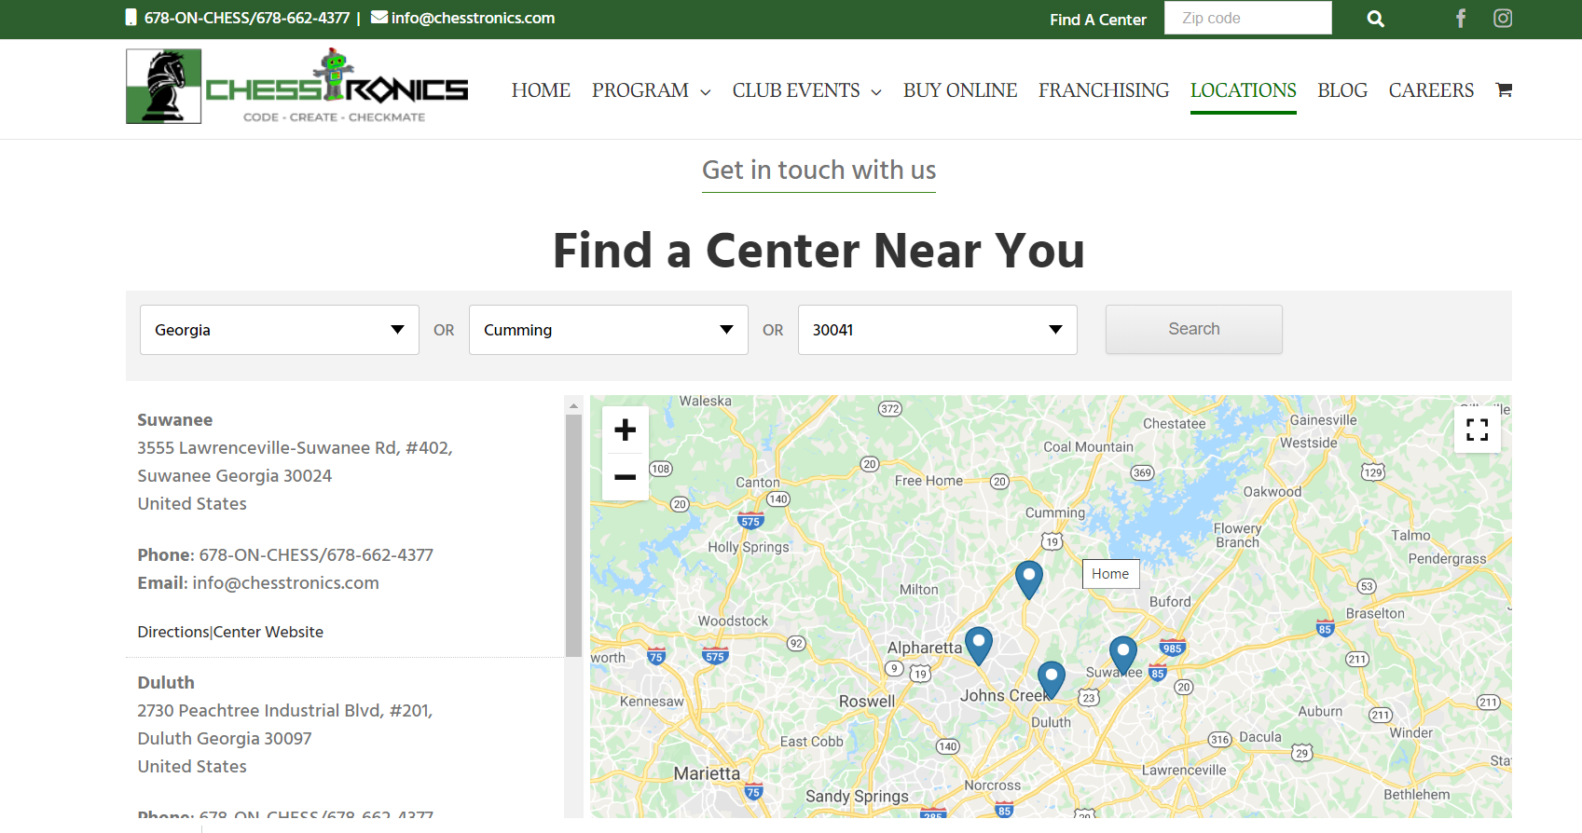
CHESSTRONICS ATLANTA LOCATIONS

Slide 4


CHESSTRONICS OTHER
OFFERINGS
CHESS : TEACHING TOURNAMENTS SUPPLIES
ROBOTICS:
VEX IQ,
STEM ROBOTS, PROGRAMMING
CODING:
K-5 Game Design 6-7-8 : Python 9-12 : AP Computer Science

Slide 5
CHESSTRONICS NEW APP &
ADRINO ROBOT

