Slide 1
CS613-Midterm Proposal
Prateek Goel
Abishek S Kumar

Slide 2
PROBLEM STATEMENT
The paper considered creates two sets of neural network architectures :
Classification: CNN Architecture for activity classification
Regression: CNN Architecture for keypoint location estimation
Our work aims at extending the methods of the paper by checking if the location of the joints in an image improve upon the activity classification performance of a CNN.

Slide 3
APPROACH
Our approach is based on authors’ suggestions in their future work.
It would primarily be divided into two steps:
First run the input image through the joint estimation regression model to obtain the human pose information
Use the result from Step 1 as a secondary input (in addition to the original input image) into the classification model.
In addition to the approach, we will be porting the entire architecture to Tensorflow and Pytorch Libraries.
As of now we are basing our models using the AlexNet Convolutional Neural Networks (same as authors), however, we are open to consider other convolutional networks depending on time and resources available.

Slide 4
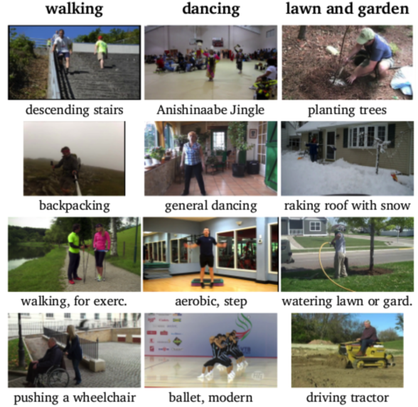
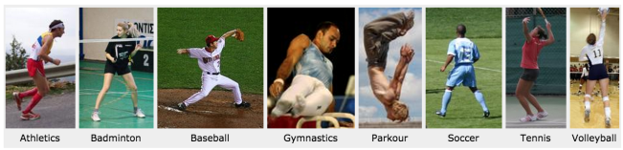
DATA SOURCES
The following datasets, as used by the original authors of the paper, will be considered:
MPII dataset (Classification) : 25000 images
Leeds sports pose dataset (Regression) : 11,000 training & 1000 testing images

Slide 5
PROBLEM RELATEDNESS TO MACHINE LEARNING
This problem uses models for both Classification and Regression and considers the output of one as a means to train the other.
This approach is loosely based on Transfer Learning
The original paper has mentioned only accuracy as a means of model correctness. We will be elaborating on that by calculating Precision, Recall and F1 -scores.
The Neural Networks considered, use concepts of cross entropy and softmax probability as a means for classification.

Slide 6
REFERENCE PAPER
Human Pose Estimation Using Convolutional Neural Networks
Citation Reference:
A. Singh, S. Agarwal, P. Nagrath, A. Saxena and N. Thakur, "Human Pose Estimation Using Convolutional Neural Networks," 2019 Amity International Conference on Artificial Intelligence (AICAI), Dubai, United Arab Emirates, 2019, pp. 946-952

