Slide 1

Маркетинговая аналитика
Дашборд:
https://1d811c51.us1a.app.preset.io/superset/dashboard/13/?native_filters_key=FNQV8AtgbzUE8unnNJsY9lWdba0kDiesoOZUQgp9braBf2guqGVpeB0NKjQ7HtTS

Slide 3
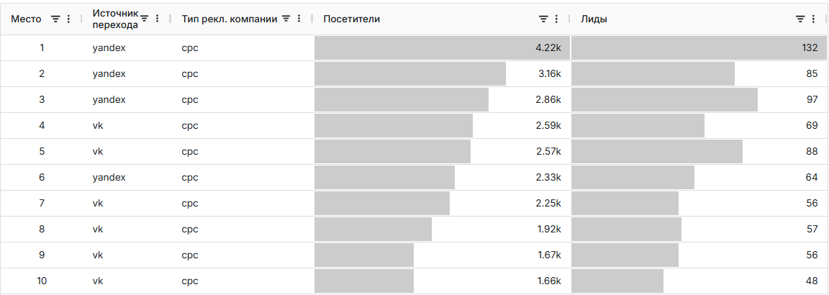

Slide 4
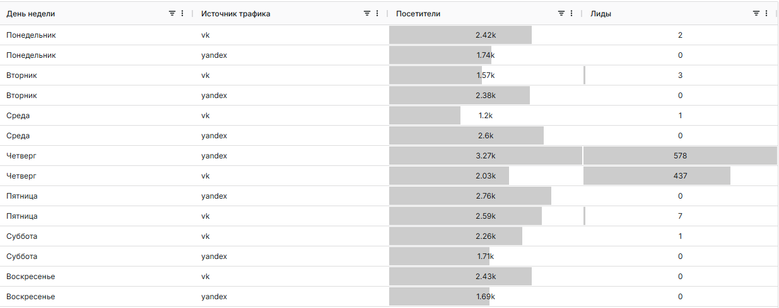

Slide 5
