Slide 1
Scheduling non-identical jobs on a batch machine
Sebastian Kosch
BASc Thesis, EngSci 1T3
Feb 27th, 2013

Slide 2
Scheduling non-identical jobs on a batch machine: Intro
b
s, p, d
s, p, d
s, p, d
s, p, d
s, p, d
s, p, d
s, p, d

Slide 3
Scheduling non-identical jobs on a batch machine: Intro
b
… minimize L_{max}!
s, p, d
s, p, d
s, p, d
s, p, d
s, p, d
s, p, d
s, p, d

Slide 4
Scheduling non-identical jobs on a batch machine: Intro
b
Earliest Due Date First (EDD)

Slide 5
Scheduling non-identical jobs on a batch machine: Intro
b
Jobs batched
Batches due with earliest-due job
Earliest Due Date First (EDD)

Slide 6
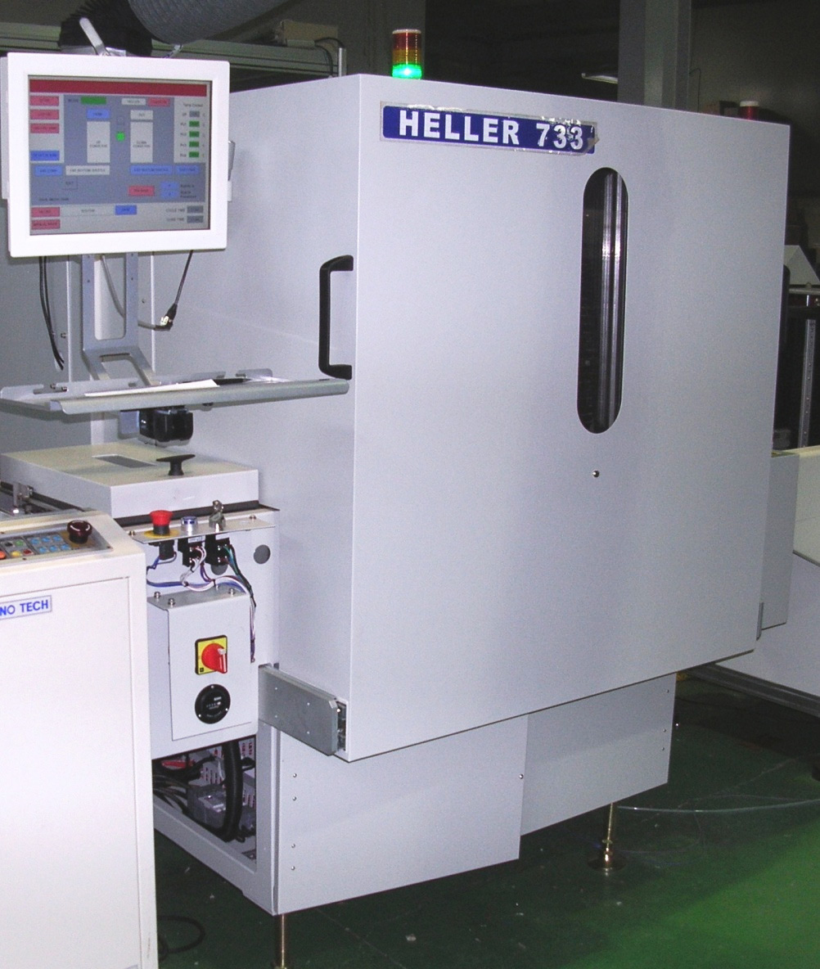

Slide 7
Scheduling non-identical jobs on a batch machine: Intro
b
Jobs batched
Batches due with earliest-due job
Earliest Due Date First (EDD)

Slide 8
Scheduling non-identical jobs on a batch machine: Intro
Objective:
Every job as early as possible
Problem:
Position of L_{max} is unknown, so which jobs should be batched?
b
Jobs batched
Batches due with earliest-due job
Earliest Due Date First (EDD)

Slide 9
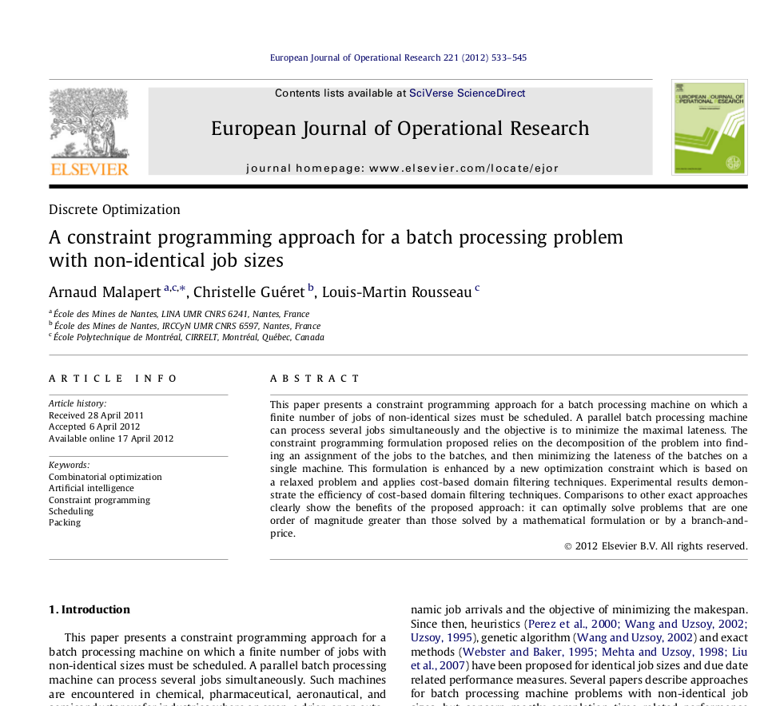
Scheduling non-identical jobs on a batch machine: Intro

Slide 10
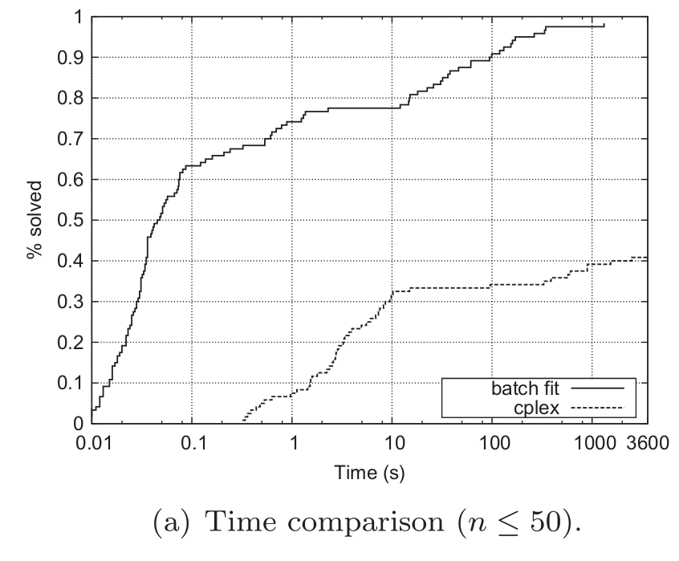
Scheduling non-identical jobs on a batch machine: Intro
Malapert's sequenceEDD global constraint
Update bounds on L_{max} based on known P_{k} and D_{k} in partial assignment
Eliminate possible assignments based on known bounds on L_{max}
Update bounds on n_{k} based on minimum cost of opening a new batch

Slide 11
Scheduling non-identical jobs on a batch machine: Intro
Malapert's sequenceEDD global constraint
Update bounds on L_{max} based on known P_{k} and D_{k} in partial assignment
Eliminate possible assignments based on known bounds ond L_{max}
Update bounds on n_{k} based on minimum cost of opening a new batch
… can we beat that?

Slide 12
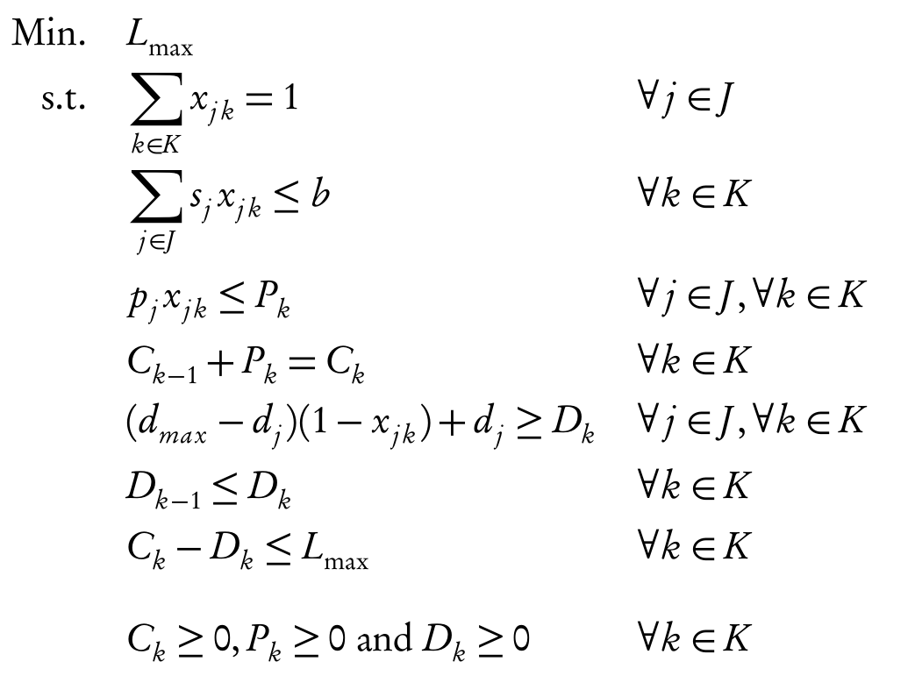
Scheduling non-identical jobs on a batch machine: MIP approach I

Slide 13
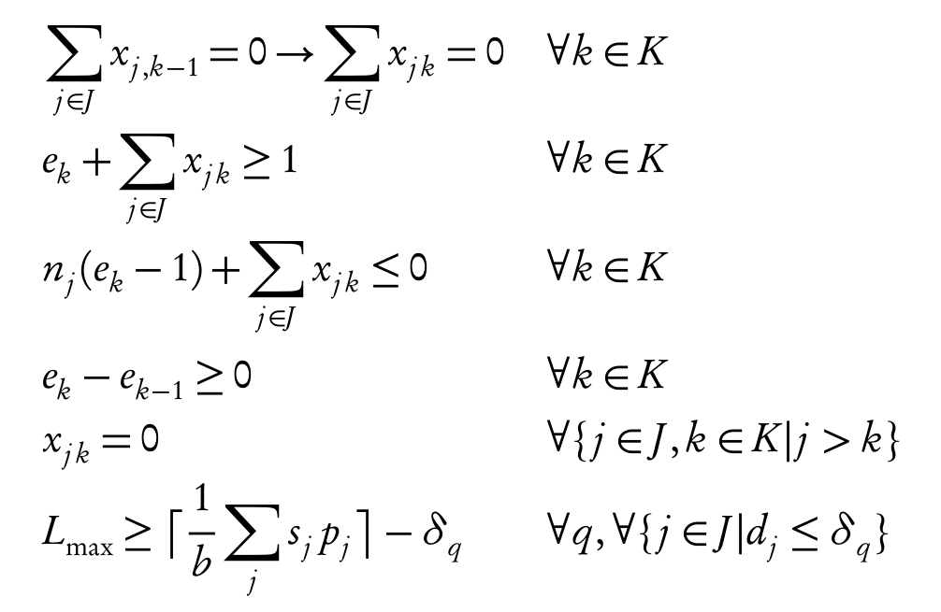
Scheduling non-identical jobs on a batch machine: MIP approach I
group empty
batches
only move
jobs back
bound on L_{max}

Slide 14
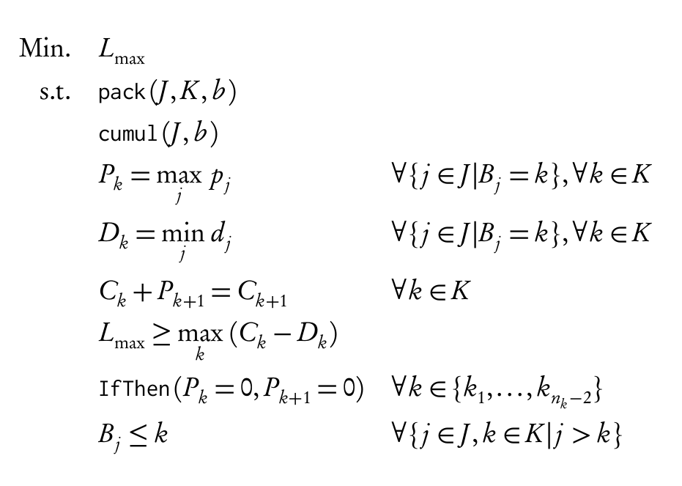
Scheduling non-identical jobs on a batch machine: CP approach I
b

Slide 15
Scheduling non-identical jobs on a batch machine: batch-by-batch approach
b

Slide 16
Scheduling non-identical jobs on a batch machine: batch-by-batch approach
b
b

Slide 17
Scheduling non-identical jobs on a batch machine: batch-by-batch approach
b
b

Slide 18
Scheduling non-identical jobs on a batch machine: batch-by-batch approach

Slide 19
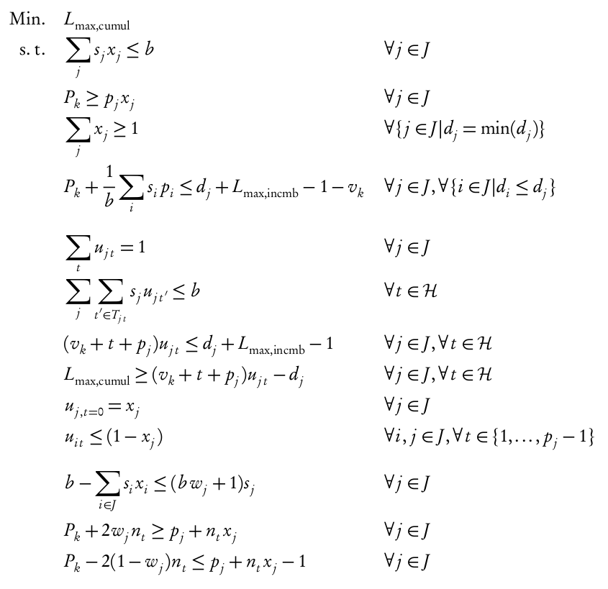
Scheduling non-identical jobs on a batch machine: batch-by-batch approach

Slide 20
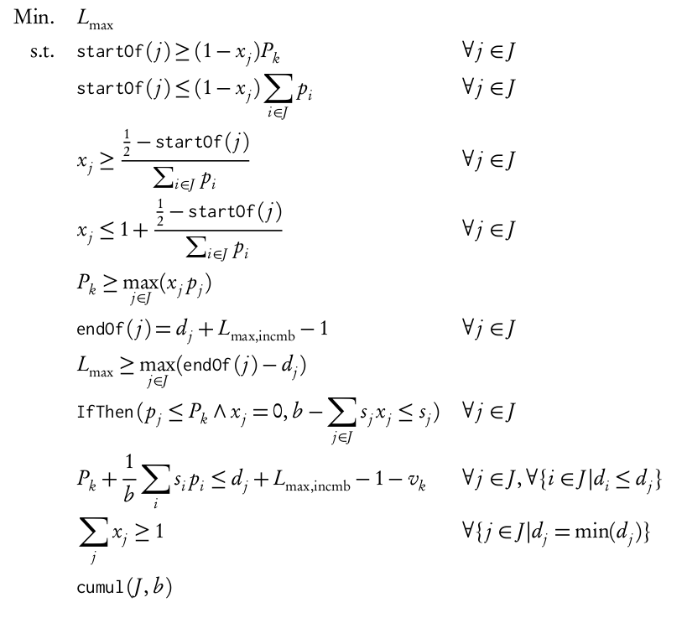
Scheduling non-identical jobs on a batch machine: batch-by-batch approach

Slide 21
Scheduling non-identical jobs on a batch machine: batch-by-batch approach

Slide 22
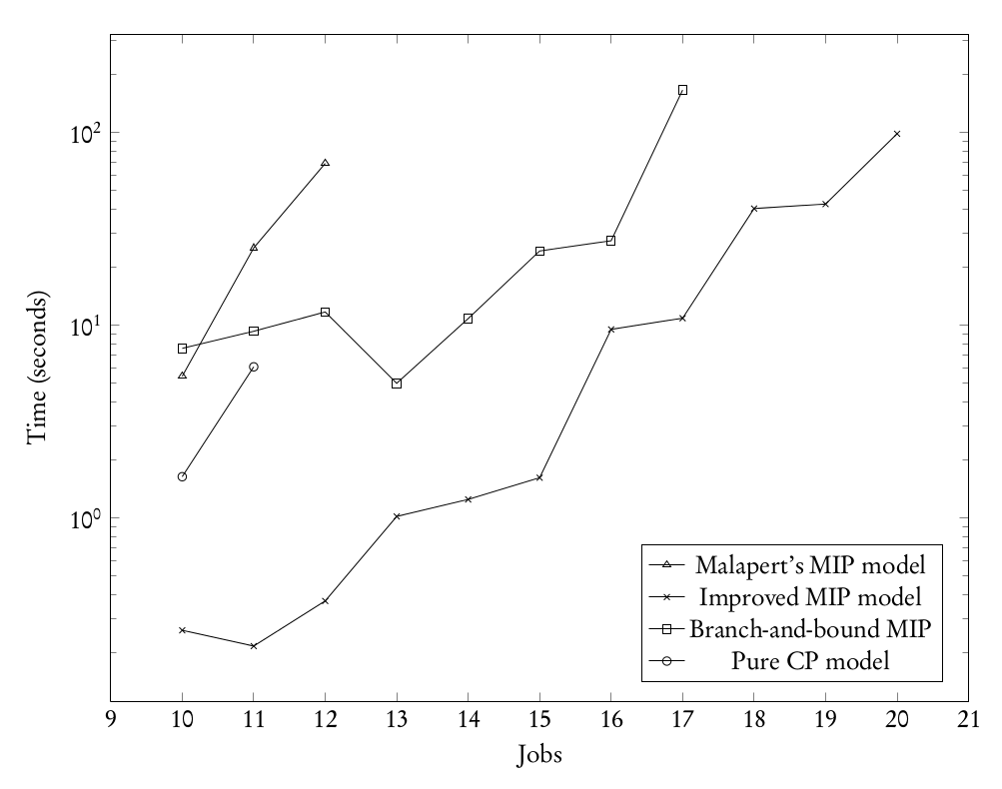
Scheduling non-identical jobs on a batch machine: Results

Slide 23
Scheduling non-identical jobs on a batch machine: Results
… what now?

Slide 24
Scheduling non-identical jobs on a batch machine: Results
… what now?

