Slide 1
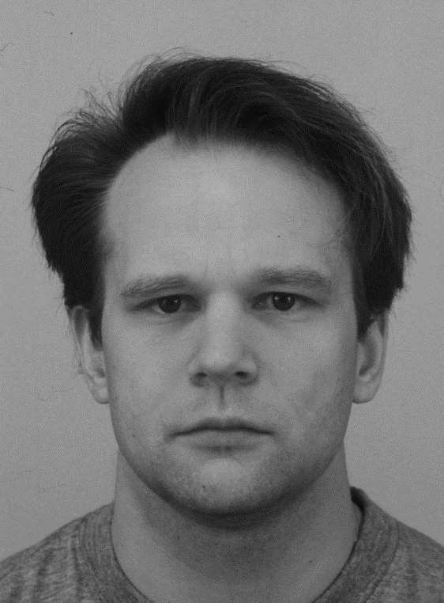
Welcome to the Face Task
In this task, you will be asked to identify the emotion of a target face.
The target face will always appear in the middle of the screen.
Target
Please press the SPACEBAR to continue.

Slide 2
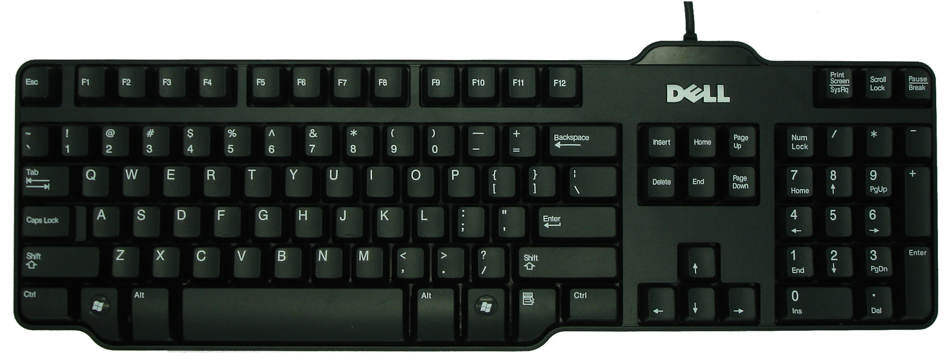
For this task, you will need to use the number pad on the keyboard for responding. You will need to use the numbers 1, 2, and 3.
Please only use your dominant hand. If you need to move the keyboard to respond comfortably, please do so.
Please press the SPACEBAR to continue.

Slide 3
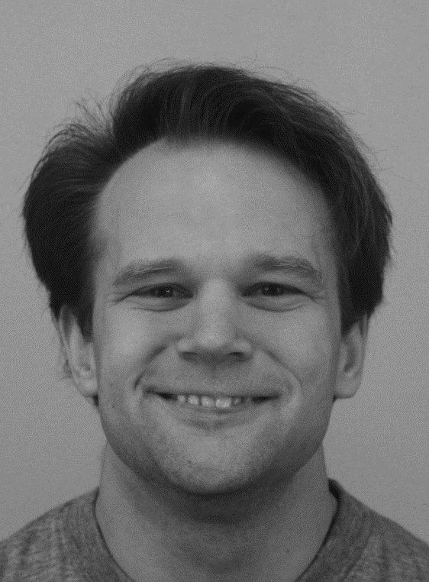


There will also be faces to the left and right of the target.
You should ignore the left and right images.
Ignore
Target
Ignore
Please press the SPACEBAR to continue.

Slide 4
If the target face is NEUTRAL (like below),
Press “1” on the keyboard number pad
Ignore
Target
Ignore
Please press the SPACEBAR to continue.

Slide 5
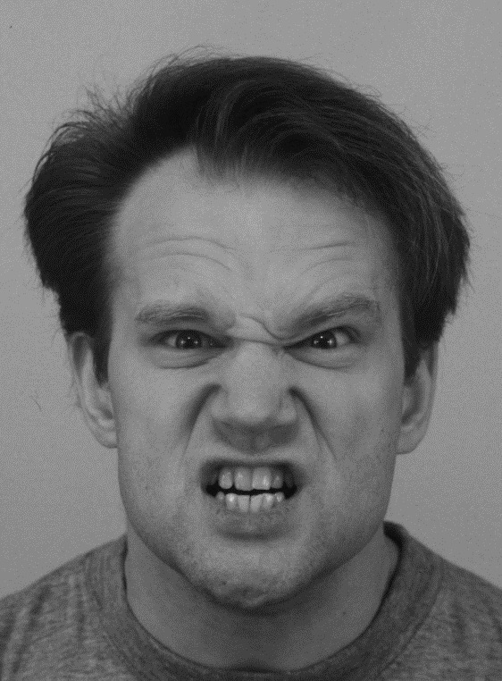
If the target face is ANGRY (like below),
Press “2” on the keyboard number pad
Ignore
Target
Ignore
Please press the SPACEBAR to continue.

Slide 6
If the target face is Happy (like below),
Press “3” on the keyboard number pad
Ignore
Target
Ignore
Please press the SPACEBAR to continue.

Slide 7
Please respond as quickly as possible, without sacrificing accuracy.
You will only have a limited amount of time to respond.
Remember:
If you think the target image is NEUTRAL, press “1”.
If you think the target image is ANGRY, press “2”.
If you think the target image is HAPPY, press “3”.
First, you will get to do some practice trials.
For the practice trials, the response buttons will be on the top of the screen.
Later in the experiment, they will not be on the screen,
so please do your best to remember the response keys.
If you are ready, press the SPACEBAR to begin practice.

Slide 8
Welcome back to the Face Task
As a reminder:
In this task, you will be asked to identify the emotion of a target face.
The target face will always appear in the middle of the screen.
Target
Please press the SPACEBAR to continue.

