Slide 1
For example,
if you see the following word…
GREEN
The correct response would be red,
not green.
Please press the SPACEBAR to Continue

Slide 2
Or if you saw…
XXXX
The correct response would be:
Blue
Please press the SPACEBAR to Continue

Slide 3
But be careful, sometimes the words and
colors match, and sometimes they don’t.
GREEN
The correct response would be:
Green
Please press the SPACEBAR to Continue

Slide 4
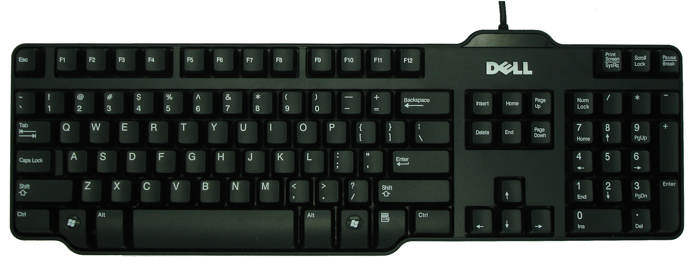
For this task, you will need to use the number pad on the keyboard for responding. You will respond using the keys for 7, 8, and 9.
Please only use your dominant hand. If you need to move the keyboard to respond comfortably, please do so.
Please press the SPACEBAR to continue.

