Slide 1

Advancing Program Rankings and Departmental Performance Analysis for Departments, Students, and Parents
Group Information
Team - Rankbusters
Members - Pradyum Mohta, Fuad Khasiyev, Ansh Dugar, Shamit Kotak.
Date - 12/3/2023

Slide 2
Background
Department Heads: Leverage departmental insights for informed decision-making and improvements.
Undergraduate Students: Access program rankings for informed decision-making on educational paths, gaining insights into the performance and reputation of specific programs.
Parents: Access program rankings and performance data to facilitate informed discussions and decisions regarding their children's educational choices.
Data/Sources
Department (01, Decision, Operations & Information Logistics, Ilya Ryzhov, Van Munching Hall, 4340);
Program (1001, Information Systems, Tejwansh (Tej) Singh Anand, MS, 2-3 semesters, 30, 01);
Source (https://www.topuniversities.com/university-rankings/university-subject-rankings/2023/computer-science-information-systems?search=university%20of%20maryland , https://www.rhsmith.umd.edu/departments , https://billpay.umd.edu/GraduateTuition , https://www.timeshighereducation.com/world-university-rankings)
Rank factor (2023, 1001, NULL, ‘$26770’, ‘$83000’);
Ranking (rnkScore, pgmId, rnfYear, srcName) (79, 1003, 2023, 'Times Higher Education’);

Slide 3
Introduction
Mission Statement
Enabling an advance database solution that delivers strategic insights into program rankings, departmental performance for department heads, undergraduate students, and their parents.
Mission Objectives
Finding the average of the rankings of the programs over the years for each department.
Determining the best performing departments in terms of rankings of their programs.
Identifying the years when the various sources had significant differences in the rankings of the programs.
Attaining the highest rankings for the programs over the years.
Obtaining the program levels (MBA, MS, etc.) that have the highest average rankings over the years.
Finding departments which offer the most programs that have been ranked in the top 10 by multiple sources.

Slide 4
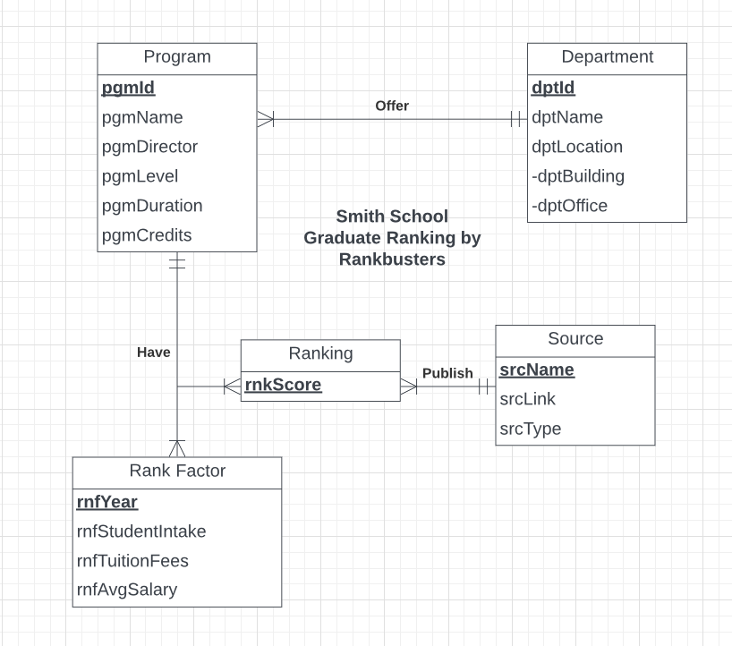

Conceptual Database Design
ER Diagram:

Slide 5
Logical Database Design
Relational Schema:
Department (dptId, dptName, dptChair, dptBuilding, dptOffice)
Program (pgmId, pgmName, pgmDirector, pgmLevel, pgmDuration, pgmCredits, dptId)
Source (srcName, srcLink, srcType)
Rank Factor (rnfYear, pgmId, rnfStudentIntake, rnfTuitionFees, rnfAvgSalary)
Ranking (rnkScore, pgmId, rnfYear, srcName)

Slide 6
Physical Database Design
CREATE TABLE [Rankbusters.Program] (
pgmId CHAR(3) NOT NULL, pgmName VARCHAR(20),
pgmDirector VARCHAR(20), pgmLevel VARCHAR(20),
pgmDuration INTEGER, pgmCredits INTEGER,
dptId CHAR(3) NOT NULL,
CONSTRAINT pk_Program_pgmId PRIMARY KEY (pgmId),
CONSTRAINT fk_Program_dptId FOREIGN KEY (dptId)
REFERENCES [Rankbusters.Department] (dptId)
ON DELETE CASCADE ON UPDATE NO ACTION
);

Slide 7
Two business transactions

