Slide 1


JBoss BRMS 6 Workshop
Stelios Kousouris
EMEA Senior Applications Architect
Automation & Big Data Practice Lead
May 2017

Slide 2
AGENDA
DroolsExpert Workshop
CEP hands on enablements (3 days)
HACEP Reference Architecture & Workshop
Workbench Editor
Deployment descriptors, Database Integration (Reactive Properties), drools engine features
Demos and other questions which will come up during the training

Slide 3
Drools / JBoss BRMS
Community version : Drools
Enterprise version : JBoss BRMS
  Release 6 to come early 2014
  JBoss BPM Suite (includes BRMS)
  Current new release: 6.4.3
  Next major release 7.0.0 (last quarter of FY18)

Slide 4
BRMS Introduction

Slide 5
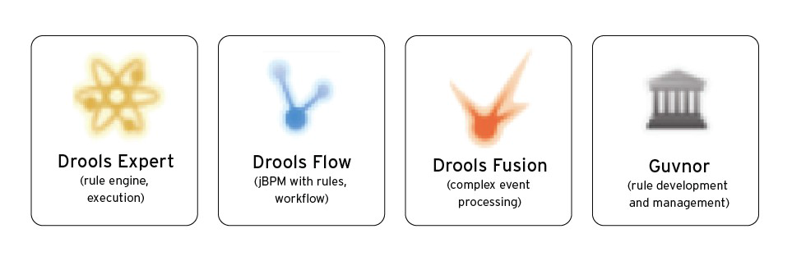
BRMS “productized” components
Drools Expert – RETE and PHREAK based rule engine
Drools Guvnor – business rules manager
Drools Flow – rule and process flow
Drools Fusion - complex event processing
Drools integrated development environment – JBDS (Eclipse)

Slide 6

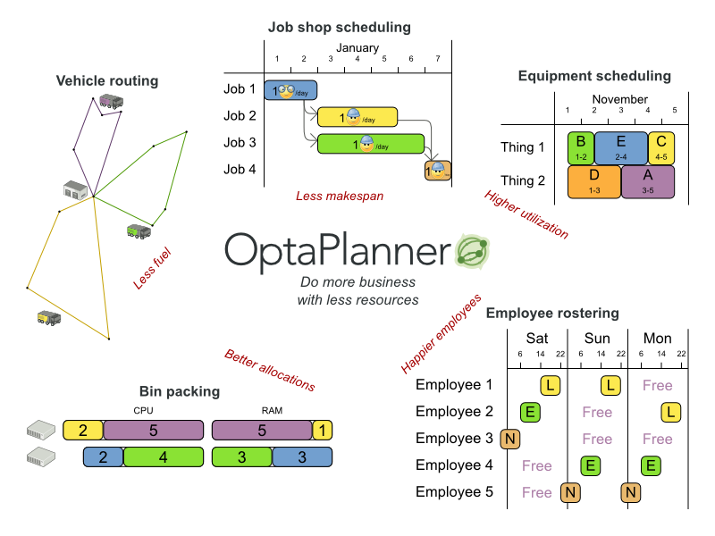
OptaPlanner
Previously Drools Planner
Planning engine for business resource usage optimization

Slide 7
Documentation
Drools
http://www.jboss.org/drools/documentation.html
JBoss BRMS
https://access.redhat.com/site/documentation/Red_Hat_JBoss_BRMS

Slide 8
Main BRMS Concepts

Slide 9
Inference
Forward Chaining
Algorithms
  RETE
  Phreak
  Sequential
Re-evaluation is a key feature
Notes:
The inference engine is the part of the BRMS engine which matches production facts and data to rules.
It will then perform actions based on what it infers from the information. A production rules system's
inference engine is stateful and is responsible for truth maintenance.

Slide 10
Rule Engine Key Components
Working Memory
  Contains references to your data objects
  Do not add the data that rules do not need
Rule Base
  The rules (part of a Knowledge Base)
  Separate bases as needed
Agenda
  Basically a list of rules instances candidates for firing
  Managed by the engine
  But possibility to act on it

Slide 11
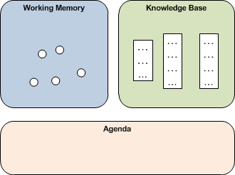
Rule Engine Key Components

Slide 12
Forward Chaining
RETE algorithm helps select the rules that are matched by facts
Among these matched rules (conflict set), one rule is selected and fired per cycle
Rule actions may change facts in working memory → new matches → potential recursiveness
When no more rule is elligible to fire, the engine returns
Notes:
Forward chaining is one of the two main methods of reasoning when using an inference engine and can be described logically as repeated application of modus ponens. Forward chaining is a popular implementation strategy for expert systems, business and production rule systems. The opposite of forward chaining is backward chaining.
Forward chaining starts with the available data and uses inference rules to extract more data (from an end user, for example) until a goal is reached. An inference engine using forward chaining searches the inference rules until it finds one where the antecedent (If clause) is known to be true. When such a rule is found, the engine can conclude, or infer, the consequent (Then clause), resulting in the addition of new information to its data.[1]
Inference engines will iterate through this process until a goal is reached.
For example, suppose that the goal is to conclude the color of a pet named Fritz, given that he croaks and eats flies, and that the rule base contains the following four rules:
If X croaks and eats flies - Then X is a frog
If X chirps and sings - Then X is a canary
If X is a frog - Then X is green
If X is a canary - Then X is yellow
Let us illustrate forward chaining by following the pattern of a computer as it evaluates the rules. Assume the following facts:
Fritz croaks
Fritz eats flies
Tweety eats flies
Tweety chirps
Tweety is yellow
With forward reasoning, the computer can derive that Fritz is green in four steps:
1. Fritz croaks and Fritz eats flies
Based on logic, the computer can derive:
2. Fritz croaks and eats flies
Based on rule 1, the computer can derive:
3. Fritz is a frog
Based on rule 3, the computer can derive:
4. Fritz is green.
The name "forward chaining" comes from the fact that the computer starts with the data and reasons its way to the answer, as opposed to backward chaining, which works the other way around. In the derivation, the rules are used in the reverse order as compared to backward chaining. Note that the computer does not use any knowledge about Tweety, when it computes that Fritz is a frog.
Because the data determines which rules are selected and used, this method is called data-driven, in contrast to goal-driven backward chaining inference. The forward chaining approach is often employed by expert systems, such as CLIPS.
One of the advantages of forward-chaining over backward-chaining is that the reception of new data can trigger new inferences, which makes the engine better suited to dynamic situations in which conditions are likely to change

Slide 13
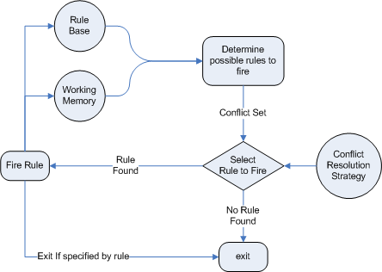
Forward Chaining

Slide 14
How it works 1/2
Rules are made of conditions and actions
Engine treats conditions and actions differently
Conditions are evaluated first
Actions are triggered when conditions are satisfied
Caution: a rule candidate to fire may not fire !

Slide 15
How it works 2/2
When conditions are satisfied, an Activation record is created (i.e. an instanciated rule
This activation is placed in the Agenda
If there are more than one rule in the agenda, then there is a conflict set (which rule is going to fire first?)
After conflict set resolution, a rule is fired and may trigger Working Memory modification
Modifications are tracked and may trigger new Activation records in the Agenda
This goes on and on until no more rules are in the Agenda, then the engine stops
NOTE: Only one rule is fired per cycle

Slide 16
RETE Key Features
Models rules as a network of different types of nodes
Exploits structural similarity
  When there are many rules, they share many patterns more often then not
  “Node sharing” i.e. multiple rules sharing the same nodes provides performance boost
Exploits temporal redundancy
  Only changes to facts require the fact to be re-inserted or retracted from the nodes in the graph
Will sacrifice memory for speed

Slide 17
Demo RETE
Rules re-evaluation in action

Slide 18
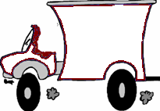


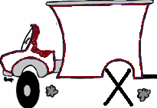

Demo RETE
Rule 1 - "Assign a driver to a truck"
When
There is a truck ready to go without a driver
And
There is a free driver
Then
Assign the driver to the truck
Rule 2 - "Repair a truck"
When
There is a truck that needs a new tire
And
There are tires available
Then
Change the tire
When
Then
When
Then

Slide 19
Demo RETE
Agenda
Fireable Rule Instances
Rules
Working Memory
Ruleset
When
When
Data (Facts)
Then
Then

Slide 20

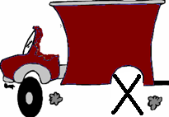



Demo RETE
Agenda
Working Memory
Ruleset
When
When
Then
Then

Slide 21
Demo RETE
Now let’s fire some rules!

Slide 22

Demo RETE
Agenda
When
Then
Working Memory
Ruleset
When
When
Then
Then

Slide 23




Demo RETE
Agenda
When
When
When
When
Then
Then
Then
Then
Working Memory
Ruleset
When
When
Then
Then

Slide 24
Demo RETE
Agenda
When
When
When
When
Selected Rule Instance
Then
Then
Then
Then
Working Memory
Ruleset
When
When
Then
Then

Slide 25
Demo RETE
Agenda
When
When
When
Then
Then
Then
Working Memory
Ruleset
When
When
Then
Then

Slide 26




Demo RETE
Agenda
When
When
When
When
When
When
Then
When
Then
Then
Then
Then
Working Memory
Ruleset
When
When
Then
Then

Slide 27
Demo RETE
Agenda
When
When
When
When
When
When
Then
When
Then
Then
Then
Then
Working Memory
Ruleset
When
When
Then
Then

Slide 28
Demo RETE
Agenda
When
When
Then
Then
Working Memory
Ruleset
When
When
Then
Then

Slide 29
Demo RETE
Agenda
When
When
Then
Then
Working Memory
Ruleset
When
When
Then
Then

Slide 30
Demo RETE
Agenda
Working Memory
Ruleset
When
When
Then
Then

Slide 31


Demo RETE
Ruleset
Rule1(t,d):
When there is a Truck t
w/out a driver,
And there is a free Driver d,
Then assign d to t
END
Yes
Agenda empty ?
No
Attach
Working Memory
4 WM is updated
Agenda
truck1(no driver)
truck2(driver1)
driver1(truck2)
driver2(free)
driver3(free)
3 rule is fired
Rule1(truck1,driver2)
Rule1(truck1,driver3)
1 WM has changed
2 agenda is updated
class Truck;
class Driver;
Application
classes

Slide 32
RETE Summary
Drools features a forward chaining inference engine
Drools implements the RETE algorithm to improve pattern matching performance
Drools RETE implementation is based on temporal redundancy, network graph of specialized nodes, node sharing, and high performance collections at each node

Slide 33
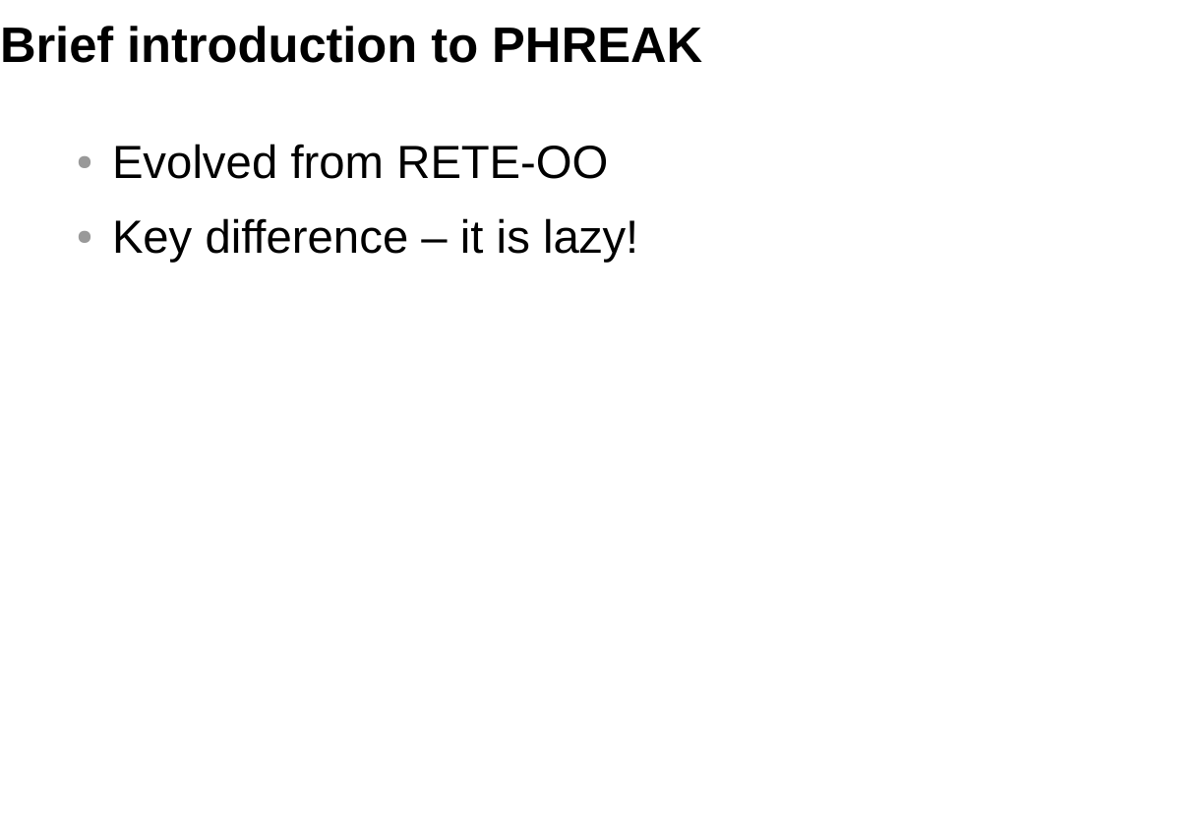
Notes:
New Innovations
-Full Rule and Rule Segment Unlinking
-Laze Evaluation → with Rule Scoping
-Conjunto de propagaciones

Slide 34
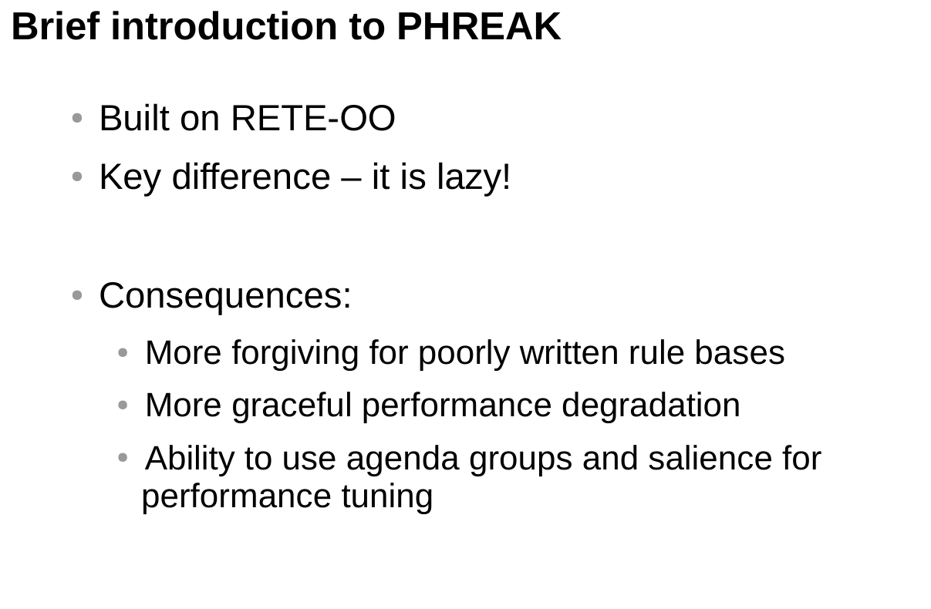
Notes:
The PHREAK algorithm used in BRMS incorporates all of the existing code from Rete00. It is an enhancement of the Rete algorithm, and PHREAK incorporates the characteristics of a lazy, goal oriented algorithm where partial matching is aggressively delayed, and it also handles a large number of rules and facts. PHREAK is inspired by a number of algorithms including the following: LEAPS, RETE/UL and Collection-Oriented Match.
PHREAK has all the enhancements listed in the Rete00 algorithm. In addition, it also adds the following set of enhancements:
Three layers of contextual memory: Node, Segment and Rule memories.
Rule, segment, and node based linking.
Lazy (delayed) rule evaluation.
Stack based evaluations with pause and resume.
Isolated rule evaluation.
Set oriented propagations.

Slide 35
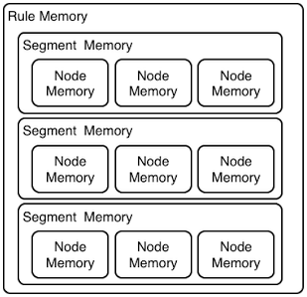
Three Layers of Contextual Memory
Notes:
Rule evaluations in the PHREAK engine only occur while rules are linked. Before entering the beta network, the insert, update, and delete actions are queued for deployment. The rules are fired based on a simple heuristic; that is, based on the rule most likely to result in the firing of other rules, the heuristic selects the next rule for evaluation which delays the firing of other rules. Once all the inputs are populated, the rule becomes linked in. Next, a goal is created that represents the rule, and it is placed into a priority queue, which is ordered by salience. The queues themselves are associated with an AgendaGroup, and only the active AgendaGroup will inspect its queue by submitting the rule with the highest salience for evaluation. The actions of insert, update, delete phase and fireAllRules phase are achieved by this point. Accordingly, only the rule for which the goal was created is evaluated, and other potential rule evaluations are delayed. Node sharing is achieved through the process of segmentation while individual rules are evaluated.
PHREAK has 3 levels of memory. This allows for much more contextual understanding during evaluation of a Rule.

Slide 36
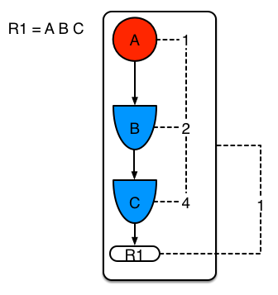
Example 1: Single rule, no sharing
Notes:
The Linking and Unlinking uses a layered bit mask system based on a network segmentation. When the rule network is built, segments are created for nodes that are shared by the same set of rules. A rule itself is made up from a path of segments; if there is no sharing, the rule will be a single segment. A bit-mask offset is assigned to each node in the segment. Another bit-mask (the layering) is assigned to each segment in the rule's path. When there is at least one input (data propagation), the node's bit is set to 'on'. When each node has its bit set to 'on,' the segment's bit is also set to 'on'. Conversely, if any node's bit is set to 'off', the segment is then also set to 'off'. If each segment in the rule's path is set to 'on', the rule is said to be linked in, and a goal is created to schedule the rule for evaluation.
The following examples illustrates the rule, segment, and node based linking in PHREAK algorithm.

Slide 37
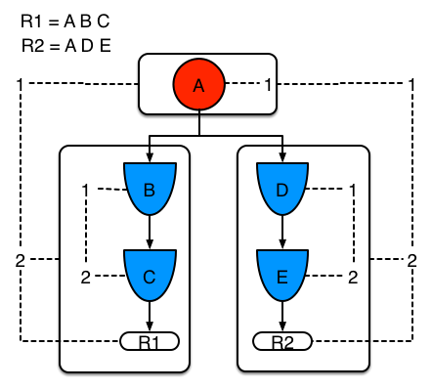
Example 2 :Two rules with sharing
Notes:
The following example demonstrates what happens when another rule is added that shares the pattern A. A is placed in its own segment, resulting in two segments per rule. These two segments form a path for their respective rules. The first segment is shared by both paths. When A is linked, the segment becomes linked; it then iterates each path the segment is shared by, setting the bit 1 to ''on'. If B and C are later turned 'on', the second segment for path R1 is linked in; this causes bit 2 to be turned 'on' for R1. With bit 1 and bit 2 set to 'on' for R1, the rule is now linked and a goal is created to schedule the rule for later evaluation and firing. When a rule is evaluated, its segments allow the results of matching to be shared. Each segment has a staging memory to queue all insert, update, and deletes for that segment. If R1 is evaluated, it will process A and result in a set of tuples. The algorithm detects that there is a segmentation split, and it will create peered tuples for each insert, update, and delete in the set and add them to R2's staging memory. These tuples will be merged with any existing staged tuples and wait for R2 to eventually be evaluated.

Slide 38
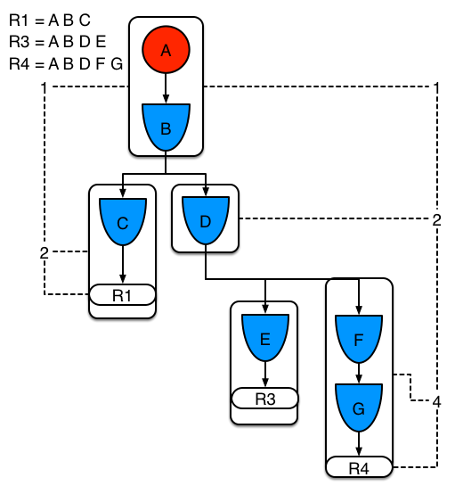
Example 3: Three rules with sharing
Notes:
The following example adds a third rule and demonstrates what happens when A and B are shared. Only the bits for the segments are shown this time. It demonstrating that R4 has 3 segments, R3 has 3 segments, and R1 has 2 segments. A and B are shared by R1, R3, and R4. Accordingly, D is shared by R3 and R4.

Slide 39
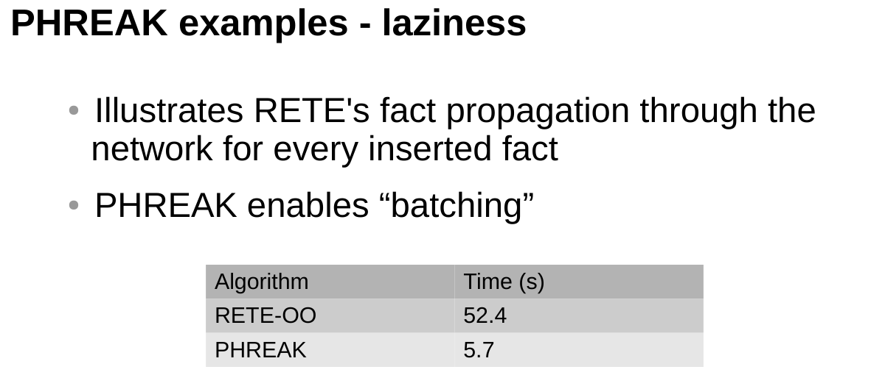
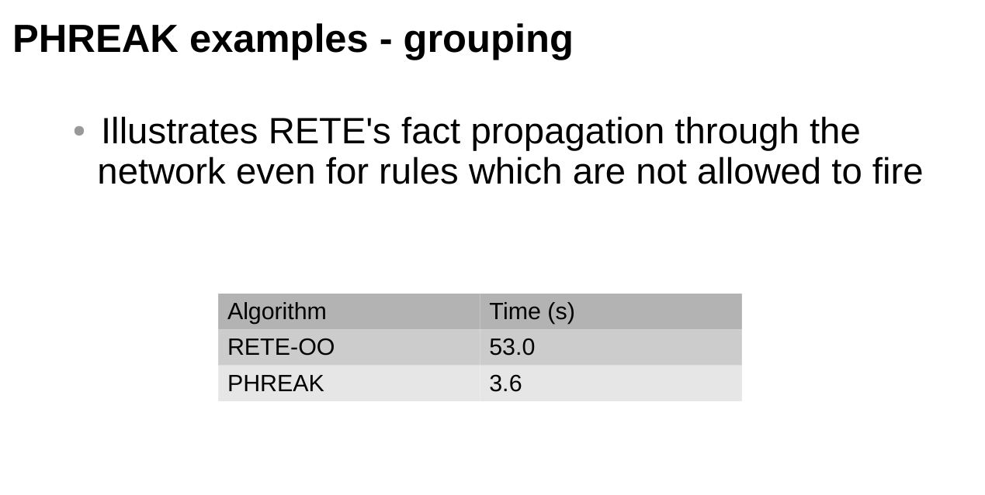
PHREAK examples
See https://github.com/winklerm/phreak-examples

Slide 40
RETE to PHREAK
Switching Using System Properties
drools.ruleEngine=phreak
drools.ruleEngine=reteoo
The Maven GAV (Group, Artifact, Version) value for ReteOO is depicted below:
<dependency>
​ <groupId>org.drools</groupId>
​ <artifactId>drools-reteoo</artifactId>
​ <version>${drools.version}</version>
​</dependency>
Switching in KieBaseConfiguration
// you can either specify phreak (default)
​kconfig.setOption(RuleEngineOption.PHREAK);
​
​// or legacy ReteOO
​kconfig.setOption(RuleEngineOption.RETEOO);
​

Slide 41
BRMS Development Environment

Slide 42
Eclipse
Versions
  Community: Eclipse + JBoss Tools
  Enterprise: JBoss Developers Studio (JBDS)
Plugins offering all BRMS functionalities

Slide 43
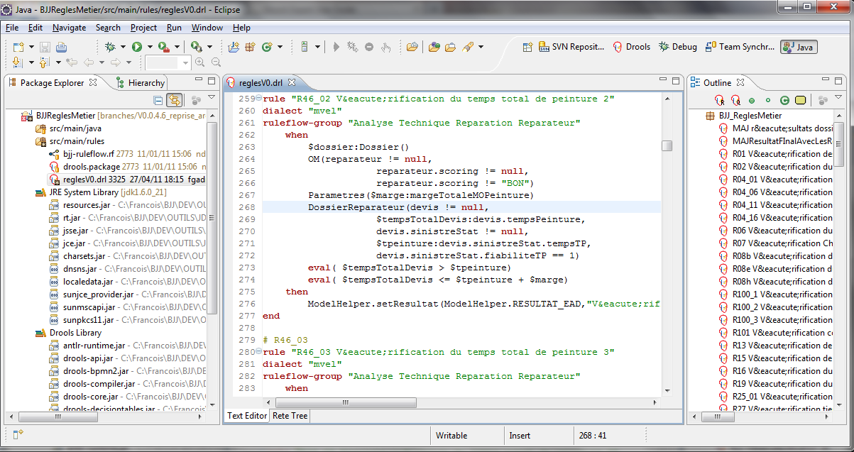
Drools plugin features
Eclipse support for DRL files
Syntax coloring
Validation
Outline view
Debug views
Working Memory
Globals
Agenda
Execution Audit
Breakpoints
RETE network view
Graphical Ruleflow
BPM integration
DSL support

Slide 44
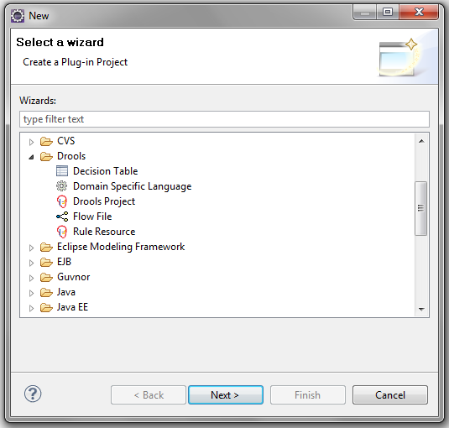
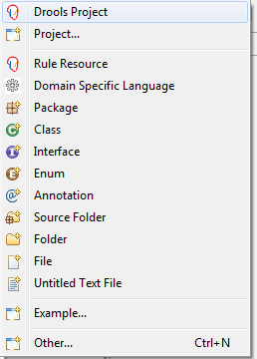
Drools Perspective
Switch to Drools perspective
Drools wizards are available
File > New > …

Slide 45
Technical rules: DRL
It is possible to have more than one technical rules in one file or to have them in separate files
If rules are in separate files, package files are created to avoid defining the same imports, globals, dsl expanders in each rule file belonging to the same package

Slide 46
Rules with DSL
Rules may be written with a Domain Specific Language
DSL configuration is done through a DSL file
  File > New > Domain Specific Language
Create a rule using a new .dslr file
Use expander myDslFile.dsl to use the DSL in the rule

Slide 47
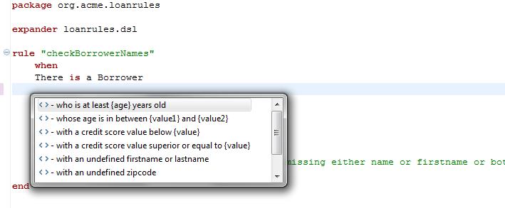
Rules with DSL

Slide 48
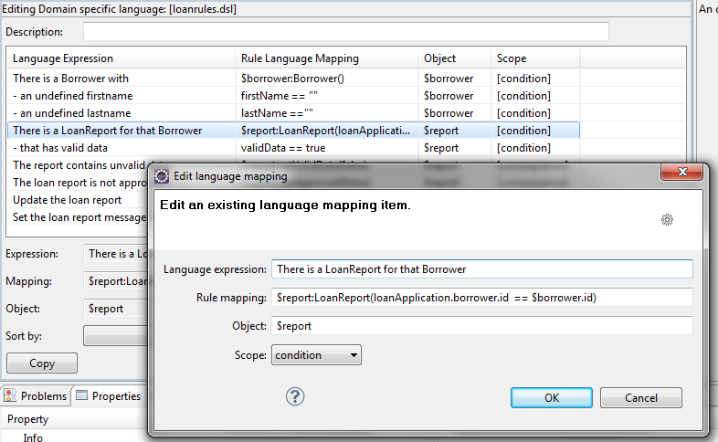
DSL Language Mapper Editor
Allows to create mapping with text sentences and rule language

Slide 49
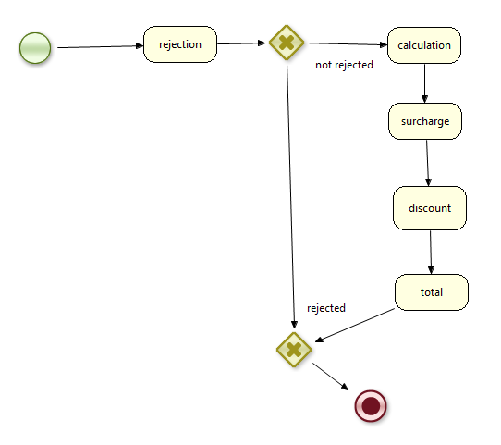
Graphical Ruleflows
File > New > Other… > Drools > Flow File
Draw ruleflow with the graphical ruleflow editor

Slide 50
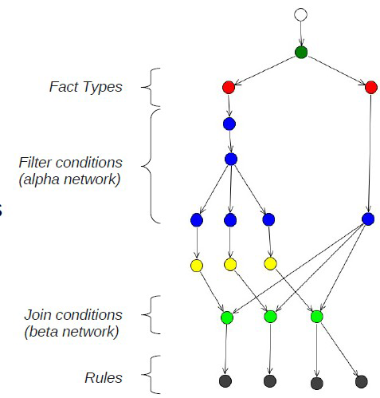
RETE Viewer
Models rules as a network of different types of nodes
Inserted facts are associated with nodes on the graph
  Facts find the rules
  Each node is collection of facts satisfying constraint modeled by the node

Slide 51
The Drools language

Slide 52
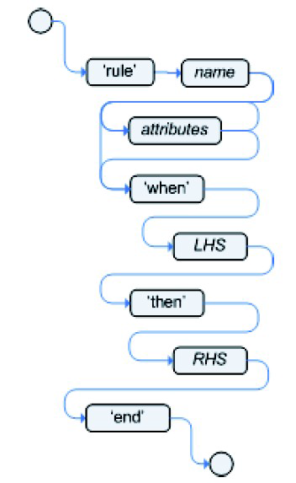
DRL Rules
Rules written in Drools language or Domain Specific Language (covered later)
“IF/Then” actions are “When/Then”
A rule has a name (unique to package), condition(s) and action(s)
When all conditions met, rule may “fire”
Rules operate on facts

Slide 53
Facts
Rules operate on facts (data) i.e. objects which are references of instances of your java application
A rule engine is usually not the only consumer of this data
In real life, facts are usually JavaBeans
  Drools uses getter and setter methods of these objects
  It does not need to be strict JavaBeans, only accessor methods are used for conditions

Slide 54
Facts and Working Memory
Working Memory can be considered as a pool of objects referred to as Facts
Engine knows only the facts that are inserted in WM, or objects directly accessible from them
WM contains references of objects
  Any fact modification is reflected into the application
Rule Engine
Production Memory (Rules)
Working memory (Facts)
Pattern Matcher

Slide 55
DRL Rules
package org.drools.examples
import org.drools.examples.Customer;
import org.drools.examples.Order;
# provide discount for platinum customers
rule "Customer Platinum Status"
when
Customer( status == “platinum” )
$order : Order( orderPriority == 3 )
then
$order.setOrderDiscount(8.5);
end
Conditions may be referred to as LHS (left handside)
Actions may be referred to as RHS (right handside)

Slide 56
Anatomy of a DRL rule file
Package
declaration
package org.drools.examples
import org.drools.examples.Customer;
import org.drools.examples.Order;
# provide discount for platinum customers
rule "Customer Platinum Status"
salience 10
when
Customer (status == “platinum”)
$order : Order (orderPriority == 3)
then
$order.setOrderDiscount(8.5);
end
Imports
declaration
A comment
Rule name
Conditions
Actions

Slide 57
DRL Rule content
rule, when, then, end keywords
  All these keywords are mandatory, they define the header part, rule name, condition and actions part of the rule
Rule Name: If name contains spaces, need to use double quotes
Header part
  Used to declare rule properties: salience, dialect, ruleflow-group, agenda-group, no-loop, lock-on-active, auto-focus, activation-group, date-effective, date-expires, duration, enabled, …
  Properties format is ‘<attribute> <value>’
Comments
  Single line comments : use # or // , multi-line comments use /* … */

Slide 58
Condition part
A.k.a. Left-Hand Side
Made of conditional elements (CEs)
  It contains 0 or more CEs
  Patterns make up Ces
  Implicit AND
when
<Conditional Element>
….
<Conditional Element>
then

Slide 59
Patterns
A simple pattern
  A pattern matches against a fact of the given type
  This pattern will match against all Cheese instances in the Working Memory
A pattern with a fact binding
  For referring a matched object, use a pattern binding
  “$” is optional but it helps to see if it’s a variable in complex rules
Cheese()
$cheese: Cheese()

Slide 60
Patterns with constraints
With a literal field constraint
With a literal field constraint and field binding
With a bound variable
Pattern and field bindings are referred to as declarations ➔ A declarative language
Cheese(type == "Roquefort")
Cheese( $t: type == "Roquefort")
$c1 : Cheese ()
$c2 : Cheese ( type != $c1.type ) // 2 different cheeses

Slide 61
this
this is a special self reference field
Can be used with any operator: ==, !=, memberOf, contains, etc.
Useful to compare facts of the same type
rule "find people who are the same age"
when
p1: Person( )
p2: Person( this != p1, age == p1.age )
then
…
end

Slide 62
Conditional Elements Composition
or
and
‘,’
rule "safe driver bonus"
when
$policy: Policy()
and ( Driver(age > 35)
or Driver(age <= 35, hadNoAccident == true) )
then
$policy.setBonus(10);
end

Slide 63
Other Conditional Elements
  exists
  not
  from
  collect
  accumulate
  etc.

Slide 64
exists
exists keyword checks for existence of a matching object in Working Memory
It is equivalent to: « there is at least… »
  Will match once even if there are 10 Cheese instances in Working Memory
  Will match once if there is at least 1 Goat Cheese instance in Working Memory
exists Cheese()
exists Cheese(milk == "goat")

Slide 65
not
not is used to negate other CEs
Will match if there are no Cheese instances in Working Memory
Will match if there are no Goat Cheese instances in Working Memory
not exists Cheese()
not exists Cheese(milk=="goat")

Slide 66
Operators
contains
memberOf
in
soundslike
matches
str
<, >, &&, ||

Slide 67
eval
eval is essentially a catch-all which allows any semantic code (that returns a primitive boolean) to be executed
Cannot be indexed and thus are not as efficient as Field Constraints.
Useful with functions return values that change over time, which is not allowed within Field Constraints
To be avoided as possible for performance reasons
p1 : Parameter()
p2 : Parameter()
eval( isValid( p1, p2 ) )

Slide 68
from
from allows the engine to reason over data not in the Working Memory
Person( $padd : address )
$address : Address( zipcode == "69000") from $padd
$p : Person( )
$address : Address( zc : zipcode == "69000") from $p.address

Slide 69
collect
collect allows rules to reason over a collection of objects obtained from the given source or from the Working Memory
Result can be any concrete class that implements the java.util.Collection interface
$alarms : ArrayList( size >= 3 )
from collect( Alarm( status == "RED" ) )

Slide 70
forall
forall evaluates to true when all facts that match the first pattern match all the remaining patterns
when
forall( $emp : Employee()
HealthCare( employee == $emp )
DentalCare( employee == $emp ) )
then
# all employees have health and dental care
…
end

Slide 71
Action part 1/2
Then section
It uses mvel and/or java dialect
Typical actions alter data in WM, by
  Inserting new facts
  Removing existing facts
  Updating existing facts
  Setting the value of a field of a fact

Slide 72
Action part 2/2
Typical actions are performed using following keywords
  insert( new Type() )
  retract( fact )
  update( fact )
  modify ( fact ) {
  <expression> [ , <expression> ]*
  }
  where « fact » refers to as a fact binding variable set in the condition part
These typical actions notify the engine that facts are being modified

Slide 73
update & modify
rule "Apply 10% discount to all items over US$100,00 in an order"
when
$order : Order()
$item : OrderItem( value > 100 ) from $order.items
then
# apply discount to the item
modify ($item){ applyDiscount(0.05) }
end
# same result
$item.setApplyDiscount(0.05);
update ($item);

Slide 74
Action not impacting the WM
It is possible to modify facts without notifying the engine that something has changed
Make sure that this is really what you want/need
  No re-evaluation is performed!
rule "Raise a warning"
when
$eng : Engine( temperature > 200 )
$errl : WarningsList()
then
# raise an error
$errl.addWarning(new Warning( "Too hot", $eng ));
end

Slide 75
Truth Maintenance System
rule "raise alarm"
when
$c : Censor( temperature > 50 )
then
logicalInsert( new TemperatureAlarm( $c ) )
end
Maintains the truth by automatically retracting
Use logicalInsert
A rule “logically” inserts an object
When the rule is no longer true, the object is retracted

Slide 76
Available object
In rules actions, drools and kcontext reserved keyword is available
drools Instance of KnowledgeHelper
kcontext instance of ??
Allows to interact with the engine being executed

Slide 77
Rule Attributes
  no-loop
  salience
  dialect
  date-effective
  date-expires
  etc.

Slide 78
no-loop 1/2
When a rule's consequence modifies a fact it may cause the rule to activate again, causing an infinite loop
Setting no-loop to true will skip the creation of another Activation for the rule with the current set of facts
Default value is false

Slide 79
no-loop 2/2
Caution: no-loop will not prevent 2 or more rules from looping with each other
rule "My rule"
no-loop
when
$al : Alarm( status == Status.ON )
then
$al.setLevel( "ORANGE" );
update( $al );
end

Slide 80
dialect
dialect species the language to be used for any code expressions in the LHS or the RHS code block
Values are mvel or java
May be set at the package level or overridden for a rule
MVEL is syntax sugar for nested object access, collections, maps, arrays etc.
Default dialect is Java

Slide 81
dialect examples
rule Rule1
dialect "java"
when
…
then
$person.getAddresses().get("home").setStreetName("my street");
end
rule Rule2
dialect "mvel"
when
…
then
$person.addresses["home"].streetName = "my street";
end

Slide 82
Dates
rule MyRule
date-effective "01-Jan-2013"
date-expires "31-Dec-2014"
when
…
then
…
end
date-effective
date-expires
A rule can only fire if the current system date and time is after date-effective attribute and before date-exires attribute
date-effective < current date < date-expires
Default format for Date litterals is dd-mmm-yyyy
Format may be changed by setting drools.dateformat System property

Slide 83
Timers
Rules support both interval and cron-based timers
  timer ( int: <initial delay> <repeat interval> )
  timer ( cron: <cron expression> )
rule MyRule
timer ( int: 30s 5m )
when
…
then
…
end
rule "Send SMS every 15 minutes"
timer (cron:* 0/15 * * * ?)
when
…
then
…
end

Slide 84
Other keywords
  function
  global
  extends
  do
  entry-points
  etc.

Slide 85
function
function provides a way to inline methods
Useful for manipulation/conversion of fields, formulas
function float weightedAverage(long num1, long num2,
long div1, long div2) {
return (num1 + num2)/(div1 + div2);
}
rule "calculate weighted average"
when
ob1 : Observation()
ob2 : Observation(this != ob1)
eval( weightedAverage(ob1.val,ob2.val,ob1.per,ob2.per) < .1)
then
…
end

Slide 86
global
global defines global variables
Used to provide data or services used by the rules
Globals are not inserted into Working Memory
  →The rule engine cannot be notified about value changes of globals
  → Do not use in conditions for pattern matching
global java.util.List myGlobalList;
rule "Check temperature"
when
CensorEvent( temperature > 70 )
then
myGlobalList.add( "Too hot" );
end

Slide 87
extends
Extends allows rules to « inherit » from others
Useful for specialization
Be careful with ordering!
rule "Europe discount"
salience 5
when
c: Command(total >= 1000.0)
then
c.setDiscount(0.30);
end
rule "France discount" extends "Europe discount"
when
Command(this==c, country=="FR")
then
c.setDiscount(0.31);
end

Slide 88
Entry points 1/2
Possibility to have several entry points
rule "authorize withdraw"
when
WithdrawRequest( $ai : accountId, $am : amount )
from entry-point "ATM Stream"
CheckingAccount( accountId == $ai, balance > $am )
then
// authorize withdraw
end
KieSession session = ...
EntryPoint atmStream = session.getEntryPoint("ATM Stream");
atmStream.insert( aWithdrawRequest );

Slide 89
Entry points 2/2
Possibility to have multiple entry points
Mostly used in a CEP context for events entry channel
Provides a proper abstraction for streams
Allow to scope facts in the working memory
Reducing cross products explosions

Slide 90
Metadata
Custom metadata may be assigned to rules
Use @ to define some metadata
@metadata_key( metadata_value )
Can be retrieved at runtime
rule "Une Regle de correlation"
@RuleID("CORREL-000")
when
…
then
…
end

Slide 91
Declarative model
Possibility to define a declarative model within the scope of the rule engine
Directly in DRL files
Possibility to combine with Java modeling
Perfect for POC and prototypes
Used for CEP
import org.people.Person // Java type
// repeat the supertype
declare Person
end
// extend the type
declare Student extends Person
school : String
end

Slide 92
Accessing Declared Types from the Application Code
Declared types can be used outside the DRL
Instanciation in Java requires a specific API FactHandle
KieBase kbase = ...
FactType personType =
kbase.getFactType( "org.drools.examples", "Person" );
Object bob = personType.newInstance();
personType.set( bob, "name", "Bob" );
personType.set( bob, "age", 42 );
KieSession ksession = ...
ksession.insert( bob );
ksession.fireAllRules();

Slide 93
Suggestions
1. To stop a rule from reactivating itself, use "no-loop true”
2. To stop a rule from reactivating itself and others in the same ruleflow-group, use "lock-on-active true”
3. On your fact set the propertyReactive setting to true. This puts a change listener around every individual property in a fact, so that rules know exactly which properties was modified
4. Never use “update" to set values in a rule, always use “modify”

Slide 94
Suggestions II
5. I also recommend use ruleflow (bpmn2 file with ruleflow groups) for all rules engines. In 6, this can have a dramatic impact on performance as only the rules in the current ruleflow group are active.Other things to be checking for:
  Over use of salience or activation-groups (both can cause maintainability and performance concerns)
  External data source access from the rules (LHS is particularly bad). Data should be retrieved before the session

Slide 95
Workbench

Slide 96
Workbench
Centralized repository
Handle concurrent authoring
Web-based GUI
Aimed at non-technical people

Slide 97
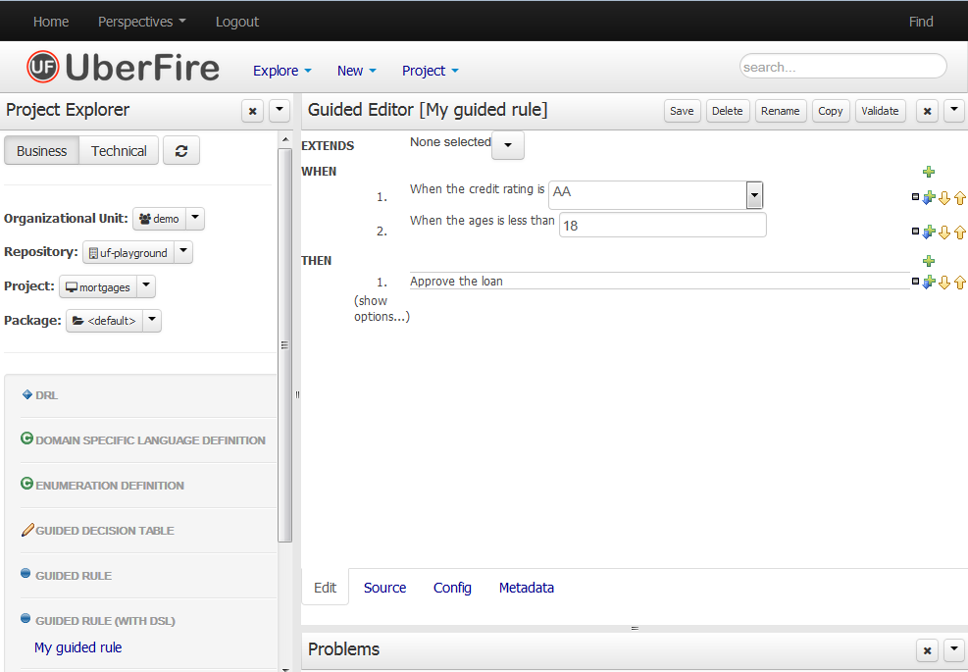
Workbench

Slide 98
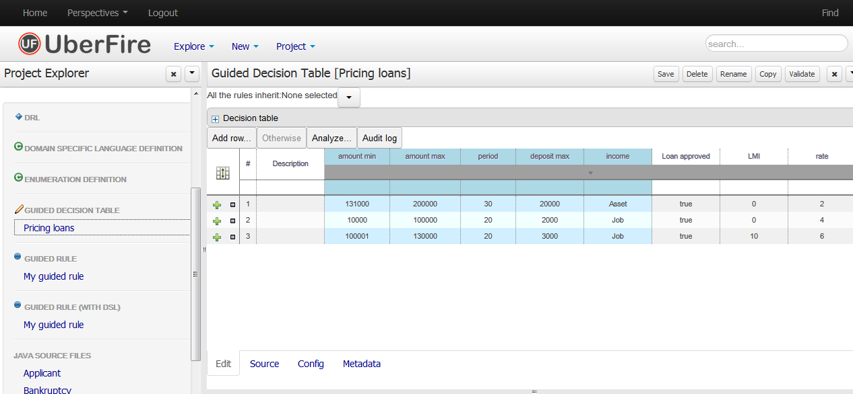
Workbench

Slide 99
Decision Tables
Grouping similar rules in one view

Slide 100
Decision Tables?
Decision tables offer a concise and yet powerful way to present logic
Useful when rules share the same patterns for conditions and actions
Use Excel spreadsheet
  Excel, Open Office, CSV
  Within Eclipse or Guvnor/Workbench
Hide the underlying object model

Slide 101
DT Characteristics
Despite the look, rules are not processed top-down!
  Authored irrespective to the rows
  Rows may be shifted around
Structure
  1 column → 1 condition or 1 action
  1 row → 1 rule
All rules end up being compiled
  Origin doesn’t matter for the engine!

Slide 102
When not to use DT?
Small number of rules
Rules do not have a similar structure
Dislike of Excel or OpenOffice

Slide 103
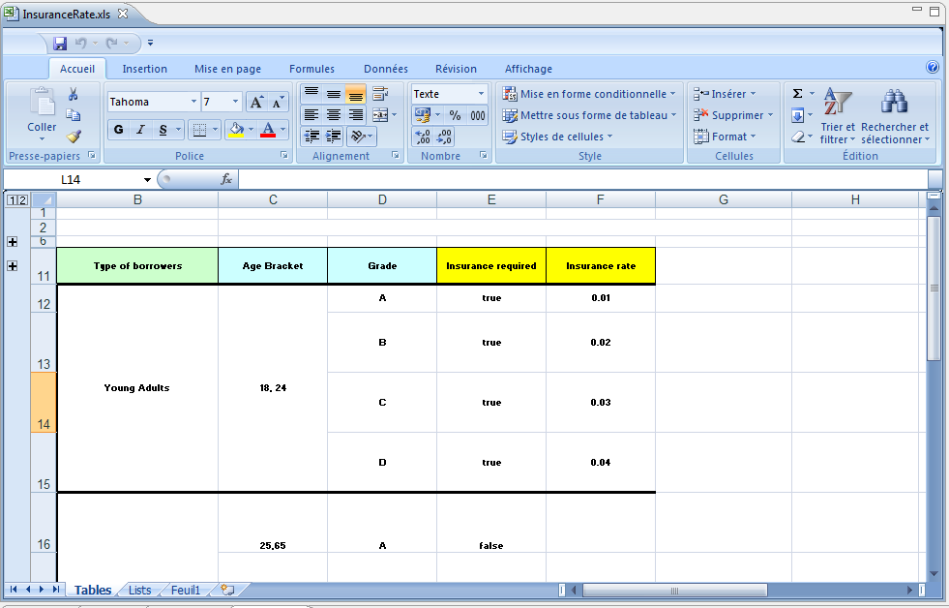
DT example

Slide 104
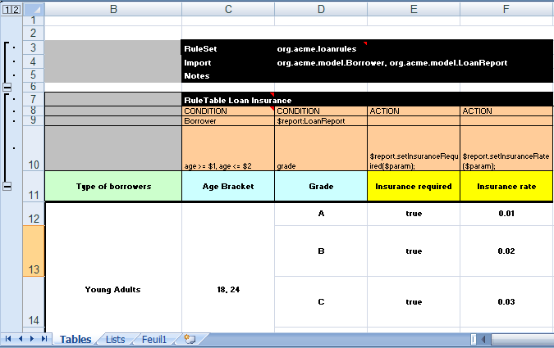
XLS Decision Table Setup
  Header rows define global settings for a table and define column holder values for data

Slide 105
Global settings keywords
Ruleset: mandatory, name cell may be empty
  First keyword of the spreadsheet file
Imports: optional, used to declare imports
Variable: optional, used for setting globals
Functions: optional, used to declare functions

Slide 106
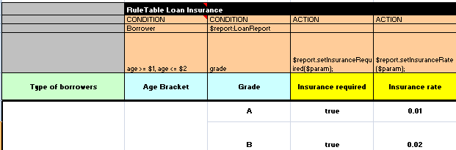
Rules Section
RuleTable keyword defines the rule section start of a DT, followed by DT’s name in the same cell
There may be more than 1 DT on a spreadsheet

Slide 107
DT Header Keywords
RuleTable: Mandatory. Defines the name of the DT
Column Keywords
CONDITION: defines a column for a condition (at least 1 per DT)
ACTION: defines a colum for an action (at least 1 per DT)
PRIORITY: defines the priority/salience (optional)
NAME: defines the name column for rules (optional)
NO-LOOP: avoid recursive behaviour
ACTIVATION-GROUP: First rules of an activation group avoids other rules from the same group to fire
AGENDA-GROUP: defines membership to an agenda group
RULEFLOW-GROUP: defines membership to ruleflow group

Slide 108
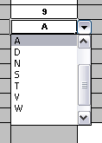
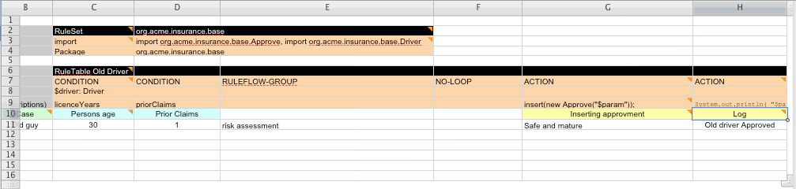
DT patterns and attributes
Fact bindings as regular rules
Multiples constraints on the same fact but on different colums
List of values for formated fields can be used to assist filling cells
For empty cells, attribute, condition or action will not apply

Slide 109
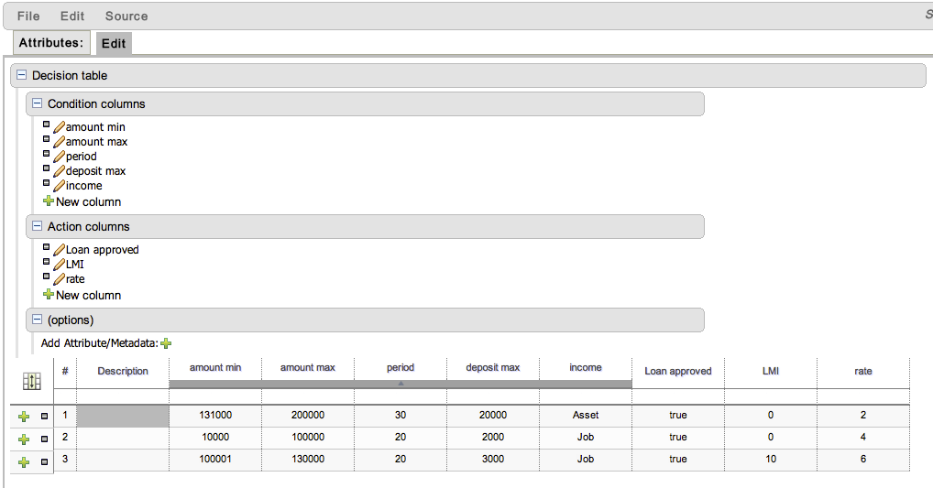
Web-Based Guided DT
To be built within Guvnor/Workbench

Slide 110
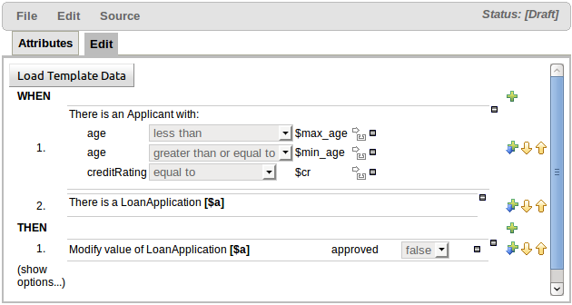
Rule Template 1/2
To define a rule structure with place-holders
Alternative for Decision Tables

Slide 111
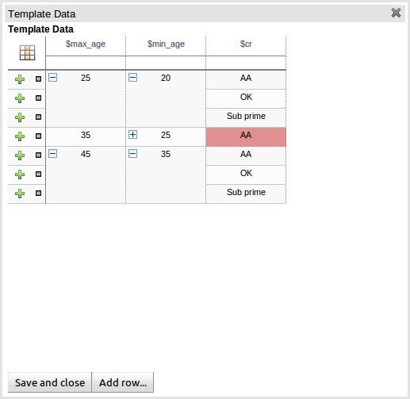
Rule Template 2/2
Substitution for rule instanciation may be performed
  At run-time
  Using another
  HTML data table

Slide 112
DSL – Domain Specific Language

Slide 113
DSL
A way to create your own language on top of the DRL
Create natural language like expressions that represent conditions or actions that are used over and over
Create a mapping from the problem domain terminology and the object model representing it to the drools rules language
Allows to get non-technical people involved (typicaly Business Analysts)

Slide 114
DSL example
rule "Driver has had too many accidents"
when
there is a Driver
- who had more than 3 accidents
then
Reject Policy with explanation : 'Too many accidents'
end
[condition][$driver]There is a Driver=$driver : Driver()
[condition][$driver]- who had more than {number} accidents=numberOfAccidents > {number}
[consequence][]Reject Policy with explanation : '{reason}'=insert(new Rejection("{reason}"));
rule "Driver has had too many accidents"
when
Driver(numberOfAccidents > 3)
then
insert(new Rejection("Too many accidents"));
end

Slide 115
Advanced Features

Slide 116
accumulate
accumulate is a more flexible and powerful form of collect
  Allows a rule to iterate over a collection of objects, executing custom actions for each of the elements of the collection
  Prototype
<result pattern> from accumulate( <source pattern>,
init( <init code> ),
action( <action code> ),
reverse( <reverse code> ),
result( <result expression> ))

Slide 117
accumulate example #1
rule "Apply 10% discount to orders over US$ 100,00"
when
$order : Order()
$total : Number( doubleValue > 100 ) from accumulate(
OrderItem( order == $order, $value : value ),
init( double total = 0; ),
action( total += $value; ),
reverse( total -= $value; ),
result( total ) )
then
# apply discount to $order
end

Slide 118
accumulate example #2
Example with a custom object returned
rule "Accumulate using custom objects"
when
$person : Person( $likes : likes )
$cheesery : Cheesery( totalAmount > 100 ) from accumulate(
$cheese : Cheese( type == $likes ),
init( Cheesery cheesery = new Cheesery(); ),
action( cheesery.addCheese( $cheese ); ),
reverse( cheesery.removeCheese( $cheese ); ),
result( cheesery ) )
then
// do something
end

Slide 119
accumulate functions 1/3
accumulate is powerful but is quite verbose to use
It is possible to use accumulate defined functions to reduce code for common calculation
rule "Apply 10% discount to orders over US$ 100,00"
when
$order : Order()
$total : Number( doubleValue > 100 ) from accumulate(
OrderItem( order == $order, $value : value ),
sum( $value ) )
then
# apply discount to $order
end

Slide 120
accumulate functions 2/3
Predefined accumulate functions
  average, min, max, count, sum
These common functions accept any expression as input
rule "Average profit"
when
$order : Order()
$profit : Number() from accumulate(
OrderItem( order == $order, $cost : cost, $price : price )
average( 1 - $cost / $price ) )
then
# average profit for $order is $profit
end

Slide 121
accumulate functions 3/3
It is possible to define your own accumulate functions
  Implement the following interface: org.drools.base.acumulators.AccumulateFunction
  Let the engine know about it
    jbossrules.accumulate.function.average = org.jbossrules.base.accumulators.AverageAccumulateFunction

Slide 122
Enum 1/3
For Workbench
Afraid of typo?
Want pulldowns instead of text fields?
BAs like it
Requires some Workbench customization

Slide 123
Enum 2/3
Define an enum file containing the available values for each attribute
Possibility to have drop down lists that depend on field values
'Vehicle.engineType' : [‘A=Petrol', ‘B=Diesel']
'Vehicle.color' : ['Red', 'Blue', 'Black', 'Other']
'Vehicle.engineType' : ['Petrol', 'Diesel'] 'Vehicle.fuelType[engineType=Petrol]' : ['ULP', 'PULP']
'Vehicle.fuelType[engineType=Diesel]' : ['BIO', 'NORMAL']

Slide 124
Enum 3/3
Dynamic enums: load the lists programmatically
  E.g. from a DB
  Implement a class that returns a List
'Fact.age' : (new SampleDataSource2()).loadData()
public class SampleDataSource2 {
public List loadData() {
List list = new ArrayList();
list.add("00001=VALUE1");
list.add("00002=VALUE2");
list.add("00003=VALUE3");
return list;
}
}

Slide 125
Property Reactive 1/2
Another way of avoiding looping (cf. no-loop)
May improve performances
Use @PropertyReactive and @watch annotations to specify fact properties that the rule engine should watch for changes
The rule engine will ignore updates on all other properties of the fact
Use modify instead of update

Slide 126
Property Reactive 2/2
@PropertyReactive
public class Alarm {
…
}
declare Alarm
@propertyReactive
end
rule "My rule"
when
$al : Alarm( status == Status.ON ) @watch(status,!*)
then
$al.setLevel( "ORANGE" );
update( $al );
end

Slide 127
Controlling Rule Execution

Slide 128
Conflict resolution strategies
A conflict can arise where more than 1 rule are eligible to fire
Strategies for controlling rule execution in BRMS:
  salience i.e. priority
  Rule attributes: attributes used to control execution such as agenda-group, activation-group, ruleflow-group, dynamic salience

Slide 129
salience
salience defines the rules priority
Priorities are relative to other rules
Rules with higher salience values are given higher priority when placed into the Agenda
salience is defined as an integer
Default value is 0
Values can be positive or negative

Slide 130
salience example
rule "Handle red level alarms"
salience 1000
when
$al : Alarm( level == "RED" )
then
…
end
rule "Handle orange level alarms"
salience 500
when
$al : Alarm( level == "ORANGE" )
then
…
end
rule "Handle yellow level alarms"
# no salience means priority 0
when
$al : Alarm( level == "ORANGE" )
then
…
end

Slide 131
Dynamic salience
Priorities may be dynamic i.e. based on data
Use an expression involving bound variables
rule "high value fires first"
salience ($person.bonus * $item.price)
when
$person : Person()
$item : Item( customer == $person )
then
...
end

Slide 132
agenda-group
All rules live in agenda-group
  Setting focus to agenda-group puts it on a stack (rules in agenda-group fired only when in focus
  Engine works its way through rules in the group
  When empty, moves down the stack until MAIN group processed
  If agenda-group not specified, default is MAIN (always root of stack)
agenda-group partitions rules and controls which set of rules fire
  Rules activated when data inserted, and full match on constraints
  Each agenda group has its own agenda – own list of activations

Slide 133
agenda-group example
rule "my rule"
agenda-group "mygroup"
when
p: Person(age < 30)
then
p.setBracket("young");
update(p);
end

Slide 134
activation-group
A meta-data allowing to bind a subset of rules together
  In each group, only one rule can fire
  After that rule has fired all the other rules are cancelled from the agenda, preventing them from firing
  A clear() method can be called at any time to cancel all of the activations before one has had a chance to fire
ksession.getAgenda().getActivationGroup("GroupB").clear();

Slide 135
API

Slide 136
5.0 API
KnowledgeBuilder kbuilder = KnowledgeBuilderFactory.newKnowledgeBuilder();
kbuilder.batch().add( newClassPathResource( "Model.drl", getClass() ), DRL )
.add( newClassPathResource( "Queries.drl", getClass() ), DRL )
.add( newClassPathResource( "General.drl", getClass() ), DRL )
.add( newClassPathResource( "Response.drl", getClass() ), DRL )
.add( newClassPathResource( "Events.drl", getClass() ), DRL )
.add( newClassPathResource( "UiView.drl", getClass() ), DRL )
.add( newClassPathResource( "Commands.drl", getClass() ), DRL ).build();
if ( kbuilder.hasErrors() ) {
System.out.println( kbuilder.getErrors().toString() );
System.exit( 1 );
}
KieBaseConfiguration kbaseConf = KnowledgeBaseFactory.newKnowledgeBaseConfiguration();
kbaseConf.setOption( EqualityBehaviorOption.EQUALITY );
KnowledgeBase kbase = KnowledgeBaseFactory.newKnowledgeBase( kbaseConf );
kbase.addKnowledgePackages( kbuilder.getKnowledgePackages() );
ksession = kbase.newStatefulKnowledgeSession();

Slide 137
API Changes with 6.0
Knowledge Is Everything : KieXXX classes
  KnowledgeBase -> KieBase
  StatefulKnowledgeSession -> KieSession
  StatelessKnowledgeSession -> StatelessKieSession
KnowledegeAgents have not been ported
Packages (PKG) are no longer the unit of deployment

Slide 138
KieBase
Building the knowledge base may be costly
Build it once, typically at server start up or application deployment

Slide 139
KieModule
Convention based
No programmatic api for building
META-INF/kmodule.xml
<kmodule xmlns="http://jboss.org/kie/6.0.0/kmodule">
<kbase name="kbase1">
<ksession name="ksession1"/>
</kbase>
</kmodule>
KieServices ks = KieServices.Factory.get();
KieContainer kContainer = ks.getKieClasspathContainer();
KieSession kSession = kContainer.newKieSession("ksession1");
...
kSession.fireAllRules();

Slide 140
Programmatic API
Builder API, for tooling integration
Incremental compilation, and problem reporting
KieServices ks = KieServices.Factory.get();
KieRepository kr = ks.getRepository();
KieFileSystem kfs = ks.newKieFileSystem();
kfs.write("src/main/resources/org/kie/example5/HAL5.drl", getRule());
KieBuilder kb = ks.newKieBuilder(kfs);
kb.buildAll(); // kieModule is automatically deployed to KieRepository
// if successfully built
if (kb.getResults().hasMessages(Level.ERROR)) {
...
}
KieContainer kContainer = ks.newKieContainer(kr.getDefaultReleaseId());
KieSession kSession = kContainer.newKieSession();
kSession.fireAllRules();

Slide 141
Session
2 types of Knowledge Sessions
Stateful: KieSession
Stateless : StatelessKieSession
Creating sessions is fast
  KieBase.newStatelessKieSession()
  KieBase.newKieSession()
Several sessions may be created from the same KieBase
Each session has its own RETE

Slide 142
KieSession
Stateful reusable sessions
Allows application to call multiple times the engine for the same set of data
Eventually update/modify/retract data between calls
When session is not useful anymore, application code must call dispose() method to avoid memory leaks (Garbage Collection)

Slide 143
StatelessKieSession
Stateless
One shot / disposable sessions
Create a stateless session when no need to re-run the rule engine on the same facts

Slide 144
Executing Rules
2 use cases:
  KieSession.fireAllRules
  KieSession.fireUntilHalt

Slide 145
Listeners
Most common ones
WorkingMemoryEventListener
  For notifications about what happens in the WM : insert, retract, update)
AgendaEventListener
  For notifications about what happens in the Agenda : rules activation/deactivation, rules fired, etc.
KieSession ksession = …;
ksession.addEventListener(new AgendaEventListener() {
// list of methods to override
}
);
ksession.addEventListener(new WorkingMemoryEventListener() {
// list of methods to override
}
);

Slide 146
Filtering
AgendaFilter
  To filter rules dynamicaly right before they are about to fire
  May also be used for logging purposes
KieSession ksession = …;
ksession.fireAllRules(new AgendaFilter() {}
public boolean accept(Match match) {
… // your logic to have the rule instance fire or not!
}
);

Slide 147
Channels
To send object out of the rule engine, use :
  org.kie.api.runtime.Channel
ksession.registerChannel("out", new Channel() {
public void send(Object o) { } });
rule "my rule"
when
...
then
channels["out"].send(new ChannelData());
end

Slide 148
Testing

Slide 149
Testing rules
From Workbench
  Using the built-in test framework
From Java code
  No specific code for this
  Must be created
  Define what level of testing is needed

Slide 150
Levels of test
Testing the rules by themselves is critical
Unit tests
Non-regression tests
Integration tests
Performance tests

Slide 151
Performance Tips

Slide 152
Arranging constraints
Put most restrictive first
Generally “==” is the most restrictive
  But it is dependent on your domain (engine can't guess)

Slide 153
Flatten the object model
Object models can often have complex relationships and hierarchies
For rules you want to simplify and flatten the model where possible, and let the rule engine infer relationships (as it provides future flexibility) and often better performance
For example, if you have a parent-child relationship and your retrieve the children using from, this is ok if you have only one or two rules that use the children. However, if you have many rules that use children, then it's better to insert each child separately
This is also useful when model is changing and incur less rule refactoring

Slide 154
Avoid Cross Product
Cross product create a potential “combinatorial explosion”
Two constraints with two facts result in 4 entries at the join node
Two constraints with 10,000 facts results in 100,000,000 entries at the join node
As you filter the facts, the number of combinations decreases significantly, depending on the constraint
rule "this is bad"
when
p1: Person()
p2: Person()
then
panic();
end
rule "this is not so bad"
when
p1: Person(age < 5, gender == “male”)
p2: Person(this != p1, age < 5, gender == “female”)
then
dontPanicYet();
end

Slide 155
eval
Avoid eval when possible
Potentially strong impact on performance
If not possible
  Use only 1 occurrence last
  Reduce what’s in the eval
  Keep it last
Rules verbalization may breach this best practice

Slide 156
Sequential Mode
Check if the sequential mode is not an option
No RETE
  For stateless sessions only
  No rule re-eveluation
  No rules added or removed
No agenda
Salience still used
Sequential mode is OFF by default

Slide 157
Miscelaneous
Be careful with loops in conditions
Don’t overuse loops in actions
Do not put too many objects in WM
  Check your use cases
  Split your data
Do not forget to call ksession.dispose() for Stateful sessions
Think twice about mixing technology
  Typical use case: using Hibernate/JPA within conditions
  Use the rule engine for what it is good : making a decision

Slide 158
CEP – Complex Event Processing

Slide 159
CEP
CEP is about detecting and selecting the interesting events from an event cloud, finding their relationships and inferring new data from them and their relationships
Drools Fusion: module responsible for adding event processing capabilities into the BRMS platform

Slide 160
Event
An event is a record of a significant change of state in the application domain
Simplistically can be considered as a fact with a timestamp
Usually immutables
All events are facts, but not all facts are events
Usually more events than facts
Usually not all events are interesting
Concept of time between events
Managed lifecycle

Slide 161
Declaring events
To declare a fact type as an event, assign the @role metadata tag to the fact type
Possible values:
  fact : default for regular facts
  event : the type is to be handled as an event
declare Status
@role(event)
@timestamp(createdAt)
@expires(2s)
end

Slide 162
A CEP rule example
The following rule expects every 10 seconds at least one “Heartbeat” event
If not the rule fires
rule "Sound the alarm"
when
$h: Heartbeat ( )
Not ( Heartbeat ( this != $h, this after[0s,10s] $h )
then
// Sound the alarm
end

Slide 163
Metadata
@role
@timestamp
@duration
@expires

Slide 164
Clocks
2 types of clock implementation
  Real-time clock
  Pseudo clock

Slide 165
Real-time clock
Default clock implementation
Internally uses the system clock to determine the current timestamp
KnowledgeSessionConfiguration config
= KnowledgeBaseFactory.newKnowledgeSessionConfiguration();
config.setOption( ClockTypeOption.get("realtime") );

Slide 166
Pseudo clock
Clock is controlled by the application
Typical usage is for unit-testing
Usage:
KnowledgeSessionConfiguration config
= KnowledgeBaseFactory.newKnowledgeSessionConfiguration();
config.setOption( ClockTypeOption.get("pseudo") );
SessionPseudoClock clock = …; // get the session clock
clock.advanceTime( 10, TimeUnit.SECONDS );

Slide 167
Events Processing Mode
2 modes for providing data to the engine:
  Cloud
  Stream

Slide 168
CLOUD Mode
Default processing mode
No difference between facts and events
There is no notion of time
No concept of "now"
No sliding windows
No automatic events life-cycle management

Slide 169
STREAM Mode
Mode of choice when the application needs to process streams of events
Engine will force synchronization between streams through the use of the session clock
Engine knows the concept of flow of time and the concept of "now“
Enable sliding windows support
Automatic Event Lifecycle Management

Slide 170
Temporal Reasoning
To define strong temporal relationships between events
Drools implements the Interval-based Time Event Semantics and represents Point-in-Time Events as Interval-based evens with duration 0 (zero).
13 temporal operators are available to define temporal constraints on events

Slide 171
after
$eventA : Event( this after[ 3m30s, 4m ] $eventB )
→ will match if and only if the temporal distance between the time when $eventB finished and the time when $eventA started is between ( 3 minutes and 30 seconds ) and ( 4 minutes )
3m30s <= $eventA.startTimestamp - $eventB.endTimeStamp <= 4m

Slide 172
Temporal Operators
after
before
coincides
during
finishes
finished by
includes
meets
met by
overlaps
overlapped by
starts
started by

Slide 173
Sliding Time Windows
For matching events occurring in the last X time units
Ex: StockTick() over window:time( 2m )
→ matches all events in the last 2 minutes
Events are discarded only when no other rules depend on that event and the expiration policy for that event type is fulfilled

Slide 174
Sliding Length Windows
Consider events based on order of their insertion into the session instead of flow of time
Ex: StockTick( company == "RHT" ) over
window:length( 10 )
→ matches the last 10 RHT Stock Ticks, independent of how old they are
Events are not removed from WM when events fall off a length window

Slide 175
Memory Management
Automatic events memory management only performed in STREAM mode
If events have no other rules defining temporal constraints and no explicit expiration policy, the engine will keep them in the session indefinitely
A sliding window does not mean by itself that the event will be discarded from the working memory, as there might be other rules that depend on that event
The engine will discard events only when no other rules depend on that event and the expiration policy for that event type is fulfilled
Whenever an implicit expiration offset clashes with the explicit expiration offset, then engine will use the greater of the two

Slide 176
JBoss BRMS deployment architectures

Slide 177
Deployment architectures
The basic components in these architectures are:
JBoss BRMS server
Rules developer / Business analyst
Version control (GIT)
Deployment servers (JBoss EAP)
Clients using your application

Slide 178
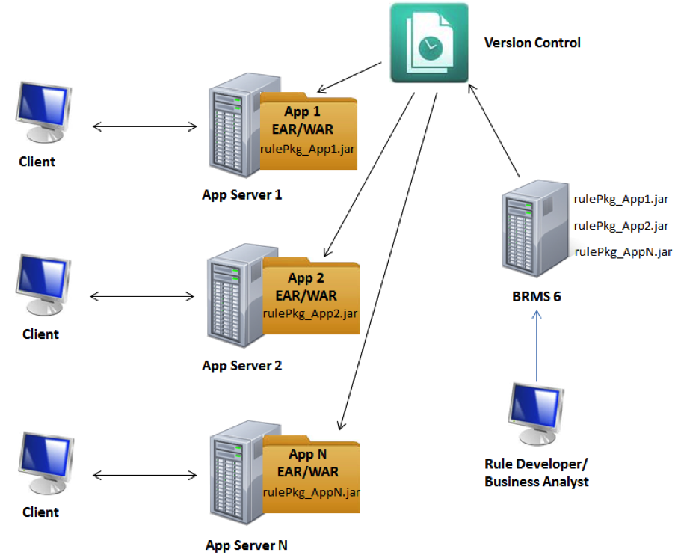
Rules deployed in application
A deployable rule package (e.g. JAR) is included in your application’s deployable artifact (e.g. EAR, WAR).
JBoss BRMS server acts as a repository to hold your rules and a design time tool.
Pros
Typically better performance than using a rule execution server since the rule execution occurs within the same JVM as your application
Cons
Do not have the ability to push rule updates to production applications. Requires a complete rebuild of the application

Slide 179
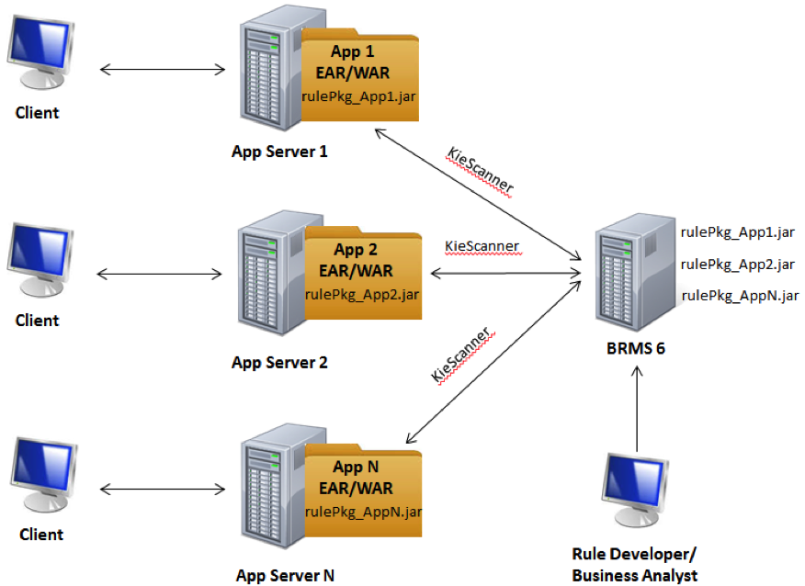
Rules scanned from application
The JBoss BRMS API contains a KieScanner that monitors the rules repository for new rule package versions. Pros
No need to restart your application servers
Cons
Risk of pushing incorrect logic into application(s) if the above process doesn’t thoroughly test

Slide 180
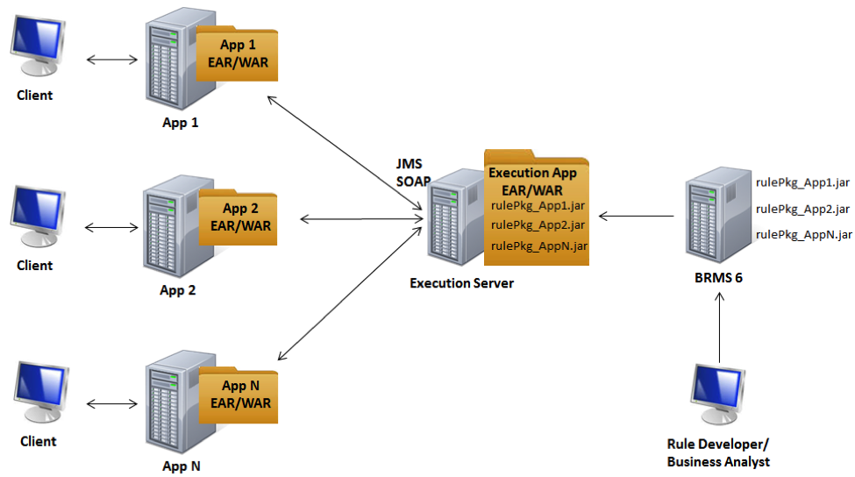
Rules execution server
Deploying JBoss BRMS as an application in its own environment. You can then expose it as a service (e.g. JMS, SOAP, etc.) so that any applications in your enterprise architecture can remotely execute rules and events.
Pros
Completely decoupled architecture
Common implementation to setup and execute rules
Cons
Possible performance implications due to externalized component relative to your applications

