Slide 1
Wellbeing Coach
Project Presentation

Slide 2
Agenda
Project objective and key capabilities
Project Structure Overview
How Functional Requirements are implemented
Rest API Endpoints and Runtime Flow
Database model and future scope

Slide 3
Project Objective
Provide AI-powered emotional wellbeing support via API endpoints
Detect user emotion from natural language input
Generate context-aware recommendations and activity suggestions
Persist interaction history and collect user feedback
Enable reliable testing with isolated test database and fixtures

Slide 4
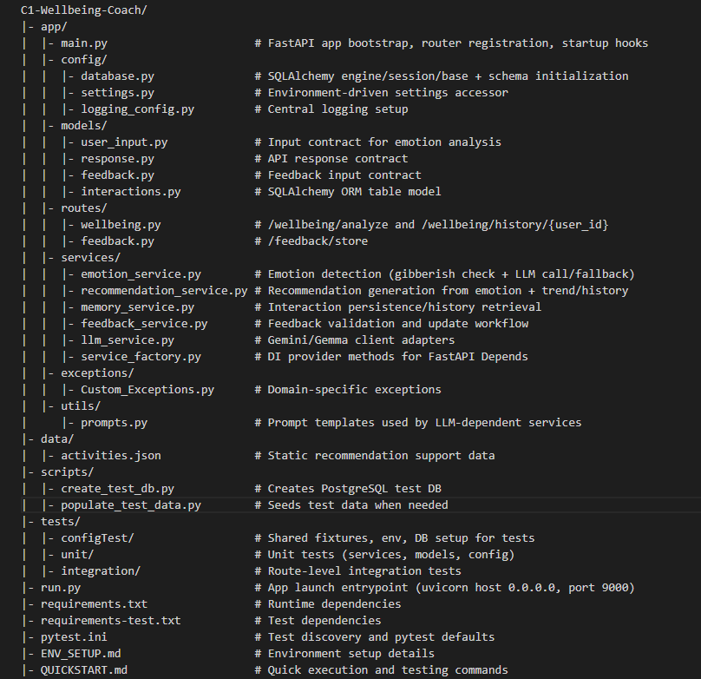
Project Structure Overview

Slide 5
How Functional Requirements Are Implemented
Requirement to Logic
- Input validation via Pydantic models (user_input.py, feedback.py)
- Route handlers in routes/wellbeing.py and routes/feedback.py
- Business logic in EmotionService, RecommendationService
- Persistence in MemoryService using SQLAlchemy Interaction model
- Feedback update path through FeedBackService -> MemoryService
Reliability and Control
- Rate limiting with slowapi decorators
- Gibberish detection with custom exception handling
- Gemini 2.5-flash primary LLM with gemma3:1b fallback
- Environment-driven configuration in config/settings.py
- Startup DB initialization to avoid missing schema runtime failures

Slide 6
REST API Endpoints
Method
Endpoint
Description
GET
/
Root endpoint returning API welcome message and version
POST
/wellbeing/analyze
Analyze user text, detect emotion,
generate recommendation, and store interaction
GET
/wellbeing/history/{user_id}
Fetch the latest stored interaction history for a user
POST
/feedback/store
Store rating, feedback text, and
comment against an existing interaction

Slide 7
Runtime Flow: Analyze Request
1. Client calls POST /wellbeing/analyze with user_id and text
2. EmotionService validates text and detects emotion using LLM
3. MemoryService fetches recent user history for trend context
4. RecommendationService builds context and generates recommendation
based on history and EmotionService output
5. MemoryService stores full interaction record in interactions table
6. API returns interaction_id, emotion, confidence, and recommendations

Slide 8
Runtime Flow: Feedback Store
1. Client calls POST /feedback/store with interaction_id and
optional rating, feedback, comment
2. FastAPI validates the payload against the Feedback model
3. FeedBackService validates rating range, text length, and requires
at least one feedback field
4. MemoryService.update_feedback loads the target interaction by interaction_id
5. If the interaction exists, rating,feedback and comment are updated and committed to the interactions table
6. Route returns a success acknowledgement; validation or missing-record errors.

Slide 9
Database Table: interactions
Column
Type
Purpose
interaction_id
String
Unique interaction identifier
user_id
String
User key for personalization/history
user_input
Text
Original user message
mood, intensity, confidence
String/Float
Emotion analysis output
activity, message
Text
Recommendation payload
rating, feedback, comment
Integer/Text
Post-interaction feedback
created_at
DateTime
Timeline and ordering

Slide 10
Future Scope
Future Scope
Separate feedback into dedicated table.
Use Groq for low-latency AI-based mood analysis

Slide 11
Thank You

