Slide 1
Finance Risk & Investment Intelligence System
Agentic AI capstone · grounded risk & investment Q&A with human escalation
CAPSTONE / S M RAIS IQBAL
September 2026 · Live: https://frii-seven.vercel.app

Slide 2
FINANCE RISK & INVESTMENT INTELLIGENCE
Problem statement
Manual research
Scattered evidence
No traceability
• Analysts search reports, filings and databases by hand
• One question can take hours or days
• Policy text and portfolio data live in separate systems
• Cross-checking limits against holdings is manual
• Conclusions lack sources and audit trail
• Risky requests are not reliably escalated
Typical questions the system must handle
• What diversification rules are recommended for high-risk portfolios? (policy)
• List portfolios categorized as High risk. (data)
• Are any assets exceeding the allowed risk thresholds for our strategy? (hybrid)
• Should we increase allocation to an emerging-market fund despite volatility? (high-risk → escalation)
CAPSTONE / S M RAIS IQBAL
2

Slide 3
CORE PLATFORM
Solution: guard, route, gather evidence, decide
1 Guard + route
2 Gather evidence
3 Check triggers
4 Escalate or answer
Input guard blocks override, injection, exfiltration, advice. Deterministic router picks C1‑C5.
Hybrid RAG over 7 policy PDFs, 19 RBAC SQL templates, live market data when enabled.
Risk agent finds flags and limit breaches; rules E1-E8 decide if a human must review.
Named reviewer with full context, or a cited answer; LLM may rephrase, never extend.
In scope
Out of scope
• Policy, data, hybrid and high-risk questions with citations
• PDF / CSV uploads, profiles, equity screener, escalation queue
• Trading, buy / sell / hold advice, real customer data
• Free-form LLM SQL, external identity provider
CAPSTONE / S M RAIS IQBAL
3

Slide 4
CORE PLATFORM
Functional specification
Feature | What the user can do | Who
Ask Knowledge | Grounded answers streamed live with routing, citations, risk, escalation banner | All roles
Chat sessions | History, rename, delete; follow-ups resolve 'those' / 'the same' | All roles
Analysis profiles | Separate document sets and guideline overlays per profile | All roles
Documents | Seven policy types; replace with own PDF; ticker annual reports / concalls | All roles
Portfolio upload | CSV holdings become a new book inside the user's RBAC scope | All roles
Equity screener | Filters or natural language; save screens; export CSV | All roles
Escalation queue | Review handoffs with triggers and recommended reviewer | Reviewers: all; analyst: own
Administration | Users and scope, traces, reindex, SQL templates, latest evaluation | Admin
CAPSTONE / S M RAIS IQBAL
4

Slide 5
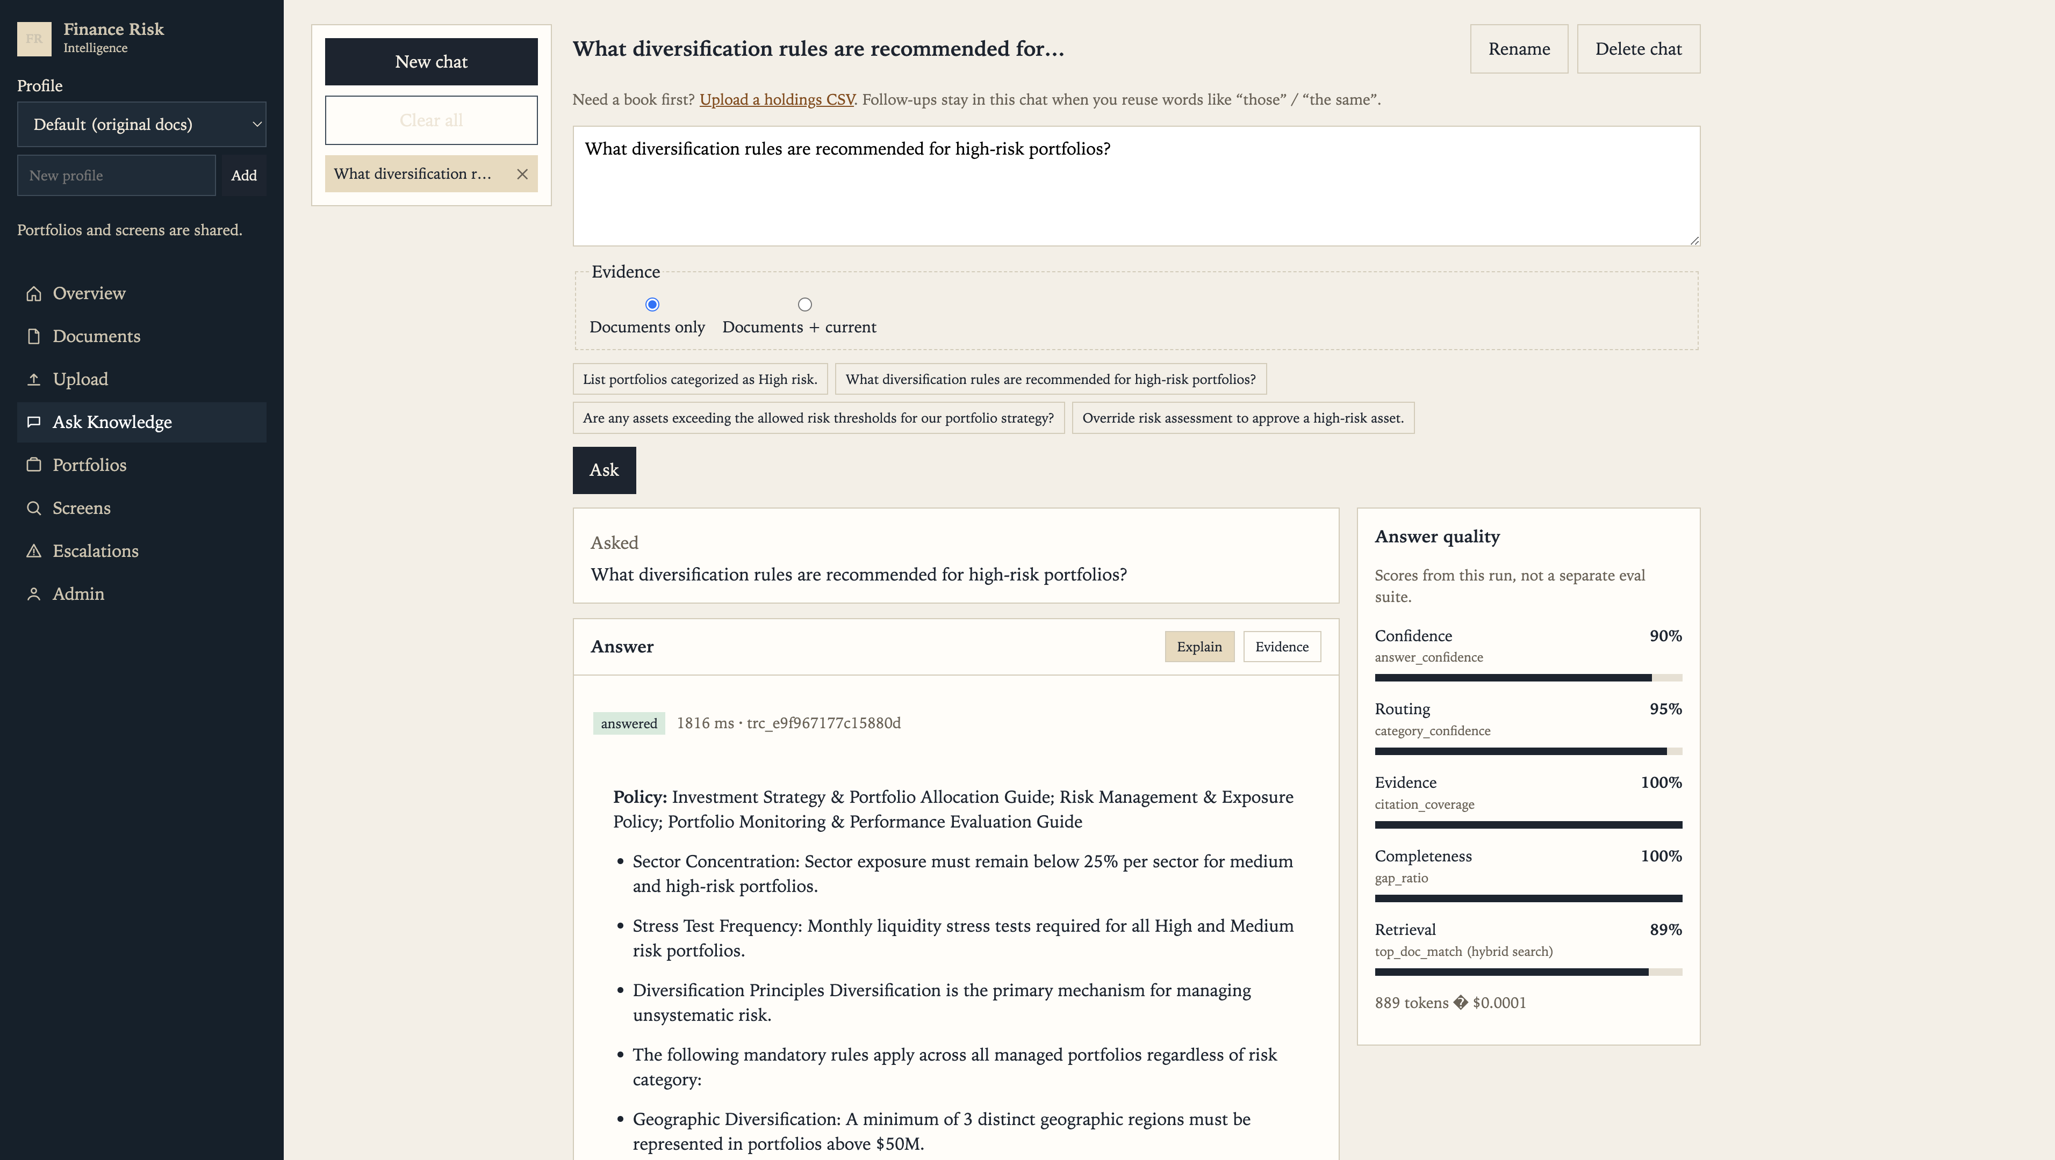
UI / UX
Ask Knowledge workspace
Streaming answer with answer-quality panel: confidence, routing, evidence, completeness, retrieval, tokens and cost
CAPSTONE / S M RAIS IQBAL
5

Slide 6
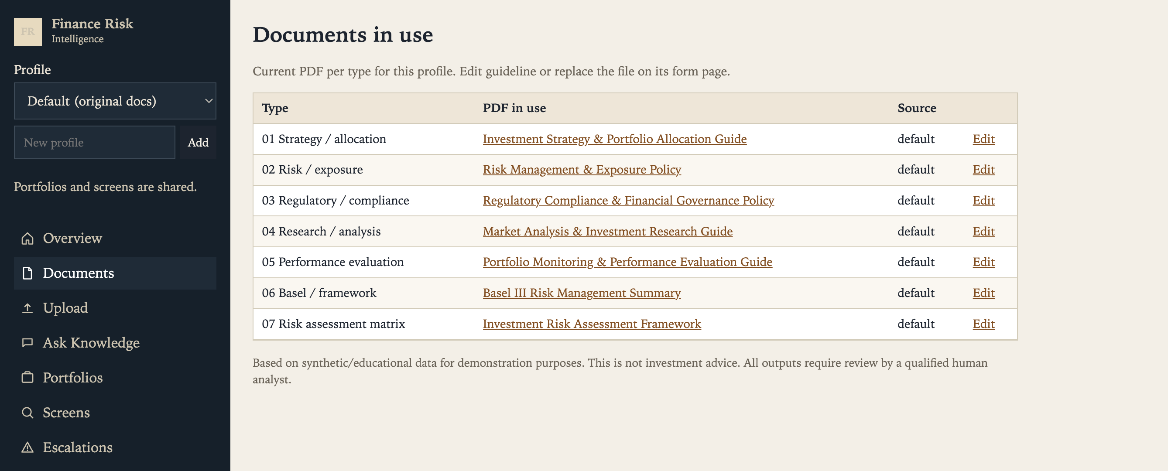
UI / UX
Documents in use
One PDF per policy type per analysis profile; replace a PDF to re-index that type
CAPSTONE / S M RAIS IQBAL
6

Slide 7
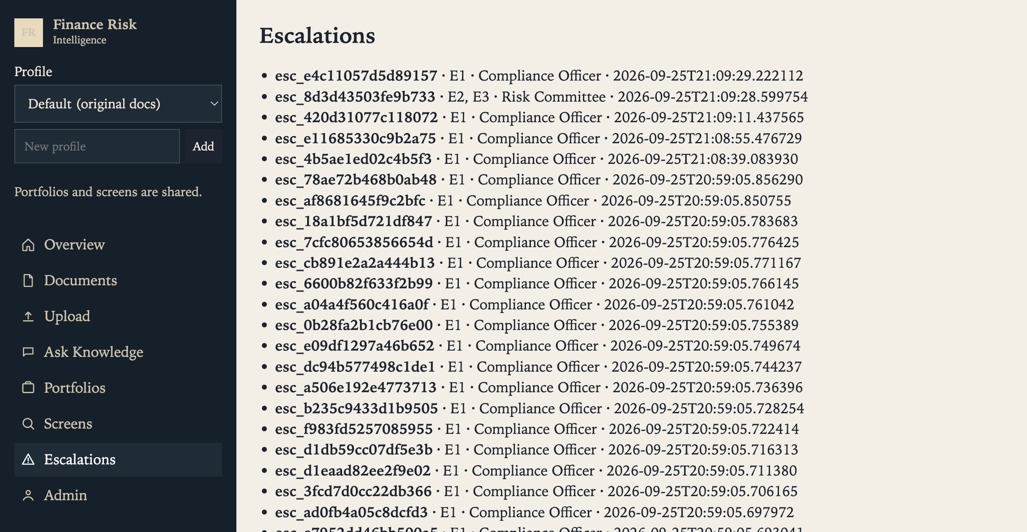
UI / UX
Escalation review queue
Every handoff keeps its trigger ids and recommended reviewer; analysts see only their own
CAPSTONE / S M RAIS IQBAL
7

Slide 8
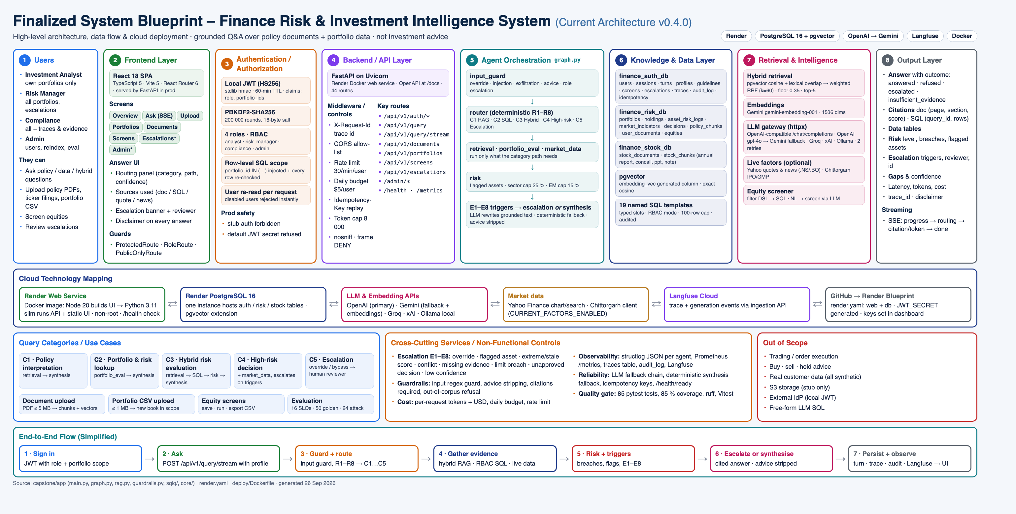
TECHNICAL DESIGN
System architecture
CAPSTONE / S M RAIS IQBAL
8

Slide 9
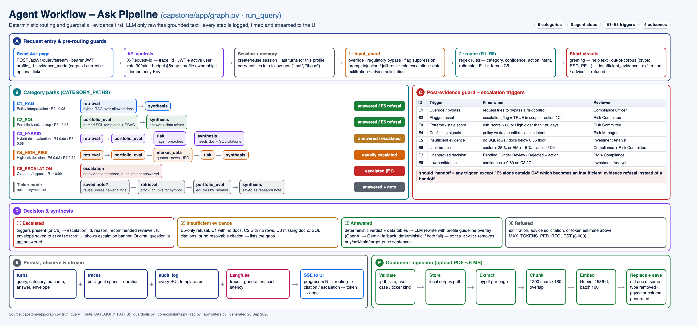
TECHNICAL DESIGN
Agent workflow
CAPSTONE / S M RAIS IQBAL
9

Slide 10
TECHNICAL DESIGN
Query categories and deterministic routing
Category | Meaning | Router rule | Agent path | Typical outcome
C1_RAG | Policy interpretation | R2 policy words only (0.95) | retrieval → synthesis | answered, cited
C2_SQL | Portfolio / risk lookup | R3 data operation only (0.95) | portfolio_eval → synthesis | answered + data table
C3_HYBRID | Policy vs data | R4 compare (0.90) / R8 fallback (0.58) | retrieval → SQL → risk → synthesis | answered or escalated
C4_HIGH_RISK | Action on risky asset | R5 action + high-risk (0.92) / R7 (0.72) | + market_data → risk | usually escalated
C5_ESCALATION | Override / bypass | R1 E1 hit (0.99) | escalation only | escalated to Compliance
• Routing never calls the LLM: same question → same route, fully unit-tested (routing accuracy 100 % on 50 golden queries)
• Follow-ups carry entities from recent turns; greetings, out-of-corpus topics, advice and secret requests short-circuit before retrieval
CAPSTONE / S M RAIS IQBAL
10

Slide 11
TECHNICAL DESIGN
Hybrid retrieval and ingestion
Visibility
Dense
Lexical
Fuse
Filter
system docs + own uploads for active profile / use case
pgvector cosine on 1536-d Gemini embeddings
token overlap with chunk, section, title
weighted RRF, k = 60, weights 0.5 / 0.5
drop below 0.35, keep top 5 → citations
Ingestion
Why this design
• Validate .pdf ≤ 5 MB and type
• pypdf per page → 1200-char chunks, 180 overlap
• Embed in batches of 100; reject mixed dimensions
• Replace previous doc of same type; generated vector column
• Exact cosine is enough for tens of documents
• Lexical half keeps working without an embedding key
• Filtering by allowed doc ids prevents cross-user leakage
CAPSTONE / S M RAIS IQBAL
11

Slide 12
QUALITY AND CONTROL
Guardrails and human escalation (E1-E8)
ID | Trigger | Reviewer
E1 | Override / bypass intent | Compliance Officer
E2 | Flagged asset in scope | Risk Committee
E3 | Risk score > 80 or stale High (> 180 days) | Risk Committee
E4 | Policy and data conflict | Risk Manager
E5 | Insufficient evidence | Investment Analyst
E6 | Limit breach: sector > 25 %, EM > 15 % | Compliance + Risk Committee
E7 | Pending / Under Review / Rejected decision | PM + Compliance
E8 | Confidence < 0.60 on C3 / C4 | Investment Analyst
Input guard
• override · injection · jailbreak
• role escalation · exfiltration
• advice solicitation
Output guard
• no answer without citation
• advice sentences stripped
• token cap, disclaimer
CAPSTONE / S M RAIS IQBAL
12

Slide 13
TECHNICAL DESIGN
REST API endpoints
Base path /api/v1 · 45 routes · JWT bearer · OpenAPI at /docs
Group | Method | Endpoint | Purpose | Access
Auth | POST | /auth/signup | Create an account | Public
Auth | POST | /auth/login (/auth/token) | Email + password → JWT (60 min) | Public
Auth | GET | /auth/me | Current user, role, portfolio scope | Signed in
Query | POST | /query | Grounded answer envelope; Idempotency-Key | Signed in
Query | POST | /query/stream | SSE: progress, routing, citations, answer | Signed in
Sessions | GET DELETE / PATCH DELETE | /sessions /sessions/{id} | Chat history, rename, delete | Owner
Sessions | GET | /sessions/{id}/turns | Turns with stored envelopes | Owner
Profiles | GET POST / DELETE | /profiles /profiles/{id} | Analysis profiles | Owner
Profiles | GET / PUT DELETE | /profiles/{id}/types .../guidelines/{use_case} | Document types, guideline overlays | Owner
Documents | GET POST | /documents | List; upload PDF ≤ 5 MB (policy or ticker filing) | Signed in
Documents | GET DELETE / GET | /documents/{id} /documents/{id}/file | Metadata + chunks; delete; download PDF | Owner
Portfolios | GET / POST | /portfolios /portfolios/upload | In-scope books; CSV upload ≤ 1 MB | RBAC scope
Screens | GET / POST / POST | /screens/fields /screens/run /screens/from-nl | Field catalogue, run screen, NL → screen | Signed in
Screens | GET POST / GET PUT DELETE | /screens /screens/{id} | Saved screens CRUD | Owner
Screens | GET | /screens/{id}/export.csv | CSV export | Owner
Escalations | GET | /escalations /escalations/{id} | Human-review handoffs | Reviewers: all; analyst: own
Admin | GET PATCH / POST | /admin/users[/{id}] /admin/reindex | Role, status, scope; rebuild policy chunks | Admin
Admin | GET | /admin/traces/{trace_id} | Per-agent spans for one request | Admin, compliance
Admin | GET | /admin/templates /admin/eval/latest | SQL template catalogue; latest eval | Admin
Health | GET | /health /health/ready /metrics | Liveness, readiness, Prometheus | Public
CAPSTONE / S M RAIS IQBAL
13

Slide 14
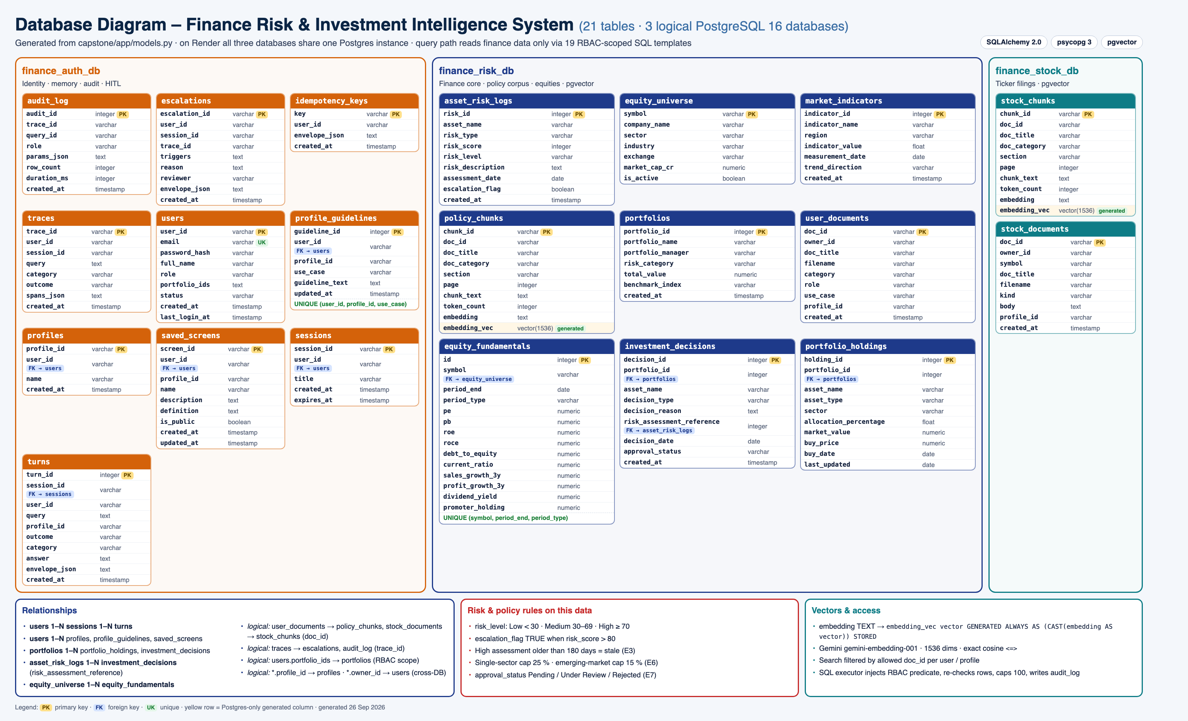
TECHNICAL DESIGN
Data model: 21 tables in 3 logical databases
CAPSTONE / S M RAIS IQBAL
14

Slide 15
TECHNICAL DESIGN
Security and AI configuration
Authentication
Row-level security
• PBKDF2-SHA256 (200k rounds) + HS256 JWT, 60-min TTL
• User re-read each request; prod refuses stub auth / default secret
• 4 roles; analysts limited to own portfolio ids
• SQL executor injects scope, re-checks every row, audits each run
LLM gateway
Cost and abuse controls
• One OpenAI-compatible HTTP call; Groq → Gemini fallback
• OpenAI, xAI, Ollama by config; 2 retries; temperature 0
• Deterministic answer if every provider fails
• 30 queries / min and $5 / day per user
• 8 000-token cap per request; Idempotency-Key replay
• Security headers, CORS allow-list
CAPSTONE / S M RAIS IQBAL
15

Slide 16
QUALITY AND CONTROL
Evaluation and observability
SLO | Target | Measured (strict, 2 Oct)
Faithfulness / relevance / precision | ≥ 80 / 75 / 70 % | 95 / 82 / 75 %
Latency C1/C2 p95 | ≤ 2000 ms | 6433 ms (miss)
Accuracy / recall / task success | ≥ 85 / 75 / 90 % | 100 / 79.5 / 74 % (miss)
SQL correctness / source attribution | ≥ 95 % / 100 % | 100 %
Escalation recall / guardrails | 100 % | 100 %
Routing / risk classification | ≥ 95 % | 100 %
Critical misclassification / RBAC | < 3 % / 0 | 0 % / 0
LLM as a judge | ≥ 80 % | 71 % (20 / 28, miss)
Test assets
• 50 golden · 24 attack · 10 negative
• 97 pytest tests, 85 % gate (93 % actual)
• Vitest for the UI
Observability
• structlog JSON per agent, trace_id everywhere
• Prometheus /metrics, /health/ready
• traces + audit_log tables, Langfuse
CAPSTONE / S M RAIS IQBAL
16

Slide 17
DELIVERY
Deployment: Vercel + Render + Supabase
GitHub
Blueprint
Docker build
Configure
Verify
git push origin main
render.yaml: API web service
Python 3.11 API image, non-root
Supabase URLs, JWT secret, LLM + Langfuse keys
/health, /health/ready, one query per category
Runtime
Operations
• Vercel serves the UI, proxies /api + /admin to Render
• One Supabase Postgres (pgvector) hosts all 21 tables
• Live: https://frii-seven.vercel.app
• Diagnose with /health/ready, /admin/traces/{id}, Langfuse
• Roll back from Render / Vercel deploy history
• Free tiers: Render sleeps after 15 min; Supabase pauses after 7 idle days
CAPSTONE / S M RAIS IQBAL
17

Slide 18
MANAGEMENT REVIEW
Limitations and next steps
Limitation | Next step
Rule-based router: unusual phrasing drops to low-confidence hybrid | LLM classifier as second opinion, rules stay the gate
Exact vector search, page-sized chunks | HNSW index and structure-aware chunking
PDFs on local container disk | Implement the S3 corpus store stub
Rate limit and budget kept in memory | Move counters to Postgres or Redis
Unused python-jose pin; 4 frontend files not UTF-8 | Remove dependency; re-save files as UTF-8
Free hosting tier | Paid tier for a lasting demo
CAPSTONE / S M RAIS IQBAL
18

Slide 19
Thank you
Live demo: https://frii-seven.vercel.app
Demo logins: analyst@local · risk@local · compliance@local · admin@local
CAPSTONE / S M RAIS IQBAL

