Slide 1
Threads in Programming (with a C++ focus)

Slide 2
Threads
-Execute different code at the “same” time
-Have their own PC, registers and stack
-Are scheduled by the OS

Slide 3
Why use threads?
App level:
  -Improved code structure
  -Natural consequence of multicore CPUs
  -More efficient use of CPU resources
  -Faster execution
Operating system level:
  -Many users

Slide 4
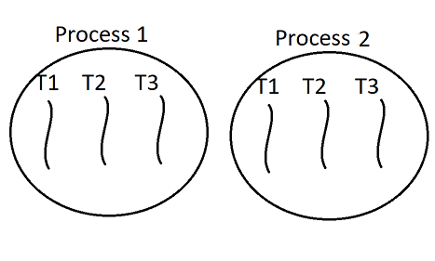

Threads vs Processes
Threads:
  -lightweight
  -exists within process
  -shared memory within a process
  -quick,cheap context switch
Processes:
  -more heavyweight
  -has its own threads
  -independent memory
  -slow,expensive context switch

Slide 5
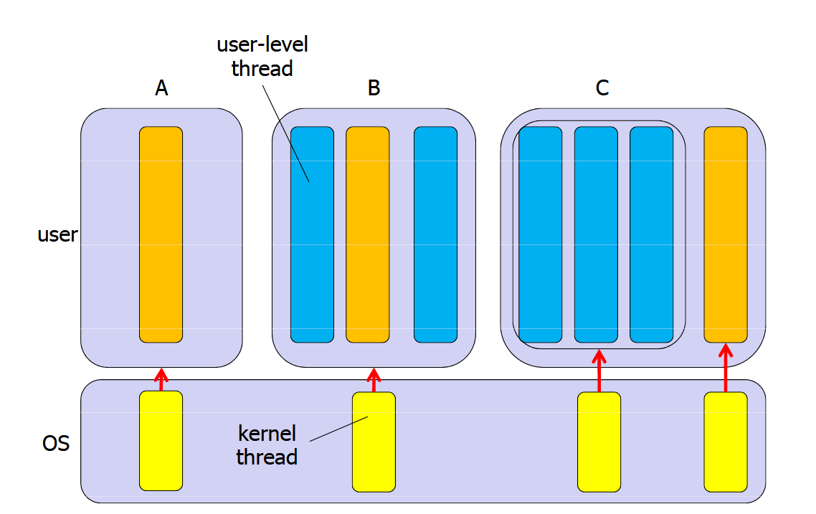
Kernel Threads – User Threads
What’s the difference?
True parallelism

Slide 6
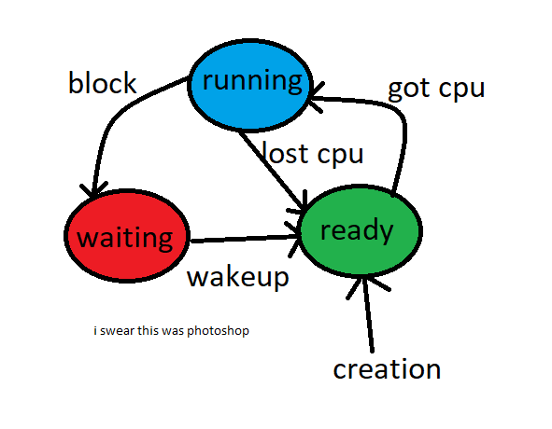

Thread states

Slide 7
CPU
When does a thread lose the cpu?
  -Periodically according to a “clock”
  -If it yields
And which thread gets it?
  -Priorities, demands.
Scheduling algorithms:
  -FCFS
  -Round robin
  -SJF

Slide 8
Threads in C++
C++11 introduced std::thread
  Before:UNIX pthread library
std::thread my_thread(thread_job(), arguments[]);
my_thread.join();

Slide 9
Demonstration of a simple race condition.
K++;
Is this just one command?

Slide 10
Demonstration of a simple race condition.
High level code:
  (K is a global variable)
  K++;
Low level code:
  load &k,temp
  add temp 1
  store temp, &k

Slide 11
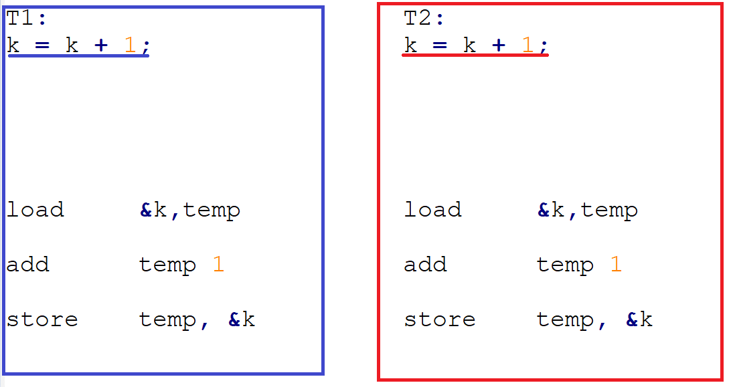
Demonstration of a simple race condition.

Slide 12
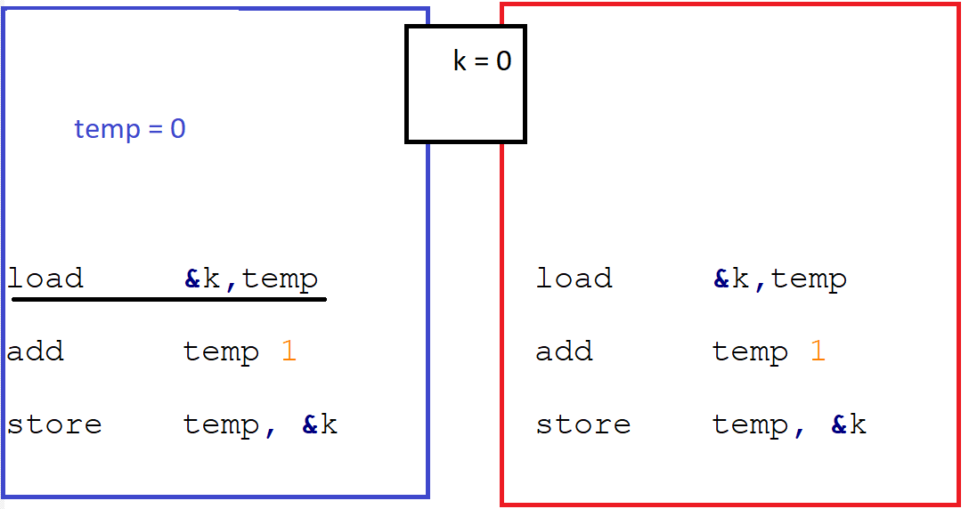
Demonstration of a simple race condition.

Slide 13
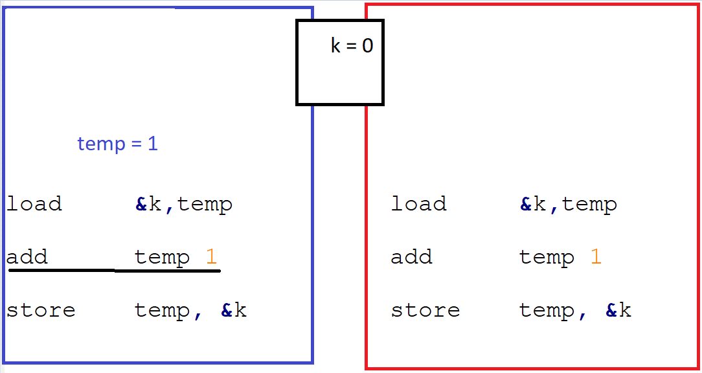
Demonstration of a simple race condition.

Slide 14
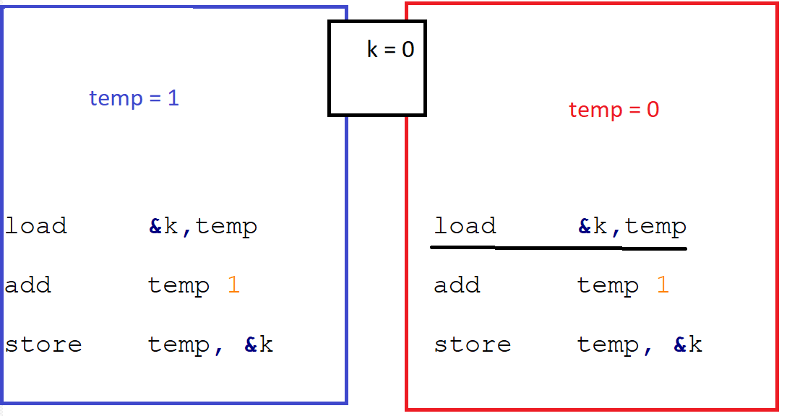
Demonstration of a simple race condition.

Slide 15
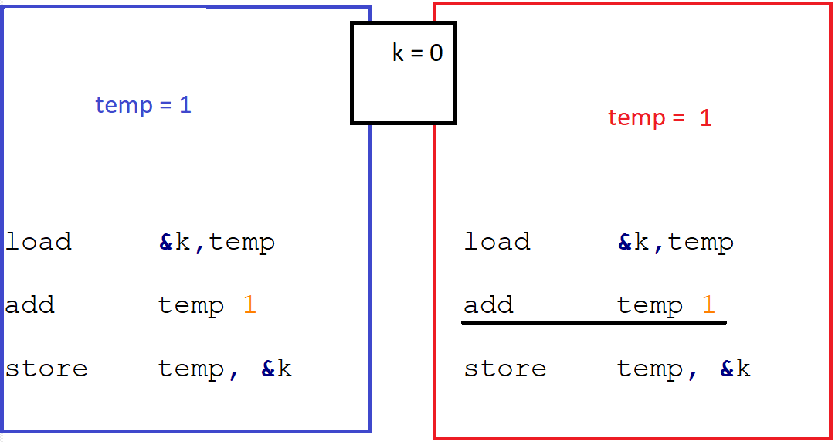
Demonstration of a simple race condition.

Slide 16
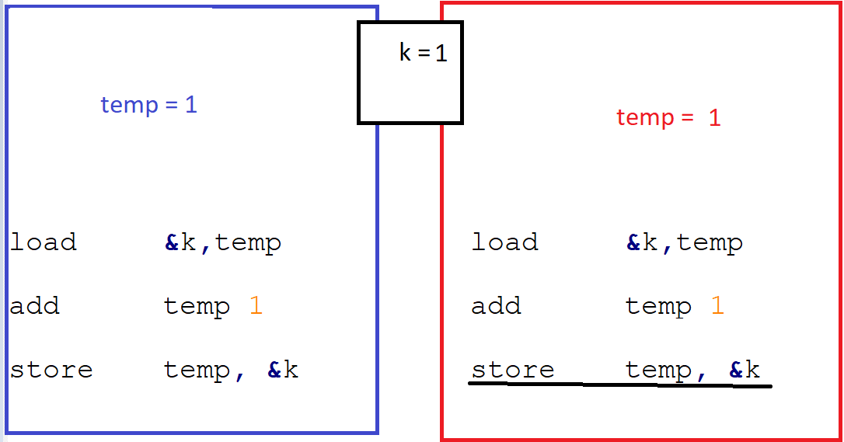
Demonstration of a simple race condition.

Slide 17
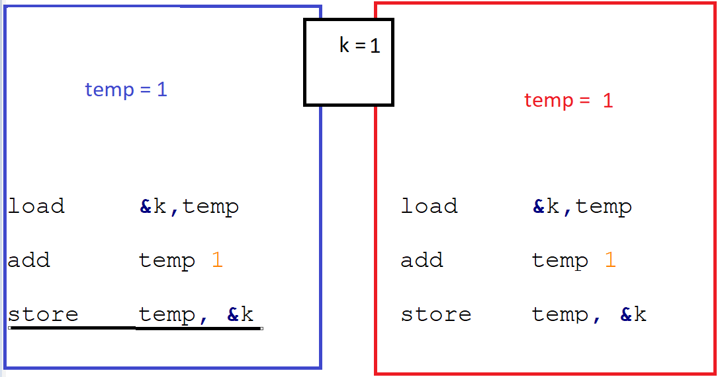
Demonstration of a simple race condition.

Slide 18
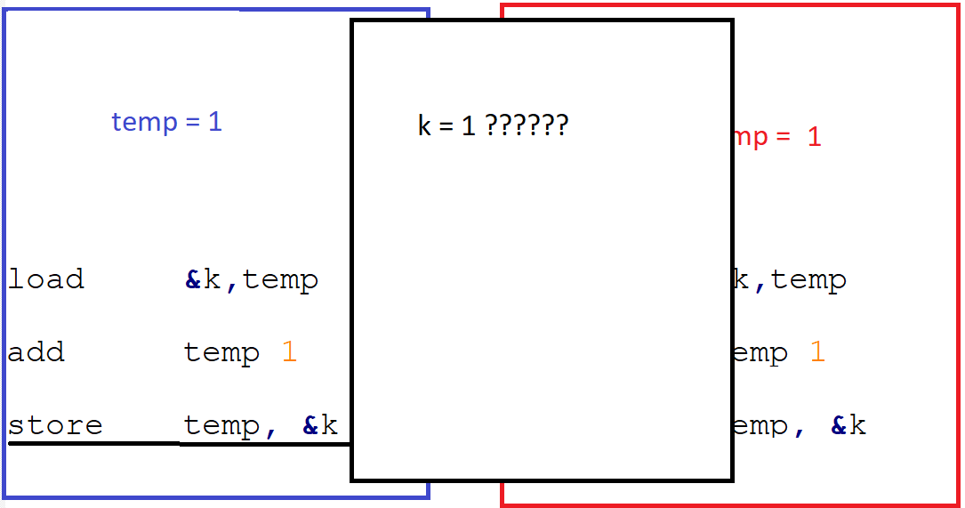
Demonstration of a simple race condition.

Slide 19
Demonstration of a simple race condition.

Slide 20
Critical Section
Critical section is a segment of code that needs to be run without interference from “competing” code.
  Depends on what the programmer is trying to achieve. He is responsible for recognizing critical sections within his code.

Slide 21
Requirements of a proper solution
1. Mutual exclusion
  If a thread is running its CS, no other thread can enter that CS.
2. Progress
  If a thread demands access to a CS, it will eventually be granted.
No deadlock:
    No possibility of threads blocking one another from entering the CS resulting in none of them entering.
No starvation:
    No possibility of a thread continually failing to enter the CS while there are other threads running it.

Slide 22
Spinlocks
Wait in a loop, until no one is running the CS.
  Complex in practice.
while (lock not available)
{
// Do Nothing
}
CS
lock .available()

Slide 23
Spinlocks
while (lock not available)
  Lock could be a memory address accessed and changed by hardware atomic commands such as test_and_lock(x) or swap_and_compare(x).
Light, usually used in the kernel.

Slide 24
Semaphores in C++
-Not built-in.
-Can be implemented.
sem s1;
Basically a counter that is atomically accessed and modified.
2 basic functions:
down(s1); //decrease by 1
up(s1); // increase by 1

Slide 25
Semaphores in C++
If a thread tries to decrease a semaphore with a value of 0, it BLOCKS and yields the cpu.
If a thread increases a semaphore with a value of 0 :
  A blocked thread gets unblocked(which?) and value stays at 0.
  Or else
  The value increases to 1.
If a thread increases a semaphore with a value of 1 :
  Binary: nothing happens Counting: becomes 2 and so on

Slide 26
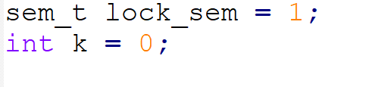
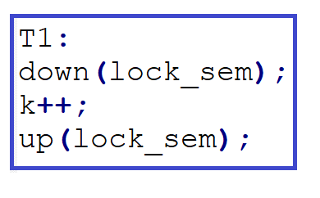
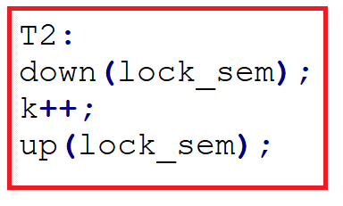
Simple solution to the crazy counter problem

Slide 27
So what is a Deadlock?
A deadlock happens when one thread needs a resource that is held by a waiting thread.

Slide 28
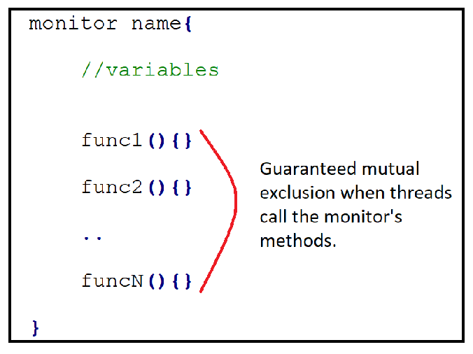
The Monitor class in C++
High level synchronization provided by the monitor “class”.

Slide 29
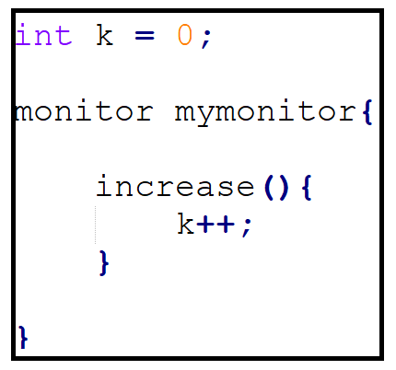

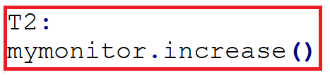
The counter problem using monitors

Slide 30
Condition variables
What if a thread needs to wait inside the monitor – e.g. for data.
Condition variables act as a fair waiting queue.
  They are declared inside the monitor.

Slide 31
Condition variables
condition x; //declaration
wait(x); //The calling thread blocks,all the while, the monitor //CS lock is lifted.(Why?)
signal(x); //A blocked thread wakes up from its block on x, //if none exists nothing happens.

Slide 32
But...
Now more threads can be inside the monitor but only one can run.
Different policies dictate which threads will run next after a thread waits.
Eggshell: Threads which were waiting inside(on cond) have bigger priority than threads waiting outside.

Slide 33
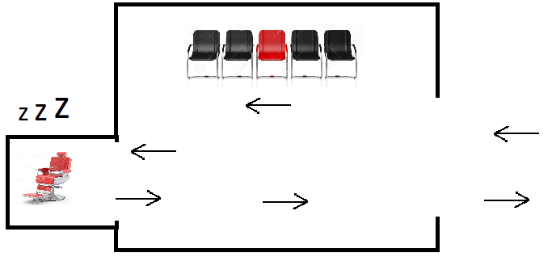
Sleeping barber problem
The barber shop has 1 barber and N waiting chairs for customers.
  -If there are no customers in the shop the barber takes a nap in the barber room.
  -When a customer arrives he wakes up the barber.
  -If the barber is busy the customer that arrived either sits in a chair and waits, or leaves because he doesn’t want to wait standing.

Slide 34
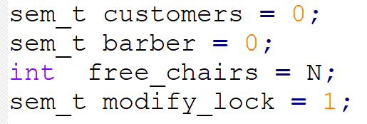
Sleeping barber problem
We need :
  -2 semaphores, for sleeping(customers) and waiting(barber)
  -1 counter for free seats
  -1 semaphore to protect the seat shared variable(see unprotected k++ example)

Slide 35
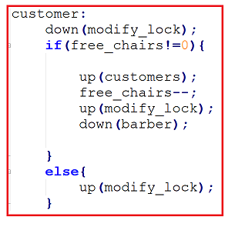
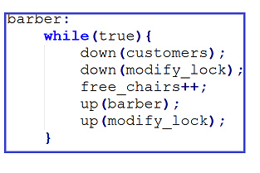
Sleeping barber problem

