Slide 1
SERVE |  | RALLY |  | ENDING
< LET > |  | TYPE |  | < ATTEMPT >
< TIME VIOLATION > |  | DIRECTION |  | WINNER/ ERROR
DIRECTION |  | < DEPTH >
FAULT |  | < POSITION >

Slide 2
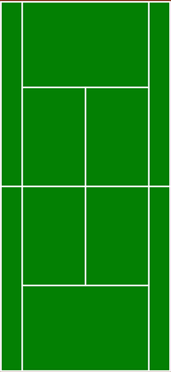
Wide
Body
Down the T

