Slide 1
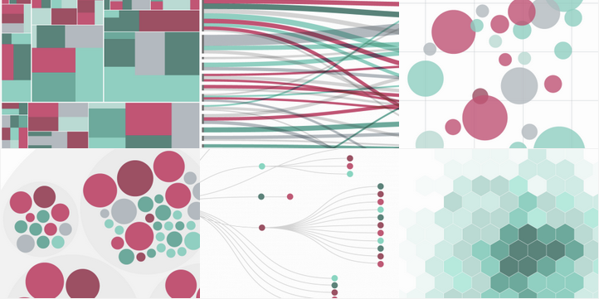
Data Visualization in R
RAND BUILD DAT DEMO SERIES
Wednesday October 14 Noon
m4307, p6208, w6330; 800.747.5150, code: 1395332

Slide 2



Slide 3
Usage & Features | ggvis | googleVis | plotly | rCharts
Gentle learning curve
Faceting
Documentation
Not buggy
Integration with shiny
Ease of customization
Ease of deployment

