Slide 1



Slide 2

Google Analytics - is a service for analyzing the behavior of users of websites and applications. This is a must have a tool for website owners and internet marketers.

Slide 3
Adding a Google Analytics counter gives you an opportunity to understand who, when and why you visited your site / app!

Slide 4

Google Analytics is the most commonly used website statistics service, currently in use on around 55% of the most popular websites.

Slide 5

What you can do in Google Analytics:
What you can do in Google Analytics:
Analysis of the effectiveness of the web-resource (download speed, user route);
Conduct A / B testing;
Generating reports in real time;
Evaluation of media, search and social advertising channels;
Analysis of the conversion and exit of the site to business objectives;
Estimation of the amount of "mobile" traffic;
And many more useful things…..

Slide 6
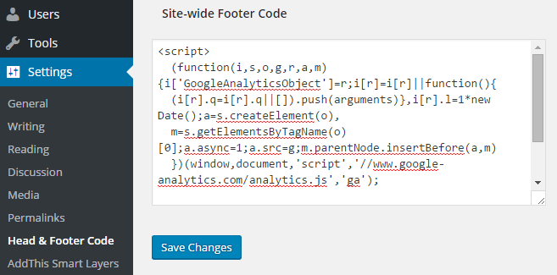
To get started with Google Analytics, you need:
1. Register in the system
2. Get the Google Analytics tracking code.
3. Add the code to your site.

Slide 7
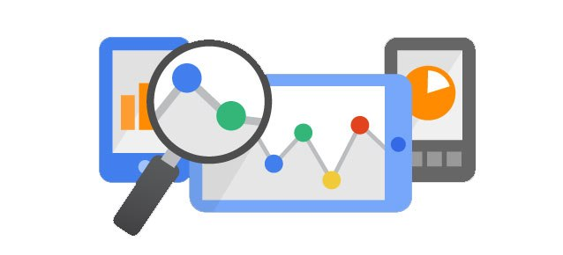
The service is suitable for various tasks

Slide 8
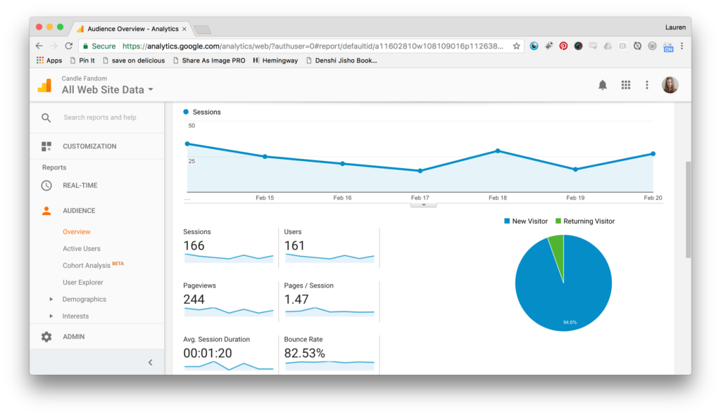
Сan be easy

Slide 9
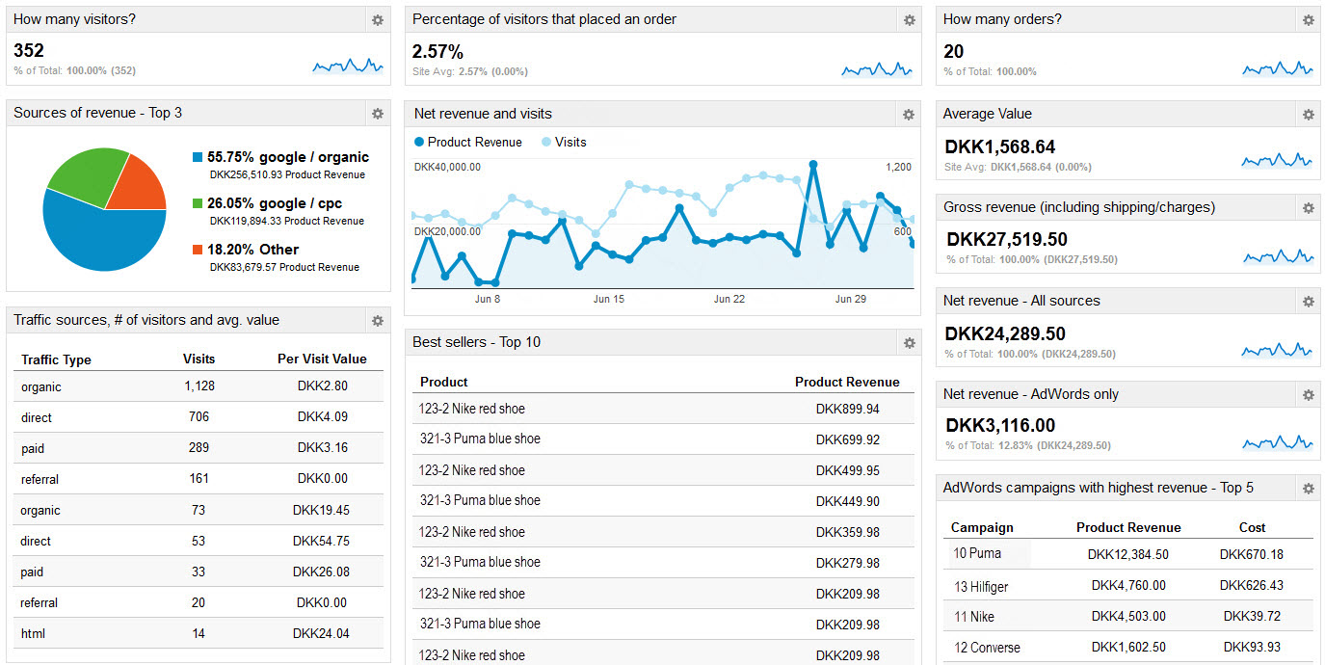
and solve complex problems!

Slide 10
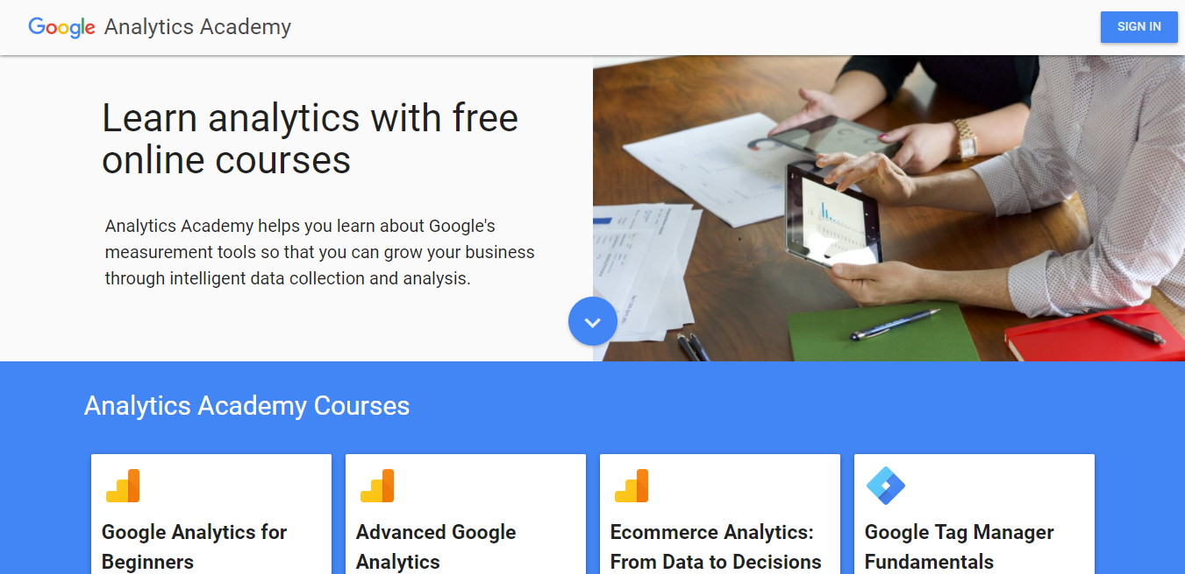
Learn how to use this tool to the full you can on free
Analytics Academy Courses

Slide 11

Useful links:
https://analytics.google.com/analytics/academy/
https://support.google.com/analytics/answer/4553001
https://www.youtube.com/googleanalytics
https://support.google.com/analytics/?hl=ru#topic=3544906
https://analytics.googleblog.com

Slide 12

Thank you

