Slide 1
Study of the ¹⁹F(p,γ)²⁰Ne reaction at LUNA400
J. Skowronski
Università degli Studi di Padova, Padova, Italy
Istituto Nazionale di Fisica Nucleare, Sezione di Padova, Padova, Italy
24/09/2024
24/09/24
¹⁹F(p,γ)²⁰Ne WG – Kick-off Meeting
1

Slide 2
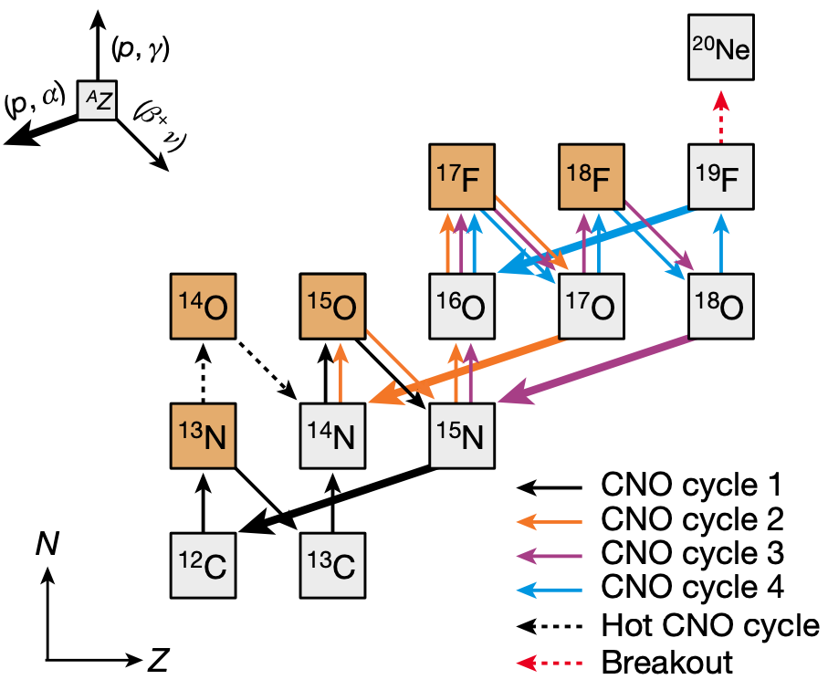
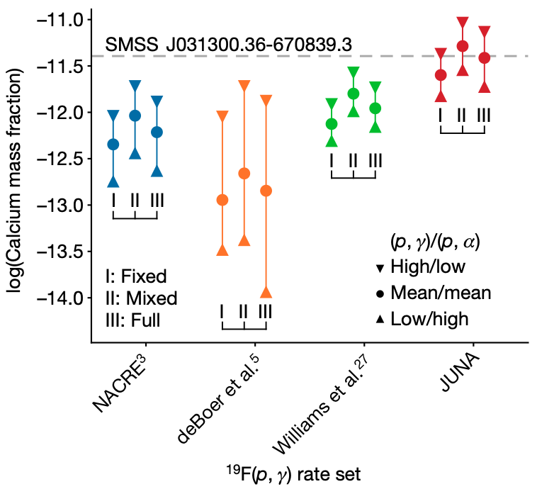
¹⁹F(p,γ)²⁰Ne Reaction: Motivation
Link between the CNO and NeNa cycles
Hot CNO breakout may play a key role in explaining the observed Ca abundance in metal-poor stars
¹⁹F(p,γ)²⁰Ne and ¹⁹F(p,α)¹⁶Ne ratio defines the evolution of first stars
Zhang et al. Nature 610, 656 (2022)
Fig. 1 CNO Cycle.
Fig. 2 Ca abundance versus (p,γ) rate.
24/09/24
¹⁹F(p,γ)²⁰Ne WG – Kick-off Meeting
2

Slide 3
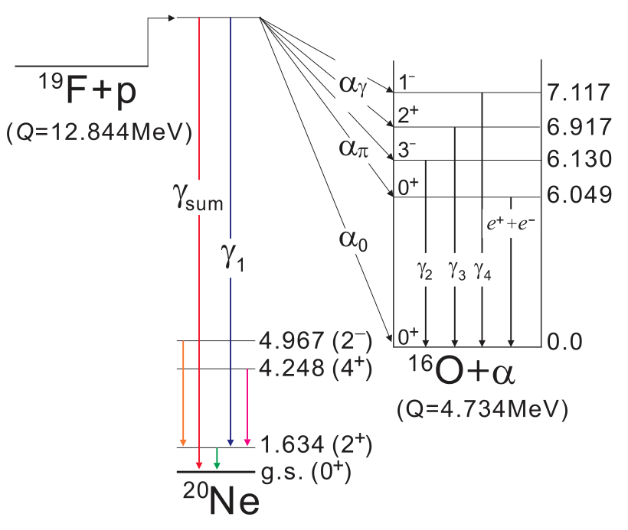
¹⁹F(p,γ)²⁰Ne and ¹⁹F(p,α)¹⁶O Reactions
24/09/24
¹⁹F(p,γ)²⁰Ne WG – Kick-off Meeting
3

Slide 4
¹⁹F(p,γ)²⁰Ne and ¹⁹F(p,α)¹⁶O Reactions
Problem 1
The ¹⁹F(p,α)¹⁶O creates a huge (pile-up) background for the ¹⁹F(p,γ)²⁰Ne measurement
¹⁹F(p,α₂)¹⁶O
¹⁹F(p,γ₁)²⁰Ne
Fig. 1 R-matrix of the ¹⁹F(p,γ)²⁰Ne and the ¹⁹F(p,α)¹⁶O
24/09/24
¹⁹F(p,γ)²⁰Ne WG – Kick-off Meeting
4

Slide 5
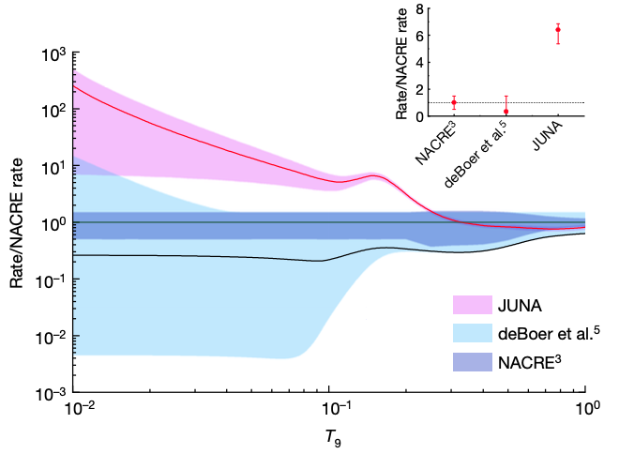
¹⁹F(p,γ)²⁰Ne Reaction: State-of-the-Art
Zheng et al. (2022) found the E_{cm} = 225 keV resonance, drastically enhancing the reaction rate (Fig. 2)
No other literature data are available under 300 keV
ωγ_{γ1} = 2.09 ± 0.21 meV
ωγ_{γ0} = 1.07 ± 0.21 meV
Fig. 1 S-factor for the ¹⁹F(p,γ)²⁰Ne
Fig. 2 Reaction rate from Zheng et al. (2022)
24/09/24
¹⁹F(p,γ)²⁰Ne WG – Kick-off Meeting
5

Slide 6
¹⁹F Targets
Type | Composition | Thickness @ 320 keV | Backing | Coating | Reference | Comments
Evaporated | CaF₂, MgF₂, LiF | 5 – 100 keV | Ta, W, Cu, C | - | [2,3,4,5] | Stable up to few μA of current
Sputtered | MgF₂, LiF | 10 keV | Ta, Fe | Cr | [5] | Degradation of 25% after 4 C
Implanted | - | 10 – 20 keV | Ta, Fe | Cr | [1,4,5] | Degradation of 0.05% per C (used with 1 mA)
Acid Bath | TaF₆ | 4.4 keV | Ta | - | [6] | Stable with 200 μA beam and quick to produce
[1] Zhang et al. Nature 610 (2022)
[2] Lombardo et al. Phys. Lett. B 748 (2014)
[3] Couture et al. Phys. Rev. C 77 (2008)
[4] Zhang et al. Nucl. Inst. Meth. Phys. Res. B 438 (2019)
[5] Zhang et al. Nucl. Inst. Meth. Phys. Res. B 496 (2021)
[6] Lorenz-Wirzba, PhD. Thesis (1978)
24/09/24
¹⁹F(p,γ)²⁰Ne WG – Kick-off Meeting
6

Slide 7
¹⁹F Targets
Type | Composition | Thickness @ 320 keV | Backing | Coating | Reference | Comments
Evaporated | CaF₂, MgF₂, LiF | 5 – 100 keV | Ta, W, Cu, C | - | [2,3,4,5] | Stable up to few μA of current
Sputtered | MgF₂, LiF | 10 keV | Ta, Fe | Cr | [5] | Degradation of 25% after 4 C
Implanted | - | 10 – 20 keV | Ta, Fe | Cr | [1,4,5] | Degradation of 0.05% per C (used with 1 mA)
Acid Bath | TaF₆ | 4.4 keV | Ta | - | [6] | Stable with 200 μA beam and quick to produce
Problem 2
Find the most suitable target for the ¹⁹F(p,γ)²⁰Ne measurement
[1] Zhang et al. Nature 610 (2022)
[2] Lombardo et al. Phys. Lett. B 748 (2014)
[3] Couture et al. Phys. Rev. C 77 (2008)
[4] Zhang et al. Nucl. Inst. Meth. Phys. Res. B 438 (2019)
[5] Zhang et al. Nucl. Inst. Meth. Phys. Res. B 496 (2021)
[6] Lorenz-Wirzba, PhD. Thesis (1978)
24/09/24
¹⁹F(p,γ)²⁰Ne WG – Kick-off Meeting
7

Slide 8

Experimental Setup
Components
Target Chamber: new aluminum chamber will be prepared to prevent ¹⁹F contamination
Detector: BGO Detector
DAQ: CAEN V1724 Board
Current: TetrAMM Module
Targets
Evaporated: 6 CaF₂ on Ta @ LNL (120 nm, 360 nm)
Acid Bath: 6 TaF₆ @ LNL (5 s, 10 s, 15 s)
Implanted: Ready by end of October @ HZDR (Joao will help in the characterization)
Sputtered: Not available (maybe in 2025?)
Fig. 1 Geant4 model of the experimental setup
24/09/24
¹⁹F(p,γ)²⁰Ne WG – Kick-off Meeting
8

Slide 9
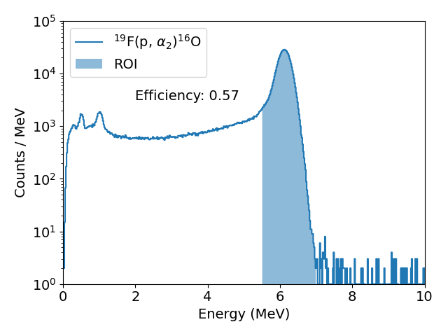
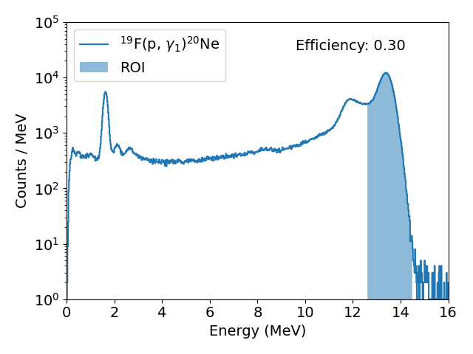
Geant4 Simulations
Geant4 model of the same experimental setup (except for the bPE) from the ¹³C(p,γ)¹³N study was used to estimate the asses the measurement feasibility
¹⁹F(p,α₂)¹⁶O
¹⁹F(p,γ)²⁰Ne
24/09/24
¹⁹F(p,γ)²⁰Ne WG – Kick-off Meeting
9

Slide 10
Geant4 Simulations
Geant4 model of the same experimental setup (except for the bPE) from the ¹³C(p,γ)¹³N study was used to estimate the asses the measurement feasibility
¹⁹F(p,α₂)¹⁶O
¹⁹F(p,γ)²⁰Ne
We could consider a bigger ROI in the analysis, increasing the efficiency up to 50%
24/09/24
¹⁹F(p,γ)²⁰Ne WG – Kick-off Meeting
10

Slide 11
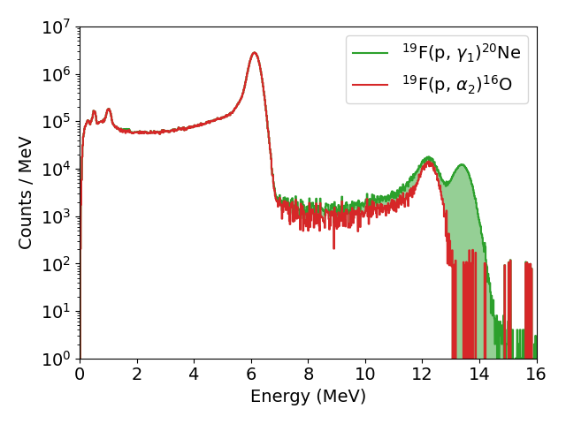
Geant4 Simulations: Pile-Up Study
Large count rate from (p,α) create pile-up, e.g. random coincidence from two instantaneous events
Sum-peak under the (p,γ) is created, reducing the efficiency
Event Rate: 1 kHz
24/09/24
¹⁹F(p,γ)²⁰Ne WG – Kick-off Meeting
11

Slide 12
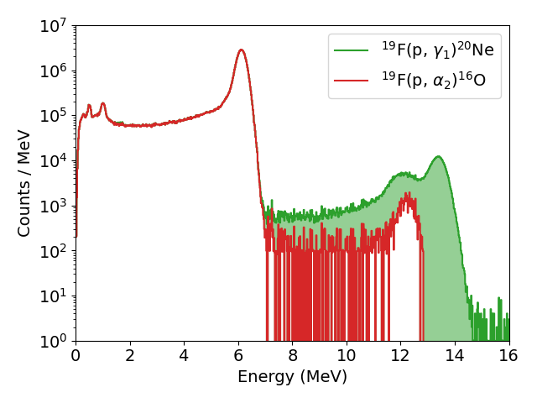
Geant4 Simulations: Pile-Up Study
Large count rate from (p,α) create pile-up, e.g. random coincidence from two instantaneous events
Sum-peak under the (p,γ) is created, reducing the efficiency
Solution 1.1
Maintain the event rate at 0.1 kHz
Event Rate: 1 kHz
Event Rate: 0.1 kHz
24/09/24
¹⁹F(p,γ)²⁰Ne WG – Kick-off Meeting
12

Slide 13
Geant4 Simulations: Pile-Up Study
Large count rate from (p,α) create pile-up, e.g. random coincidence from two instantaneous events
Sum-peak under the (p,γ) is created, reducing the efficiency
Solution 1.1
Maintain the event rate at 0.1 kHz
Event Rate: 1 kHz
Event Rate: 0.1 kHz
Solution 1.2
Use BGO fast signals with PSD software
Should reduce pile-up by 1 order of magnitude
Needs testing!
24/09/24
¹⁹F(p,γ)²⁰Ne WG – Kick-off Meeting
13

Slide 14
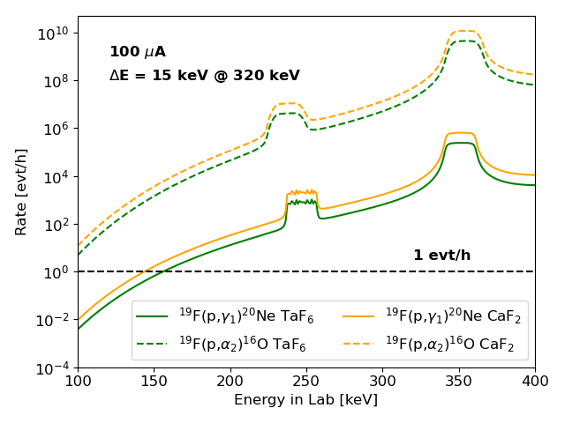
Expected Rate
We should be able to measure down to 150 keV (lower than JUNA)
The event rate from the (p,α) will create huge pile-up if not controlled
24/09/24
¹⁹F(p,γ)²⁰Ne WG – Kick-off Meeting
14

Slide 15
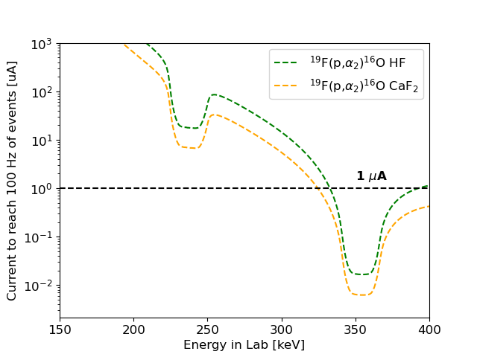
Expected Rates
The 100 Hz limit can not be achieved above 330 keV
Study of BGO signals necessary to measure the 350 keV resonance
We should be able to measure down to 150 keV (lower than JUNA)
The event rate from the (p,α) will create huge pile-up if not controlled
24/09/24
¹⁹F(p,γ)²⁰Ne WG – Kick-off Meeting
15

Slide 16
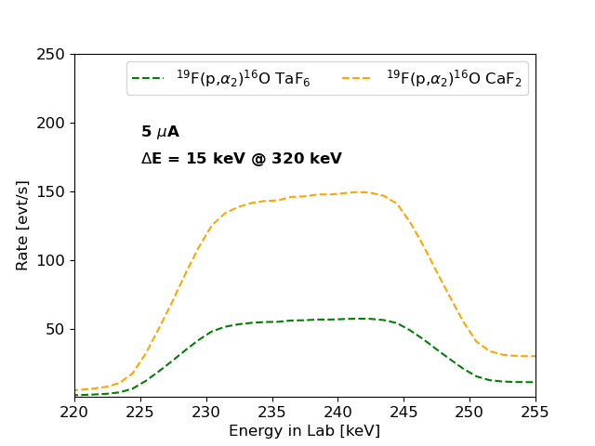
Target Scans
The (p,α) channel at the 225 keV resonance can be used for target scans
The scan should be quick ~ 1 hour due to the high event rate
24/09/24
¹⁹F(p,γ)²⁰Ne WG – Kick-off Meeting
16

Slide 17
Beamtime
Beamtime | Duration | Description
1 | 3 weeks (Maybe November 2024) | Task 1: Study of the BGO signals ~ 1 or 2 days Task 2: Evaporated target study ~ 5 days for 2 targets (30 C each) Task 3: “Acid bath” target study ~ 5 days for 2 targets (30 C each) Task 4: Implanted target study ~ 5 days for 2 targets (30 C each) Task 5: Ta backing run ~ 1 day (approximately 10 C) + 4 days of contingencies
2 | (?) 4 weeks (February/March 2025) | Task 1: Detector calibration ~ 2 days Task 2: Cross section measurement ~ (?) 3 weeks for 10 keV steps + 5 days of contingencies
3 | (?) 3 weeks (June/July 2025) | Task 1: Additional calibration for reproducibility ~ 2 days Task 2: Long runs at lowest energies ~ (?) 2 weeks Task 3: Systematic uncertainty studies ~ 2 days + 4 extra days
24/09/24
¹⁹F(p,γ)²⁰Ne WG – Kick-off Meeting
17

Slide 18
Conclusion
The measurement seems promising, in principle we can measure much lower than JUNA
A new target chamber will be bought in the next month
Several ideas (to be tested) on how to keep “pile-up” low
Several target options (to be tested)
Mailing: luna-19f+p@lists.infn.it
Trello: https://shorturl.at/zaNtt
GSBox: https://shorturl.at/ZofJ8
Github: https://github.com/skowrons94/19F_pg_LUNA
24/09/24
¹⁹F(p,γ)²⁰Ne WG – Kick-off Meeting
18

Slide 19
Conclusion
The measurement seems promising, in principle we can measure much lower than JUNA
A new target chamber will be bought in the next month
Several ideas (to be tested) on how to keep “pile-up” low
Several target options (to be tested)
Tasks
New PhD. Student @ UNIPD
Riccardo Biasissi
will lead the analysis of the data
DAQ Improvements
Target Studies
Simulations
Let me know what you are interest in
24/09/24
¹⁹F(p,γ)²⁰Ne WG – Kick-off Meeting
19

