Slide 1
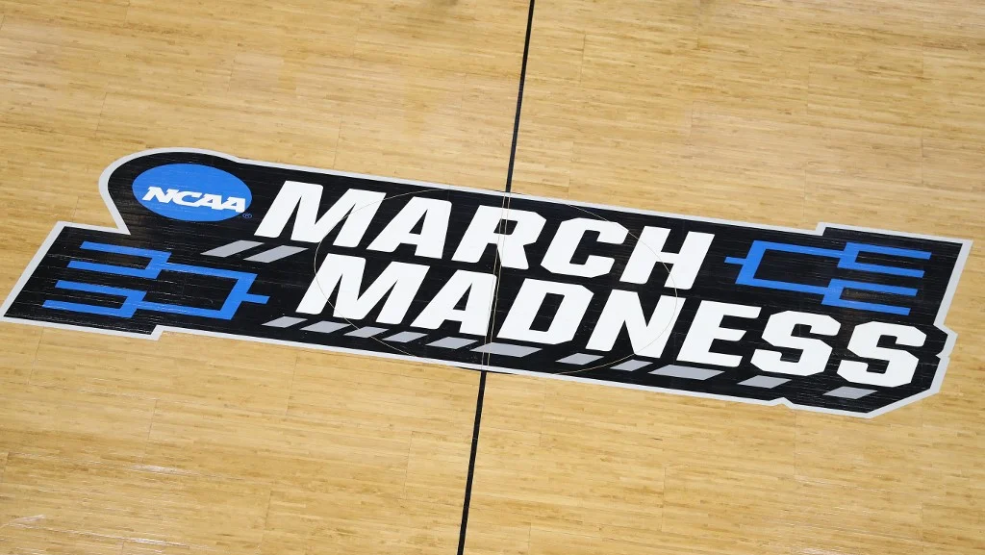
]--- March Machine Learning Mania 2023 – Kaggle Competition ---[
Source: https://sports.inquirer.net/files/2021/03/063_1137152686.jpg

Slide 2
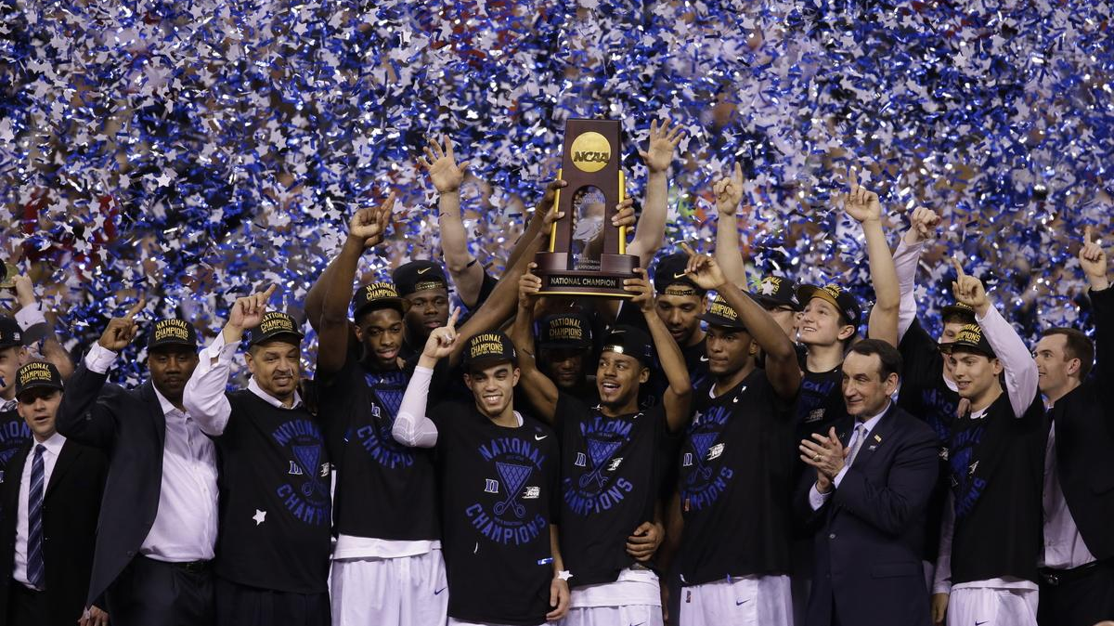
What is March Madness?
One of the most popular sporting events in the United States.
Every year around March/April ~19-21 days ~3 weeks
The season-ending tournament for NCAA Division I
both the men's and women's leagues.

Slide 3
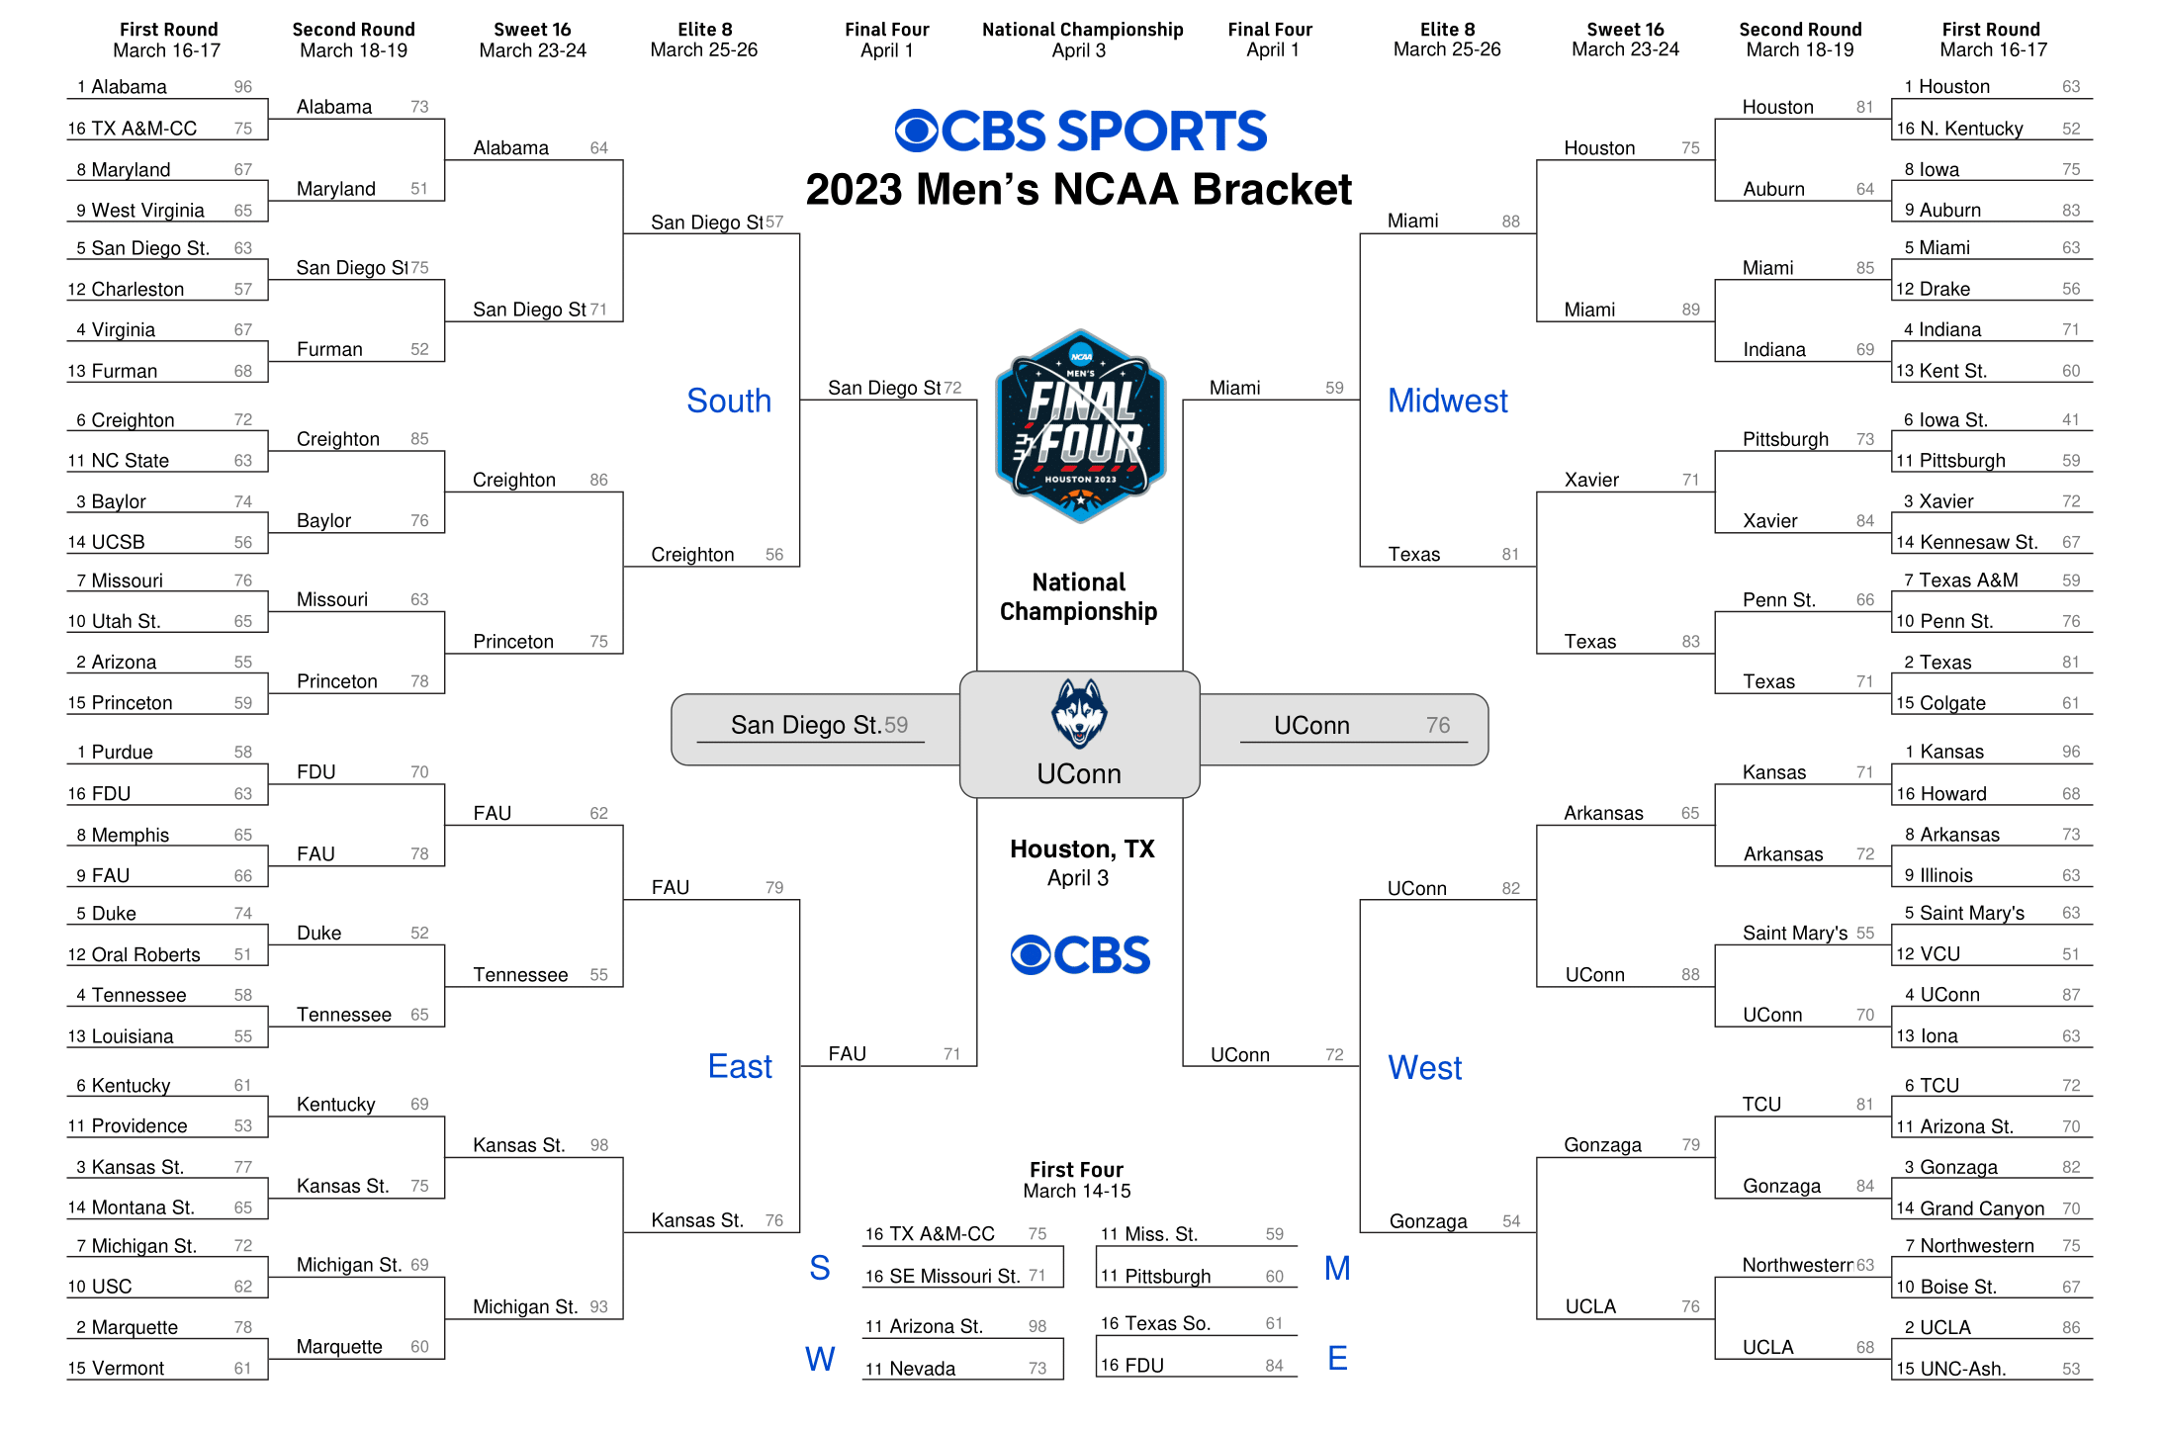
Source: https://www.cbssports.com/college-basketball/ncaa-tournament/bracket/printable-men/

Slide 4
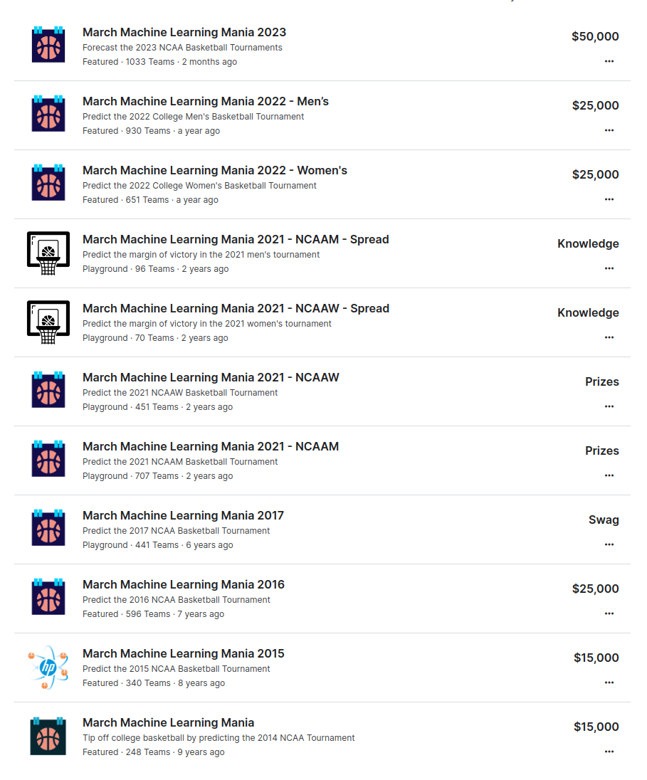
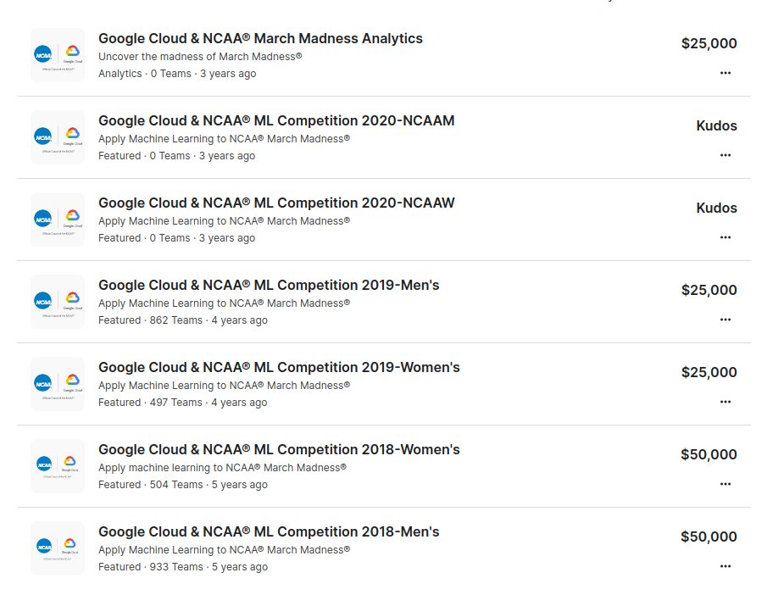
There has been a Kaggle competition for March Madness every season for the last 10 seasons
In 2020 the tourney didn't happen due to covid

Slide 5
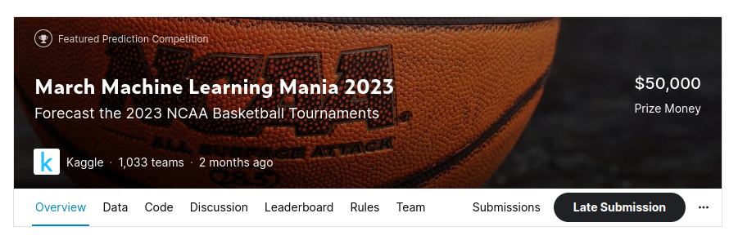
Use the provided data to generate features
Optionally add some other data
Train a model
Predict the probability each possible game's outcome
Submit before the tourney starts
Enjoy the games

Slide 6
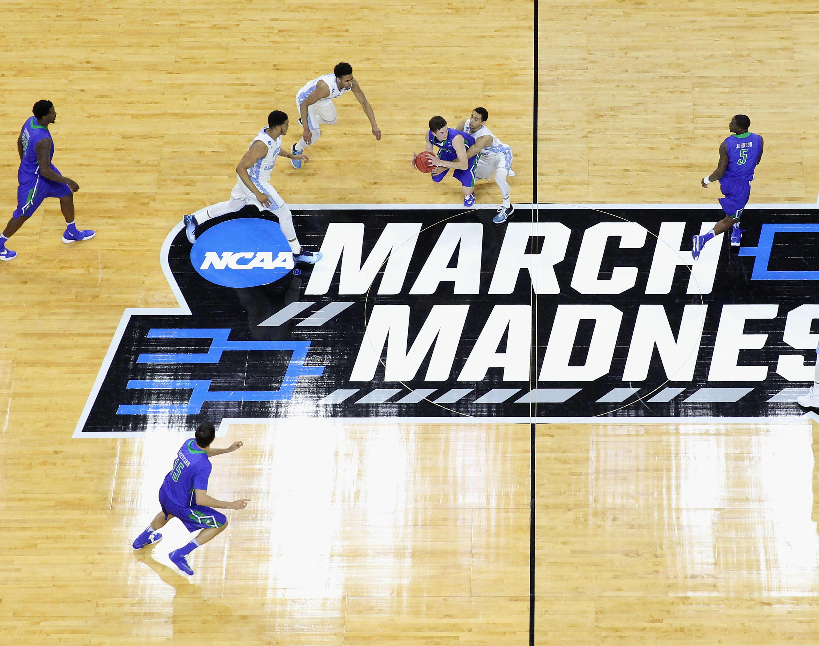
Used data
Provided:
(M/W)RegularSeasonDetailedResults
(M/W)NCAATourneyDetailedResults
(M/W)NCAATourneySeeds
(M/W)TeamConferences
MMasseyOrdinals_thru_Season2023_Day128
Added:
WRatings
Mtournament_team_data
https://image.cnbcfm.com/api/v1/image/103480791-GettyImages-516278604.jpg?v=1532564157

Slide 7
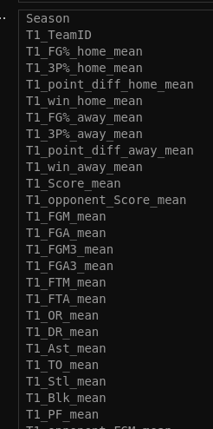
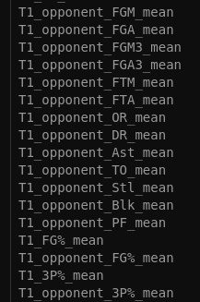
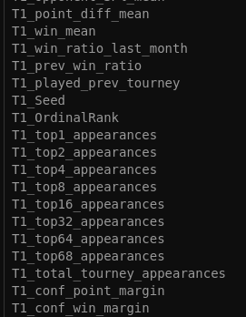
Features
Target:
win=0/1
+ the same attributes for the second team

Slide 8
XGBoost Classifier
Modelling
Null values
Test data:
last 3 seasons
Training data: previous seasons
Hyperparemeter tuning with
grid search and
cross-validation
Predicted probabilities
____________
Brier score evaluation metric

Slide 9
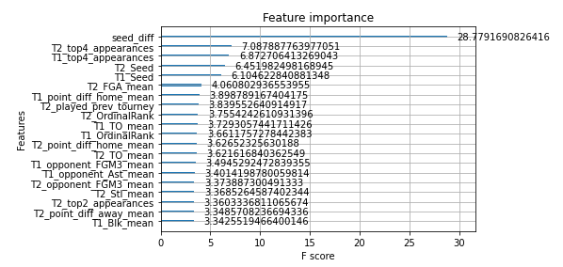
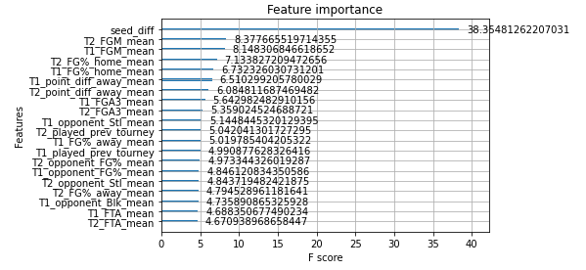
Results
Men
Brier score: 0.2189
Accuracy: 0.6685
Women
Brier score: 0.1602
Accuracy: 0.7539

Slide 10
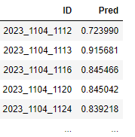
Final submission
Brier score: 0.1936
Men: 0.2176
Women: 0.1697
Median Kaggle result: 0.1984
Best Kaggle result: 0.1737
Replacing predicted probabilities with 1s for big favourites
Accuracy: 0.7143
Men: 0.6825
Women: 0.7460

Slide 11
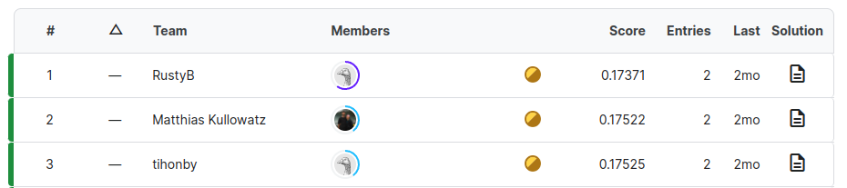
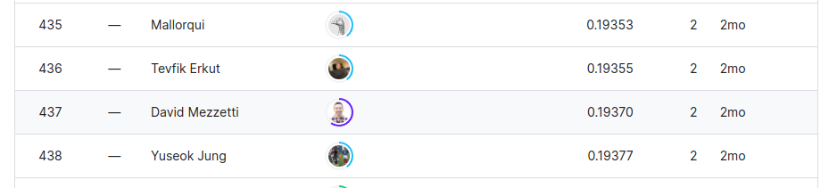
Our placing
us

