Slide 1

M.TECH PROJECT PRESENTATION
EMPLOYING MACHINE LEARNING TECHNIQUES TO PREDICT MATERIAL PROPERTIES FROM STRUCTURAL DATA
DEPARTMENT OF CHEMICAL ENGINEERING
INDIAN INSTITUTE OF TECHNOLOGY KHARAGPUR
Supervisor: Prof. Somenath Ganguly
Mentor: Dr. Smruti Ranjan Sethi
SAURABH KUMAR PANDEY 17CH30055

Slide 2
OBJECTIVE
OBJECTIVE
DATASET
REPRESENTATION
GRAPH CONVOLUTION NETWORKS
CRYSTAL GRAPH CNN
HYPERPARAMETER OPTIMIZATION
RESULTS
FUTURE SCOPE
Study of machine learning based approach to study different properties of porous media and electrolytes from their structural data
Development of a simple Convolutional Neural Network to predict Effective Diffusivity of porous media
Employing Graph based methods to predict elastic properties like Bulk and Shear modulus for solid electrolytes
Hyperparameter optimization of Convolutional Neural Networks (CNNs) and Crystal Graph CNNs to create a generalized model to predict material properties
Notes:
We have used a Teacher-Student model because the base ArcFace model has 85,000 classes and hence a very high number of parameters. Due to compute resources, we were not able to utilize the GPU completely. So we have used the concept of distillation loss to preserve the features of all 85,000 classes but to train it with just 2000 classes and we were able to maximize GPU Utilization

Slide 3
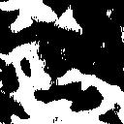
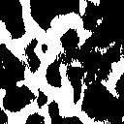
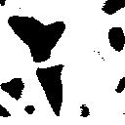
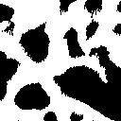
DATASET
OBJECTIVE
DATASET
REPRESENTATION
GRAPH CONVOLUTION NETWORKS
CRYSTAL GRAPH CNN
HYPERPARAMETER OPTIMIZATION
RESULTS
FUTURE SCOPE
Dataset for Predicting Effective Diffusivity of Porous media
The images are obtained from the raw csv file using OpenCV library from Python
SEM images of the porous film of a nanostructured electrode used in electrochemical energy storage
Pore space is marked as 0 (black) and solid space is marked as 1 (white)
Figure – Sample SEM images of porous film
The diffusivity values are also provided for corresponding image, these are the target values to be used for model development and training
Notes:
We have used a Teacher-Student model because the base ArcFace model has 85,000 classes and hence a very high number of parameters. Due to compute resources, we were not able to utilize the GPU completely. So we have used the concept of distillation loss to preserve the features of all 85,000 classes but to train it with just 2000 classes and we were able to maximize GPU Utilization

Slide 4
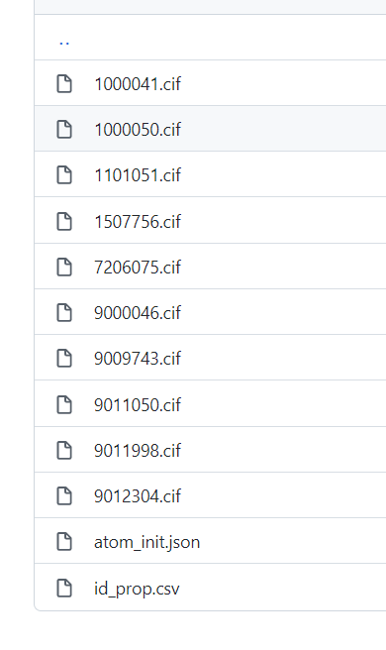
DATASET
OBJECTIVE
DATASET
REPRESENTATION
GRAPH CONVOLUTION NETWORKS
CRYSTAL GRAPH CNN
HYPERPARAMETER OPTIMIZATION
RESULTS
FUTURE SCOPE
Dataset for Predicting Elastic Constants of Electrolytes
data_LiGdAu2
_symmetry_space_group_name_H-M 'P 1'
_cell_length_a 6.91600800
_cell_length_b 6.91600800
_cell_length_c 6.91600800
_cell_angle_alpha 90.00000000
_cell_angle_beta 90.00000000
_cell_angle_gamma 90.00000000
_symmetry_Int_Tables_number 1
_chemical_formula_structural LiGdAu2
_chemical_formula_sum 'Li4 Gd4 Au8'
_cell_volume 330.80073124
_cell_formula_units_Z 4
loop_
_symmetry_equiv_pos_site_id
_symmetry_equiv_pos_as_xyz
1 'x, y, z'
loop_
_atom_site_type_symbol
_atom_site_label
_atom_site_symmetry_multiplicity
_atom_site_fract_x
_atom_site_fract_y
_atom_site_fract_z
_atom_site_occupancy
Li Li0 1 0.00000000 0.00000000 0.00000000 1
Li Li1 1 0.00000000 0.50000000 0.50000000 1
Li Li2 1 0.50000000 0.00000000 0.50000000 1
Li Li3 1 0.50000000 0.50000000 0.00000000 1
Gd Gd4 1 0.50000000 0.00000000 0.00000000 1
Gd Gd5 1 0.50000000 0.50000000 0.50000000 1
Gd Gd6 1 0.00000000 0.00000000 0.50000000 1
Gd Gd7 1 0.00000000 0.50000000 0.00000000 1
Au Au8 1 0.25000000 0.75000000 0.75000000 1
Au Au9 1 0.25000000 0.25000000 0.75000000 1
Au Au10 1 0.25000000 0.25000000 0.25000000 1
Au Au11 1 0.25000000 0.75000000 0.25000000 1
Au Au12 1 0.75000000 0.75000000 0.25000000 1
Au Au13 1 0.75000000 0.25000000 0.25000000 1
Au Au14 1 0.75000000 0.25000000 0.75000000 1
Au Au15 1 0.75000000 0.75000000 0.75000000 1
Our database has around 46744 materials covering 87 elements, 7 lattice systems and 216 space groups
The elastic tensor which has properties like bulk and shear moduli has only been calculated for around 9507 materials properties out of all these 46744 materials
The dataset directory has the following substructure – cif files contain the properties of the crystal, atom_init.json contains the dictionary of feature vector of all the atoms and id_prop.csv contains the material ids and properties of all the materials.
Crystallographic Information File (CIF) of LiGdAu₂
Notes:
We have used a Teacher-Student model because the base ArcFace model has 85,000 classes and hence a very high number of parameters. Due to compute resources, we were not able to utilize the GPU completely. So we have used the concept of distillation loss to preserve the features of all 85,000 classes but to train it with just 2000 classes and we were able to maximize GPU Utilization

Slide 5
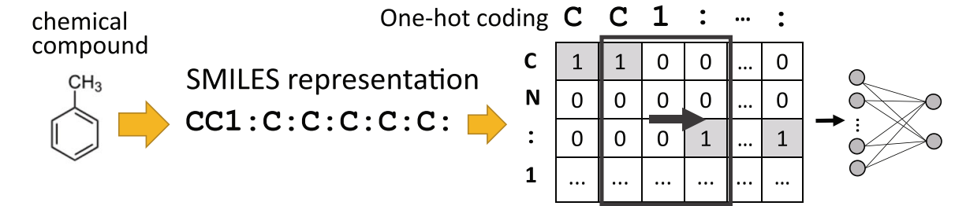
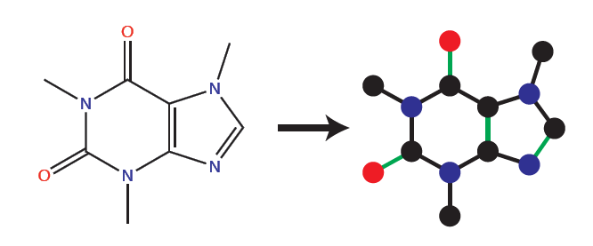
REPRESENTATION OF MATERIALS
OBJECTIVE
DATASET
REPRESENTATION
GRAPH CONVOLUTION NETWORKS
CRYSTAL GRAPH CNN
HYPERPARAMETER OPTIMIZATION
RESULTS
FUTURE SCOPE
SMILES (Simplified Molecule Input Line Entry System)
Molecule Graphs
Graph construction is straightforward
All information is encoded
Notes:
We have used a Teacher-Student model because the base ArcFace model has 85,000 classes and hence a very high number of parameters. Due to compute resources, we were not able to utilize the GPU completely. So we have used the concept of distillation loss to preserve the features of all 85,000 classes but to train it with just 2000 classes and we were able to maximize GPU Utilization

Slide 6
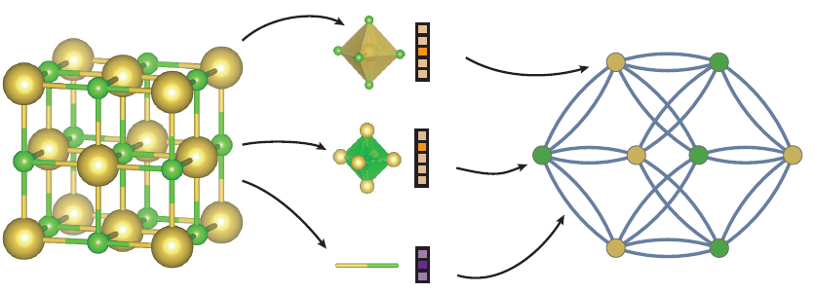
REPRESENTATION OF MATERIALS
OBJECTIVE
DATASET
REPRESENTATION
GRAPH CONVOLUTION NETWORKS
CRYSTAL GRAPH CNN
HYPERPARAMETER OPTIMIZATION
RESULTS
FUTURE SCOPE
Crystal Graphs (Crystallographic Information Files)
A crystal graph G is an undirected multigraph defined by nodes representing atoms and edges representing connections between atoms in a crystal
The crystal graph is unlike normal graphs since it allows multiple edges between the same pair of end nodes, a characteristic for crystal graphs due to their periodicity, in contrast to molecular graphs
Each node i is represented by a feature vector v_{i}, encoding the property of the atom corresponding to node i. Similarly, each edge (i,j)_{k} is represented by a feature vector u(i,j)_{k} corresponding to the k-th bond connecting atom i and atom j.
Notes:
We have used a Teacher-Student model because the base ArcFace model has 85,000 classes and hence a very high number of parameters. Due to compute resources, we were not able to utilize the GPU completely. So we have used the concept of distillation loss to preserve the features of all 85,000 classes but to train it with just 2000 classes and we were able to maximize GPU Utilization

Slide 7
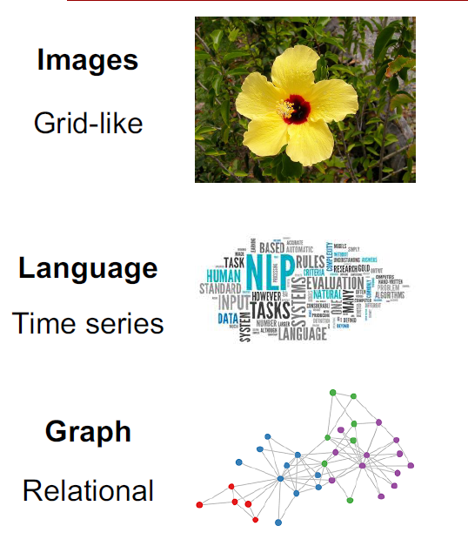
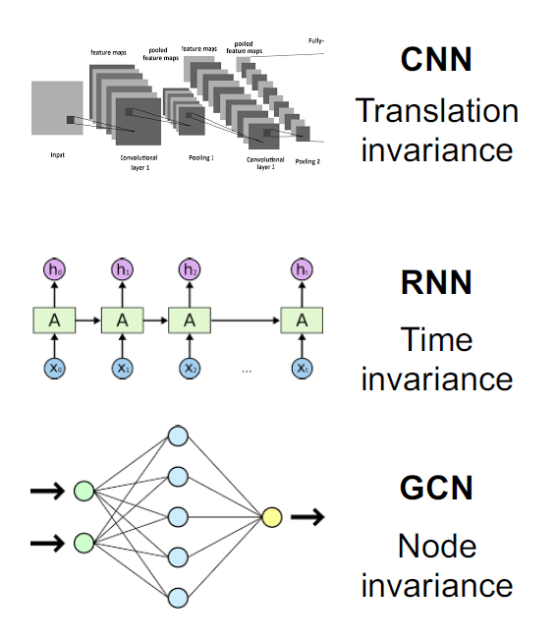
GRAPH CONVOLUTION NETWORKS
OBJECTIVE
DATASET
REPRESENTATION
GRAPH CONVOLUTION NETWORKS
CRYSTAL GRAPH CNN
HYPERPARAMETER OPTIMIZATION
RESULTS
FUTURE SCOPE
Deep Learning for different data types
Invariances are built into the neural networks to prevent overfitting
Notes:
We have used a Teacher-Student model because the base ArcFace model has 85,000 classes and hence a very high number of parameters. Due to compute resources, we were not able to utilize the GPU completely. So we have used the concept of distillation loss to preserve the features of all 85,000 classes but to train it with just 2000 classes and we were able to maximize GPU Utilization

Slide 8
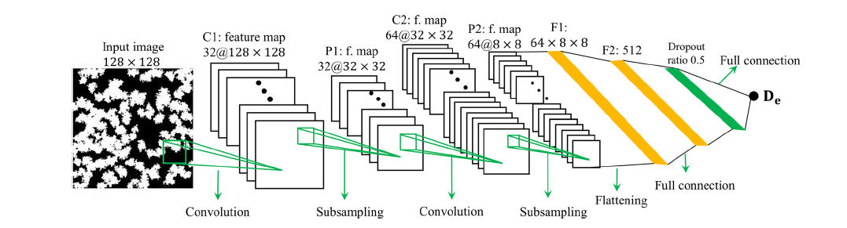
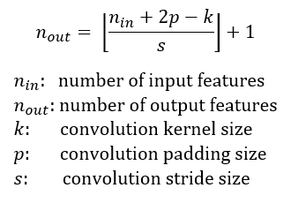
GRAPH CONVOLUTION NETWORKS
OBJECTIVE
DATASET
REPRESENTATION
GRAPH CONVOLUTION NETWORKS
CRYSTAL GRAPH CNN
HYPERPARAMETER OPTIMIZATION
RESULTS
FUTURE SCOPE
Convolutional Neural Network
Figure – 2 layer CNN architecture
CNN are highly popular because of their architecture as there is no need for feature extraction.
2 layer CNN architecture can be used to predict effective diffusivity of porous media from their structural images
Notes:
We have used a Teacher-Student model because the base ArcFace model has 85,000 classes and hence a very high number of parameters. Due to compute resources, we were not able to utilize the GPU completely. So we have used the concept of distillation loss to preserve the features of all 85,000 classes but to train it with just 2000 classes and we were able to maximize GPU Utilization

Slide 9


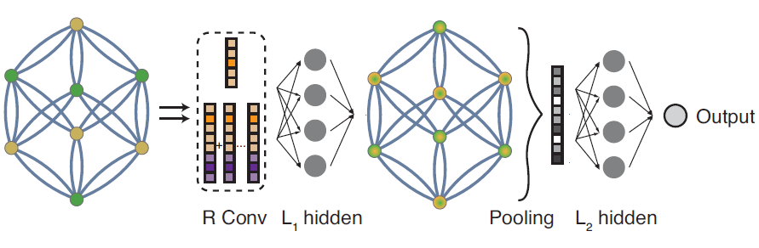
CRYSTAL GRAPH CNN
OBJECTIVE
DATASET
REPRESENTATION
GRAPH CONVOLUTION NETWORKS
CRYSTAL GRAPH CNN
HYPERPARAMETER OPTIMIZATION
RESULTS
FUTURE SCOPE
Crystal Graph Convolutional Neural Network
Convolutional layers
Pooling layers
Figure – Convolutional neural network on top of the crystal graph
Notes:
We have used a Teacher-Student model because the base ArcFace model has 85,000 classes and hence a very high number of parameters. Due to compute resources, we were not able to utilize the GPU completely. So we have used the concept of distillation loss to preserve the features of all 85,000 classes but to train it with just 2000 classes and we were able to maximize GPU Utilization

Slide 10
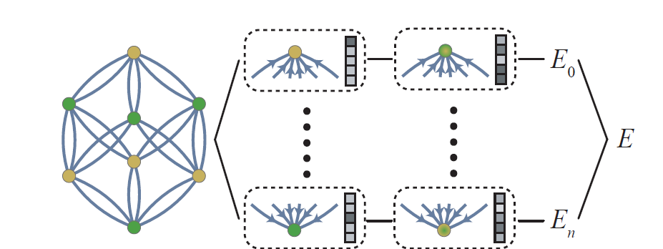
CRYSTAL GRAPH CNN
OBJECTIVE
DATASET
REPRESENTATION
GRAPH CONVOLUTION NETWORKS
CRYSTAL GRAPH CNN
HYPERPARAMETER OPTIMIZATION
RESULTS
FUTURE SCOPE
Hierarchical Visualization of CGCNN
Global
Properties
Elemental Representation
Learns the information of individual elements
Local Representation
Learns the configuration of surrounding elements
Local Properties
Predicts the local properties
Notes:
We have used a Teacher-Student model because the base ArcFace model has 85,000 classes and hence a very high number of parameters. Due to compute resources, we were not able to utilize the GPU completely. So we have used the concept of distillation loss to preserve the features of all 85,000 classes but to train it with just 2000 classes and we were able to maximize GPU Utilization

Slide 11

HYPERPARAMETER OPTIMIZATION
OBJECTIVE
DATASET
REPRESENTATION
GRAPH CONVOLUTION NETWORKS
CRYSTAL GRAPH CNN
HYPERPARAMETER OPTIMIZATION
RESULTS
FUTURE SCOPE
Hyperparameters of CNN model to predict effective diffusivity
Kernel size | (2,2) | (3,3) | (4,4) | (5,5)
Learning Rate | 1e-2 | 1e-3 | 1e-4
Number of filters | (8,16) | (16,32) | (32,64)
Strides | (2,2) | (3,3) | (4,4)
Pool size | (2,2) | (3,3) | (4,4)
Padding | “same” | “valid”
Activation | ReLU | Linear
Test hyperparameters of the CNN model
900 different valid combinations of the above hyperparameters have been trained and tested using Relative Error as the performance metric
Performance Metric
RE – Relative Error
$$RE=\frac{Predicted value−Target value}{Target value}$$
Notes:
We have used a Teacher-Student model because the base ArcFace model has 85,000 classes and hence a very high number of parameters. Due to compute resources, we were not able to utilize the GPU completely. So we have used the concept of distillation loss to preserve the features of all 85,000 classes but to train it with just 2000 classes and we were able to maximize GPU Utilization

Slide 12
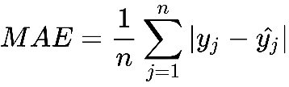
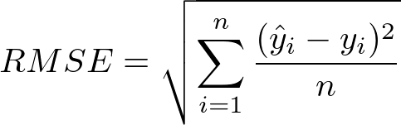
HYPERPARAMETER OPTIMIZATION
OBJECTIVE
DATASET
REPRESENTATION
GRAPH CONVOLUTION NETWORKS
CRYSTAL GRAPH CNN
HYPERPARAMETER OPTIMIZATION
RESULTS
FUTURE SCOPE
Hyperparameters of CGCNN model to predict elastic constants
Number of conv. layers | Number of hidden layers | Feature vector length (atoms) | Feature vector length (hidden) | Learning rate | Optimizer | MAE (Bulk Modulus) | MAE (Shear Modulus)
2 | 1 | 32 | 64 | 0.01 | SGD | 0.097 | 0.142
3 | 1 | 64 | 128 | 0.01 | SGD | 0.099 | 0.145
3 | 2 | 64 | 128 | 0.01 | SGD | 0.101 | 0.145
4 | 1 | 16 | 32 | 0.01 | Adam | 0.103 | 0.153
5 | 2 | 128 | 512 | 0.01 | SGD | 0.276 | 0.298
3 | 1 | 128 | 32 | 0.01 | Adam | 0.093 | 0.149
4 | 1 | 16 | 32 | 0.001 | SGD | 0.112 | 0.153
5 | 2 | 64 | 128 | 0.001 | SGD | 0.120 | 0.156
Test hyperparameters of the CGCNN model
Performance Metrics
RMSE – Root Mean Squared Error
MAE – Mean Absolute Error
Notes:
We have used a Teacher-Student model because the base ArcFace model has 85,000 classes and hence a very high number of parameters. Due to compute resources, we were not able to utilize the GPU completely. So we have used the concept of distillation loss to preserve the features of all 85,000 classes but to train it with just 2000 classes and we were able to maximize GPU Utilization

Slide 13
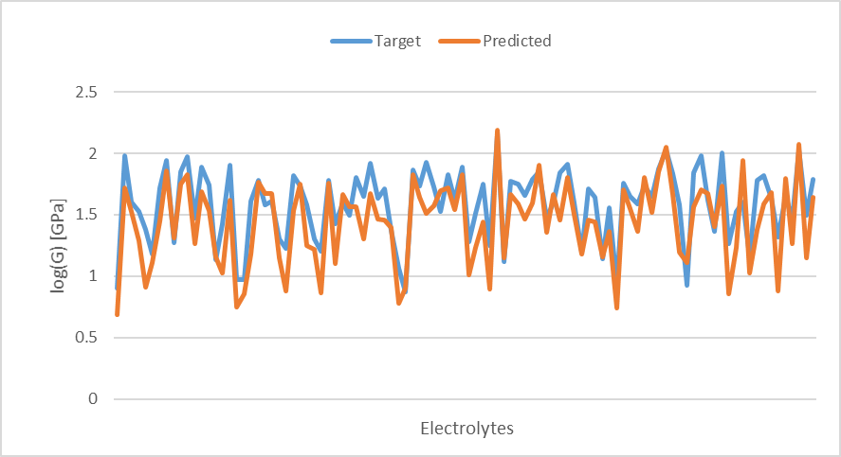
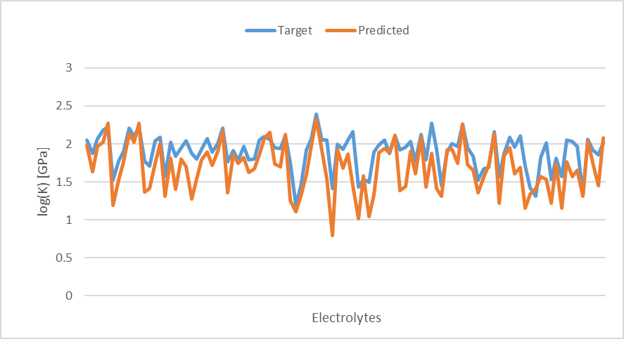
RESULTS
OBJECTIVE
DATASET
REPRESENTATION
GRAPH CONVOLUTION NETWORKS
CRYSTAL GRAPH CNN
HYPERPARAMETER OPTIMIZATION
RESULTS
FUTURE SCOPE
 | RMSE [log(K)] | RMSE [log(G)]
Ahmad et al | 0.1013 | 0.1268
Our work | 0.1437 | 0.1680
Statistical Data | 0.2773 | 0.2187
Comparison of RMSE in log(GPa) for Shear and Bulk moduli
Graph showing overlap of target and predicted values (K)
Graph showing overlap of target and predicted values (G)
Notes:
We have used a Teacher-Student model because the base ArcFace model has 85,000 classes and hence a very high number of parameters. Due to compute resources, we were not able to utilize the GPU completely. So we have used the concept of distillation loss to preserve the features of all 85,000 classes but to train it with just 2000 classes and we were able to maximize GPU Utilization

Slide 14
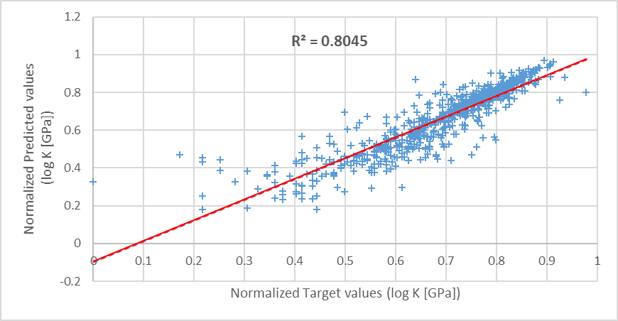
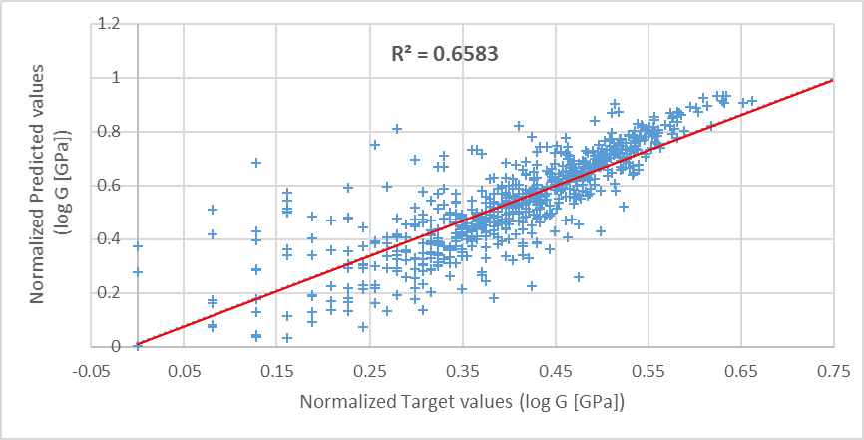
RESULTS
OBJECTIVE
DATASET
REPRESENTATION
GRAPH CONVOLUTION NETWORKS
CRYSTAL GRAPH CNN
HYPERPARAMETER OPTIMIZATION
RESULTS
FUTURE SCOPE
R²(bulk modulus) = 0.8045
Parity plot comparing CGCNN predicted values and DFT calculated target values for bulk modulus
R²(shear modulus) = 0.6583
Parity plot comparing CGCNN predicted values and DFT calculated target values for shear modulus
Notes:
We have used a Teacher-Student model because the base ArcFace model has 85,000 classes and hence a very high number of parameters. Due to compute resources, we were not able to utilize the GPU completely. So we have used the concept of distillation loss to preserve the features of all 85,000 classes but to train it with just 2000 classes and we were able to maximize GPU Utilization

Slide 15
FUTURE SCOPE
OBJECTIVE
DATASET
REPRESENTATION
GRAPH CONVOLUTION NETWORKS
CRYSTAL GRAPH CNN
HYPERPARAMETER OPTIMIZATION
RESULTS
FUTURE SCOPE
Dendritic Growth Suppression in Li metal batteries
The dendritic growth at the interface between lithium metal and electrolytes has been a major concern while designing these batteries
Causes short circuit and capacity loss
Design new electrolytes to suppress dendrite growth
CGCNN model is a very generalized model and can be used to predict a wide range of material properties
Stability parameter (χ) is used to determine the extent of dendritic growth has bulk modulus, shear modulus, poisson’s ratio and molar volumes as the inputs
Notes:
We have used a Teacher-Student model because the base ArcFace model has 85,000 classes and hence a very high number of parameters. Due to compute resources, we were not able to utilize the GPU completely. So we have used the concept of distillation loss to preserve the features of all 85,000 classes but to train it with just 2000 classes and we were able to maximize GPU Utilization

Slide 16

THANK YOU!
Questions, Suggestions and Feedbacks are always WELCOME

Slide 17
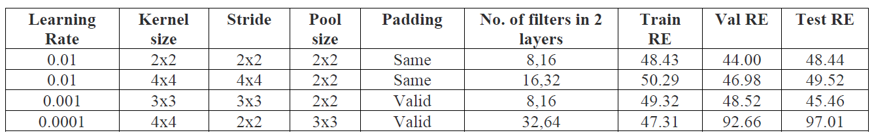
ANNEXURE
Hyperparameter tuning to predict effective diffusivity
The results for 900 valid combinations of hyperparameters has been summarized in Results_ReLU and Results_Linear. All the models are trained using the same train, validation and test dataset. Hyperparameter tuning is one of the most important aspects of developing a neural network or any machine learning model. Hyperparameters are cross validated using validation dataset. The combination of hyperparameters that gives us the lowest relative error on the validation dataset is considered to be the best model.
Effect of changing hyperparameters on train, validation & test relative errors
Notes:
We have used a Teacher-Student model because the base ArcFace model has 85,000 classes and hence a very high number of parameters. Due to compute resources, we were not able to utilize the GPU completely. So we have used the concept of distillation loss to preserve the features of all 85,000 classes but to train it with just 2000 classes and we were able to maximize GPU Utilization

Slide 18
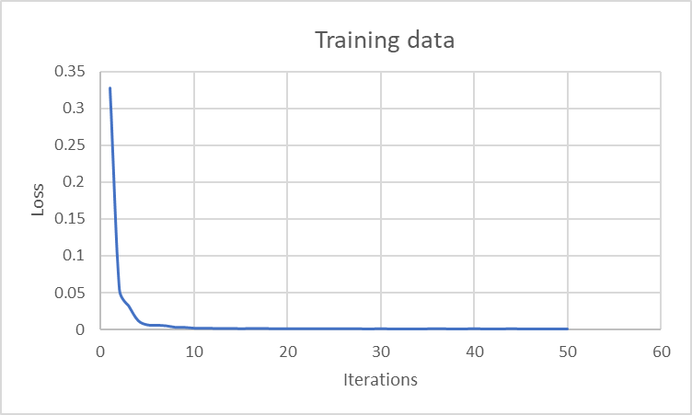
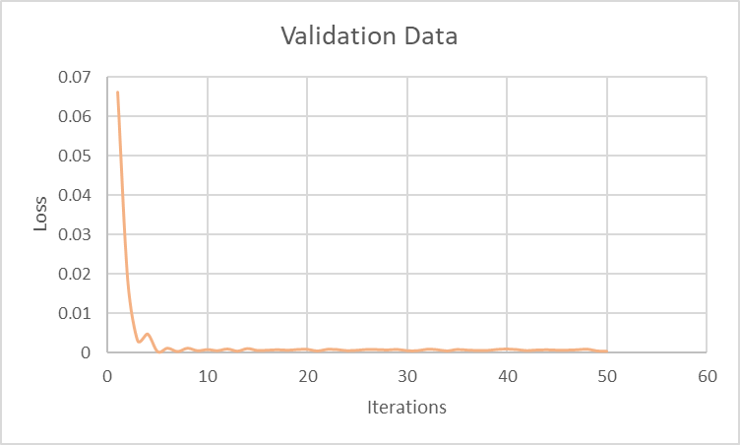
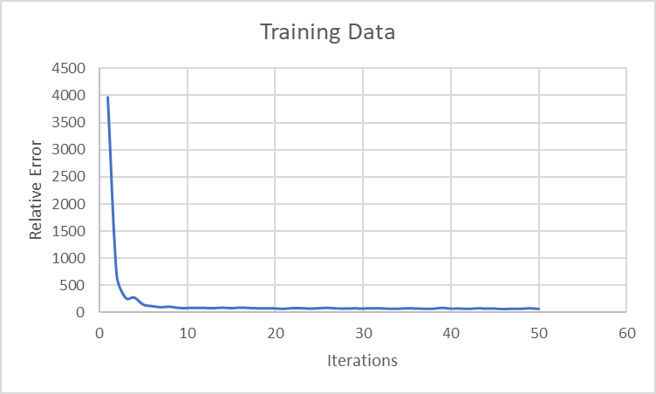
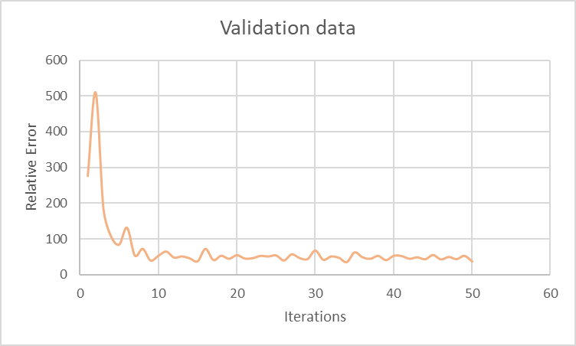
ANNEXURE
Training Plots for CNN model to predict Effective Diffusivity
Figures – Training Plots on Loss & Relative Error on training and validation data
Notes:
We have used a Teacher-Student model because the base ArcFace model has 85,000 classes and hence a very high number of parameters. Due to compute resources, we were not able to utilize the GPU completely. So we have used the concept of distillation loss to preserve the features of all 85,000 classes but to train it with just 2000 classes and we were able to maximize GPU Utilization

Slide 19
ANNEXURE
Results for CNN model to predict Effective Diffusivity
Kernel size | (4,4)
Learning Rate | 1e-2
Number of filters | (8,16)
Strides | (3,3)
Pool size | (3,3)
Padding | “valid”
Activation | Linear
Kernel size | (5,5)
Learning Rate | 1e-2
Number of filters | (32,64)
Strides | (3,3)
Pool size | (2,2)
Padding | “valid”
Activation | ReLU
Table – Hyperparameter configuration for best model with Linear Activation function
Table – Hyperparameter configuration for best model with ReLU Activation function
Train Set | 35.79
Validation Set | 30.73
Test Set | 39.71
Train Set | 39.66
Validation Set | 36.39
Test Set | 45.55
Table – Train, Val and Test Relative Error for CNN with Linear Activation function
Table – Train, Val and Test Relative Error for CNN with ReLU Activation function
Notes:
We have used a Teacher-Student model because the base ArcFace model has 85,000 classes and hence a very high number of parameters. Due to compute resources, we were not able to utilize the GPU completely. So we have used the concept of distillation loss to preserve the features of all 85,000 classes but to train it with just 2000 classes and we were able to maximize GPU Utilization

Slide 20
ANNEXURE
Crystal Graph Convolution Neural Network Model Summary
CrystalGraphConvNet(
(embedding): Linear(in_features=92, out_features=64, bias=True)
(convs): ModuleList(
(0): ConvLayer((fc_full): Linear(in_features=169, out_features=128, bias=True)
(sigmoid): Sigmoid()
(softplus1): Softplus(beta=1, threshold=20)
(bn1): BatchNorm1d(128, eps=1e-05, momentum=0.1, affine=True, track_running_stats=True)
(bn2): BatchNorm1d(64, eps=1e-05, momentum=0.1, affine=True, track_running_stats=True)
(softplus2): Softplus(beta=1, threshold=20)
)
(1): ConvLayer(
(fc_full): Linear(in_features=169, out_features=128, bias=True)
(sigmoid): Sigmoid()
(softplus1): Softplus(beta=1, threshold=20)
(bn1): BatchNorm1d(128, eps=1e-05, momentum=0.1, affine=True, track_running_stats=True)
(bn2): BatchNorm1d(64, eps=1e-05, momentum=0.1, affine=True, track_running_stats=True)
(softplus2): Softplus(beta=1, threshold=20)
)
(2): ConvLayer(
(fc_full): Linear(in_features=169, out_features=128, bias=True)
(sigmoid): Sigmoid()
(softplus1): Softplus(beta=1, threshold=20)
(bn1): BatchNorm1d(128, eps=1e-05, momentum=0.1, affine=True, track_running_stats=True)
(bn2): BatchNorm1d(64, eps=1e-05, momentum=0.1, affine=True, track_running_stats=True)
(softplus2): Softplus(beta=1, threshold=20)
)
(3): ConvLayer(
(fc_full): Linear(in_features=169, out_features=128, bias=True)
(sigmoid): Sigmoid()
(softplus1): Softplus(beta=1, threshold=20)
(bn1): BatchNorm1d(128, eps=1e-05, momentum=0.1, affine=True, track_running_stats=True)
(bn2): BatchNorm1d(64, eps=1e-05, momentum=0.1, affine=True, track_running_stats=True)
(softplus2): Softplus(beta=1, threshold=20)
)
)
(conv_to_fc): Linear(in_features=64, out_features=128, bias=True)
(conv_to_fc_softplus): Softplus(beta=1, threshold=20)
(fc_out): Linear(in_features=128, out_features=1, bias=True)
)
layer | input_shape | output_shape
Linear | (256,16,92) | (256,16,128)
Conv_1 | (256,16,128) | (256,16,64)
Conv_2 | (256,16,64) | (256,16,32)
Conv_3 | (256,16,32) | (256,16,16)
Pooling | (256,16,16) | (256,16,16)
FC | (256,16,16) | (256,16,32)
Output | (256,16,32) | (256,16,1)
Different layers and their input and output shapes in a CGCNN
Notes:
We have used a Teacher-Student model because the base ArcFace model has 85,000 classes and hence a very high number of parameters. Due to compute resources, we were not able to utilize the GPU completely. So we have used the concept of distillation loss to preserve the features of all 85,000 classes but to train it with just 2000 classes and we were able to maximize GPU Utilization

