Slide 1
Selenium Automation Tool

Slide 2
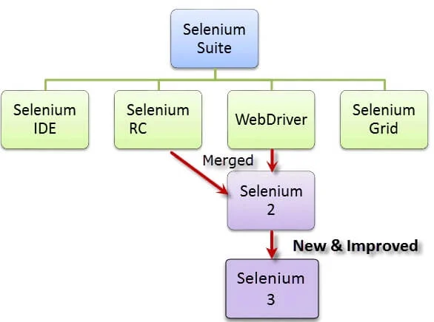
What is Selenium? Selenium is a free (open-source) automated testing framework used to validate web applications across different browsers and platforms. You can use multiple programming languages like Java, C#, Python, etc to create Selenium Test Scripts. Open source→ meaning you don’t need any license or payment to use the tool Limitation→ You can only automate web applications using Selenium Selenium Tool Suite or Components of Selenium Selenium Software is not just a single tool but a suite of software, each piece catering to different Selenium QA testing needs of an organization. Here is the list of tools : 1. Selenium Integrated Development Environment (IDE) 2. Selenium Remote Control (RC) 3. WebDriver 4. Selenium Grid

Slide 3
Why do we automate web applications? 1. Reduce manual effort 2. Save time 3. Accurate results because human can make mistakes 4. Save cost/reduce cost What do we automate? 1. Any operation performed on web application can be automated 2. In testing, we automate all the regression test cases and if possible then new feature test cases

Slide 4
What is Selenium IDE? Selenium Integrated Development Environment (IDE) is the simplest framework in the Selenium suite and is the easiest one to learn. It is a record and playback test automation for the web applications, it means that you can record an operation (like adding a product to cart in flipkart) and playback the recording anytime again, so the Selenium IDE will do the same job (adding product to card) automatically for you without any manual intervention. What is Selenium RC(remote control) ? It is a testing framework that enables a QA or a developer to write test cases in any programming language in order to automate UI tests for web applications against any HTTP website. What is Selenium Grid? Selenium Grid is a tool used together with Selenium RC to run tests on different machines against different browsers in parallel. That is, running multiple tests at the same time against different machines running different browsers and operating systems.

Slide 5
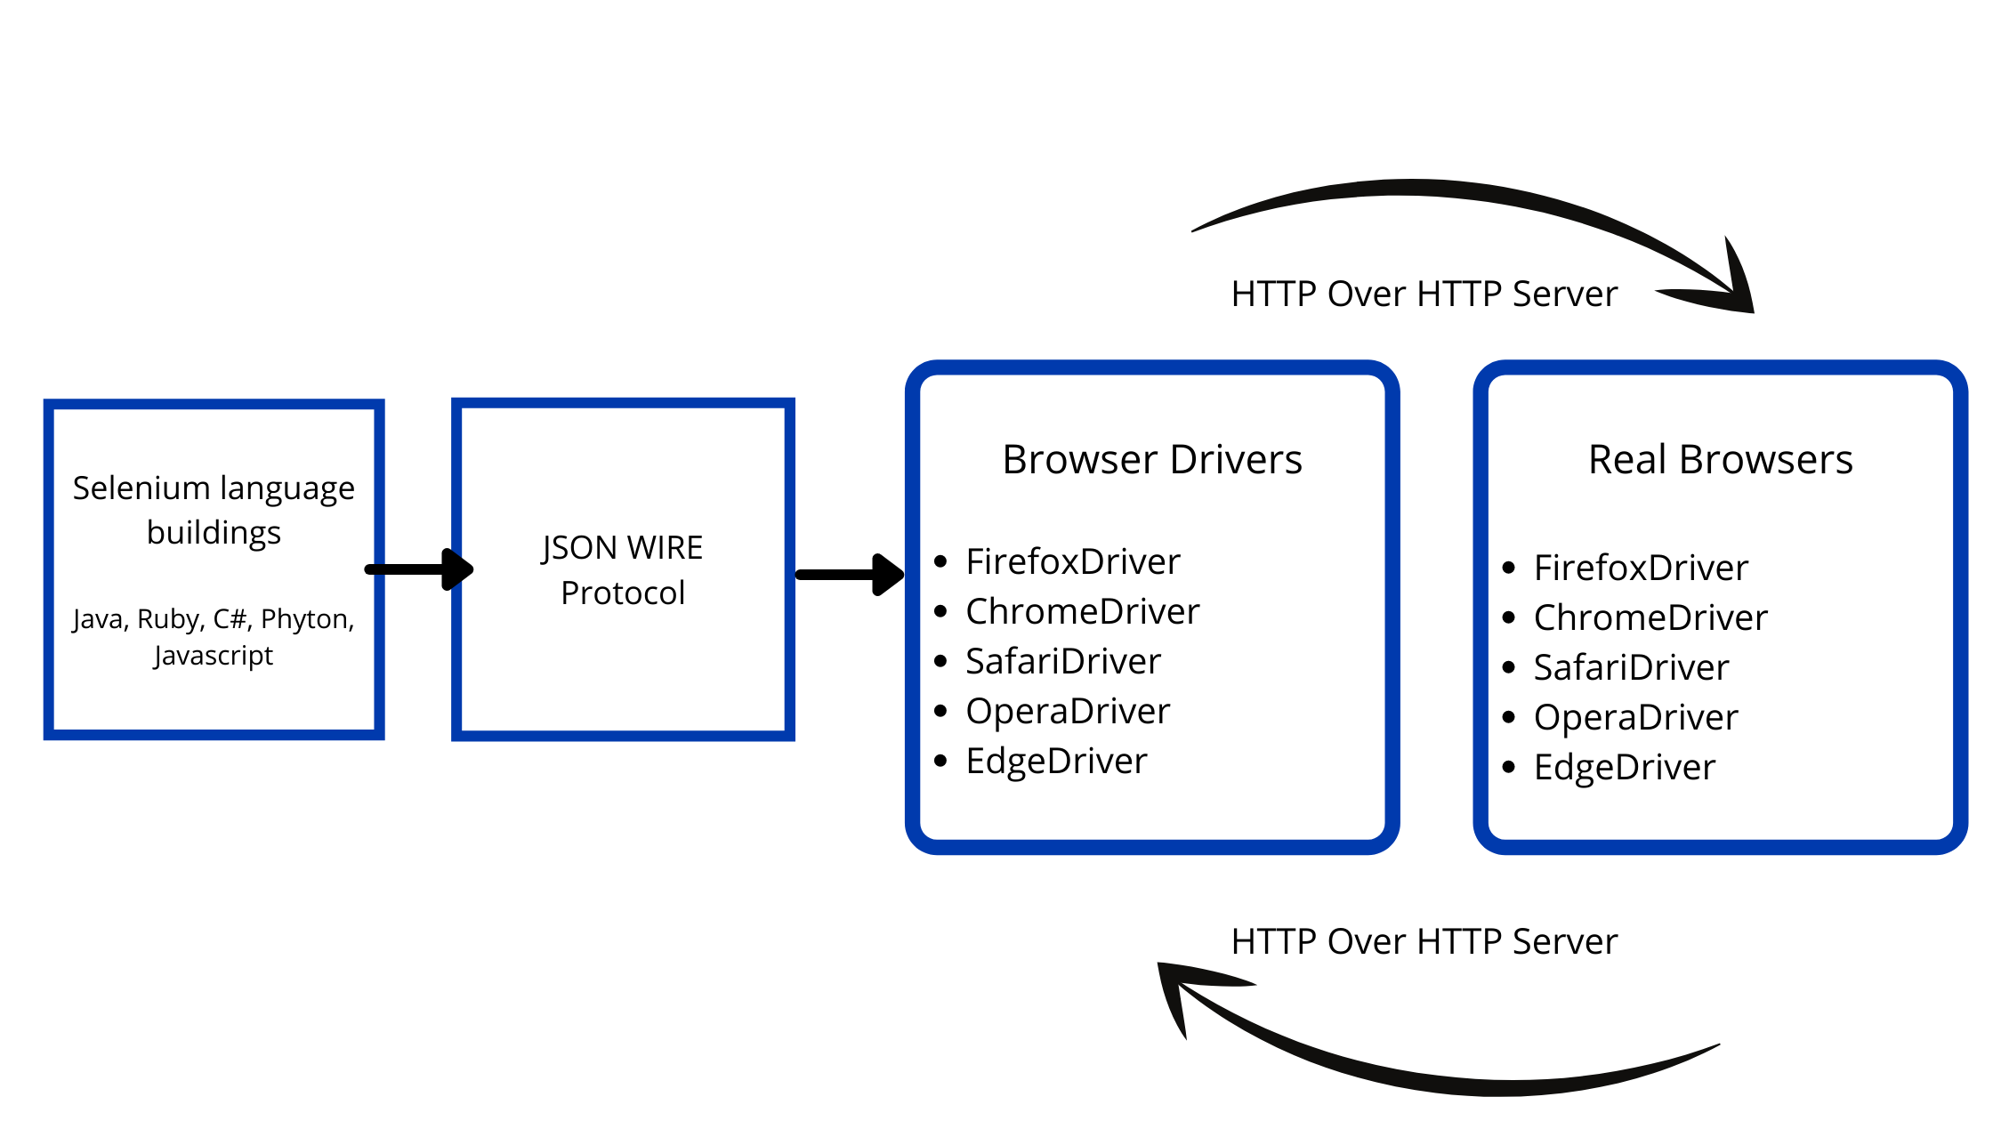
What is Selenium Webdriver? WebDriver is a web framework that permits you to execute cross-browser tests. This tool is used for automating web-based application testing to verify that it performs expectedly. Selenium WebDriver allows you to choose a programming language to create test scripts. Web driver is the mostly used frameworks in IT and it can automate any type of Web applications. JSON- java script object notation

Slide 6
What is Locator ? Every website has textboxes, buttons, link, dropdown etc, these are called ‘Web elements’ So when you want to perform some action on website, for example you need to click on the button or enter something in the textbox, so how do we do this using automation tools like Selenium? Answer is, we do this using ‘Locator’, so in simple term locator is a way to identify a web element in the website. How can we identify web elements using Locators? There are 8 types of locators in selenium but you need to use just 1 to identify elements in a web page, you can choose any one out of below 8 locators:
Method | Syntax | Description
By ID | driver.findElement(By.id (<element ID>)) | Locates an element using the ID attribute
By name | driver.findElement(By.name (<element name>)) | Locates an element using the Name attribute
By class name | driver.findElement(By.className (<element class>)) | Locates an element using the Class attribute
By tag name | driver.findElement(By.tagName (<htmltagname>)) | Locates an element using the HTML tag
By link text | driver.findElement(By.linkText (<linktext>)) | Locates a link using link text
By partial link text | driver.findElement(By.partialLinkText (<linktext>)) | Locates a link using the link's partial text
By CSS | driver.findElement(By.cssSelector (<css selector>)) | Locates an element using the CSS selector
By XPath | driver.findElement(By.xpath (<xpath>)) | Locates an element using XPath query

Slide 7
Locators example: Website- https://www.taskarmall.com/Adminlogin 1. Identify action/operation→ for example Enter user name 2. Right click on the web element( textbox or button or link) 3. Click on inspect 4. Note down the locator you want to use for example id=“LoginID” ID locator= driver.findElement(By.id (LoginID)) Or xpath= //*[@id="LoginID"]
Method | Syntax | Description
By ID | driver.findElement(By.id (<element ID>)) | Locates an element using the ID attribute
By name | driver.findElement(By.name (<element name>)) | Locates an element using the Name attribute
By class name | driver.findElement(By.className (<element class>)) | Locates an element using the Class attribute
By tag name | driver.findElement(By.tagName (<htmltagname>)) | Locates an element using the HTML tag
By link text | driver.findElement(By.linkText (<linktext>)) | Locates a link using link text
By partial link text | driver.findElement(By.partialLinkText (<linktext>)) | Locates a link using the link's partial text
By CSS | driver.findElement(By.cssSelector (<css selector>)) | Locates an element using the CSS selector
By XPath | driver.findElement(By.xpath (<xpath>)) | Locates an element using XPath query

