Slide 1
Strategy Design Pattern

Slide 2
What is Strategy?
A plan of action or policy designed to achieve a major or overall aim.

Slide 3
Why Need Pattern for Strategy?
The Strategy pattern is known as a behavioural pattern - its used to manage algorithms, relationships and responsibilities between objects.
The Strategy pattern is to be used where you want to choose the algorithm to use at runtime. A good use of the Strategy pattern would be saving files in different formats, running various sorting algorithms, or file compression.

Slide 4
Strategy Pattern Says
Define a family of algorithms, encapsulate each one, and make them interchangeable. Strategy lets the algorithm vary independently from clients that use it.

Slide 5
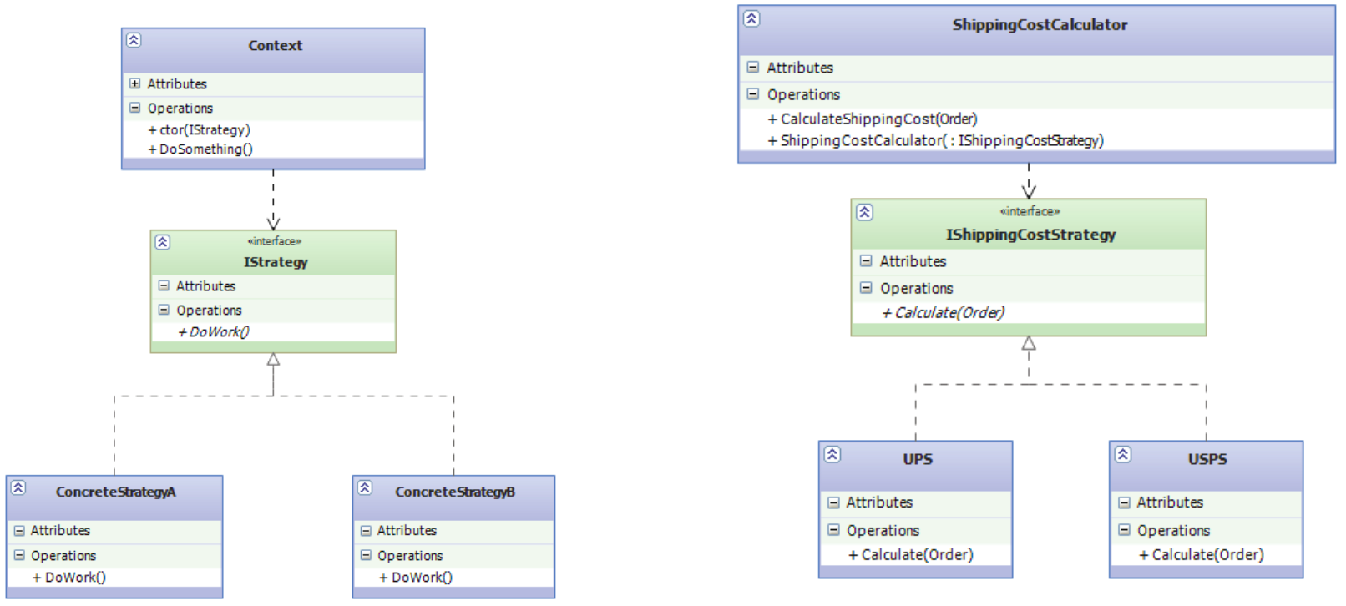
Class Diagram

Slide 6
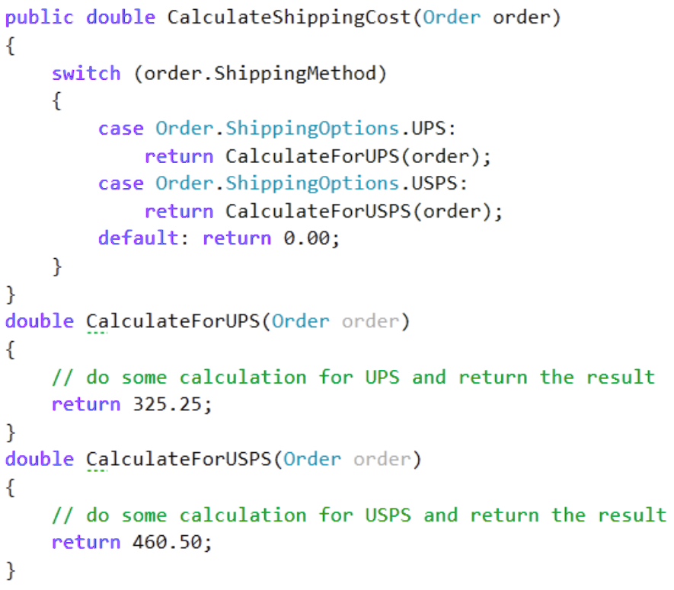
Pattern less Implementation

Slide 7
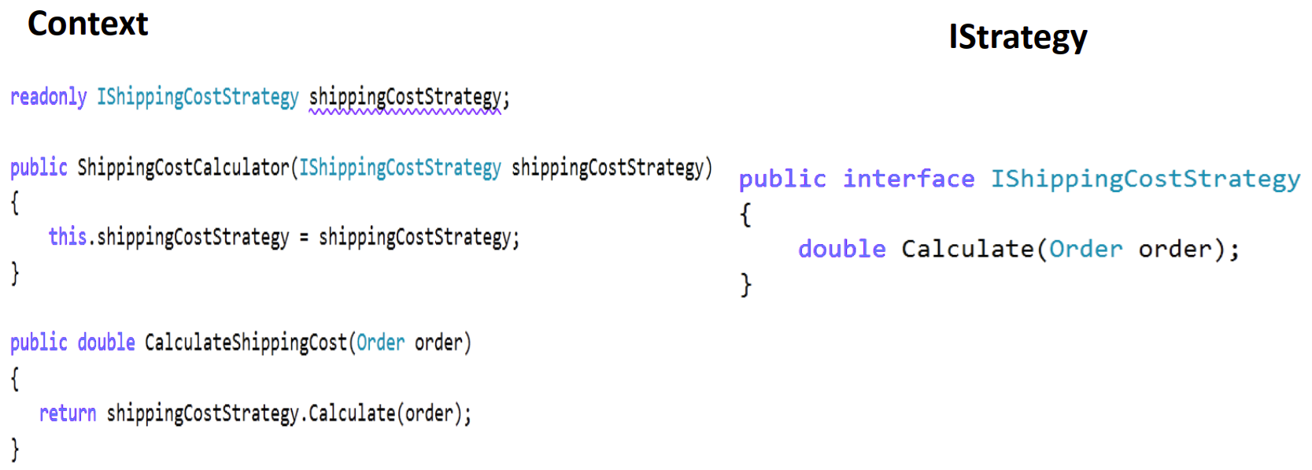
Pattern Implementation

Slide 8
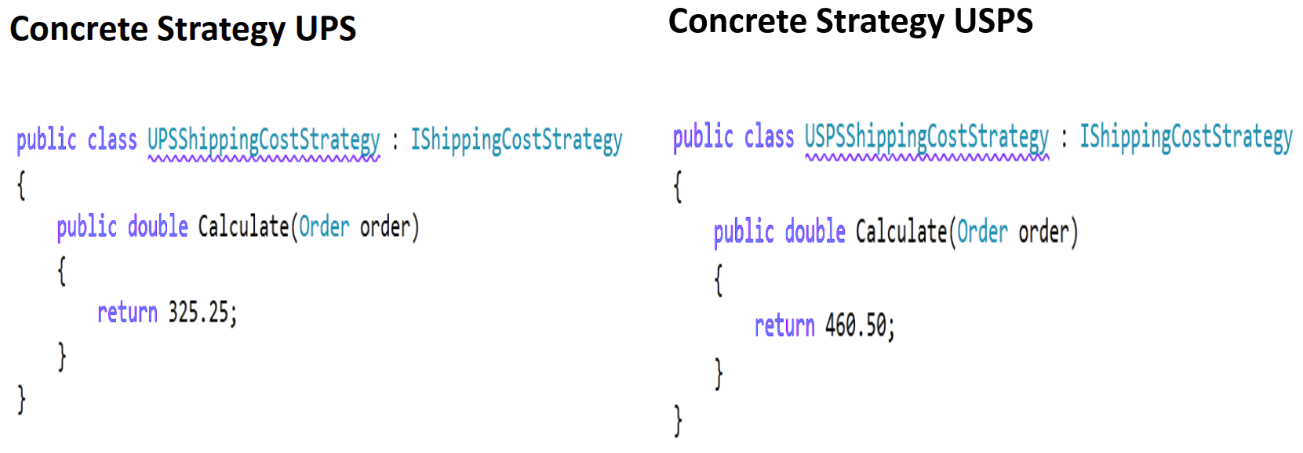
Pattern Implementation

Slide 9

That’s It!!

Slide 10
Sudipta Kumar Paik
Associate Technology Manager
W3Engineers Ltd.
Mobile: +8801719100070
Date: 2018-02-01
CodeBase: https://github.com/skpaik/StrategyPattern

