Slide 1
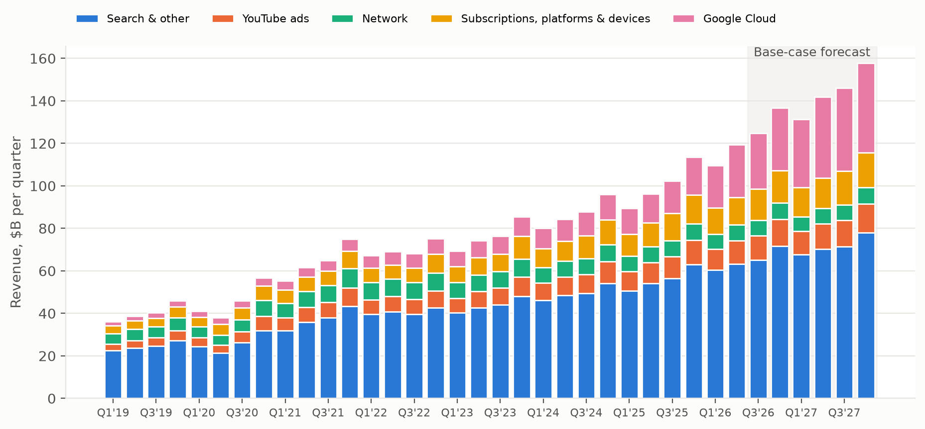
Alphabet is forecast to reach ~$492B revenue in FY26 and ~$578B in FY27, led by Cloud
Q2'26 revenue $119.8B, +24% YoY; Cloud now 21% of revenue (Q2'25: 14%).
Base case: FY26E revenue +22% to $492B; operating income $168B (34% margin).
Q4 is the seasonal peak every year, so each forecast quarter grows off the same quarter a year earlier.
Search & other is still ~half of revenue; Cloud adds the most incremental dollars.
Source: SEC EDGAR XBRL filings (10-K/10-Q), author's models. Forecasts are illustrative, not investment advice.

Slide 2
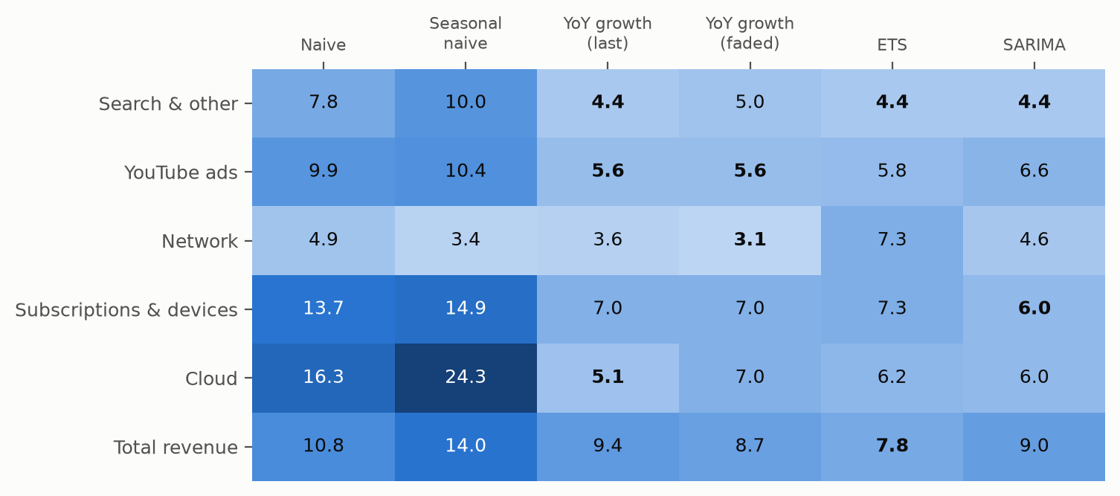
Simple YoY growth rules match or beat ETS and SARIMA at 1–4 quarter horizons
Rolling-origin backtest: 13 origins per segment (train through t, forecast t+1…t+4), 4 horizons each.
Cloud: best model is the plain YoY rule (5.1% MAPE); seasonal naive is worst (24%) because Cloud grows ~30–80% a year.
Search: SARIMA, ETS and the YoY rule are tied at ~4.4% MAPE; no model clearly wins.
Subscriptions & devices is among the hardest for the better models (6–7% MAPE): launch- and promo-driven.
Caveat: only 30 quarters of consistent segment data, so differences under ~1pt are noise.
Source: SEC EDGAR XBRL filings (10-K/10-Q), author's models. Forecasts are illustrative, not investment advice.

Slide 3
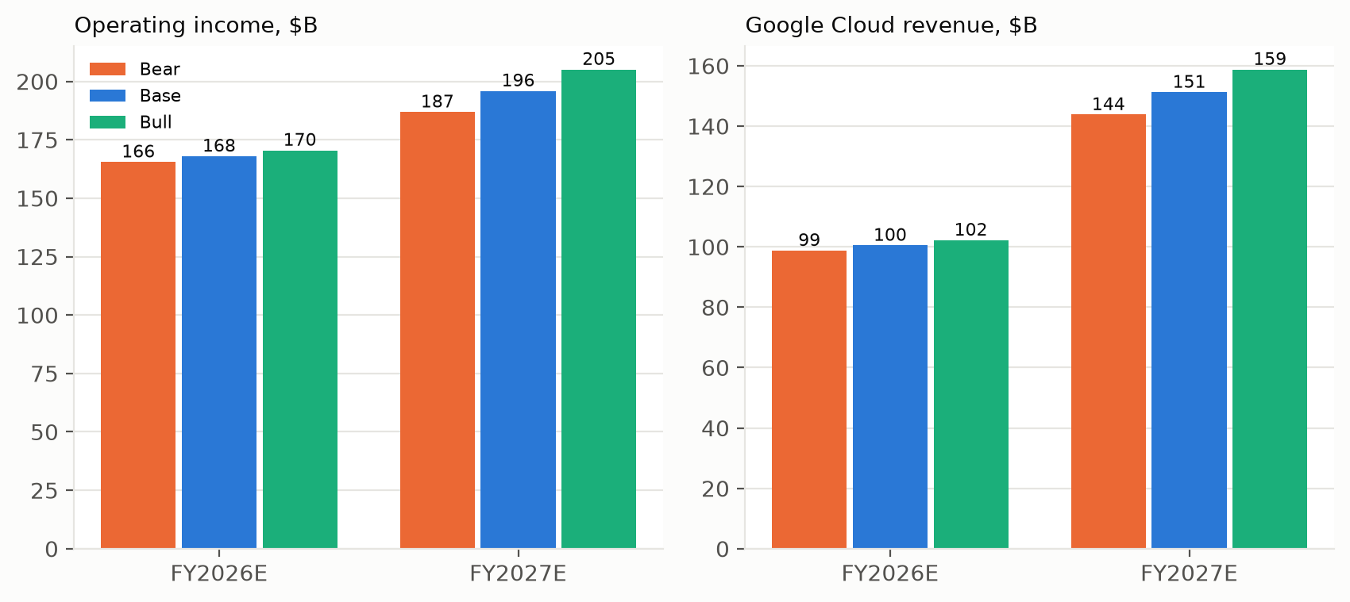
Cloud is the swing factor: ±5pp of growth moves FY27E operating income by about ±5%
Bear/Bull = Base growth −/+ 5pp on Cloud and −/+ 2pp on Search and YouTube.
FY27E operating income: Bear $187B / Base $196B / Bull $205B.
FY27E Cloud revenue ranges $144B–$159B.
R&D and G&A are held at Base dollars in Bear/Bull, so the downside shows real operating deleverage.
Source: SEC EDGAR XBRL filings (10-K/10-Q), author's models. Forecasts are illustrative, not investment advice.

Slide 4
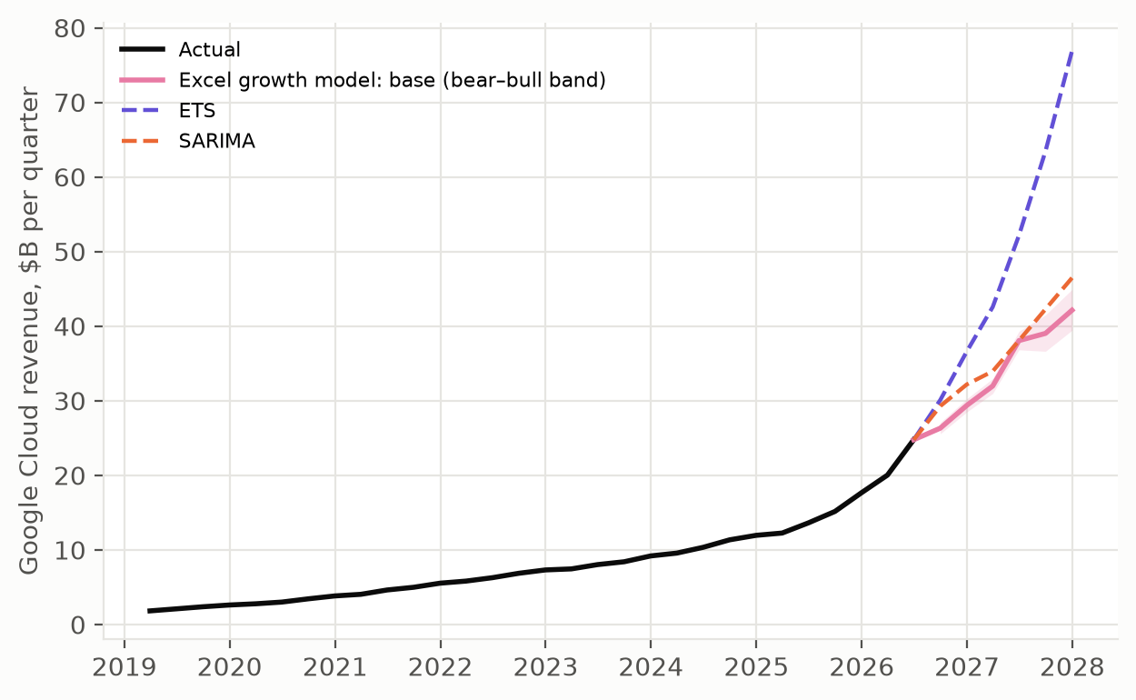
Cloud forecasts diverge widely: FY27E ranges from $151B (growth model) to $235B (ETS)
FY27E Cloud revenue: Excel base $151B, SARIMA $161B, ETS $235B.
ETS extrapolates the recent acceleration (+82% YoY in Q2'26); the Excel base fades growth 10% per quarter, so it is the conservative end.
Even the Bull case ($159B) sits below ETS. In the backtest, fading growth cost accuracy on Cloud.
Recommendation: plan off the transparent growth-rate model, treat ETS/SARIMA as upside cross-checks, and re-run the backtest each quarter.
Source: SEC EDGAR XBRL filings (10-K/10-Q), author's models. Forecasts are illustrative, not investment advice.

