Slide 1
Crop Output Prediction
Project Progress Presentation on
Under the supervision of Dr. Amitava Nag (Associate Professor, HoD, Dept. of IT)
Presented by
Nayan Jeet Dewri
Shubham Pandey
Swasat Dutta

Slide 2
Contents
Introduction
Definition of ML
Types of Learning model
Problem Definition
Proposed Solution
Random Forest
Results/Screenshots
Conclusion
Future Work

Slide 3
Introduction
ML is crucial in Decision making
Predicting crop yield is necessary
-To develop agricultural policies
-To forecast
-To identify effective adaption against climate change.

Slide 4
Definition of Machine Learning
“A computer program is said to learn from experience E with respect to some class of tasks T and performance measure P if its performance at tasks in T, as measured by P, improves with experience E.” - Tom M. Mitchell.
Analysis
ML Algorithm
Decision/Prediction
Output
Past Data
Learn
Errors/Feedback

Slide 5
Types of Learning Models
CLASSIFICATION
SVM,RANDOM FOREST
SUPERVISED
REGRESSION
LINEAR REGRESSION,DECISION TREES
(Data with labels)
MACHINE LEARNING
UNSUPERVISED
CLUSTERING
K MEANS,HIERARCHICAL,
(Data without labels)
ASSOCIATION
APRIORI,FP GROWTH
REINFORCEMENT
( Reward based )
Notes:
<a href="http://www.freepik.com/free-photo/top-view-of-co-workers-planning-a-strategy_864127.htm">Designed by Freepik</a>
http://www.freepik.com/free-photo/happy-co-workers-close-to-the-window_866124.htm

Slide 6
Problem Definition
Finding best supervised Machine Learning algorithm for crop yield prediction in Assam

Slide 7
Proposed Solution
50%
Analysis of the different ML algorithms
32%
70%
Notes:
<a href='http://www.freepik.com/free-photo/skyscraper-urban-view_881301.htm'>Designed by Freepik</a>

Slide 8
Random Forest
No overfitting
Builds multiple decision trees
Training time is less
For large data, it produces highly accurate predictions
Can maintain accuracy even if some data are missing

Slide 9
Random Forest contd.
Am I feeling sleepy?
YES
NO
Pending Work?
Study
YES
NO
Finish the work
Go to sleep
Fig: Decision Tree

Slide 10
Random Forest contd.
Sample dataset
……..
Sub sample 1
Sub sample 2
Sub sample n
……..
Tree 1
Tree 2
Tree n
Class A
Class B
Class B
Majority voting
Final Class

Slide 11
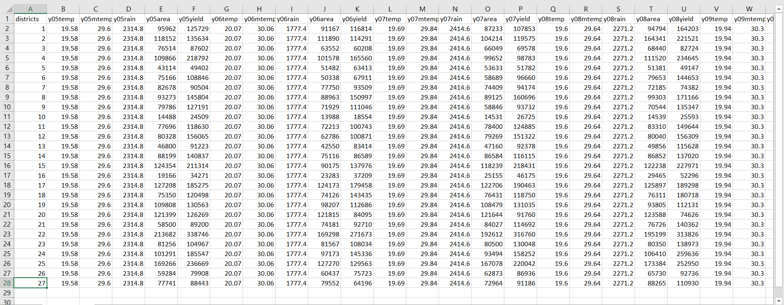
Dataset
Area: ‘000 hect
Production: ‘000 tonne
Rainfall: mm
Temperature: Celsius

Slide 12
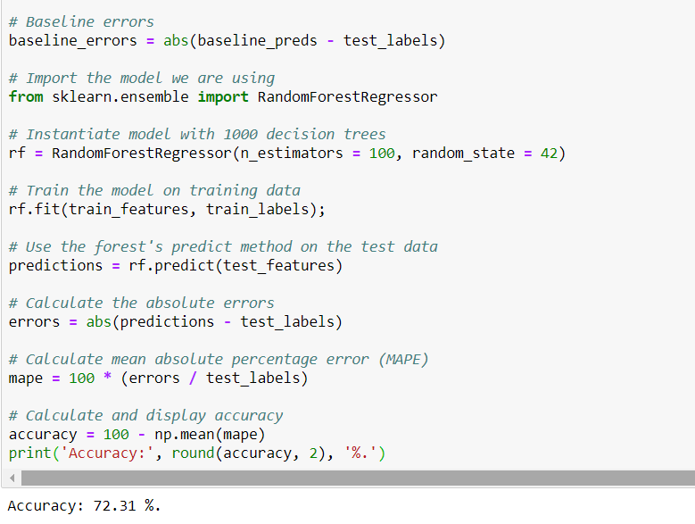
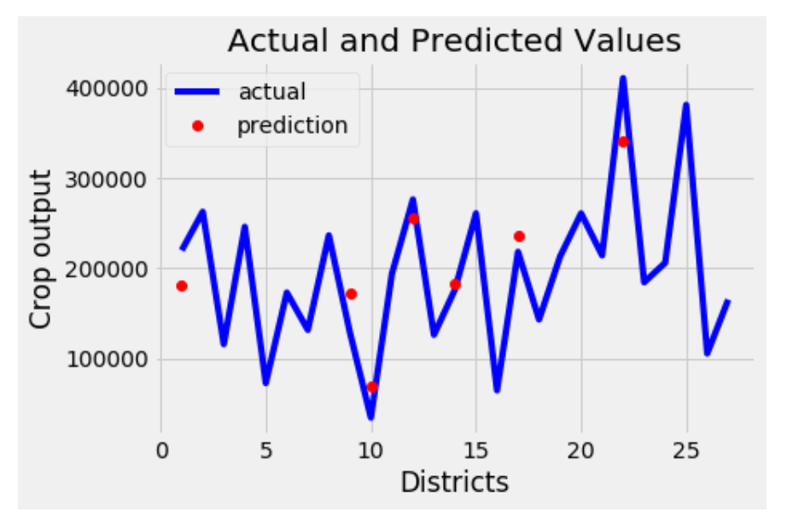
Results and Screenshots
Prediction is done with 72.31% accuracy

Slide 13
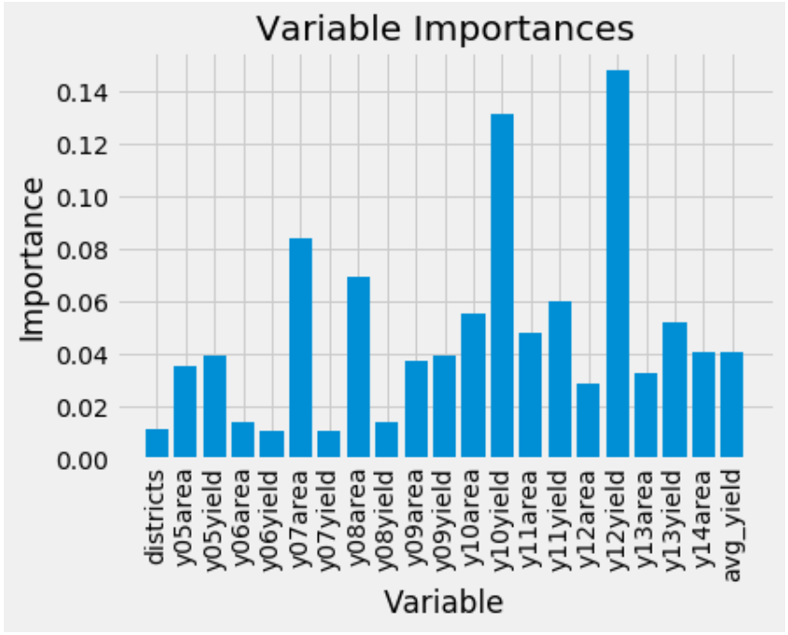

Slide 14
Conclusion
RF turned out to be good for yield prediction
Better understanding of RF is achieved

Slide 15
Future Work
Analysing other algorithms for prediction
Determining the best algorithm for crop output prediction

