Slide 1
Urological Biofeedback System
Advisor: Dr. Amit Nimunkar
Client: Dr. Patrick McKenna
Team:
Samual Lines, Michael Simonson, Andrew Vamos, Shawn Patel

Slide 2
Overview
Background
Motivation
Problem Statement
Client Requirements
Designs
Decision Matrices
Microcontroller
Signal Processing
Power Supply
Future Work and Timeline
Questions
References and Acknowledgements

Slide 3
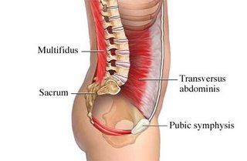
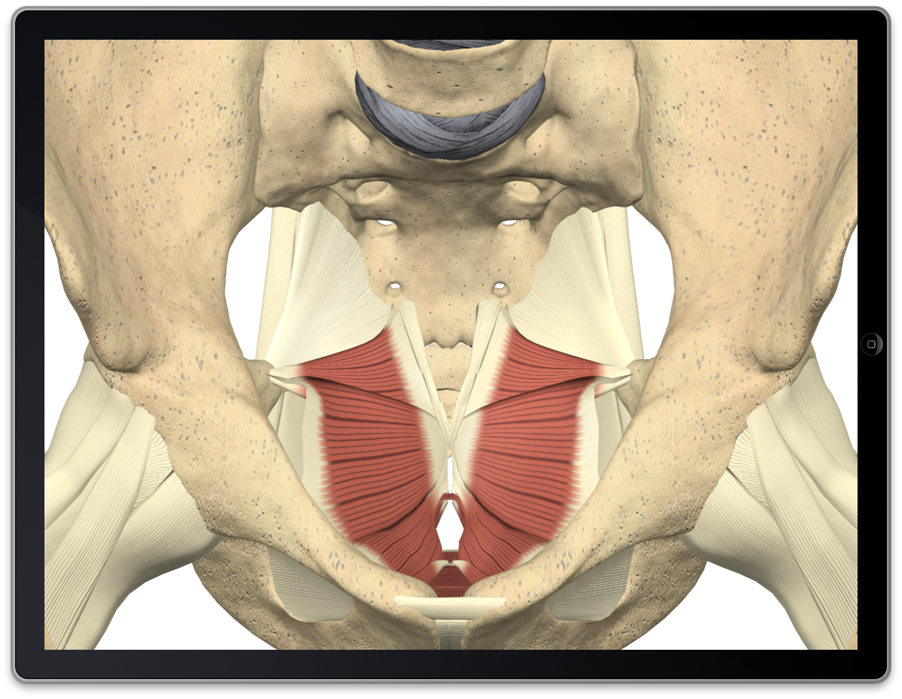
Background
Combinations of incontinence, UTI and constipation afflict around 30% of children in the United States.[1]
Improper voiding of the bladder is the result of failing to contract Pelvic Floor (PF) while relaxing abdominal muscles.
Figs 1-2. Images of Pelvic Floor and Transverse Abdominals.
EMG analysis and retraining has been used as effective alternative to surgery. [2]

Slide 4
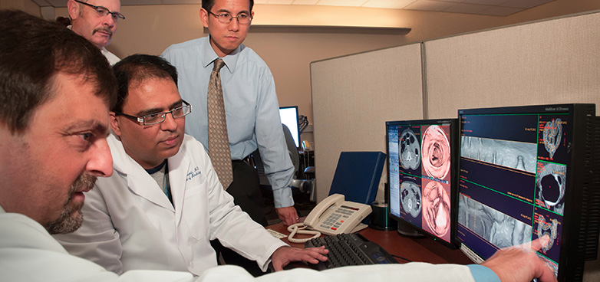
Motivation
What does background mean?
BIG MARKET -
BIG OPPORTUNITY
Our client (Dr. McKenna) is internationally renowned Urologist
Training appointments are currently booked until May 2015
Our device could be in use in this and other clinics throughout the US/World.
Fig 3. A group of physicians diagnosing pelvic floor dysfunction.

Slide 5
Problem Statement
Biofeedback training of Pelvic Floor muscle groups
No devices currently coordinate both muscle groups w/ video game interface
Improve our hardware to commercializable standards
Provide supporting software for product development

Slide 6
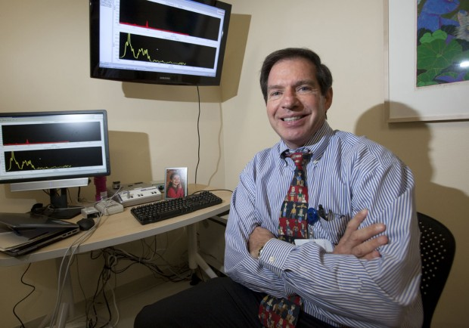
Client Requirements
Acquire data that can accurately track/train patient exercises.
Produce a device that can be manufactured simply and cost-effectively.
Prepare a design for IRB & FDA approval moving forward.

Slide 7
Current Design Progress
Currently have a working EMG biofeedback system
We are looking to standardize:
Frequency Response
Gain
Microcontroller
Power Supply
Right Leg Drive
Computer Analysis & GUI
Patient Signal
(Muscle Contract)
Pre-Amplifier
Filters & Rectifier
(Analog)
Arduino
Microcontroller

Slide 8
DM 1 = Microcontroller
Criteria | Weights | Arduino Micro | MSP430 Launch Pad (G2) | Pinguino Pic32
Developer Support | 25 | 5 (25) | 5 (25) | 4 (20)
Multi-Channel | 25 | 5 (25) | 5 (25) | 4 (20)
Hard/Software Reqs. | 20 | 4 (16) | 3 (12) | 4 (16)
Processing & Analysis | 15 | 3 (9) | 5 (15) | 4 (12)
Ease of Use | 15 | 5 (15) | 3 (9) | 4 (12)
TOTAL SCORE | 100 | 90 | 86 | 80

Slide 9
DM 2 = Signal Processing
Criteria | Weights | Analog | Digital
Latency | 35 | 4 (28) | 2 (14)
Processing Load | 35 | 5 (35) | 2 (14)
Signal Integrity | 20 | 2 (8) | 4 (16)
Cost | 10 | 4 (8) | 5 (10)
TOTAL SCORE | 100 | 79 | 54
Notes:
Analog gets a 4 in latency due to the delay caused by capacitors/low pass filtering of rectified signal. Digital gets a 1 due to periodic windowing followed by heavy processing

Slide 10
DM 3 = Power Supply
Criteria | Weights | Disposable Batteries | Rechargeable Batteries | Single Supply With DC/DC Converter
Safety | 25 | 5 (25) | 4 (20) | 4 (20)
IRB Approval | 20 | 5 (20) | 3 (16) | 4 (12)
Longevity | 20 | 3 (12) | 4 (16) | 5 (20)
Ease of Use | 15 | 2 (6) | 3 (9) | 5 (15)
Cost | 10 | 3 (6) | 1 (2) | 5 (10)
Size | 10 | 3 (6) | 1 (2) | 5 (10)
TOTAL SCORE | 100 | 75 | 65 | 87

Slide 11
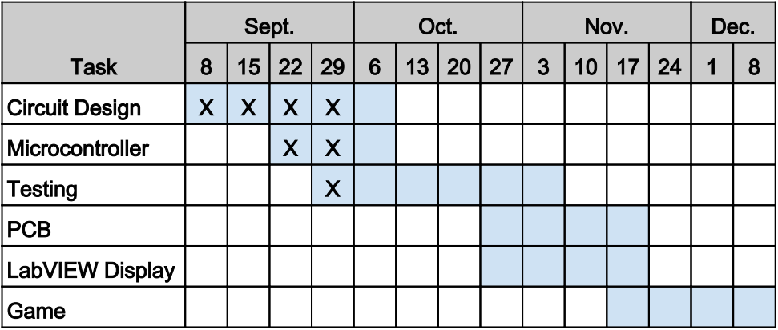
Future Work and Timeline
Ensure our design stays consistent with FDA & IRB Regulations
Class II Medical Device
Look to Print our Board on PCB - apply necessary revisions
Begin Industrial-EMG comparison testing
Gather results, strength commercial case

Slide 12
Acknowledgements
Dr. Amit Nimunkar
Dr. Patrick McKenna
Ms. Sarah Novinske
Dr. Thomas Yen

Slide 13
Questions
Thank you for coming.
Any questions or comments?

Slide 14
References & Thanks!
[1]. “National Kidney and Urologic Diseases Information Clearinghouse.” National Institute of Diabetes and Kidney Diseases. Accessed 30 Nov 2013.
<http://kidney.niddk.nih.gov/kudiseases/pubs/uichildren/>
[2]: New Therapy for Incontinence Pioneered by madison Doctor. 30 Nov 2013.
http://host.madison.com/news/local/health_med_fit/new-therapy-for-incontinence-pioneered-by-madison-doctor/article_faf27fb2-55b0-11e2-8888-001a4bcf887a.html
Figures:
[1 & 2]: http://www.pilatesfanatic.co.za/wp-content/uploads/2011/03/iSpineCare_iPad_pelvic-floor1.png & http://blog.corewalking.com/wp-content/uploads/2013/10/transverse-abdominis.jpg

