Slide 1
DAY 1

Slide 2
Java for QA
Inheritance
Static and non static methods
Method overloading and overriding
Access modifiers
Java Arrays and Collections

Slide 3
Some terms
Member variables
Local variable – if declared inside a method
Instance variable – Inside class, but outside method (accessed by object)
Class/static variable - Inside class, but outside method (accessed by ClassName)
Methods / Functions
Keyword “new” – to create an object
Constructor – method name same as class name
Default
Parameterized
Keyword “this” – if local and instance variable is same name

Slide 4
Inheritance
Inheritance is a mechanism wherein a new class is derived from an existing class
Child classes may inherit or acquire the properties and methods of parent classes
Parent
Parent
Child1
Child1
Child2
Child3
Child2

Slide 5
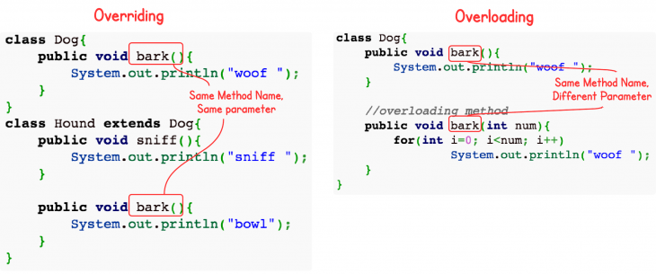
Polymorphism
One in many forms
Polymorphism can be achieved in 2 ways
Method Overloading
Method Overriding

Slide 6
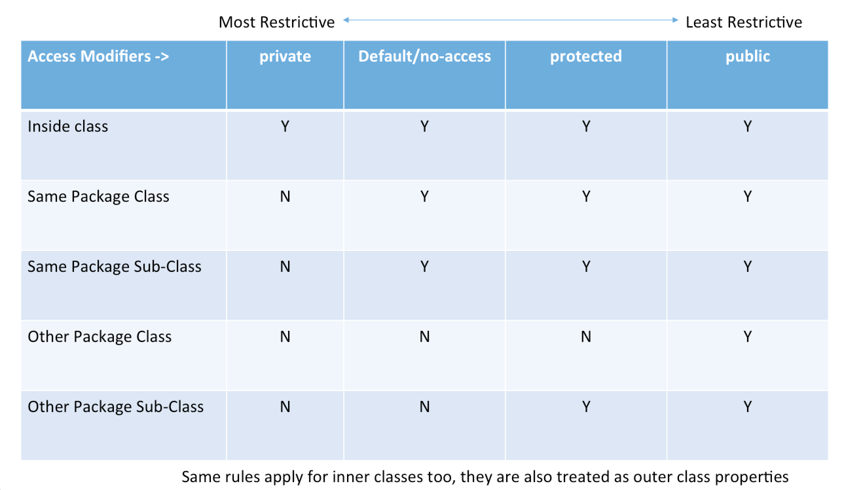
Access modifiers
Java modifiers
Java provides a number of access modifiers to set access levels for classes, variables, methods, and constructors

Slide 7
Arrays and collections
Java modifiers
Array
<DataType> ArrayName[] = new <DataType>[Size];
List
List<DataType> ListName = new ArrayList<>();
Set
Set<DataType> SetName = new HashSet<>();
HashMap
Map<dataType, dataType> hmName = new HashMap();
Arrays
Collections
Map

