Slide 1

Provide Insights For Telangana Govt Tourism Department

Slide 2
Objectives
Telangana is one of India’s leading states and has published its tourism data under its open data policy.
As a data analyst, Peter Pandey saw this as an opportunity to expand his skills and show his work on a bigger scale.
Peter Pandey’s idea is to find the patterns in the given data, do additional research, and give data-informed recommendations to the Telangana government which can be used to increase their revenue by improving administrative operations.

Slide 3
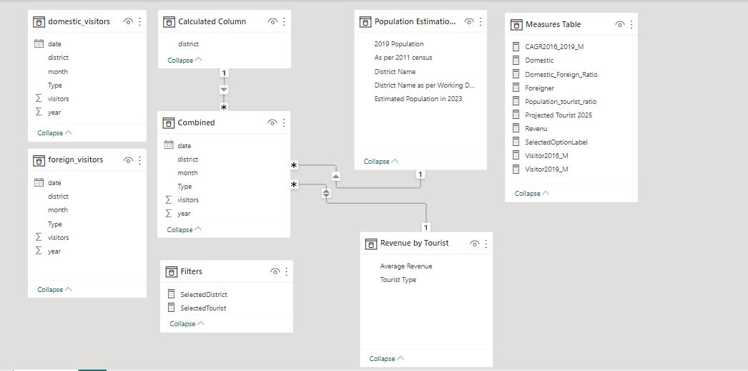
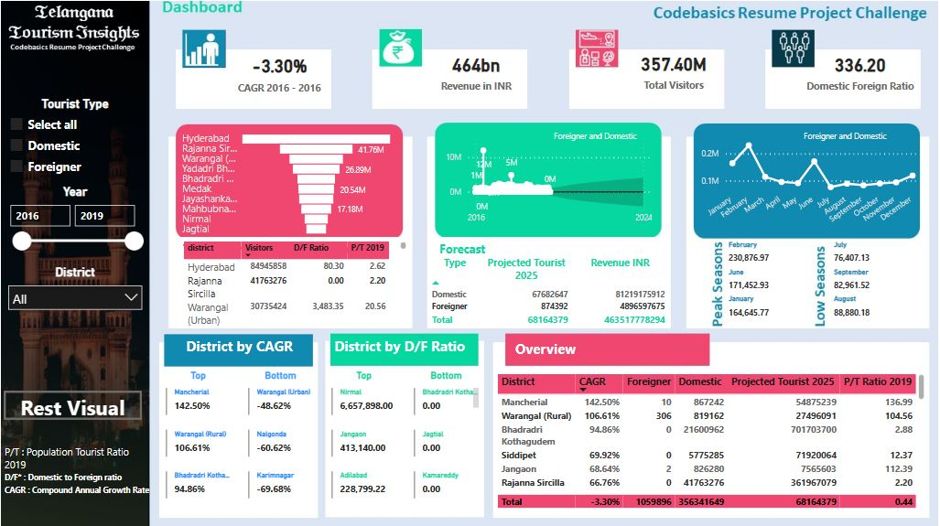
Data and Tools
For Analysis and Visualization Power BI is used
The provided data was in separate 8 files which is merged into two files Domestic and Foreigner using Python.
Which is further merged as Combined in Power BI.

Slide 4
Assumptions
For Getting the Population in any year there are two methods
Estimation : If want to know the population in a year between two Census.
Forecasting : Forecasting The population based on estimates like birth rate, death rate, migration rate, occupied houses etc.
In our case we want to known the district wise population of Telangana in 2019.
There were no Census conducted in 2021.
Later method require lots of data and research, which will deviate the project.
So to estimate the Population in 2019, first method is used with considering 2023 population forecast data from unofficial source as Correct data and on this basis Estimating the 2019 population of Telangana districts.

Slide 5
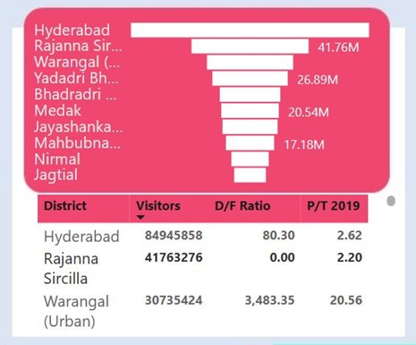
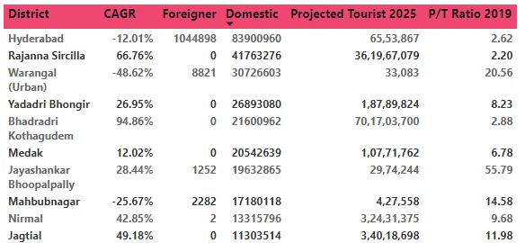
Q1. List down the top 10 districts that have the highest number of domestic visitors overall (2016 - 2019)?
Insights :
Out of top 10 districts as per Domestic Visitors These 4 Districts are performing very well and have Good CAGR(Domestic and Foreigner).
Bhadradri Kothagudem - 94.86 %
Rajanna Sircilla – 66.76%
Jagtial – 49.18%
Nirmal – 42.85%

Slide 6
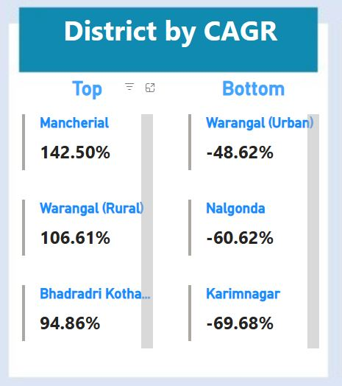
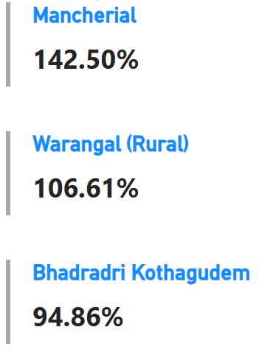
Q2. List down the top 3 districts based on compounded annual growth rate(CAGR) of visitors between (2016 - 2019)?
Insights :
Mancherial, Wrangal (Rural), and Bhadradri Kothagudem are performing very well.

Slide 7
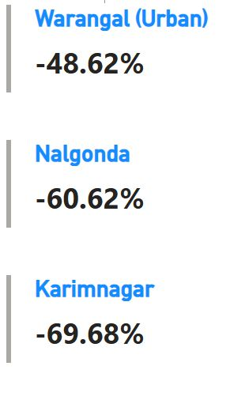
Q3. List down the bottom 3 districts based on compounded annual growth rate(CAGR) of visitors between (2016 – 2019?
Insights:
Wrangal(Urban), Nalgonda and Karimnagar are performing very low.
Tourism in these areas are declining at very faster rate. Special Attention must be given to these places so they can perform well.

Slide 8
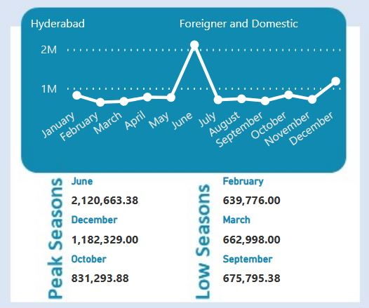
Q4. What are the peak and low season months for Hyderabad based on the data from 2016 to 2019 for Hyderabad district?
Insights:
June, December and October are peak months out of which June and December are attractive lots of tourist.
February, March and September are low seasons and by introducing activities and events can attract the tourist.

Slide 9
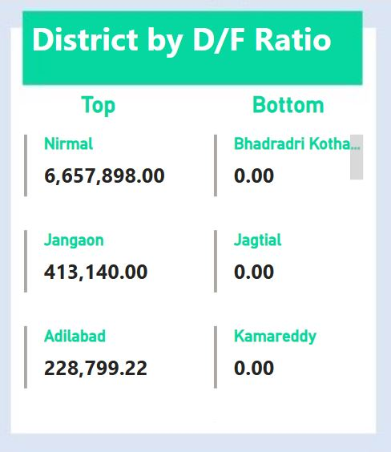
Q5. Show the top & bottom 3 districts with high domestic to foreign tourist ratio?
Insights :
Nirmal, jangaon and Adilabad are having higher Domestic to Tourist Ratio.
Observing the top performing district and Replicating them in bottom Districts can attract the foreign tourist which will bring more revenue.

Slide 10
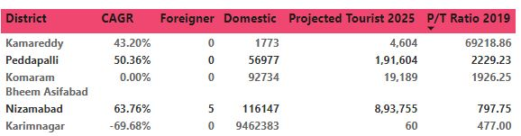
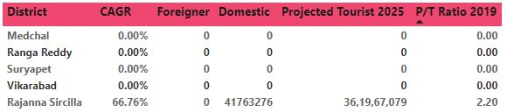
Q6. List the top & bottom 5 districts based on ‘population to tourist footfall ratio* ratio in 2019 ( * ratio: Total Visitors / Total Residents Population in the given year)
Insights :
Proper Advertisement of Bottom district with the places to visit must be done.
The basic facilities in these areas like transportation, Hotels, etc must be compared with top perfuming districts and necessary actions must be done to improve them if its needed.

Slide 11
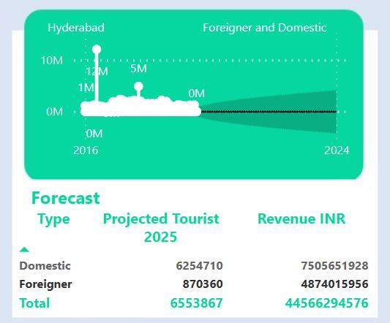
Q7. What will be the projected number of domestic and foreign tourists in Hyderabad in 2025 based on the growth rate from previous years?
Insights :
As by CGAR:
Domestic Tourist in Hyderabad will be 62,354,710
Foreign Tourist in Hyderabad will be 870360.
So to better facilitate these tourist government must ensure planning better infrastructure for them.

Slide 12
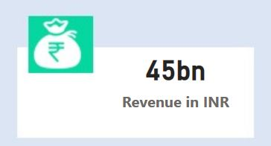
Q8. Estimate the projected revenue for Hyderabad in 2025 based on average spend per tourist (approximate data)
Insights:
In 2025 Domestic and Foreign Tourist Both will bring 45 Billion INR
So Proper planning to provide better experience to tourist must be done.

Slide 13
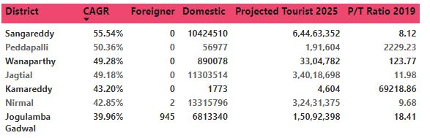
Q9. Districts with highest potentials. A. Which districts has the highest potential for tourism growth and what actions government can take?
Insights :
Districts shown in right have very good CAGR and Population to Tourist ratio. Proper Planning can further boost the Tourism in these areas.

Slide 14

Q10. Cultural / Corporate Events to boost tourism. A. What kind of events the government can conduct. B. Which month(s)? C. Which districts?
Insights :
Events
Telangana Food Festival, Handicraft and Handloom exhibition are great ideas to showcase Telangana rich culture and attract Tourist.
Startup Conclave, Adventure Sports like climbing, Trekking and water sports
Hyderabad, Rajanna Sircilla and Wrangal (Urban) will be good choice for such events in the month of June And December

Slide 15
Q11. Dubai has made itself a business hub and enjoys massive business tourism. Can Hyderabad emulate the Dubai model? Provide insights based on your research.
Insights :
Yes, Hyderabad has The potential to Emulate Dubai Model.
Developing Infrastructure : Dubai has very well developed infrastructure which helps business in doing and by improving the infrastructure in Hyderabad it can attract more business tourists.
Business friendly Environment : Its very convenient to business in Dubai, because of the business friendly environment and by simplifying the regulations in Hyderabad and introducing tax incentives can help in achieving the same in Hyderabad.
Key Industries : Dubai has focused on key industries and identifying the key industries and focusing on its strengths like IT, biotech and pharma can attract more business and tourists.

Slide 16
Q12. Provide all other recommendations that can boost the Telangana tourism, particularly Hyderabad.
Insights :
Highlighting Hyderabad rich history and cultural heritage through campaigns and social Media can attract Tourists.
Restoring and preserving Hyderabad historic Monuments, Buildings and landmarks can help in showing Hyderabad rich heritage.
Collaborating with international organizations and tourism boards to promote Hyderabad's heritage to a global audience can attract tourists from around the world.

Slide 17
Thank you
Sanjay Kumar Prasad

