Slide 1
Simple POC
Angular
Rest receiver
(Producer)
RabbitMQ
Consumer:
Spring Boot listener, which is process the received message
Postman (trigger message)

Slide 2
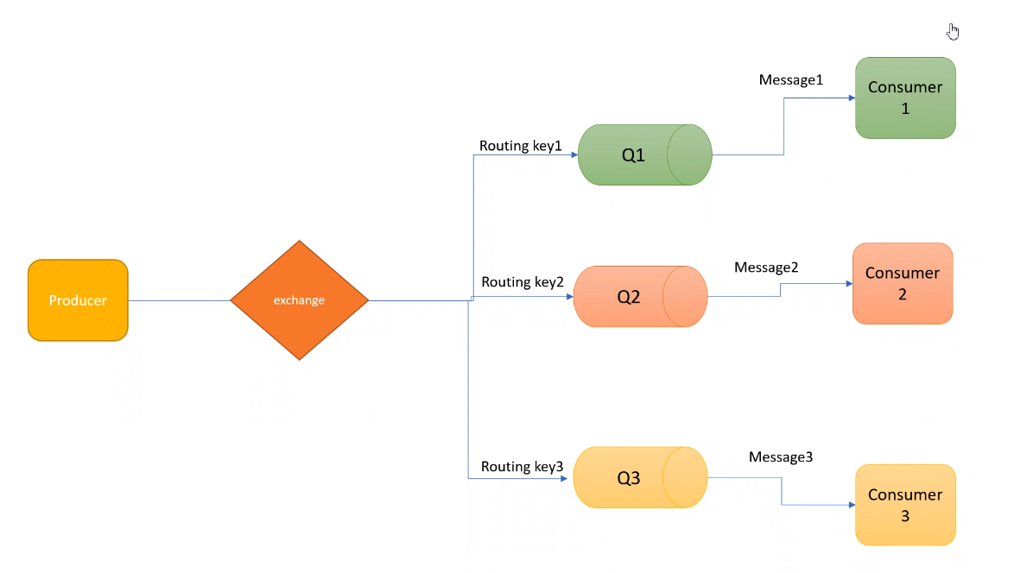
Target system

