Slide 1
Digital Portfolio
STUDENT NAME: Priyadharshini K
REGISTER NO AND NMID: 24131210500122031 and asanm121anm12124213031
DEPARTMENT: BCA
COLLEGE: Immaculate college for women/Annamalai University.

Slide 2
PROJECT TITLE
Student portfolio

Slide 3


AGENDA
Problem Statement
Project Overview
End Users
Tools and Technologies
Portfolio design and Layout
Features and Functionality
Results and Screenshots
Conclusion
Github Link
3/21/2024 Annual Review

Slide 4

PROBLEM STATEMENT
The lack of a personalized platform to showcase academic achievements,skills,and project create a challenge for students during internship jobs application and academic evaluations

Slide 5

PROJECT OVERVIEW
This project focuses on creating a responsive student portfolio website using HTML,CSS,and JAVASCRIPT
The portfolio is designed to professionally showcase persnol information, academic, qualification,and skills
The main goal is to develop a visually engaging user-friendly,and device-responsive platforms

Slide 6

WHO ARE THE END USERS?
*student –to showcase their academic and technical profile
*Recruiter –to evaluate student skills achievements,and project
*Faculty –to access student progress and provide academic reference
*General Audience –to gain on overview of the student background and expertise

Slide 7

TOOLS AND TECHNIQUES
.HTML- for content structure
.CSS-for styling and layout
. JavaScript–for interactive and dynamic features
.codepen-as the development environment
.GitHub-for for version control and development

Slide 8
POTFOLIO DESIGN AND LAYOUT
The p ortfolio features a clean, minimalist design to emphasize. clarity and Professionalism
It includes a Homepage with aPersonal introduction,along with dedication Section for academic , background,Skills and a content page
The responsive layout ensures optimal assessibility on both desktop and mobile device while maintainin Consistent visual aesthetic
8

Slide 9
FEATURES AND FUNCTIONALITY
Clearly defined sect Education For about me, Education ,skills and resume
A contect fo with link Integration for easy communication
GitHub Integration to display and access project respositories
A user –friendly Interface featuring Clean typograpy and an organized layout

Slide 10
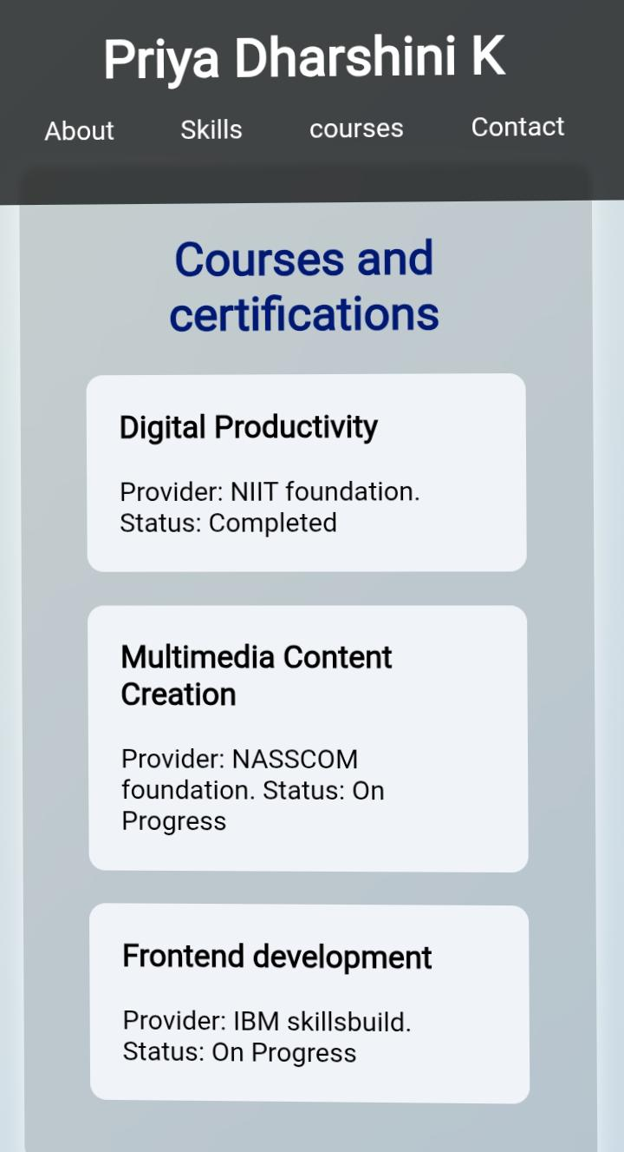
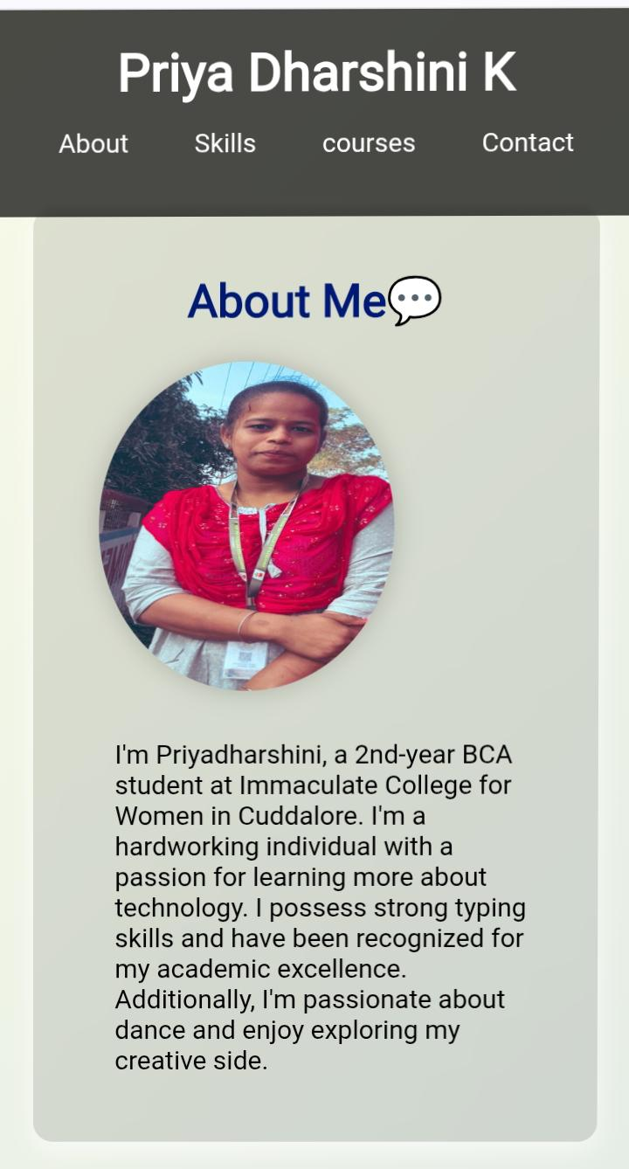
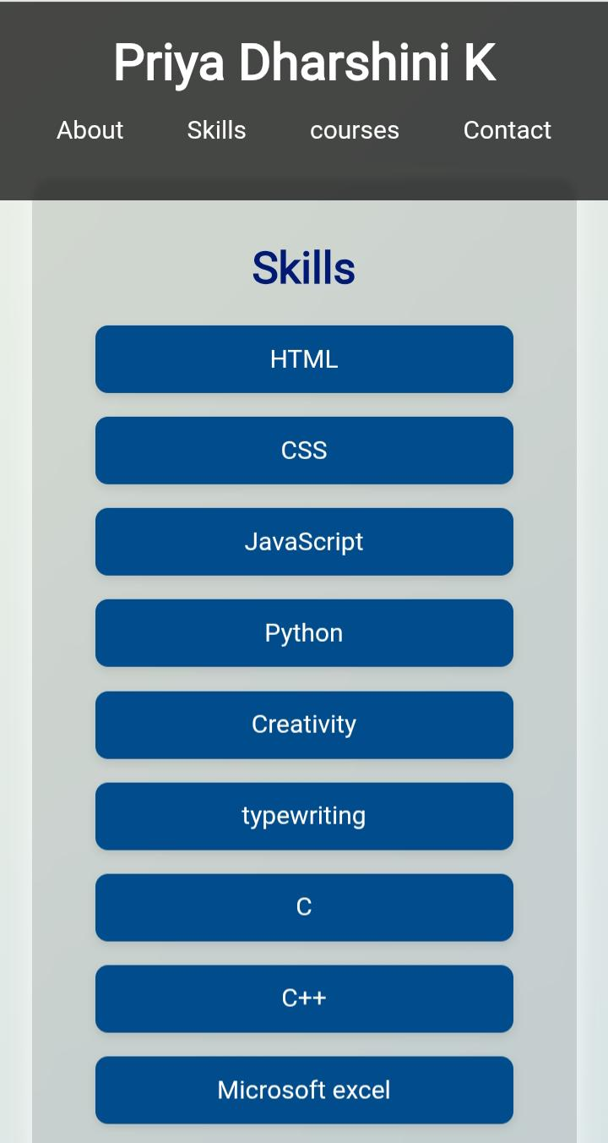

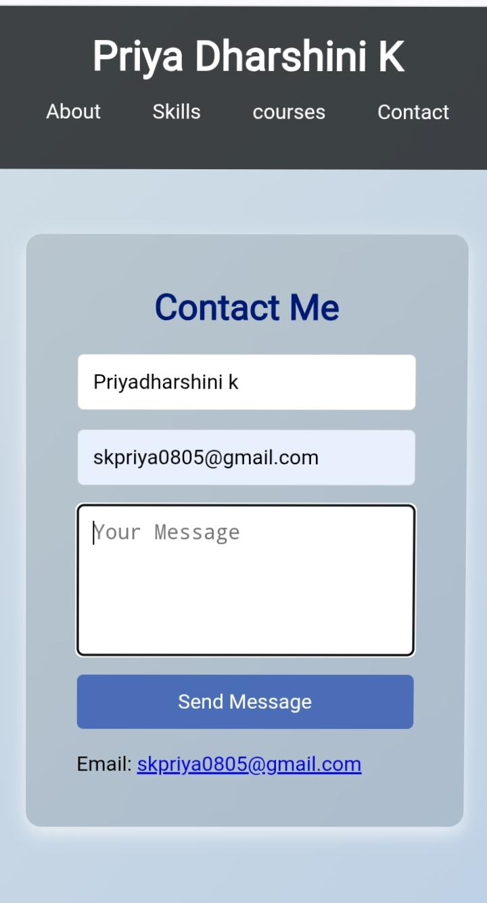
RESULTS AND SCREENSHOTS
3/21/2024 Annual Review
10

Slide 11
CONCLUSION
The portfolio website successfully adresses the limitations of traditionals Resume by Provideing an interactive , accessable and professional Platform to reprasent academic and technical accomplishments
11

