Slide 1
SECURITY ACCESS(0x27)
Content
Introduction
Authorization
3A. Request Seed
3B. Request Key

Slide 2
1. INTRODUCTION
The CAN-interface provides different ways for data access like reading or writing of data or even re-programming of parts or all of the flash memory.
This data access is confidential to TIER-I and/or OEM. To prevent any unauthorized access to these data, security features are required.
functionalities are used to achieve security:
Authorization
Verification and error detection
Authentication
Confidentiality

Slide 3
Authorization is used to allow the access to internal ECU data. Some services can be successfully executed only if the ECU has been unlocked before. It is achieved by using the Seed/Key procedure of service $27 to unlock an ECU.
Verification and error detection is mainly used for flash re-programming. It is used to verify, that a set of data has correct contents. checksum calculations applied to a set of data, e.g. flash segments.
Authentication:set of data has been created by the originator and has not been manipulated by someone else. To achieve this, a signature is generated on the data. Secret keys are used to create the signature. StartRoutineByLocalID-CheckRoutine”($31$E1) is used to pass the signature.
Confidentiality is achieved by data encryption and decryption. Known services, where data encryption and decryption can be applied to, are the services “RequestDownload” (service $34) in combination with the service “TransferData” (service $36) used for flash re-programming.

Slide 4
2. SECURITY ACCESS
- AUTHORIZATION
The purpose of this service is to provide a means to access data and/or diagnostic services, which have restricted access for security, emissions, or safety reasons. Diagnostic services for downloading/uploading routines or data into a server and reading specific memory locations from a server are situations where security access may be required. The security concept uses a seed and key relationship.
Step1 :
The client shall request the server to unlock by sending the service SecurityAccess-Request Seed message. The server shall respond by sending a seed.
Step2 :
The client shall request the key comparison, by sending the calculated key to the server using the appropriate service Security Access-Send Key.
The server shall compare this key to one internally stored/calculated.
If the two numbers match, then the server shall enable (unlock) the client's access to specific services/data and indicate that with the service Security
Access-Send Key positive response.

Slide 5
Seed calculation
The ECU shall be able to generate a random seed at runtime.
The seed must be 8 bytes long and is splitted into two 4-bytes(SeedX and SeedY)
long words.
The generation of the seed shall not be re-producable.

Slide 6
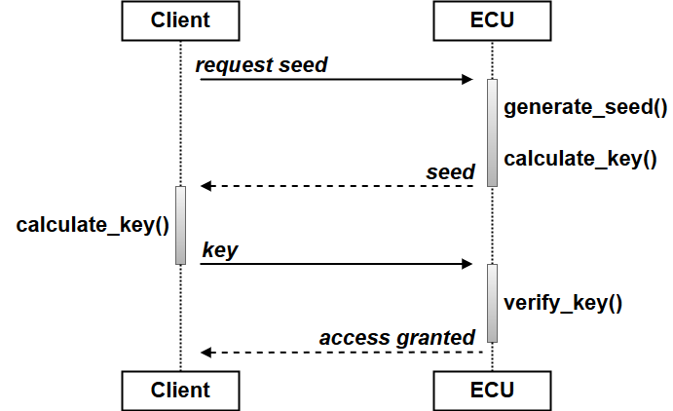
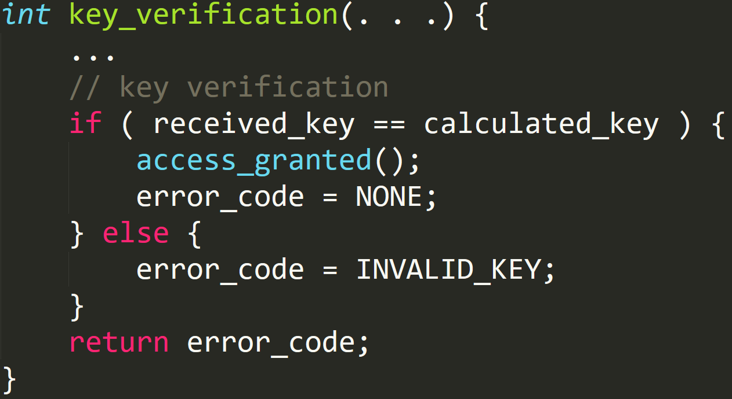
Security access

Slide 7
3A.SECURITY ACCESS
- Request seed
Security level :01

Slide 8
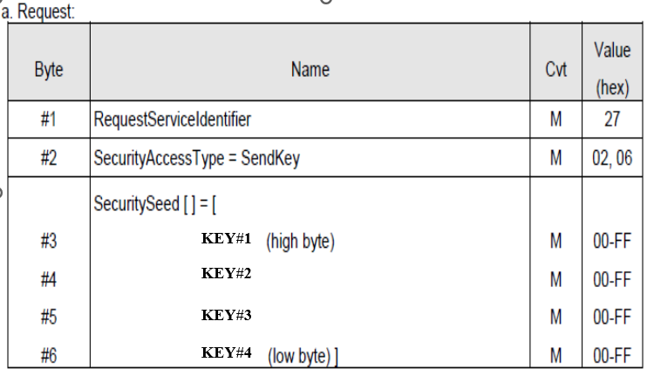
3B. SECURITY ACCESS
- Send Key
Security level :01

