Slide 1
CPPUnit
Welcome

Slide 2
What is CppUnit
Background
  A c++ unit testing framework
  A library
  A port of JUnit around 1998
  First xUnit version for smalltalk (SUnit) , around 94‘)
Workflow
  write test code for your source code
  Compile
  Run resulting binary
  Evaluate output

Slide 3
History
Initial port in 2000 by Michael Feathers on Windows
Ported to Unix/Solaris by Jerome Lacoste
Forked at least twice
  CppUnit2
  CppUnitv1.3 by for freedesktop.org
    LibreOffice
    Now the official version
    This version is presented

Slide 4
How to get it
Git Repositiory
  Build it yourself (windows)
    configure → make → make install
    Has integration for VisualStudio
  Present in many package systems in linux
  OS X port present in home brew
  Also available for *BSD and others (Haiku OS, etc)

Slide 5
Features
tools to make testing your code easier
  Test fixtures for preparing a series of tests
  A test registry: tests can be registered and called from
  Macros to reduce boiler plate code (assertion & test
  management)
  Several Testrunner (text/gui) based
    TextTestRunner, MFCTestRunner, QTTestRunner
  A Test listener (can report events during testing)
  A result collector
  Output Classes for presenting the results (Build Integration)

Slide 6
Integration into Development
Several tools provide integration into build step
  Jenkins CI
  VisualStudio
  cmake module
However newer tools focus on more recent frameworks such as googletest, etc

Slide 7
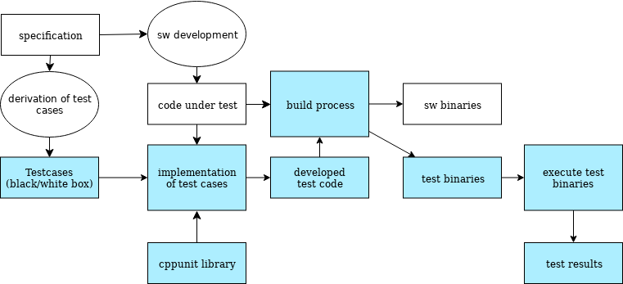
Workflow

Slide 8
Usage - Basic
Inherit from TestCase
Override runTest()
Use macro CPPUNIT_assert(bool) to test for condition
  list of assertions
Group Test in TestSuite
Use TestSuite to execute runTest() for each testcase

Slide 9
Usage - typically
Subclass TestFixture for a set of tests
Prepare test conditions: setup() and teardown()
Write testcases as member methods of your class
Register TestFixture in TestRegistry
makeTest(): get a list of tests executable in TestRunner

Slide 10
Resources:
General information
  CppUnit Cookbook
  CPPUnit presentation
  history of test frameworks
Tool Integration
  MFCTestRunner in VisualStudio6
  Jenkins CI xUnit
https://github.com/skraatz/softwaretesting

