Slide 1
Type databases

Slide 2
Toepassing databases

Slide 3
Deep dive databases
- Waarom deze dbs

Slide 4

MongoDB Document store

Slide 5
Concepts

Slide 6
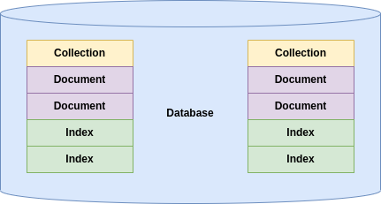

Slide 7
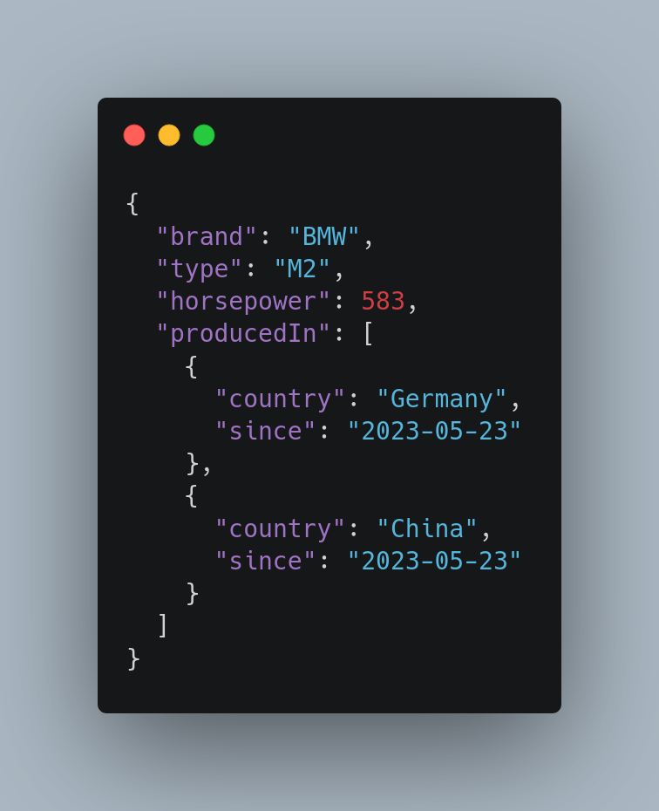

Slide 8
Query operators

Slide 9
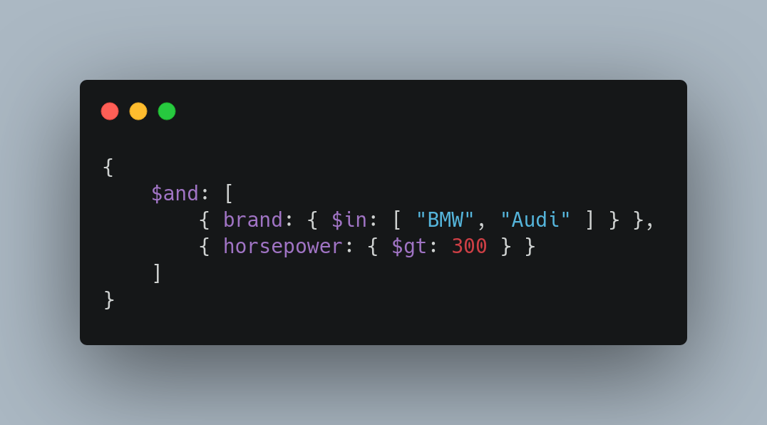
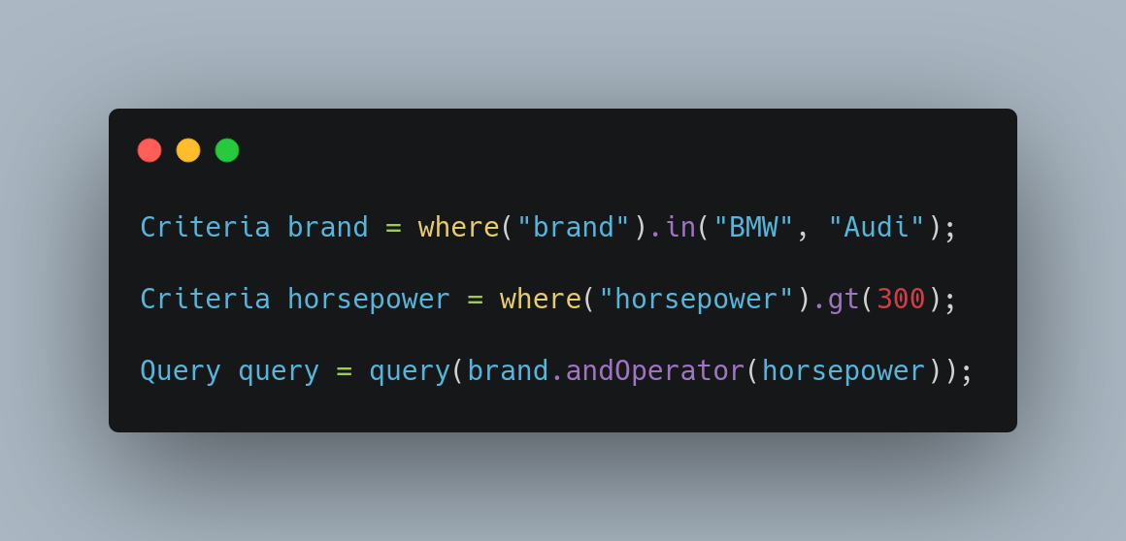
JSON
MongoDB Shell
Java (Spring)

Slide 10
Update operators

Slide 11
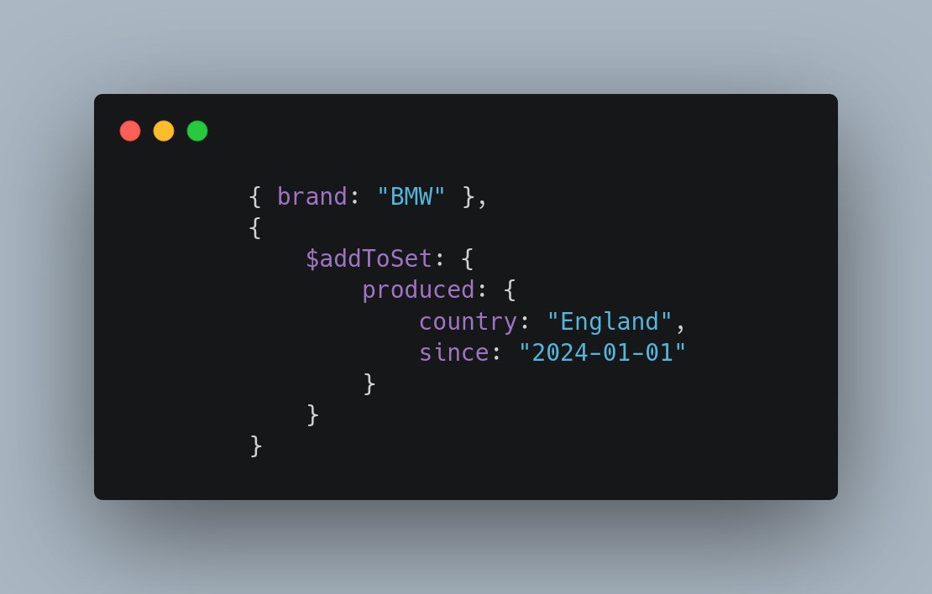
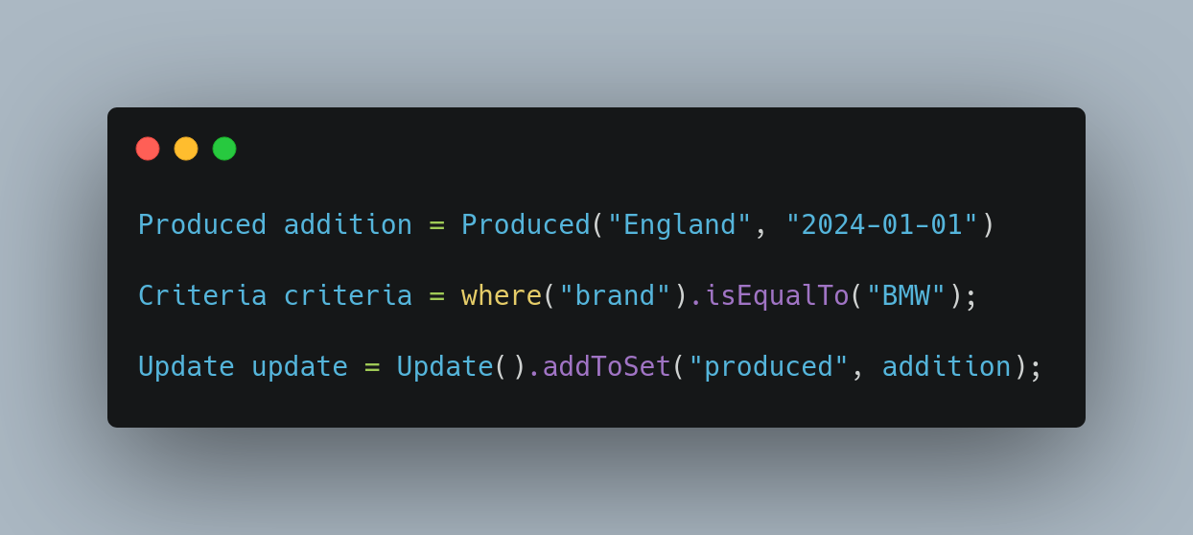
MongoDB Shell
Java (Spring)

Slide 12
Aggregate pipelines
Multi-stage pipelines that transform documents into aggregated results
- Simplify complex queries
- Create new documents
- Sorting, grouping, aggregating etc.

Slide 13
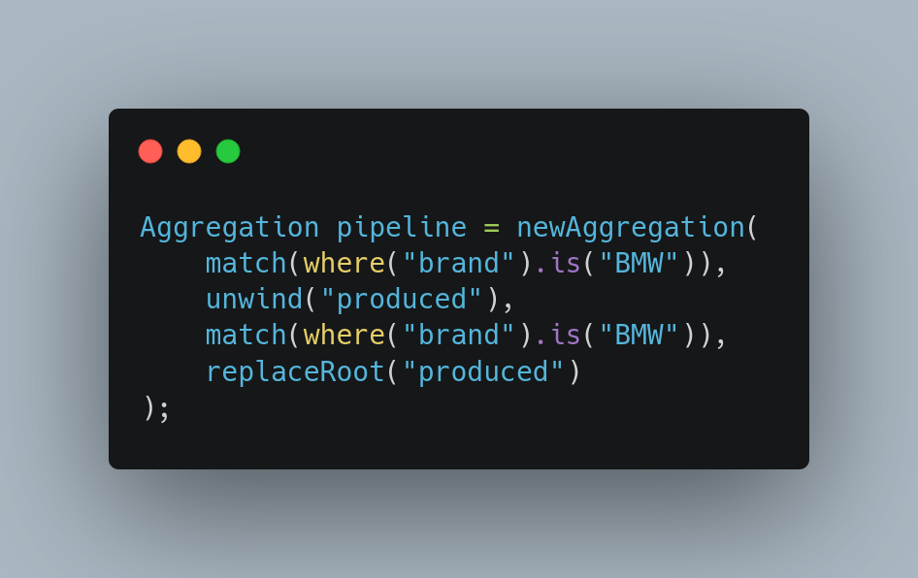

Slide 14
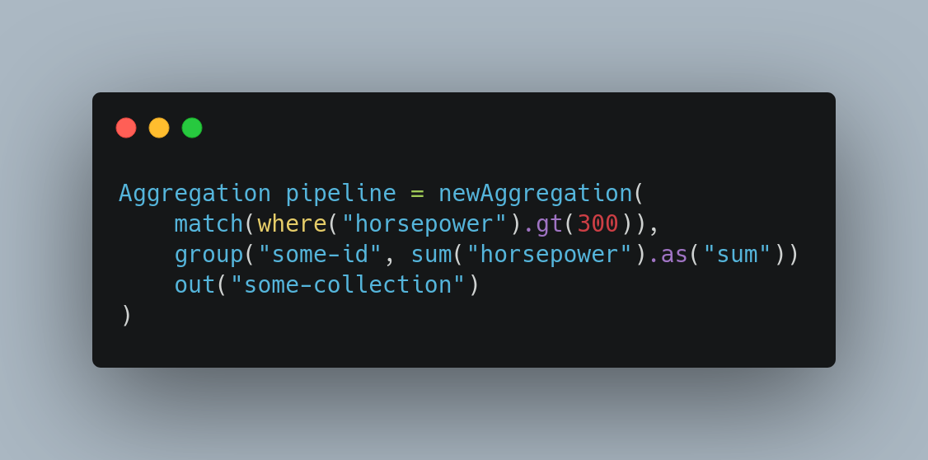
A

Slide 15
Transactions
Atomicity across multiple:
- Operations
- Collections
- Databases
- Shards

Slide 16
Change streams Access real-time data changes on:
- Collections
- Databases
- Deployments

Slide 17
And much more
- Document references
- Time series
- Tree structures
- Etc.

Slide 18

InfluxDB Time series database

Slide 19
Concepts

Slide 20
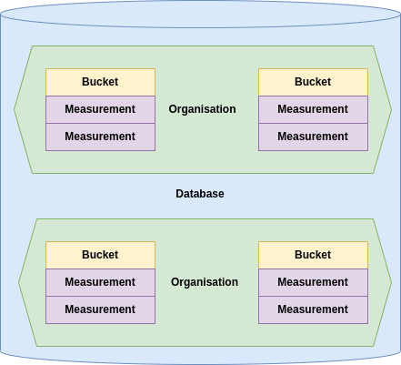

Slide 21
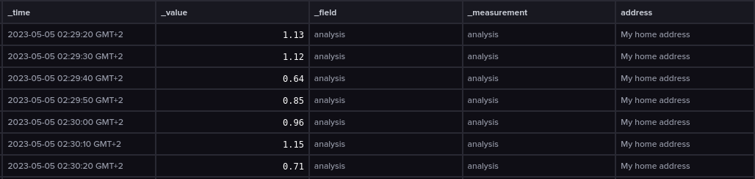

Slide 22
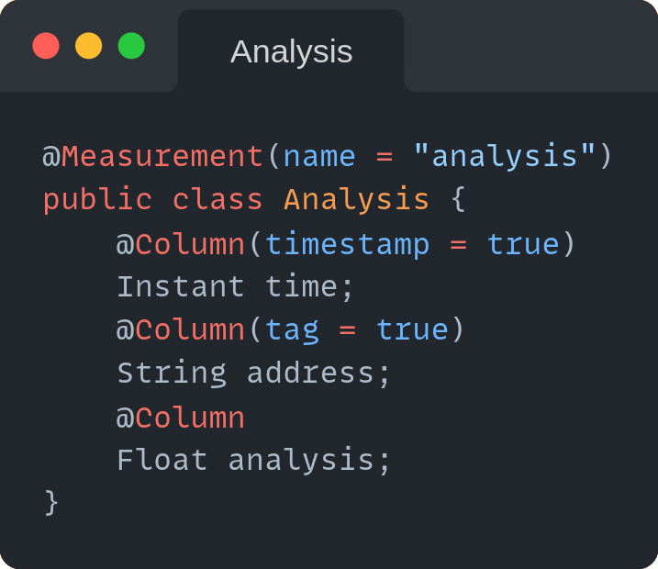

Slide 23
Query Languages

Slide 24
InfluxQL
SQL like query language with limited capability
SELECT * FROM temperature WHERE time > 1677628800 AND time < 1678579200

Slide 25
Advantages
- Simplicity
- Recognizable
Disadvantages
- Can’t query across measurements
- Can only perform simple operations

Slide 26
Flux
Functional query language
from(bucket: “temperature”)
|> range(start: 167762880, end: 1678579200)

Slide 27
Advantages
- Much more functionality than InfluxQL, i.e.:
- Can query across measurements
- Loads of statistical tools
- And many more
Disadvantages
- Complex query language

Slide 28
Features

Slide 29
Tasks
Queries that run automatically and periodically on real-time data
- Down sizing data
- Aggregating data
- Cleansing data
etc.

Slide 30
Alerts
Trigger alerts based on measurement values
- Mail
- Slack
- HTTP POST
etc.

Slide 31
Visualize
Visualize measurements in a multitude of graphs
- Gauge
- Bar
- Heatmap
- Histogram
etc.

Slide 32
Retention policies
Retain data only for a specific period of time.

Slide 33

Neo4j Graph database

Slide 34
Concepts

Slide 35
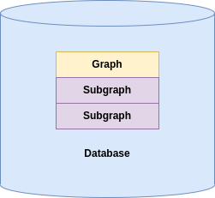

Slide 36
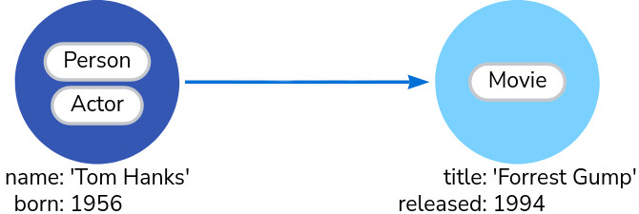

Slide 37
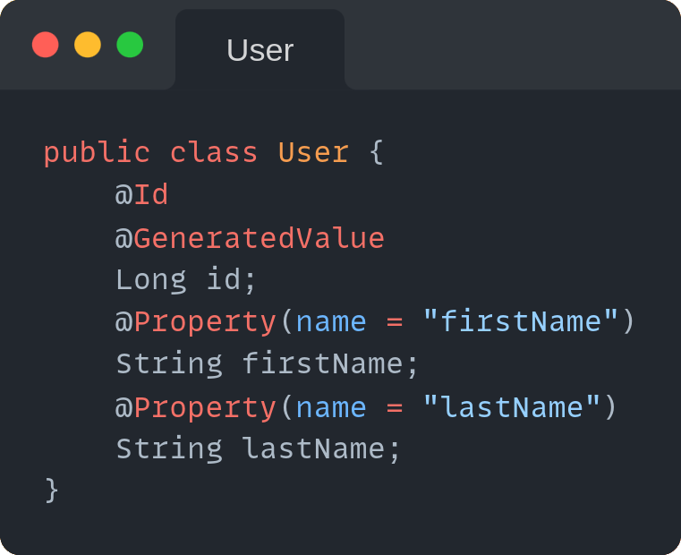
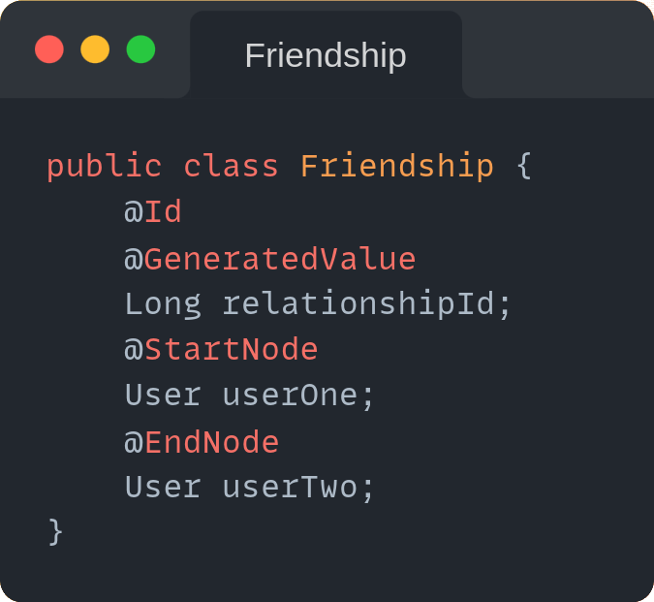

Slide 38
Query Language

Slide 39
Cypher
Cypher
MATCH (:Person {name: 'Tom Hanks'})-[:DIRECTED]→(movie:Movie) RETURN movie

Slide 40
Features

Slide 41
Visualize
Visualize nodes and relations

Slide 42
Conclusie

