Slide 1
Type databases

Slide 2
Toepassing databases

Slide 3
Deep dive databases
Three distinct models
- Document store
- Timeseries database
- Graph database

Slide 4

MongoDB Document store

Slide 5
Concepts

Slide 6
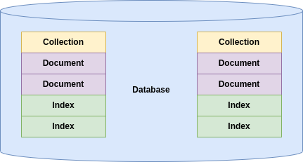

Slide 7
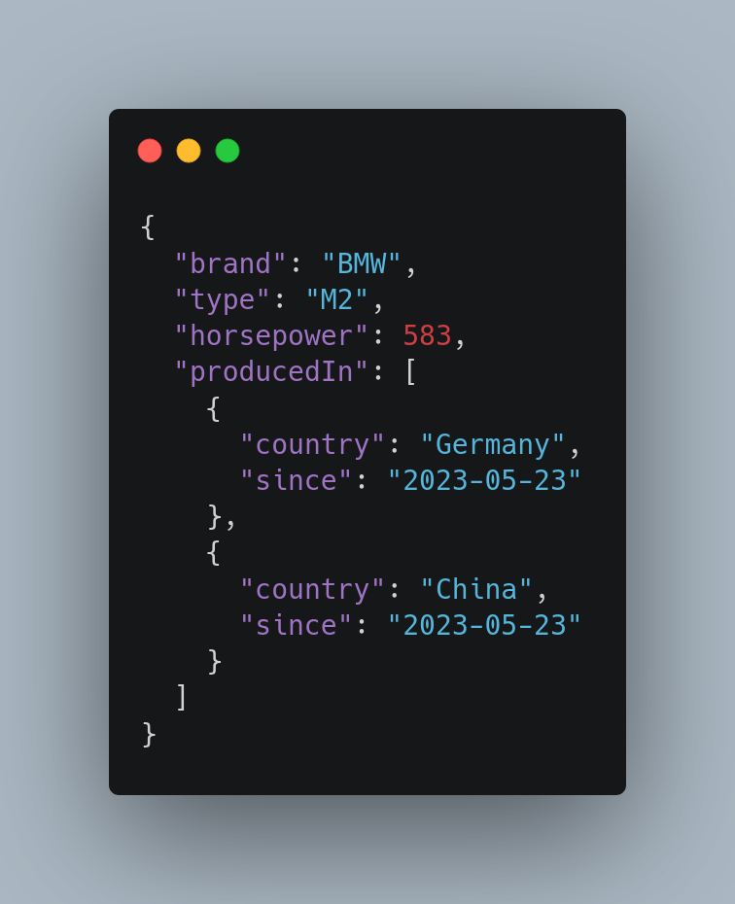

Slide 8
String/Num/Bool
Root
Key/Value
Array
Object

Slide 9
Query operators

Slide 10
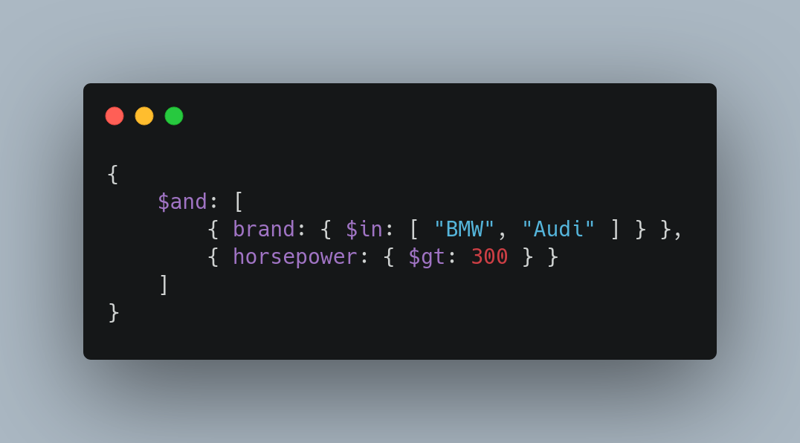
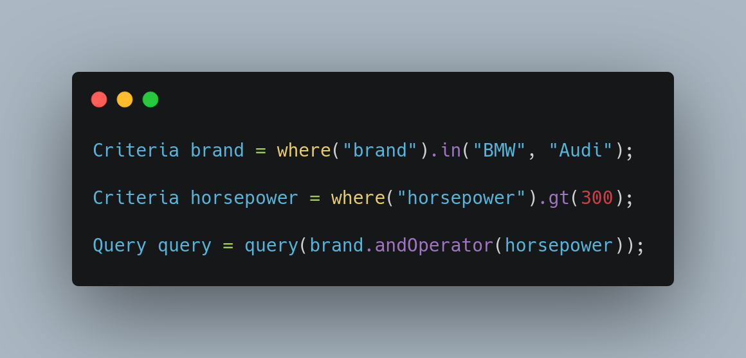
JSON
MongoDB Shell
Java (Spring)

Slide 11
Update operators

Slide 12
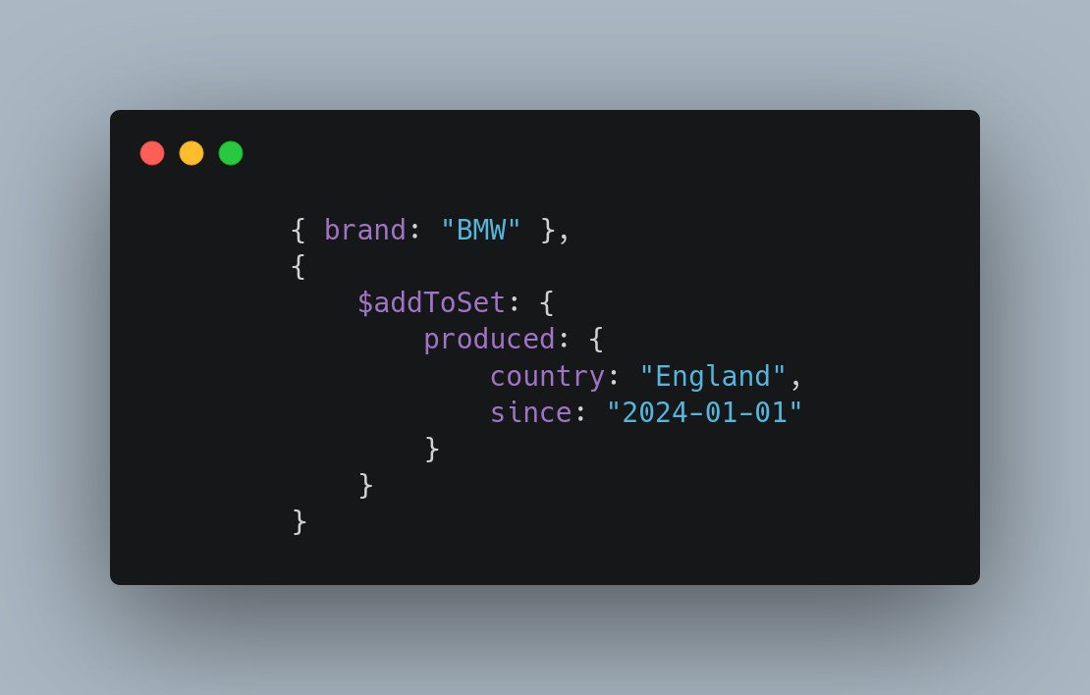
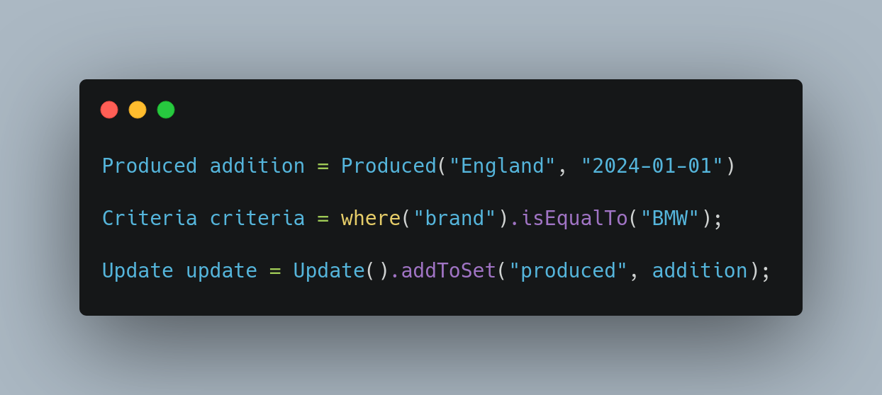
MongoDB Shell
Java (Spring)

Slide 13
Aggregate pipelines
Multi-stage pipelines that transform documents into aggregated results
- Simplify complex queries
- Create new documents
- Sorting, grouping, aggregating etc.

Slide 14
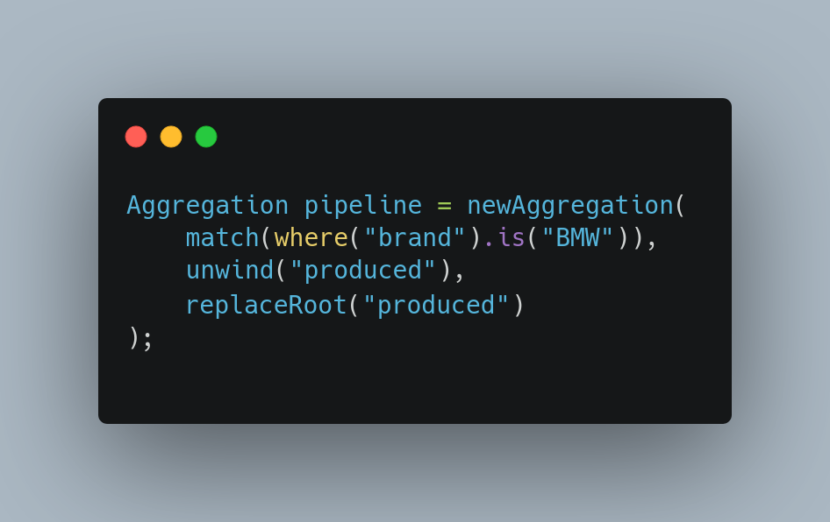

Slide 15
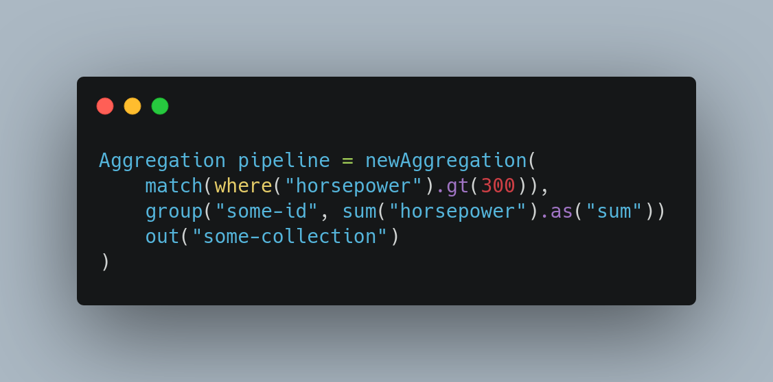

Slide 16
Change streams Access real-time data changes on:
- Collections
- Databases
- Deployments

Slide 17
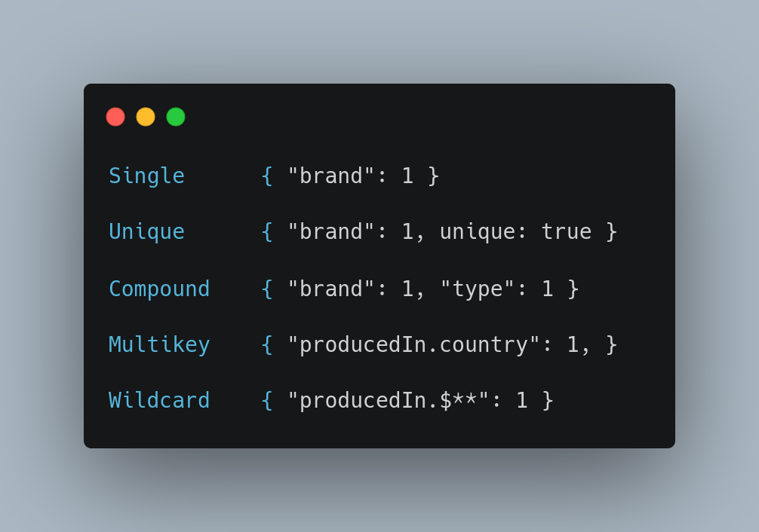
Indices Optimize and put constraints on queries

Slide 18
Transactions
Atomicity across multiple:
- Operations
- Collections
- Databases
- Shards

Slide 19
And more
- Document references
- Time series
- Tree structures
- Etc.

Slide 20

InfluxDB Time series database

Slide 21
Concepts

Slide 22
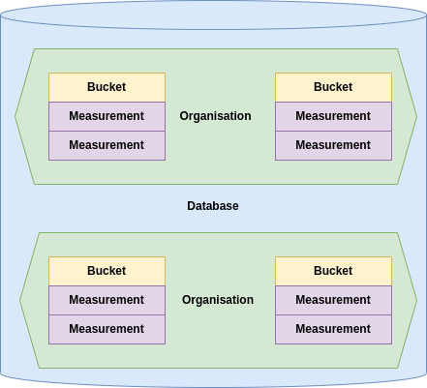

Slide 23
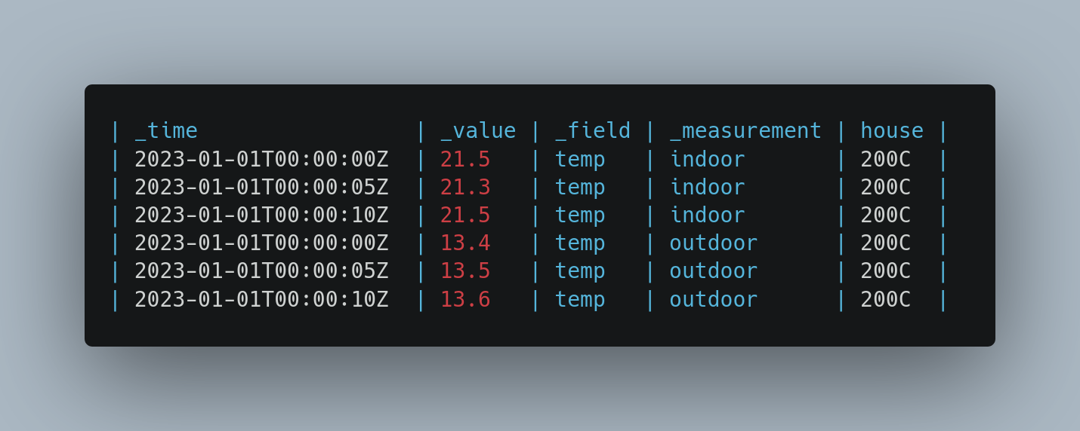

Slide 24
Timestamp
Key/Value
Type
Tag

Slide 25
Multiple query languages

Slide 26
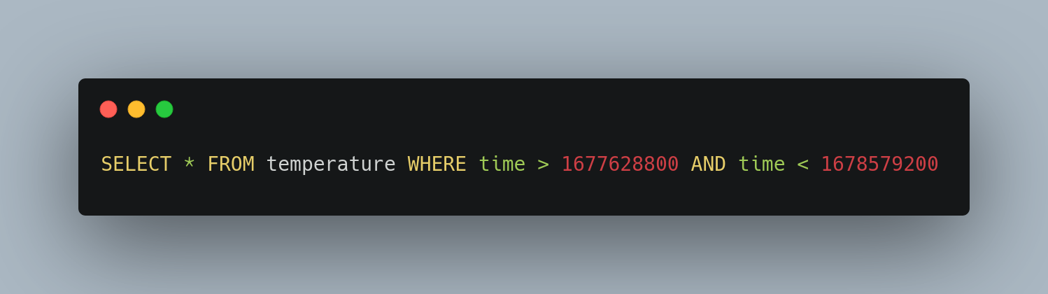
InfluxQL
SQL like query language with limited capability

Slide 27
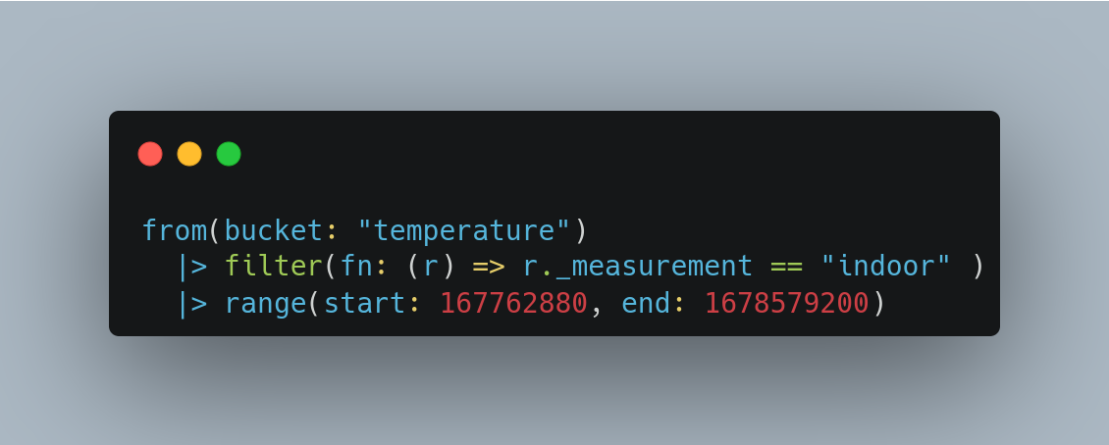
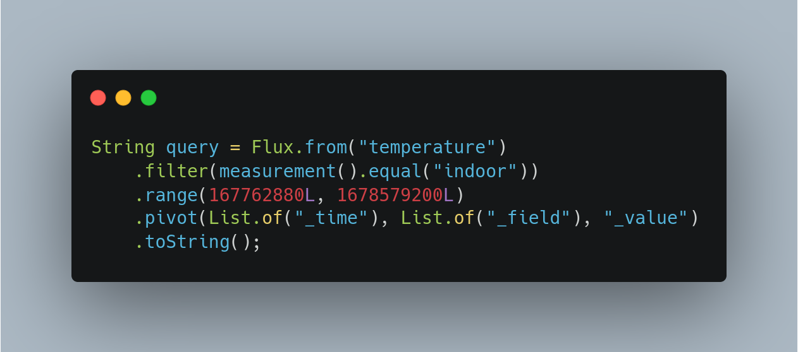
Flux
Functional query language

Slide 28
Flux has more functionality than InfluxQL - Group data by any column, not just tags / time intervals
- Query across measurements (joins) - Statistical tools

Slide 29
Features

Slide 30
Tasks
Queries that run automatically and periodically on real-time data
- Down sizing data
- Aggregating data
- Cleansing data
etc.

Slide 31
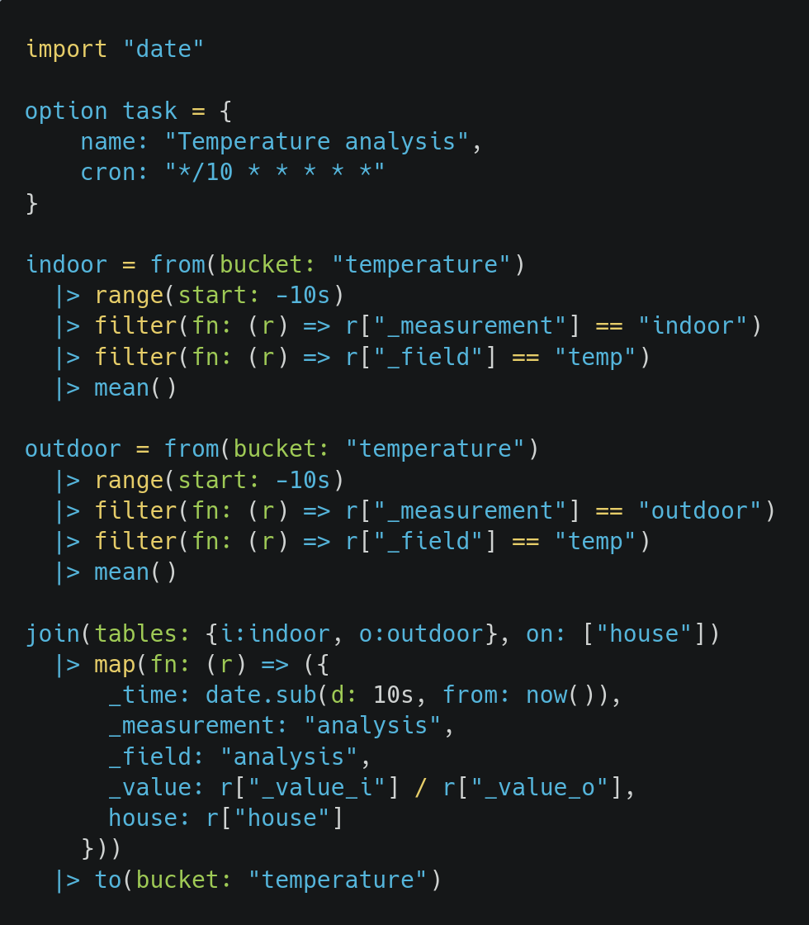

Slide 32
Visualize
Visualize measurements in a multitude of graphs
- Gauge
- Bar
- Heatmap
- Histogram
etc.

Slide 33
Alerts
Trigger alerts based on measurement values
- Mail
- Slack
- HTTP POST
etc.

Slide 34
Retention policies
Retain data only for a specific period of time.

Slide 35

Neo4j Graph database

Slide 36
Concepts

Slide 37
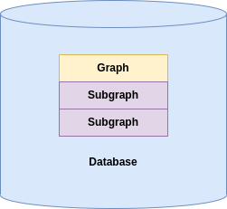

Slide 38
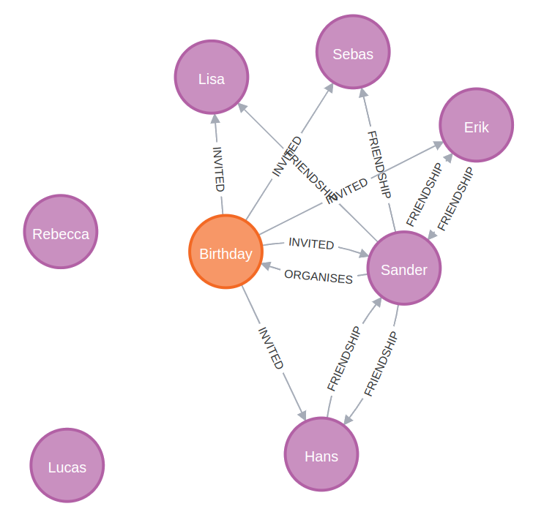

Slide 39
Node
Property
Relation
Label Person
Label Event

Slide 40
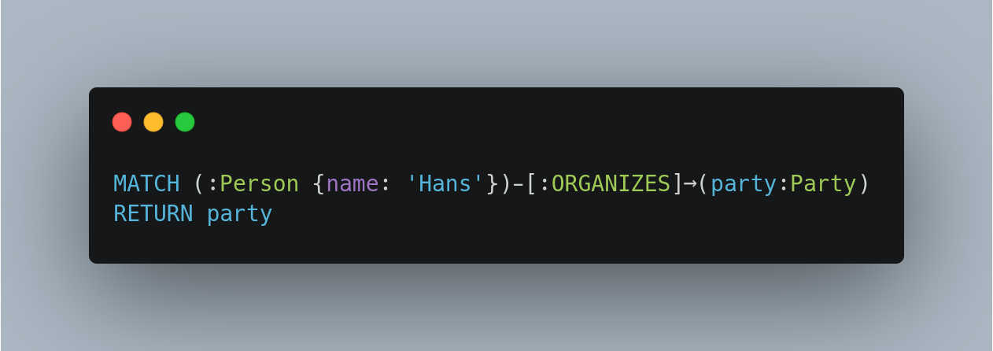
Cypher

Slide 41
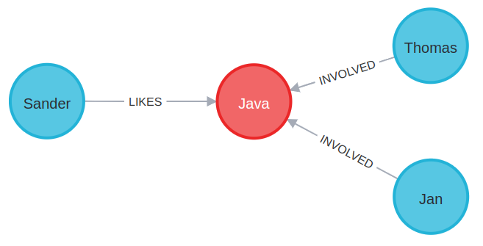
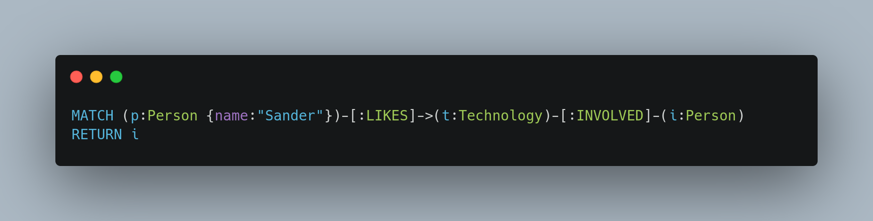
Joins

Slide 42
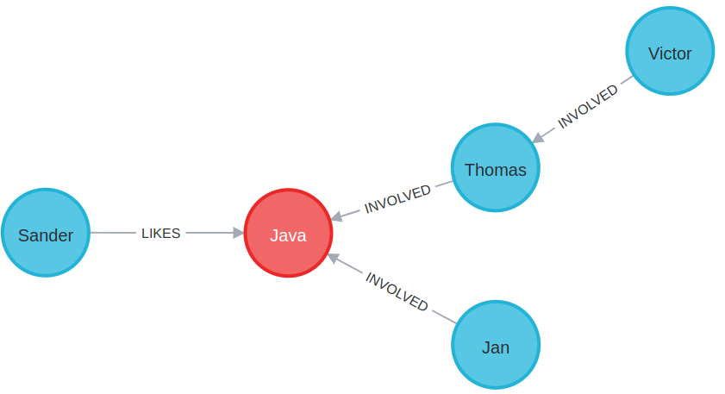
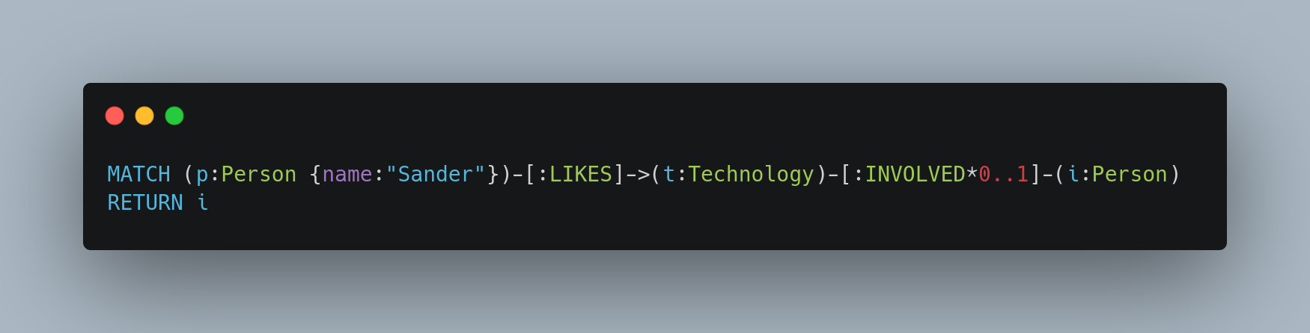
Depth search

Slide 43
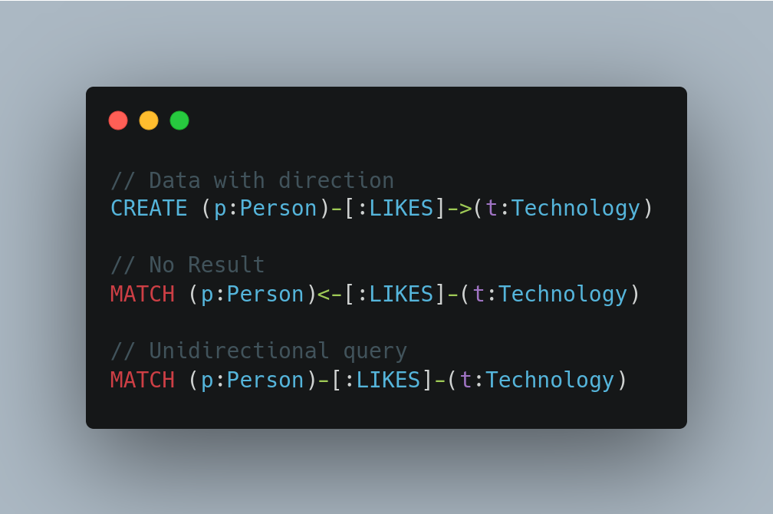
Directionality

Slide 44
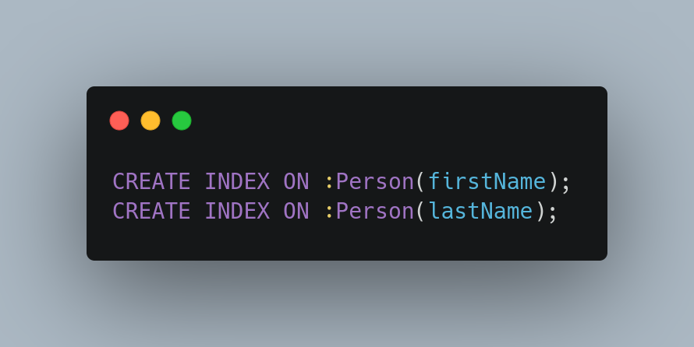
Indices

Slide 45
Features

Slide 46
Visualize
Visualize nodes and relations

Slide 47
Constraints
- Unique node property
- Unique relationship property
- Node property existence (enterprise)
- Relationship property existence (enterprise)
- And more

Slide 48
Conclusion
- Do proper research prior to usage -The basics are not that hard, the devil is in the details
- Choose a database that fits the model
- Choose a database that fits the throughput

