Slide 1

InfluxDB Time series database

Slide 2
Concepts

Slide 3
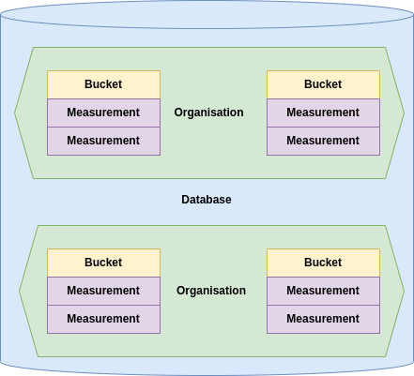

Slide 4
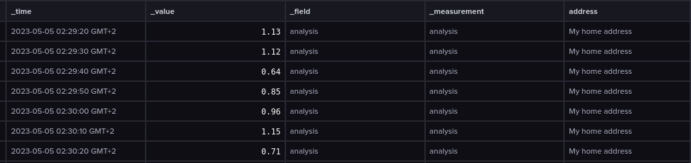

Slide 5
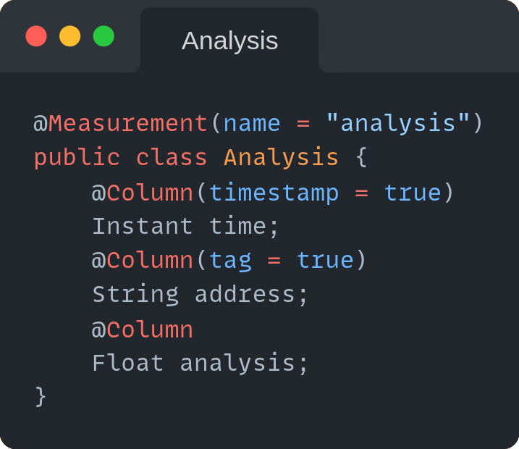

Slide 6
Query Languages

Slide 7
InfluxQL
SQL like query language with limited capability
SELECT * FROM temperature WHERE time > 1677628800 AND time < 1678579200

Slide 8
Advantages
- Simplicity
- Recognizable
Disadvantages
- Can’t query across measurements
- Can only perform simple operations

Slide 9
Flux
Functional query language
from(bucket: “temperature”)
|> range(start: 167762880, end: 1678579200)

Slide 10
Advantages
- Much more functionality than InfluxQL, i.e.:
- Can query across measurements
- Loads of statistical tools
- And many more
Disadvantages
- Complex query language

Slide 11
Features

Slide 12
Tasks
Queries that run automatically and periodically on real-time data.
- Down sizing data
- Aggregating data
- Cleansing data
etc.

Slide 13
Alerts
Trigger alerts based on measurement values.
- Mail
- Slack
- HTTP POST
etc.

Slide 14
Visualize
Visualize measurements in a multitude of graphs.
- Gauge
- Bar
- Heatmap
- Histogram
etc.

Slide 15
Retention policies
Retain data only for a specific period of time.

Slide 16
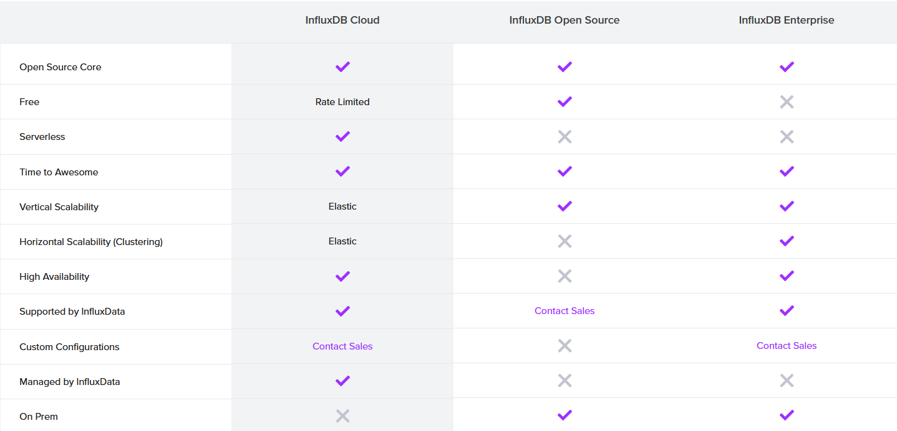

Slide 17

Neo4j Graph database

Slide 18
Concepts

Slide 19
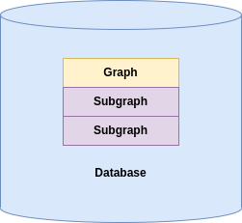

Slide 20
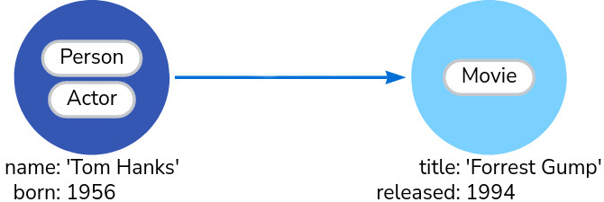

Slide 21
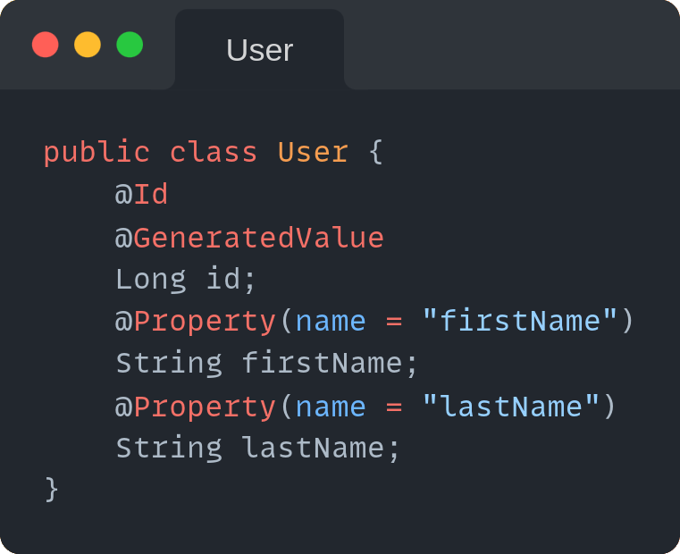
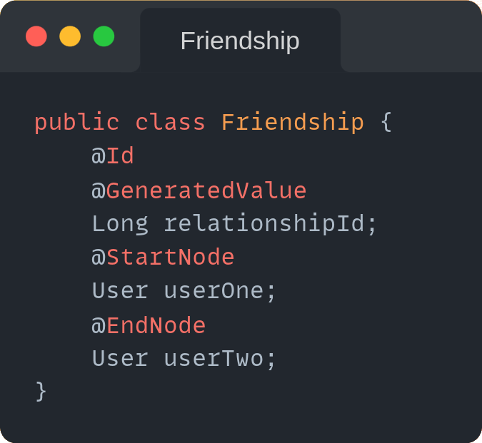

Slide 22
Query Language

Slide 23
Cypher
Cypher
MATCH (:Person {name: 'Tom Hanks'})-[:DIRECTED]→(movie:Movie) RETURN movie

Slide 24
Features

Slide 25
Visualize
Visualize nodes and relations

Slide 26
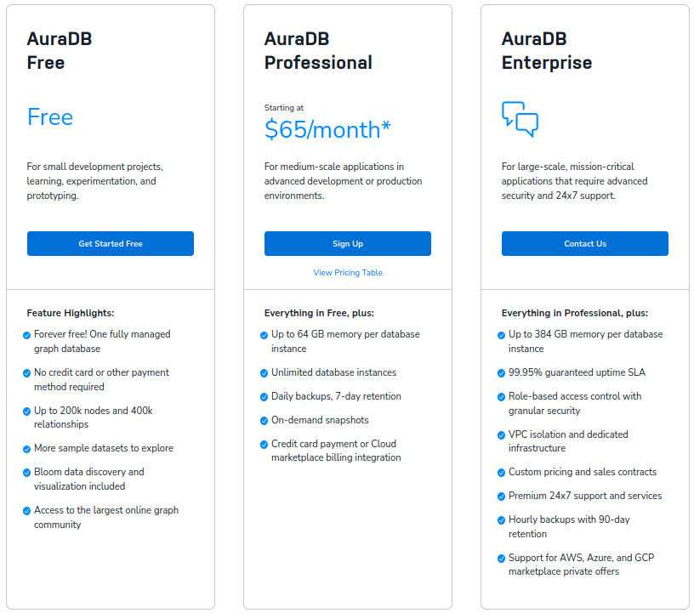

Slide 27

MongoDB Document store

Slide 28
Concepts

Slide 29
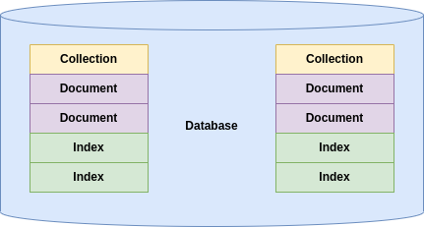

Slide 30
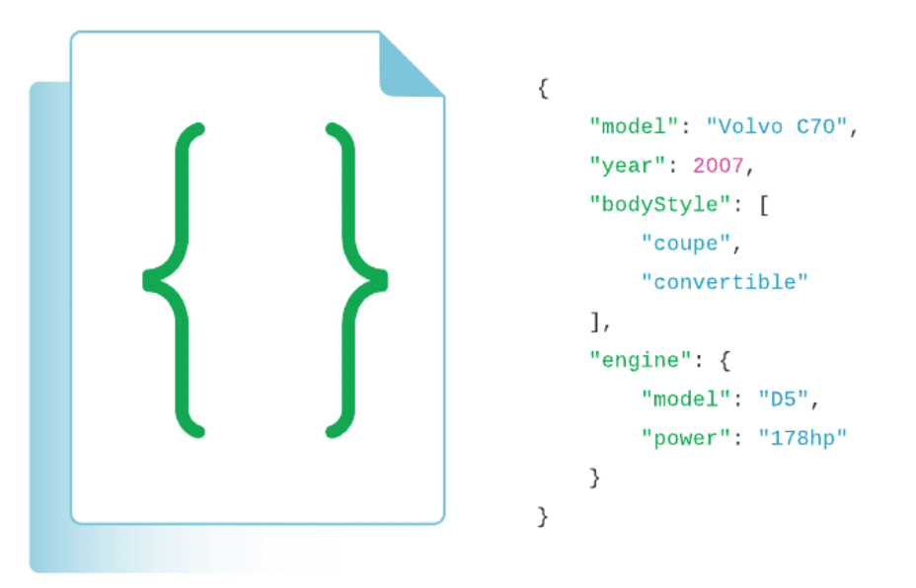

Slide 31
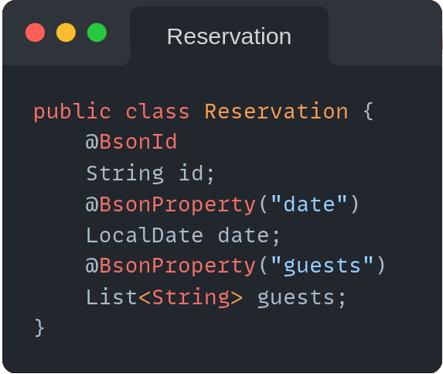

Slide 32
Query Language

Slide 33
JSON
{
$or: [
{ status: "A" },
{ qty: { $lt: 30 } }
] }
{
$or: [
{ status: "A" },
{ qty: { $lt: 30 } }
] }

Slide 34
Features

Slide 35
Aggregate pipelines
Multi-stage pipelines that transform documents into aggregated results
- Simplify complex queries
- Create new documents
-

