Slide 1

InfluxDB Time series database

Slide 2
Concepts

Slide 3
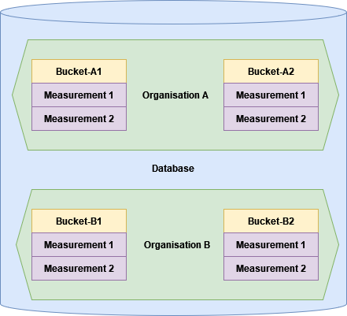

Slide 4
Data model

Slide 5
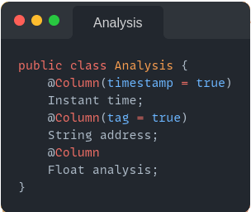

Slide 7
Query Languages

Slide 8
InfluxQL
SQL like query language with limited capability
SELECT * FROM temperature WHERE time > 1677628800 AND time < 1678579200

Slide 9
Advantages
- Simplicity
- Recognizable
Disadvantages
- Can’t query across measurements
- Can only perform simple operations

Slide 10
Flux
Functional query language
from(bucket: “temperature”)
|> range(start: 167762880, end: 1678579200)

Slide 11
Advantages
- Much more functionality than InfluxQL, i.e.:
- Can query across measurements
- Loads of statistical tools
- And many more
Disadvantages
- Complex query language

Slide 12
Features

Slide 13
Tasks
Queries that run automatically and periodically on real-time data.
- Down sizing data
- Aggregating data
- Cleansing data
etc.

Slide 14
Alerts
Trigger alerts based on measurement values.
- Mail
- Slack
- HTTP POST
etc.

Slide 15
Visualize
Visualize measurements in a multitude of graphs.
- Gauge
- Bar
- Heatmap
- Histogram
etc.

Slide 16
Retention policies
Retain data only for a specific period of time.

Slide 17
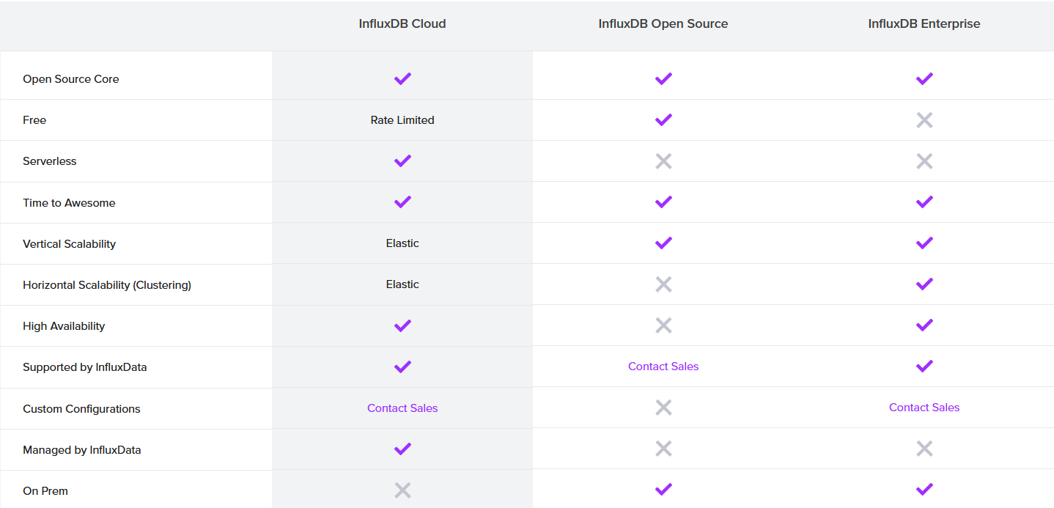

Slide 18

Neo4j Graph database

Slide 19
Concepts

Slide 20
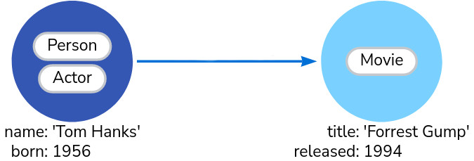

Slide 21
Data model

Slide 22
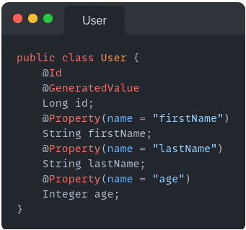
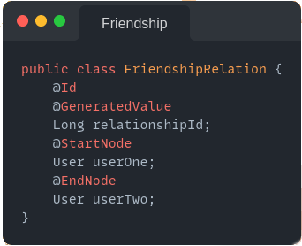

Slide 24
Query Languages

Slide 25
Cypher
MATCH (:Person {name: 'Tom Hanks'})-[:DIRECTED]→(movie:Movie) RETURN movie

Slide 26
Features

Slide 27
Todo
Todo
- TODO

Slide 28
