Slide 1
Type databases

Slide 2
Toepassing databases

Slide 3
Deep dive databases
Three distinct models
- Document store
- Timeseries database
- Graph database

Slide 4

MongoDB Document store

Slide 5
Concepts

Slide 6
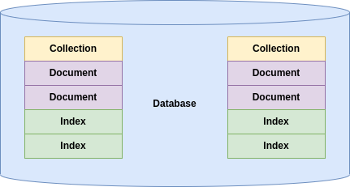

Slide 7
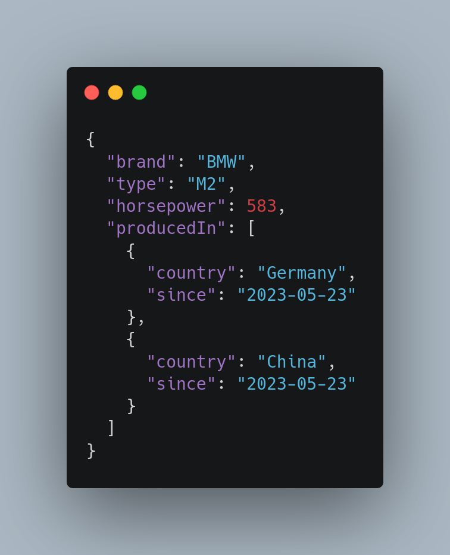

Slide 8
Query operators

Slide 9
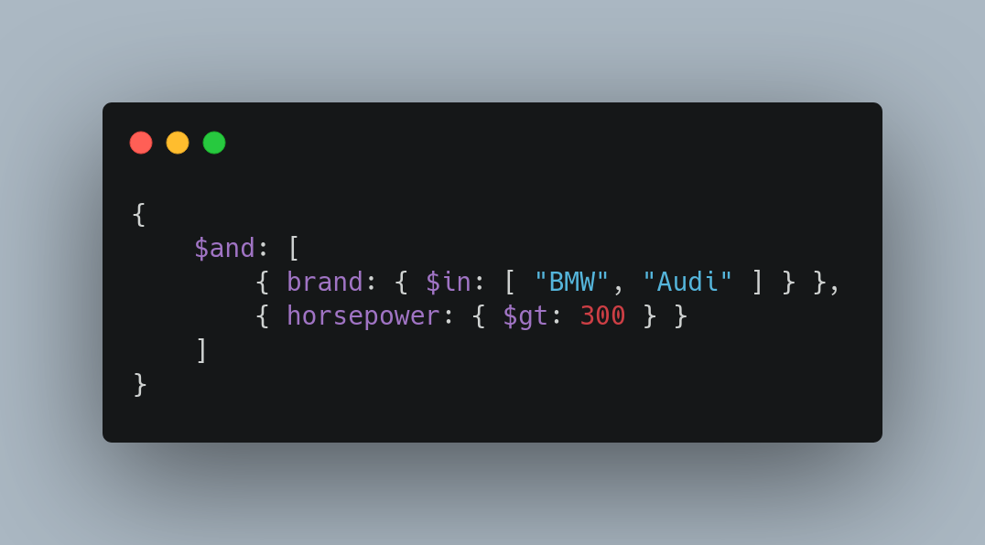
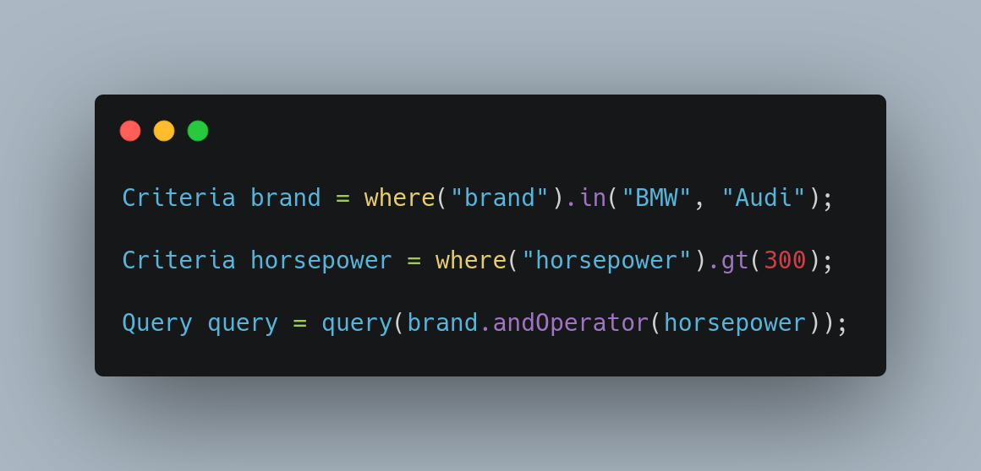
JSON
MongoDB Shell
Java (Spring)

Slide 10
Update operators

Slide 11
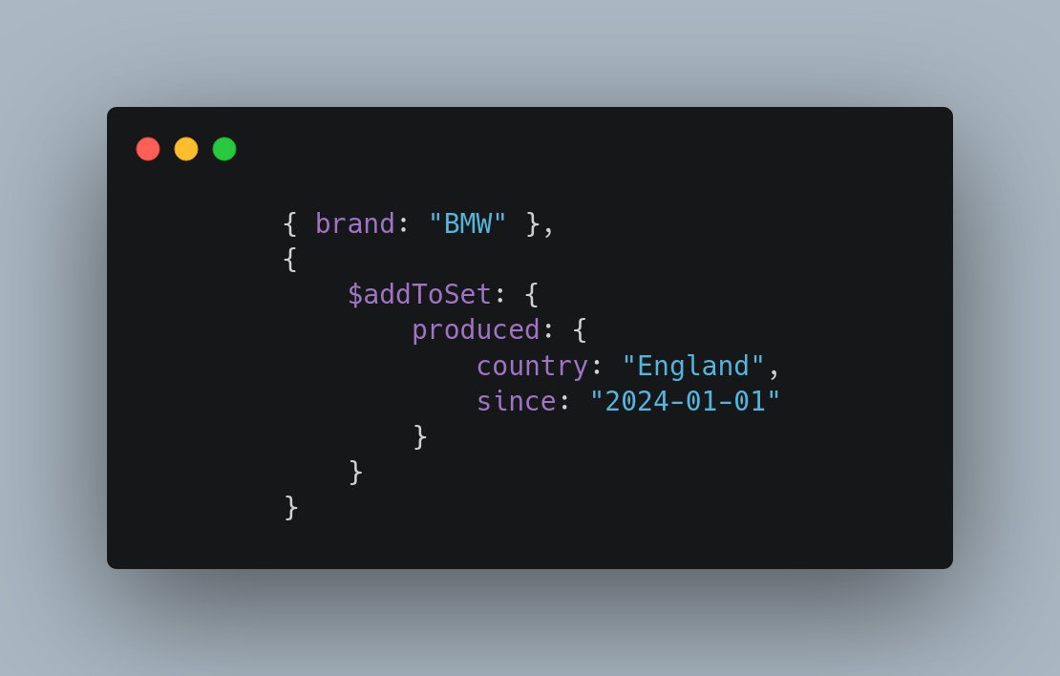
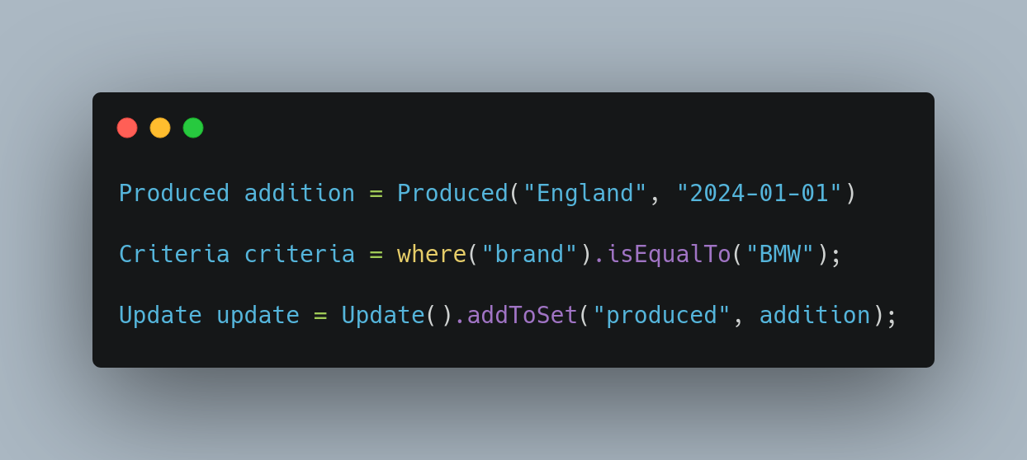
MongoDB Shell
Java (Spring)

Slide 12
Aggregate pipelines
Multi-stage pipelines that transform documents into aggregated results
- Simplify complex queries
- Create new documents
- Sorting, grouping, aggregating etc.

Slide 13
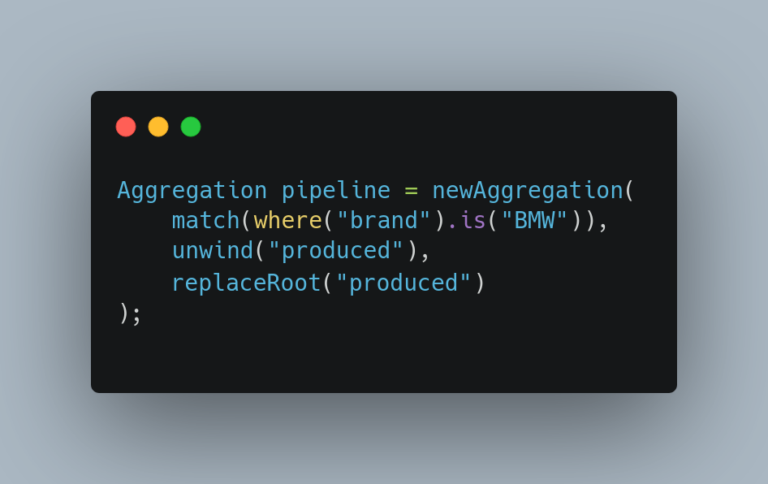

Slide 14
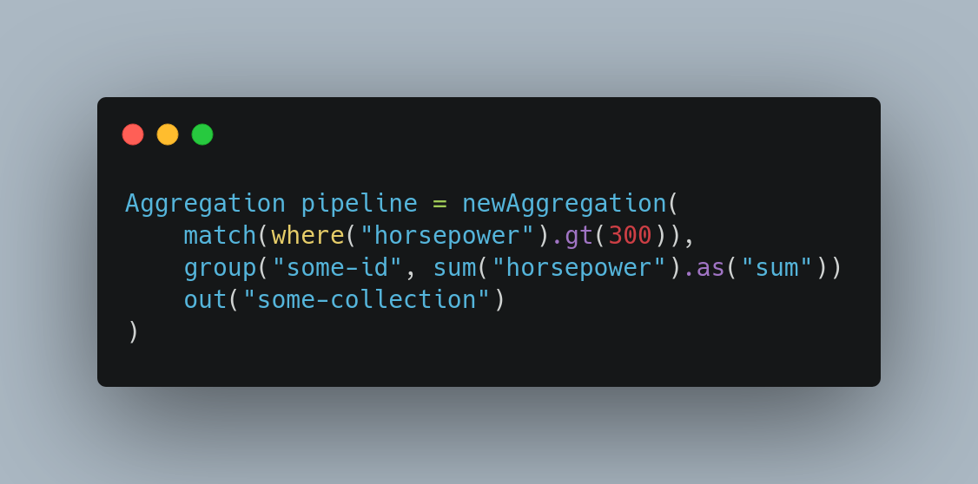

Slide 15
Change streams Access real-time data changes on:
- Collections
- Databases
- Deployments

Slide 16
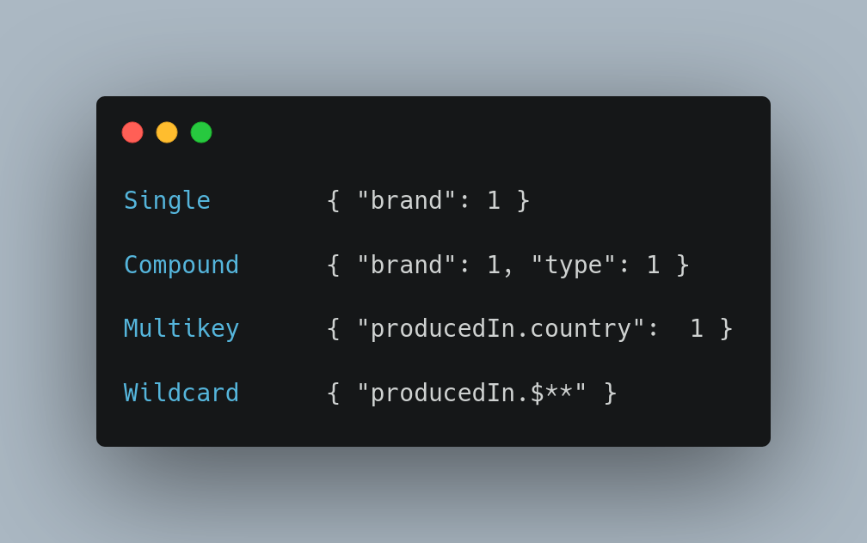
Indices Optimize and put constraints on queries

Slide 17
Transactions
Atomicity across multiple:
- Operations
- Collections
- Databases
- Shards

Slide 18
And more
- Document references
- Time series
- Tree structures
- Etc.

Slide 19

InfluxDB Time series database

Slide 20
Concepts

Slide 21
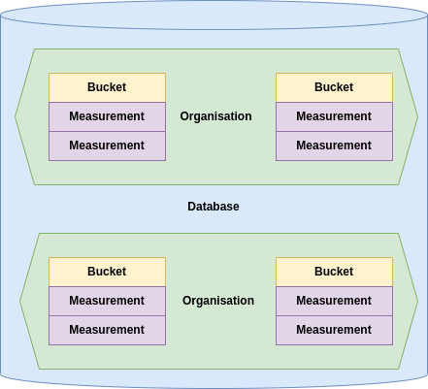

Slide 22
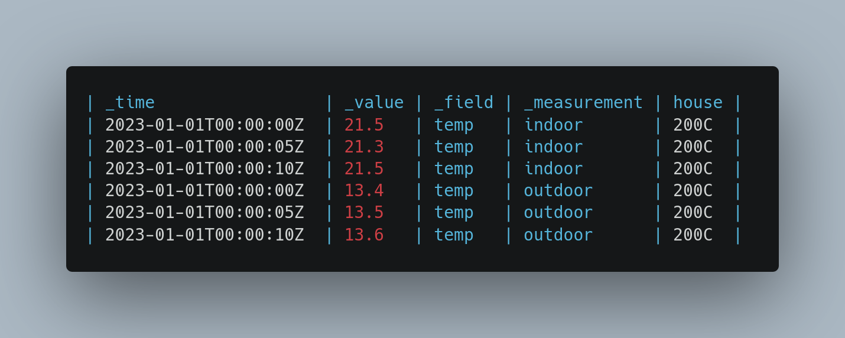

Slide 23
Type
Tag

Slide 24
Multiple query languages

Slide 25
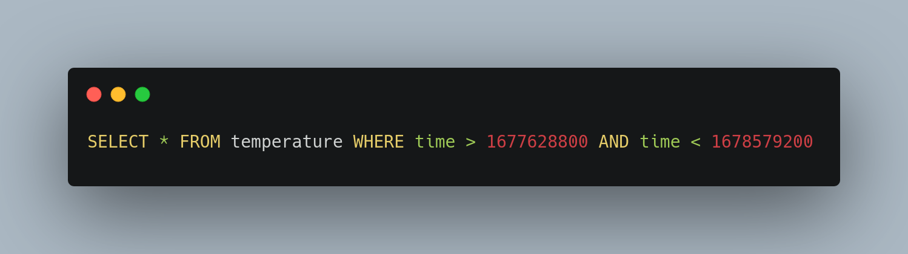
InfluxQL
SQL like query language with limited capability

Slide 26
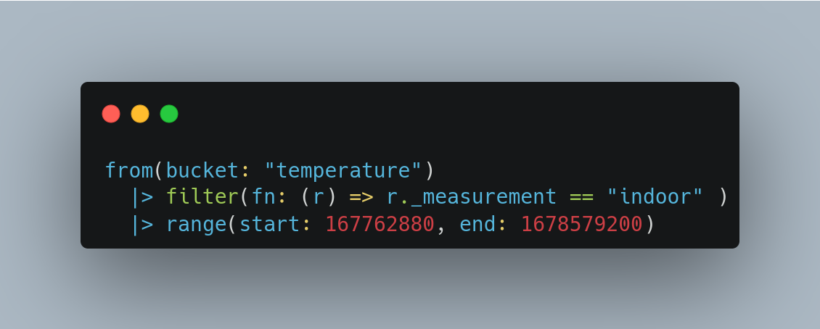
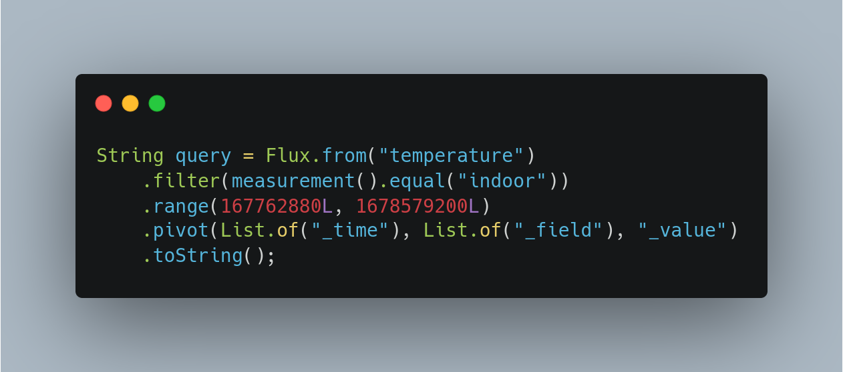
Flux
Functional query language

Slide 27
Flux has more functionality than InfluxQL - Group data by any column, not just tags / time intervals
- Query across measurements (joins) - Statistical tools

Slide 28
Features

Slide 29
Tasks
Queries that run automatically and periodically on real-time data
- Down sizing data
- Aggregating data
- Cleansing data
etc.

Slide 30
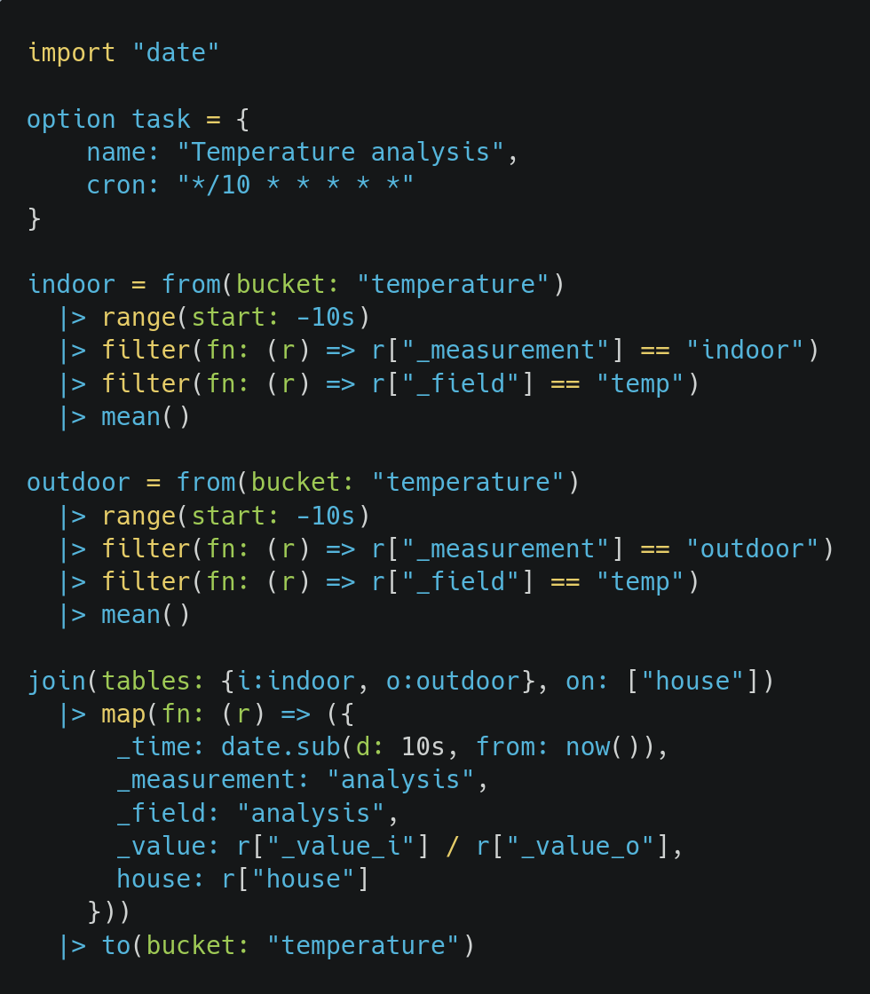

Slide 31
Visualize
Visualize measurements in a multitude of graphs
- Gauge
- Bar
- Heatmap
- Histogram
etc.

Slide 32
Alerts
Trigger alerts based on measurement values
- Mail
- Slack
- HTTP POST
etc.

Slide 33
Retention policies
Retain data only for a specific period of time.

Slide 34

Neo4j Graph database

Slide 35
Concepts

Slide 36
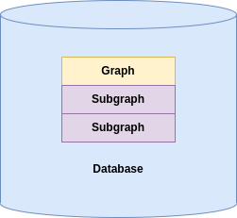

Slide 37
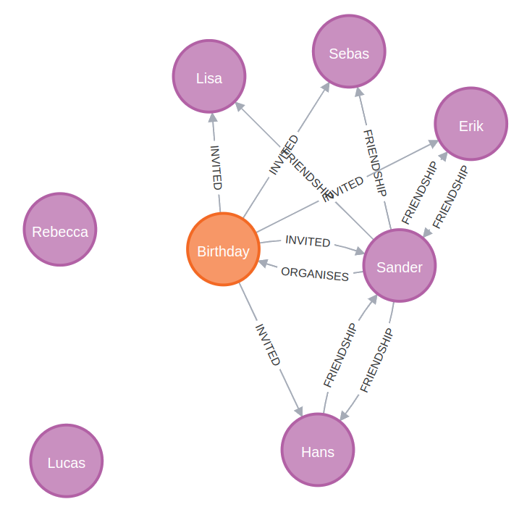

Slide 38
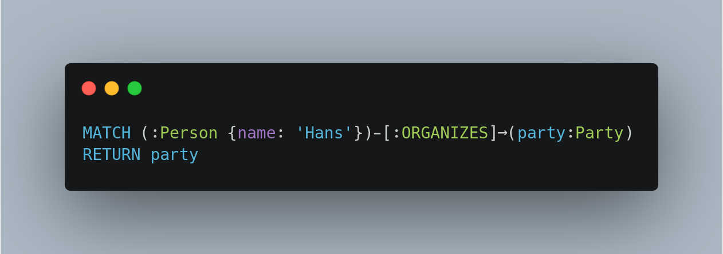
Cypher

Slide 39
Cypher
Clause
Label
Property
Relation

Slide 40
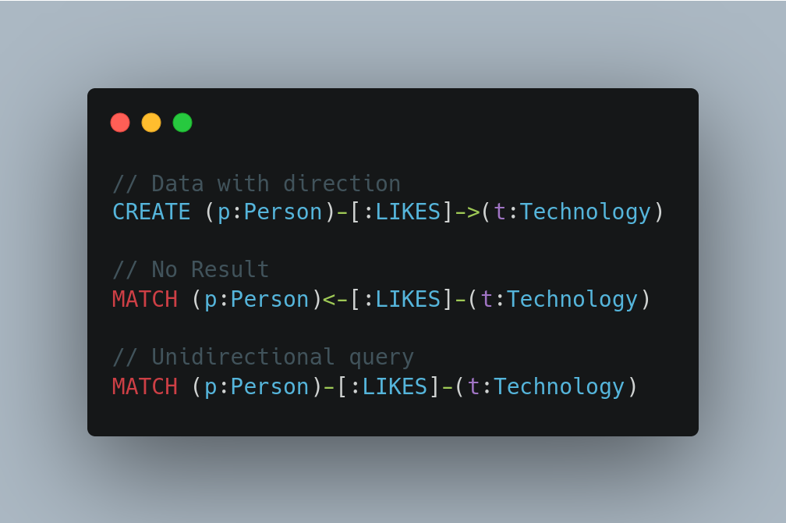
Directionality

Slide 41
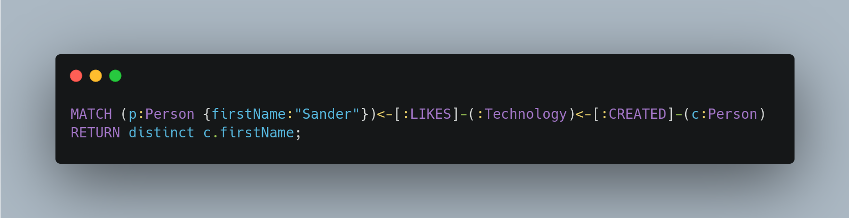
Joins

Slide 42
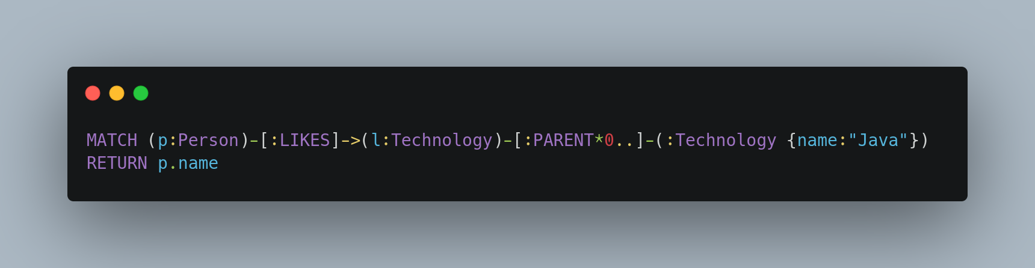
Depth search

Slide 43
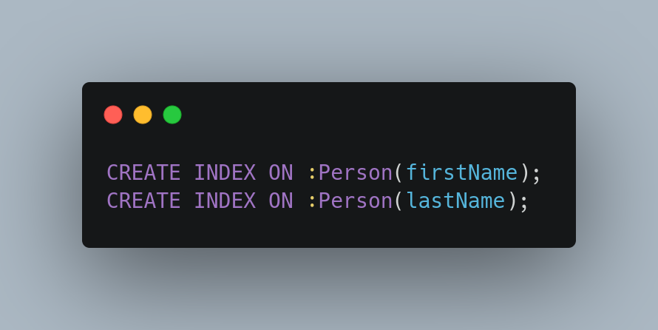
Indices

Slide 44
Features

Slide 45
Visualize
Visualize nodes and relations

Slide 46
Constraints
- Unique node property
- Unique relationship property
- Node property existence (enterprise)
- Relationship property existence (enterprise)
- And more

Slide 47
Conclusion
- Do proper research prior to usage -The basics are not that hard, the devil is in the details
- Choose a database that fits the model
- Choose a database that fits the throughput

