Slide 1

InfluxDB Time series database

Slide 2
Concepts

Slide 3
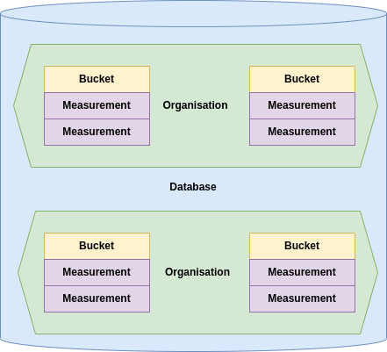

Slide 4
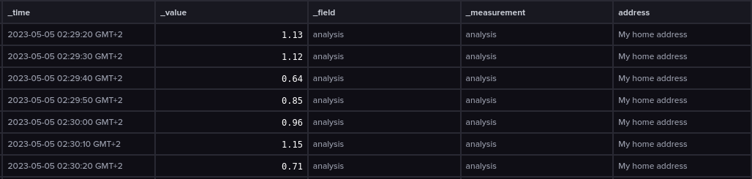

Slide 5
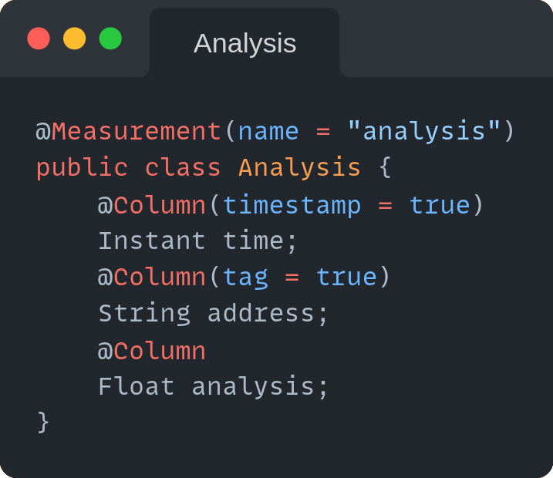

Slide 6
Query Languages

Slide 7
InfluxQL
SQL like query language with limited capability
SELECT * FROM temperature WHERE time > 1677628800 AND time < 1678579200

Slide 8
Advantages
- Simplicity
- Recognizable
Disadvantages
- Can’t query across measurements
- Can only perform simple operations

Slide 9
Flux
Functional query language
from(bucket: “temperature”)
|> range(start: 167762880, end: 1678579200)

Slide 10
Advantages
- Much more functionality than InfluxQL, i.e.:
- Can query across measurements
- Loads of statistical tools
- And many more
Disadvantages
- Complex query language

Slide 11
Features

Slide 12
Tasks
Queries that run automatically and periodically on real-time data
- Down sizing data
- Aggregating data
- Cleansing data
etc.

Slide 13
Alerts
Trigger alerts based on measurement values
- Mail
- Slack
- HTTP POST
etc.

Slide 14
Visualize
Visualize measurements in a multitude of graphs
- Gauge
- Bar
- Heatmap
- Histogram
etc.

Slide 15
Retention policies
Retain data only for a specific period of time.

Slide 16

Neo4j Graph database

Slide 17
Concepts

Slide 18
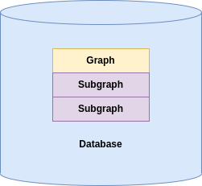

Slide 19
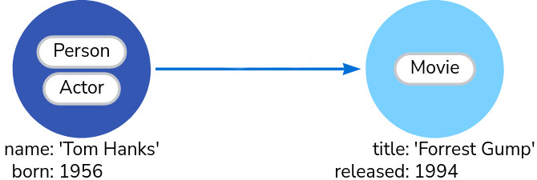

Slide 20
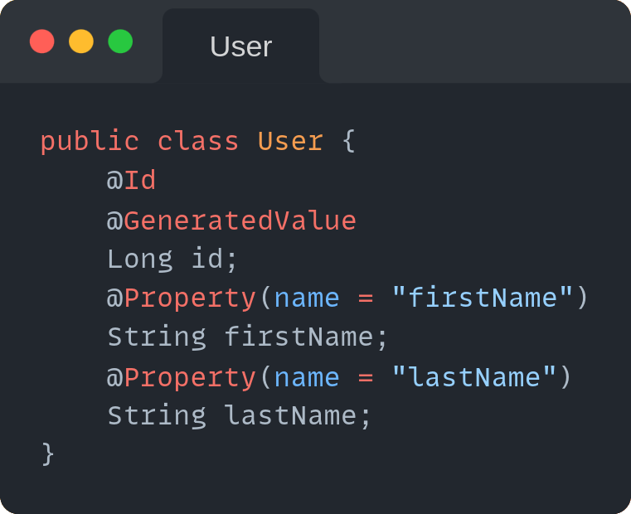
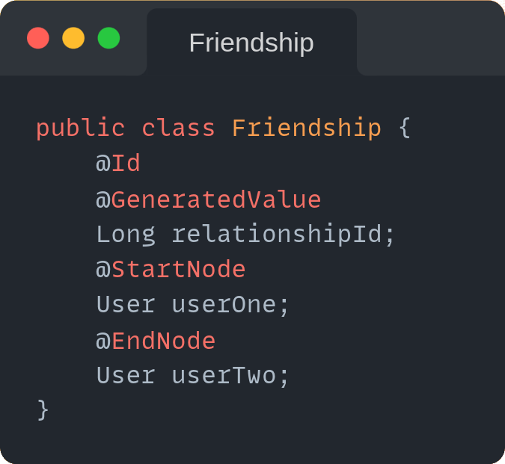

Slide 21
Query Language

Slide 22
Cypher
Cypher
MATCH (:Person {name: 'Tom Hanks'})-[:DIRECTED]→(movie:Movie) RETURN movie

Slide 23
Features

Slide 24
Visualize
Visualize nodes and relations

Slide 25

MongoDB Document store

Slide 26
Concepts

Slide 27
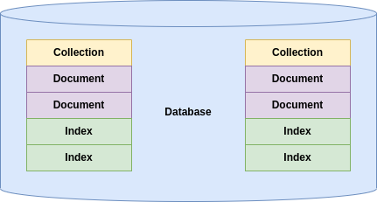

Slide 28
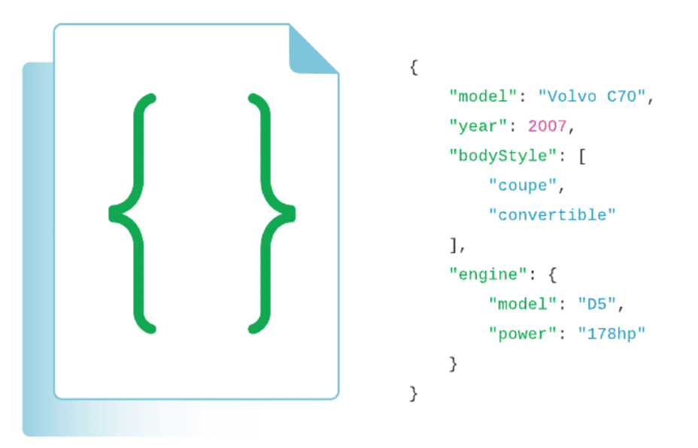

Slide 29
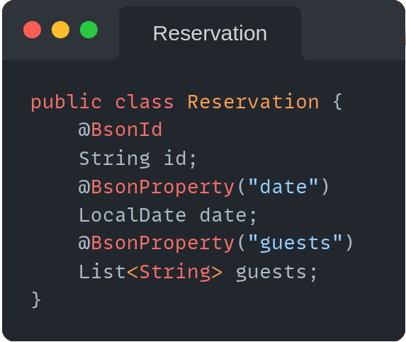

Slide 30
Query Language

Slide 31
JSON
{
$or: [
{ status: "A" },
{ qty: { $lt: 30 } }
] }
{
$or: [
{ status: "A" },
{ qty: { $lt: 30 } }
] }

Slide 32
Features

Slide 33
Aggregate pipelines
Multi-stage pipelines that transform documents into aggregated results
- Simplify complex queries
- Create new documents
- Sorting, grouping, aggregating etc.

Slide 34
Transactions
Atomicity across multiple:
- Operations
- Collections
- Databases
- Shards

Slide 35
Change streams Access real-time data changes on:
- Collections
- Databases
- Deployments

Slide 36
And much more
- Document references
- Time series
- Tree structures
- Etc.

