Slide 1

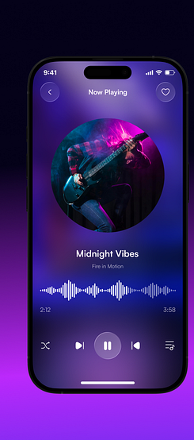
SOUND MOVES
UI Design System & Screen Reference Deck
Companion to Document SM-UI-SPEC-001 · v2.0 Enterprise Edition
9 unique screens · 22 components · 14 finalized decisions · 0 open questions
COVER · SLIDE 1 / 19
SOUND MOVES — UI DESIGN SYSTEM & SCREEN REFERENCE DECK

Slide 2




EXECUTIVE SUMMARY
How to Use This Deck
The .txt document is the source of truth
Every exact hex value, spacing number, and finalized decision lives in SM-UI-SPEC-001.txt — this deck never overrides it.
This deck is the visual walkthrough
It puts the actual reference screenshots next to each rule, so anyone — not just someone comfortable reading a written spec — can confirm the target UI at a glance.
If the two ever disagree, the document wins
This deck is a presentation layer generated to match it, not an independent source of decisions.
Use the cross-reference map to jump between them
Every slide is tagged with the exact Part / Section it illustrates (see footer) — Section C10 of the document lists the full map both ways.
PART C · SECTION C10 · SLIDE 2 / 19
SOUND MOVES — UI DESIGN SYSTEM & SCREEN REFERENCE DECK

Slide 3
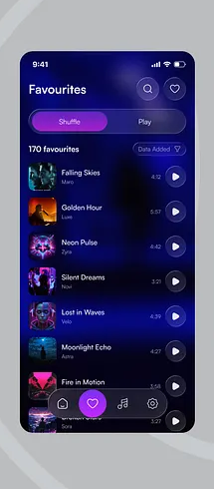
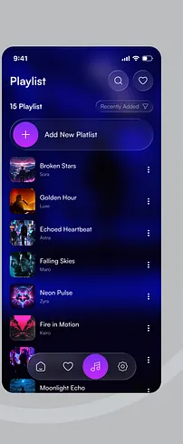
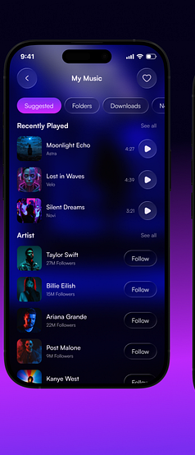
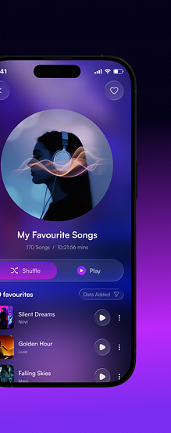
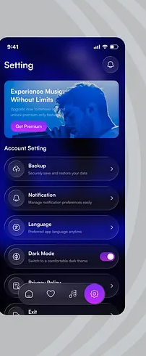
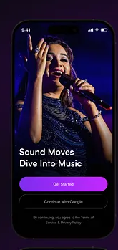
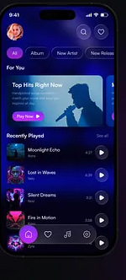
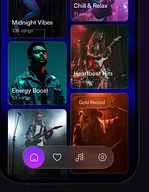
PART B · SECTION 3
9 Screens. Zero Ambiguity.
Every screen below is fully specified — layout, components, sample data, and exact spacing — in Part B, Section 3 of the document.
3.1 Onboarding
3.2 Home / For You
3.3 Moods & Genres Grid
3.4 Favourites
3.5 Playlist
3.6 My Music
3.7 Now Playing
3.8 My Favourite Songs
3.9 Setting
PART B · SECTION 3 · SLIDE 3 / 19
SOUND MOVES — UI DESIGN SYSTEM & SCREEN REFERENCE DECK

Slide 4
PART B · SECTION 1.2
Color System
App Canvas — layered dark background
Primary Brand Gradient — “Aurora”
One token, angle parameter — every primary/active/selected element app-wide
0% gradient stop
#0A0A52 · deep indigo-navy
accent-violet
#8A2BF0
accent-magenta
#C92CEE
30% gradient stop
#060750 · indigo
60% gradient stop
#04041D · near-black navy
100% gradient stop
Text Colors — measured contrast vs. background
#020210 · almost pure black
text-primary
100% white
20.6 : 1 (AA pass)
+ two soft ambient glow blobs (violet, ~12% opacity, ~120dp blur) layered on top — never a hard edge.
text-secondary
60% white
7.4 : 1 (AA pass)
text-tertiary
38% white
3.4 : 1 (large text only)
Full WCAG 2.1 AA appendix: Part C, Section C5.
PART B · SECTION 1.2 · SLIDE 4 / 19
SOUND MOVES — UI DESIGN SYSTEM & SCREEN REFERENCE DECK

Slide 5
PART B · SECTION 1.3
Typography Scale
Typeface: Baloo 2 (rounded geometric sans) — Fredoka, then Poppins, as metric-similar fallbacks. Scale shown here in a system-safe font for deck portability; see the document for the exact family chain.
Aa
Display
28sp / Bold
Onboarding heading only
Aa
Title-L
22sp / Bold
Screen titles (Favourites, Playlist)
Aa
Title-M
17sp / SemiBold
Section headers, card headings
Aa
Body-L
15sp / Medium
Track titles, primary list text
Aa
Body-M
13sp / Regular
Subtitles, artist names, meta
Aa
Button-Label
15sp / SemiBold
All button and pill text
Aa
Caption
11sp / Regular
Timestamps, follower counts
PART B · SECTION 1.3 · SLIDE 5 / 19
SOUND MOVES — UI DESIGN SYSTEM & SCREEN REFERENCE DECK

Slide 6
PART B · SECTION 1.1 / 1.5 / 1.7
Spacing, Grid & Radius
8pt Spacing Scale
Corner Radius Scale
space-1
4dp
space-2
8dp
space-3
12dp
radius-xs
radius-sm
radius-md
radius-lg
radius-full
space-4
16dp
8dp
12dp
16dp
24dp
pill
space-5
20dp
radius-xs (8dp) is a deliberate exception used only on SortDropdownChip (Section 2.14) — every other chip/pill/card uses radius-sm or radius-full. Don't generalize it.
space-6
24dp
space-8
32dp
Frame reference: iPhone 14/15-class safe area, 390 x 844dp logical, 44dp status bar, 34dp home-indicator inset.
space-10
40dp
Screen margin: 20dp (space-5) · List-row height: 76dp · Bottom-nav height: 64dp
PART B · SECTION 1.1 / 1.5 / 1.7 · SLIDE 6 / 19
SOUND MOVES — UI DESIGN SYSTEM & SCREEN REFERENCE DECK

Slide 7






PART B · SECTION 2
Component Library Map
22 components total. Every screen in Section 3 is assembled ONLY from these — no one-off, screen-specific variants.
App Bars — 4 variants
Buttons & Controls
Track & Artist Rows
A (search+heart), B (back+heart), C (greeting+bell), D (title+bell) — Section 2.2–2.5
PrimaryButton, SecondaryButton, IconButton, ToggleSwitch, SortDropdownChip, FilterTabPill — 2.6–2.14
TrackListRow (3 trailing modes), ArtistRow — the single most-reused component, Section 2.11 & 2.22
Cards & Grids
Player Controls
Navigation Shell
MoodGridCard, PromoBannerCard, SettingsRowCard, SegmentedDualActionPill — 2.15–2.19
CircularHeroAlbumArt, WaveformVisualizer, TransportControlBar — 2.18–2.21
BottomNavBar (4-item, persistent) — Section 2.6, wired in Section 4
PART B · SECTION 2 · SLIDE 7 / 19
SOUND MOVES — UI DESIGN SYSTEM & SCREEN REFERENCE DECK

Slide 8
PART B · SECTION 3.1
Onboarding
Full-bleed photo background, single CTA pair, no navigation chrome — the only screen with zero bottom nav by design.
AppBar
None — first-run screen
Components used
PrimaryButton (“Get Started”), SecondaryButton (“Continue with Google”)
Type
Display (28sp Bold) headline, Body-M legal footer text
D2 — FINALIZED: render the official multi-color Google “G” logo mark inside the Secondary button; the source crop only implies it.
PART B · SECTION 3.1 · SLIDE 8 / 19
SOUND MOVES — UI DESIGN SYSTEM & SCREEN REFERENCE DECK

Slide 9
PART B · SECTION 3.2 / 3.3
Home / For You + Moods Grid
Moods & Genres Grid is the SAME scrollable screen as Home, not a separate destination — it appears below the fold.
AppBar
Variant C — avatar + greeting, bell icon
Components used
FilterTabPill row, SectionHeader, MoodGridCard (2-col grid, one large hero card), TrackListRow, BottomNavBar
Sample data
“Top Hits Right Now” hero, Recently Played list of 3–4 tracks, mood cards: Chill & Relax, Energy Boost, Heartbeat Hits, Gold Record
D6 — FINALIZED: build as one continuous scroll. Do not create a separate “MoodsGridScreen” route.
PART B · SECTION 3.2 / 3.3 · SLIDE 9 / 19
SOUND MOVES — UI DESIGN SYSTEM & SCREEN REFERENCE DECK

Slide 10
PART B · SECTION 3.4
Favourites
170-item liked-songs library. Sort control lives top-right of the list, not in the AppBar.
AppBar
Variant A — search icon + heart icon
Components used
SegmentedDualActionPill (Shuffle / Play), SortDropdownChip (“Data Added”), TrackListRow × 170 (play-icon trailing), BottomNavBar
List virtualization
Required — see Part C, Section C6 performance budget
D3 — FINALIZED: Shuffle/Play pill renders WITH icons on every screen it appears — standardized, not omitted anywhere.
PART B · SECTION 3.4 · SLIDE 10 / 19
SOUND MOVES — UI DESIGN SYSTEM & SCREEN REFERENCE DECK

Slide 11
PART B · SECTION 3.5
Playlist
Rows represent PLAYLISTS, not individual tracks — thumbnail/title/subtitle semantics differ from every other TrackListRow use.
AppBar
Variant A — search icon + heart icon
Components used
“Add New Playlist” action row, SortDropdownChip, TrackListRow in MENU_ONLY trailing mode, BottomNavBar
Navigation
Sub-destination pushed from My Music — not its own bottom-nav tab (see D12)
D7 / D8 / D12 — FINALIZED: label corrected to “Playlist” (source read “Platlist”); row subtitle = curator name; screen nests under My Music.
PART B · SECTION 3.5 · SLIDE 11 / 19
SOUND MOVES — UI DESIGN SYSTEM & SCREEN REFERENCE DECK

Slide 12
PART B · SECTION 3.6
My Music
Library root tab — filter row plus two independently-scrolling sections (Recently Played, Artists).
AppBar
Variant B — back-style layout, heart icon
Components used
FilterTabPill row (Suggested / Folders / Downloads / New), SectionHeader × 2, TrackListRow, ArtistRow (with Follow buttons), BottomNavBar
Cropped in source
BottomNavBar was cut off in the reference photo — kept visible anyway (D9), consistent with every other tab screen
D4 / D9 — FINALIZED: 4th filter tab labeled “New”; BottomNavBar always rendered regardless of source crop.
PART B · SECTION 3.6 · SLIDE 12 / 19
SOUND MOVES — UI DESIGN SYSTEM & SCREEN REFERENCE DECK

Slide 13
PART B · SECTION 3.7
Now Playing
Full-screen player, pushed (no bottom nav). The one screen with a deliberately non-standard control layout.
AppBar
Variant B — back chevron, heart icon, no title
Components used
CircularHeroAlbumArt (large), WaveformVisualizer (scrubbable), TransportControlBar
Sample data
Title “Midnight Vibes”, subtitle slot “Fire in Motion”, elapsed 2:12 / total 3:58
D5 / D10 — FINALIZED: keep the exact non-standard transport-icon order as shown — do NOT “correct” it to a conventional layout. Subtitle field = artist-name slot.
PART B · SECTION 3.7 · SLIDE 13 / 19
SOUND MOVES — UI DESIGN SYSTEM & SCREEN REFERENCE DECK

Slide 14
PART B · SECTION 3.8
My Favourite Songs
A themed sub-view of Favourites — hero illustration + heading stand in for a title; AppBar carries no text.
AppBar
Variant B, titleless — back chevron + heart icon only
Components used
CircularHeroAlbumArt (smaller size), SegmentedDualActionPill, SortDropdownChip, TrackListRow (play-icon AND kebab-menu trailing)
Sample data
“170 Songs / 10:21:56 mins” meta line beneath the heading
D3 — FINALIZED: Shuffle/Play pill icons standardized ON, matching Favourites (3.4).
PART B · SECTION 3.8 · SLIDE 14 / 19
SOUND MOVES — UI DESIGN SYSTEM & SCREEN REFERENCE DECK

Slide 15
PART B · SECTION 3.9
Setting
Promo upsell banner anchors the top; everything below is a uniform tappable settings row.
AppBar
Variant D — screen title + bell icon
Components used
PromoBannerCard (“Experience Music Without Limits” + Get Premium), SettingsRowCard × 6 (Backup, Notification, Language, Dark Mode, Privacy Policy, Exit), ToggleSwitch, BottomNavBar
Default state
Dark Mode toggle ON by default, per reference
D11 — FINALIZED: “Exit” row styled in the destructive red/coral token, not neutral white, to signal it as a destructive action.
PART B · SECTION 3.9 · SLIDE 15 / 19
SOUND MOVES — UI DESIGN SYSTEM & SCREEN REFERENCE DECK

Slide 16
PART B · SECTION 5
Motion & Animation Tokens
Duration Tokens
Key Interactions (priority order)
duration-fast
1
Screen-to-screen push/pop transitions
100ms
press feedback, toggle flip
2
Press feedback (scale 0.96) on every tappable
duration-base
3
Heart like/unlike spring micro-interaction
200ms
tab/pill selection morph
4
Tab / filter-pill selection morph
duration-medium
300ms
5
Toggle switch thumb slide
screen transitions
duration-slow
6
Waveform scrub + progress fill
400ms
hero/shared-element transform
7
List entrance stagger (fade + slight rise)
Easing: standard ease-in-out for all UI motion; spring/bounce reserved for the heart like/unlike micro-interaction only.
8
Skeleton loading shimmer (Section 5.10)
PART B · SECTION 5 · SLIDE 16 / 19
SOUND MOVES — UI DESIGN SYSTEM & SCREEN REFERENCE DECK

Slide 17
PART A · A2 / PART B · SECTION 7
Build Workflow — Stage Gates
Each phase requires the previous phase's exit gate signed off before starting. Full entry/exit criteria: Part A, Section A2.
0
Phase 0
1
Phase 1
2
Phase 2
Design Tokens
Atomic Components
Composite Components
Sign-off: DL + Eng.
Sign-off: DL
Sign-off: DL + QA
3
Phase 3
4
Phase 4
5
Phase 5
Static Screen Assembly
Navigation Wiring
Data Layer
Sign-off: DL + QA
Sign-off: Eng. + QA
Sign-off: Eng. + QA
6
Phase 6
7
Phase 7
8
Phase 8
Motion Polish
Platform Polish
Final QA & Sign-Off
Sign-off: DL + QA
Sign-off: AX + QA
Sign-off: PO + DL + AX
PART A · SECTION A2 · SLIDE 17 / 19
SOUND MOVES — UI DESIGN SYSTEM & SCREEN REFERENCE DECK

Slide 18

PART B · SECTION 8 / PART C · C4, C9
QA & Sign-Off
≤ 1.0%
1.0–2.5%
> 2.5%
mismatched pixels = PASS
= WARN, needs QA sign-off note
mismatched pixels = FAIL, blocks merge
Top checklist items (full list: Part B, Section 8)
Every color/spacing/radius/type value traces to a Section 1 token — zero hardcoded raw values
All 9 screens pass ≤ 1% pixel-diff against the original REF-1/2/3 crops (masked status-bar region excluded)
Every one of the 14 Section-9 decisions (D1–D14) verified as actually implemented, not silently reverted
Accessibility audit (Part C, C5) passes with zero unresolved AA-contrast or tap-target failures
Formal Acceptance Certificate (Part C, C9) signed by PO, DL, and AX before release
PART B · SECTION 8 / PART C · C4, C9 · SLIDE 18 / 19
SOUND MOVES — UI DESIGN SYSTEM & SCREEN REFERENCE DECK

Slide 19
PART B · SECTION 9
Finalized Decisions — D1 through D14
Every ambiguity found in the reference images, resolved once. Build against these directly; changing one later goes through Part A, Section A4.
D1
Typeface: Baloo 2, with Fredoka then Poppins as metric-similar fallbacks.
D8
Playlist row subtitle = curator/owner display name.
D2
Render the official multi-color Google “G” logo in the Continue-with-Google button.
D9
BottomNavBar kept visible on My Music despite being cropped in the source photo.
D3
Shuffle/Play pill standardized WITH icons on every screen it appears.
D10
Now Playing's subtitle field = artist-name slot.
D4
My Music's 4th filter tab labeled “New.”
D11
“Exit” settings row styled in the destructive red/coral token, not neutral white.
D5
Now Playing's non-standard transport-icon order kept exactly as shown — not “corrected.”
D12
My Music is the Library root tab; Playlist is a sub-destination pushed from it.
D6
Moods & Genres Grid = a continuation of the Home scroll, not a separate screen.
D13
A persistent mini-player strip is added — a standard UX expectation, not in the source images.
D7
“Add New Playlist” spelling corrected (source read “Platlist”).
D14
Loading / empty / offline / error states built from Section 1 tokens — undepicted in any source image.
PART B · SECTION 9 · SLIDE 19 / 19
SOUND MOVES — UI DESIGN SYSTEM & SCREEN REFERENCE DECK

