Slide 1
Chain of Responsibility
Behaviour pattern

Slide 2
Disposition
Problem
Solution
Structure
Relationship with other patterns
Example
Conclusion

Slide 3
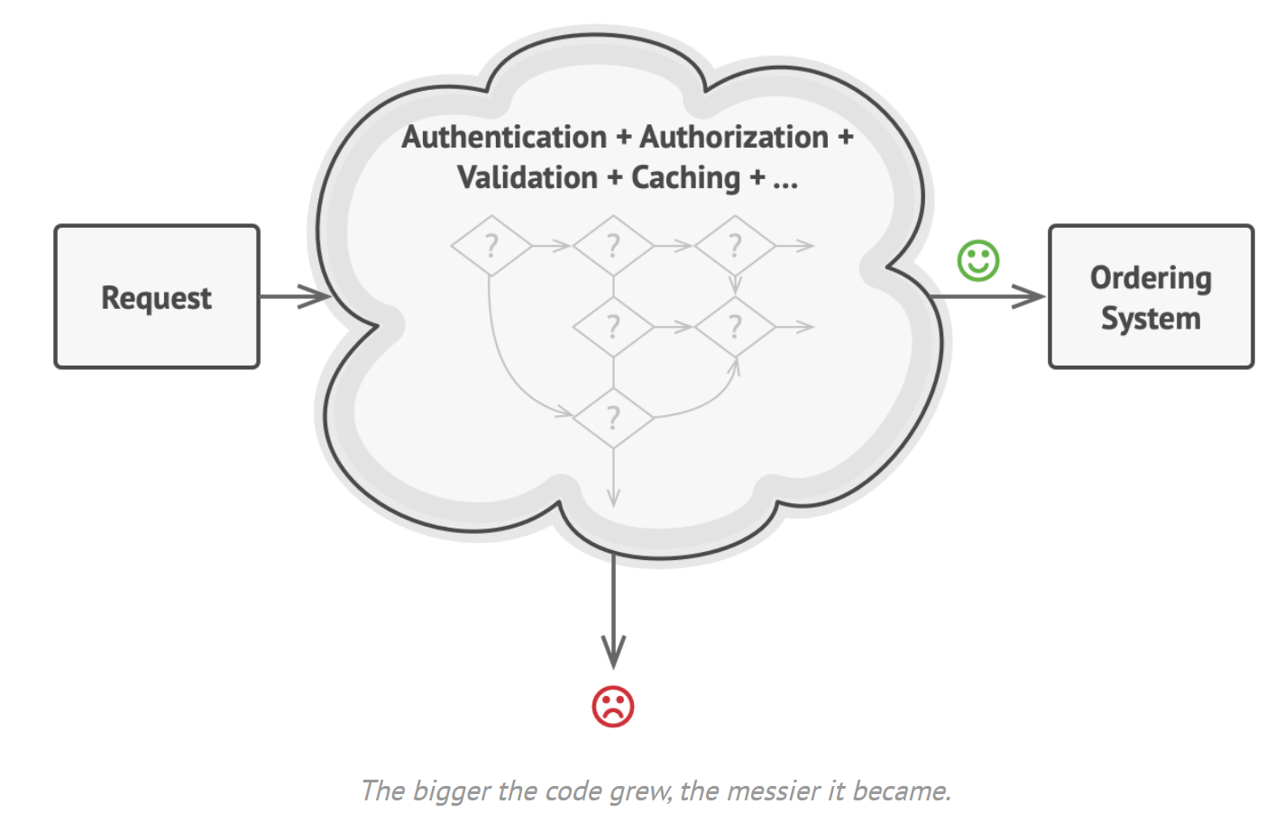
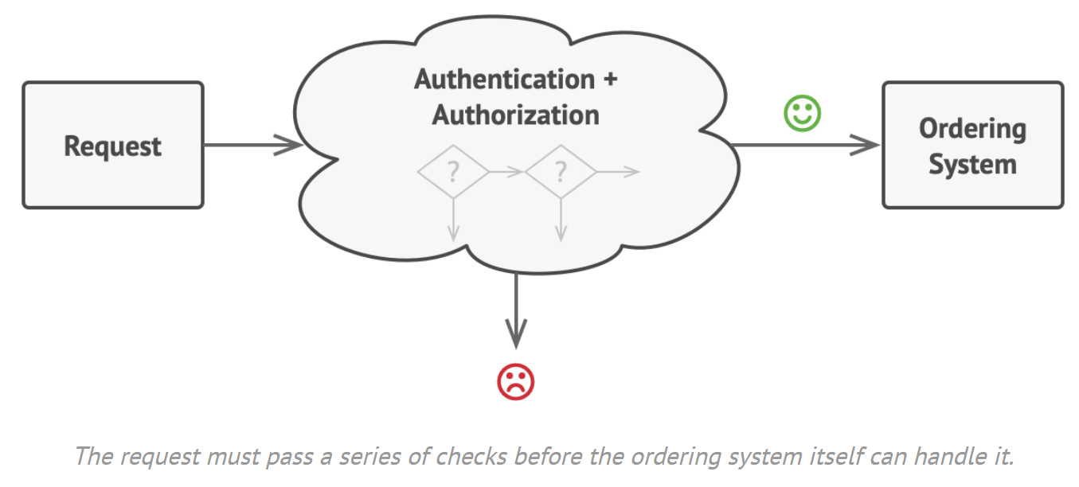
Problem
A complex order system
Multiple checks on a request
Need to adaptation
Reuse elements
Illustration source: https://refactoring.guru/design-patterns/chain-of-responsibility

Slide 4
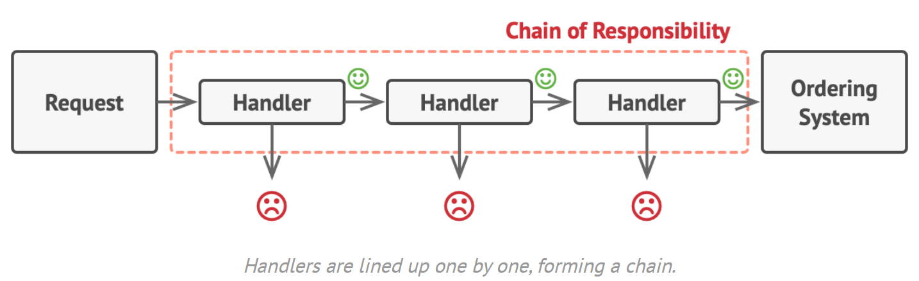
Solution - A bunch of individual handlers
Illustration source: https://refactoring.guru/design-patterns/chain-of-responsibility

Slide 5
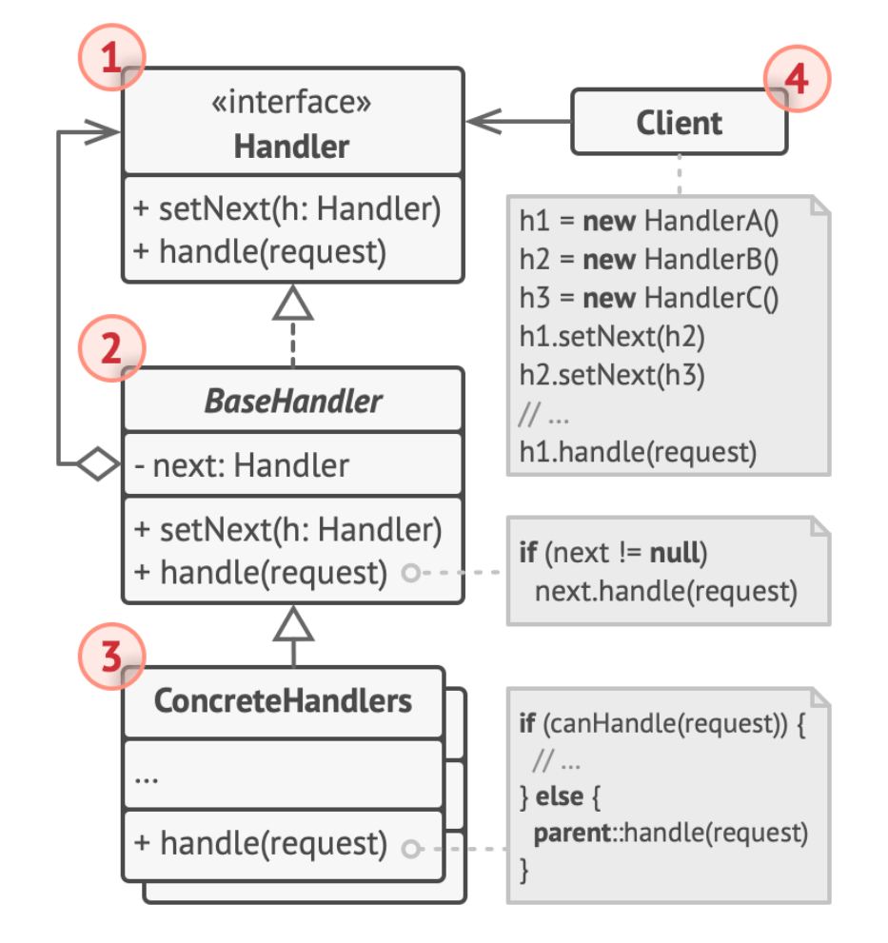
Structure
Handler: The interface to clients.
BaseHandler: Contains a reference to the next handler.
Concrete handler: Processing the request.
Client: May compose the chain.
Illustration source: https://refactoring.guru/design-patterns/chain-of-responsibility

Slide 6
Relationship with other patterns
Used in conjunction with:
Composite
Commands and Command object
Solves similar problems as:
Decorator
GoF Observer

Slide 7
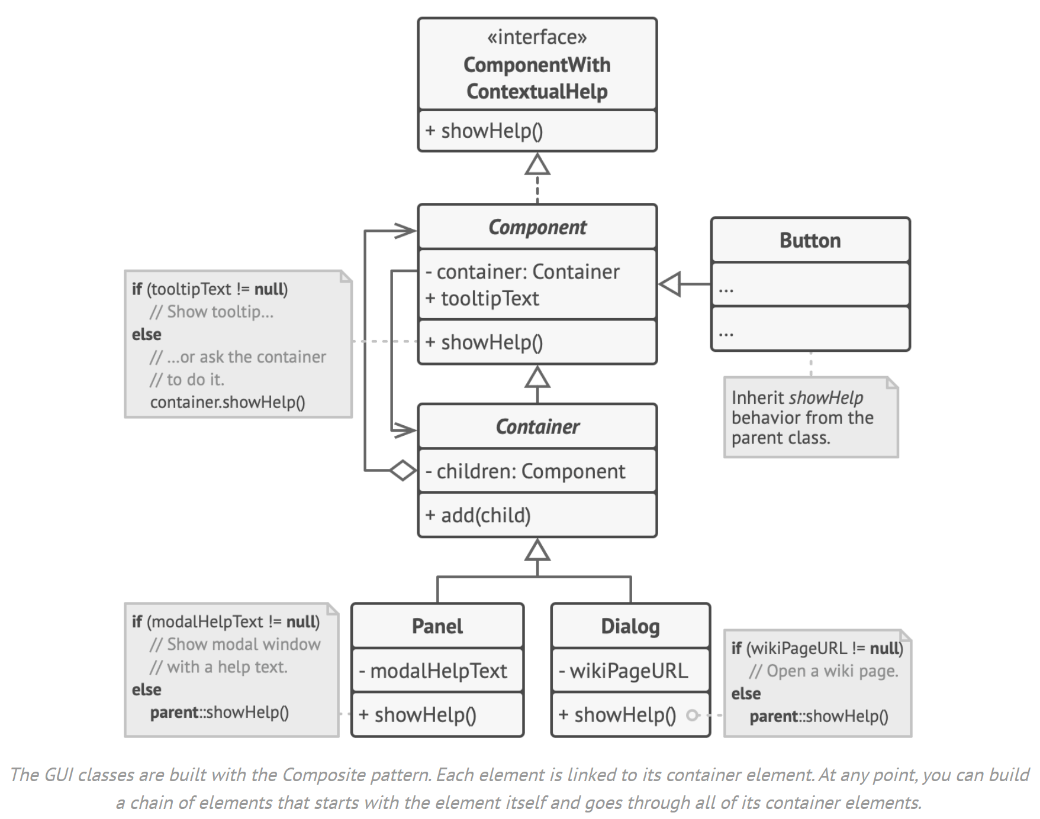
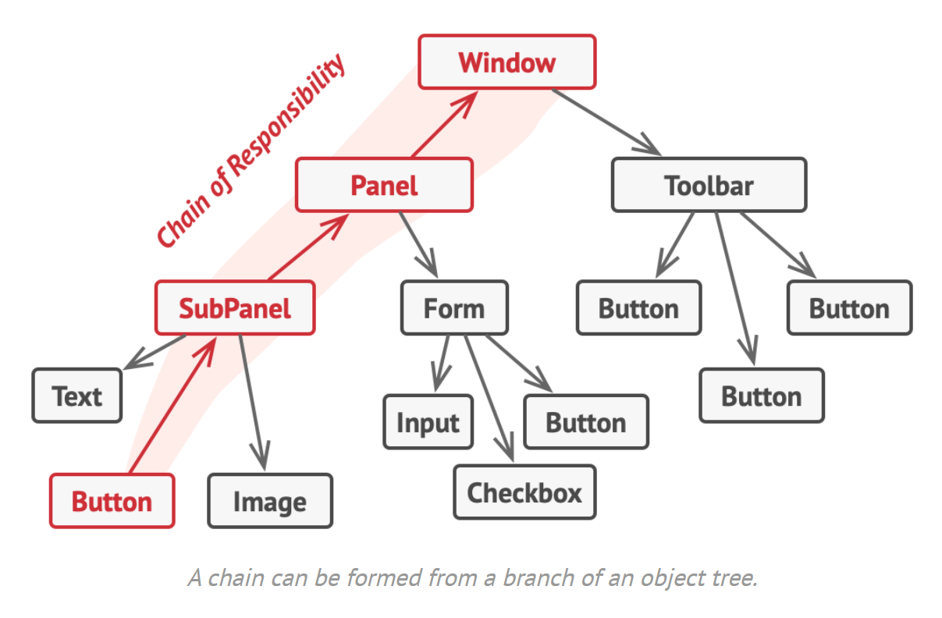
Example
Illustration source: https://refactoring.guru/design-patterns/chain-of-responsibility

Slide 8
Conclusion
Use when: Different kinds of requests in various ways. Exact type and sequence may be unknown.
Several handlers in a particular order.
A set of handlers and their order need to change during runtime
Benefits and challenges
Full control of the order
Single responsibility
Open closed principle
⚠ May not be handled

