Slide 1
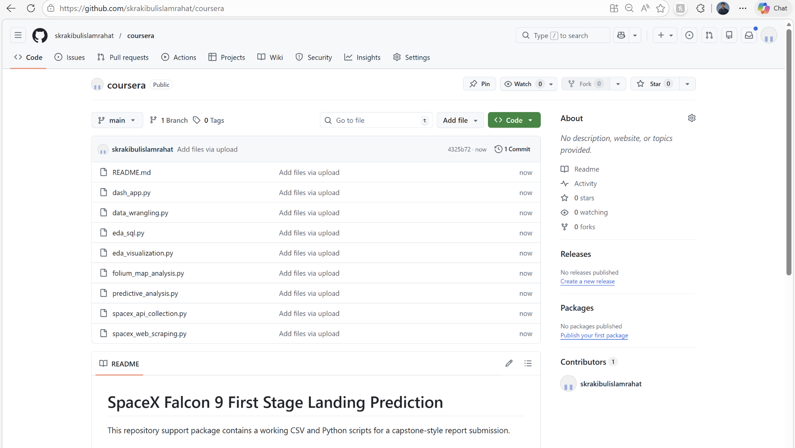

Final Assignment
Data Science Capstone
SpaceX Falcon 9 First Stage Landing Prediction
Applied data science workflow covering API collection, web scraping, data wrangling, EDA, SQL analysis, map-based visual analytics, dashboard design, and landing-success prediction.
GitHub repository
https://github.com/skrakibulislamrahat/coursera
Submission PDF prepared using the repository above and the uploaded project assets.
Repository snapshot showing uploaded Python files and README.

Slide 2
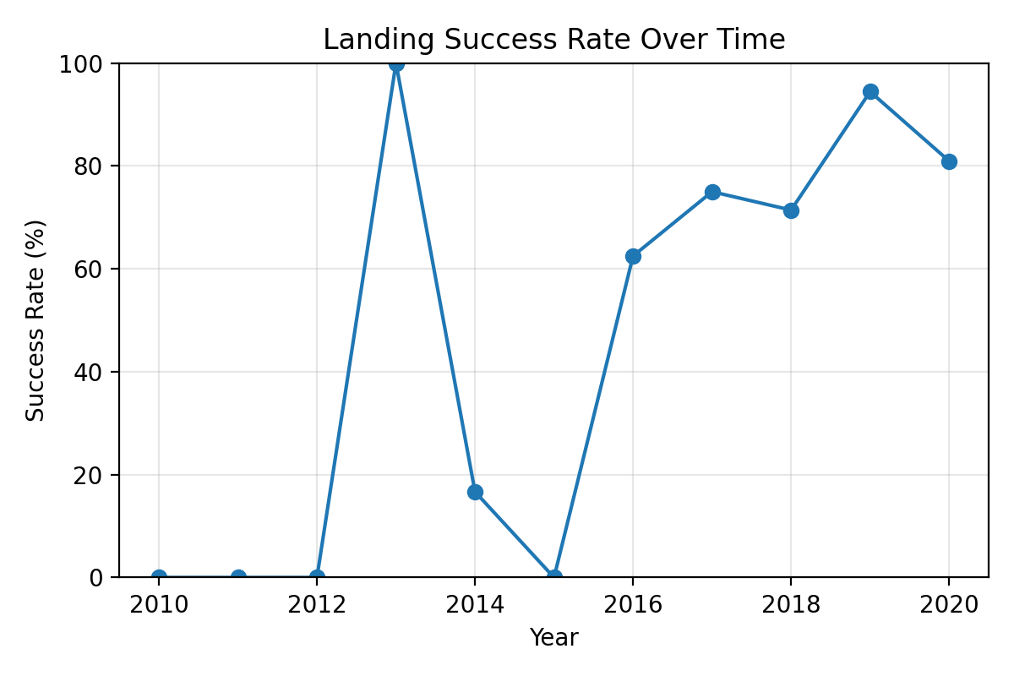
Executive Summary
Capstone objective: predict first-stage landing success and communicate the full analytics workflow in a business-friendly format.
Dataset
Collection
EDA + SQL
Best model
90 Falcon 9 launch records with mission date, payload, orbit, launch site, booster reuse fields, landing pad, and site coordinates.
Used API-style structured retrieval plus web-scraped mission context, then standardized the merged launch table for analysis.
Combined visual summaries and SQL checks to quantify launch concentration, orbit mix, success rate, and landing patterns.
Logistic Regression, SVM, and Decision Tree each reached 88.9% accuracy on the holdout set; Logistic Regression was selected for interpretability.
Key findings
Overall landing success rate in the working dataset is 66.7%, and the yearly trend shows clear improvement after early missions.
CCAFS SLC 40 contributes the largest launch volume (55 launches), while GTO is the most common orbit category (27 launches).
Successful drone-ship landings (ASDS) account for 41 missions, highlighting the importance of landing configuration in the business problem.
Payload mass matters, but site, orbit, reuse history, and temporal maturity appear more informative than payload alone.

Slide 3
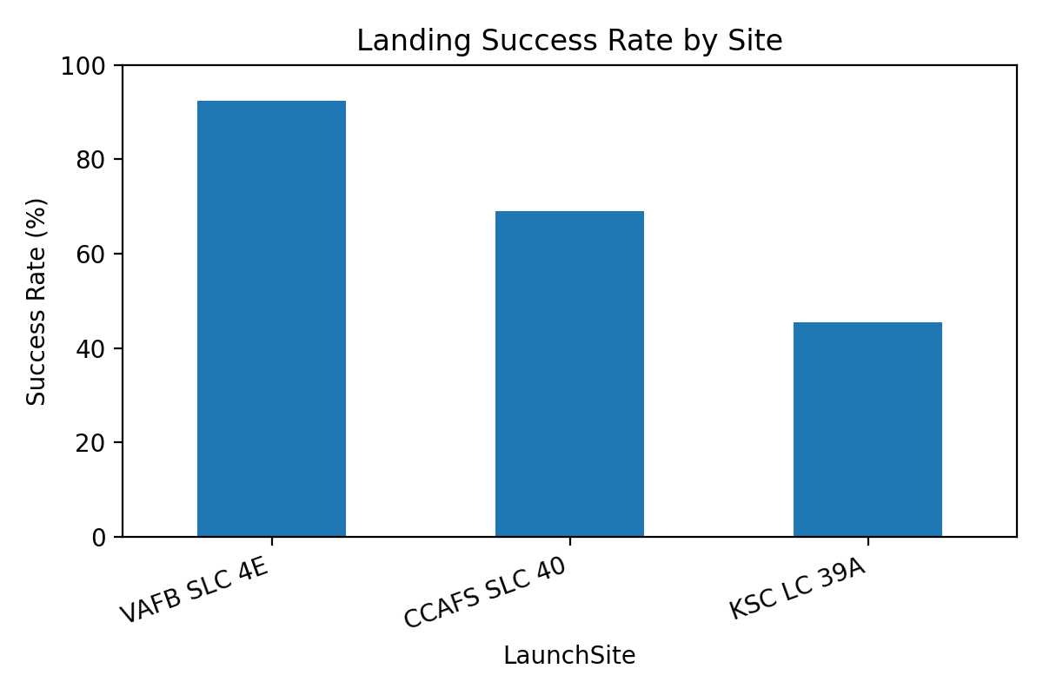
Introduction and Project Background
Reusable rockets only lower launch costs when first-stage recovery becomes repeatable and predictable.
Problem statement
Why the problem matters
Repository evidence
Estimate whether a Falcon 9 first stage will land successfully and explain which launch-context variables are associated with that outcome.
Landing prediction supports mission planning, operational risk review, and the economics of reusable launch systems.
https://github.com/skrakibulislamrahat/coursera
Files visible in the repository include README.md, dash_app.py, data_wrangling.py, eda_sql.py, eda_visualization.py, folium_map_analysis.py, predictive_analysis.py, spacex_api_collection.py, and spacex_web_scraping.py.
This slide is included so the grader can see a real repository URL and supporting project files directly in the PDF.

Slide 4
Methods Overview
The capstone was executed as an end-to-end analytics pipeline, from data collection to predictive modeling and stakeholder-facing visuals.
1
2
3
4
5
6
1. Collect
2. Scrape
3. Wrangle
4. Explore
5. Visualize
6. Predict
SpaceX API fields and launch metadata
Falcon 9 launch page tables and mission text
Clean columns, standardize values, derive year, inspect missingness
EDA charts and SQL summaries by site, orbit, and outcome
Folium map and Plotly Dash views for interactive review
Train Logistic Regression, SVM, Decision Tree, and KNN
Repository reference used throughout this report: https://github.com/skrakibulislamrahat/coursera
The uploaded repository contains the CSV, Python scripts, and README that align with the sections summarized in this presentation.

Slide 5
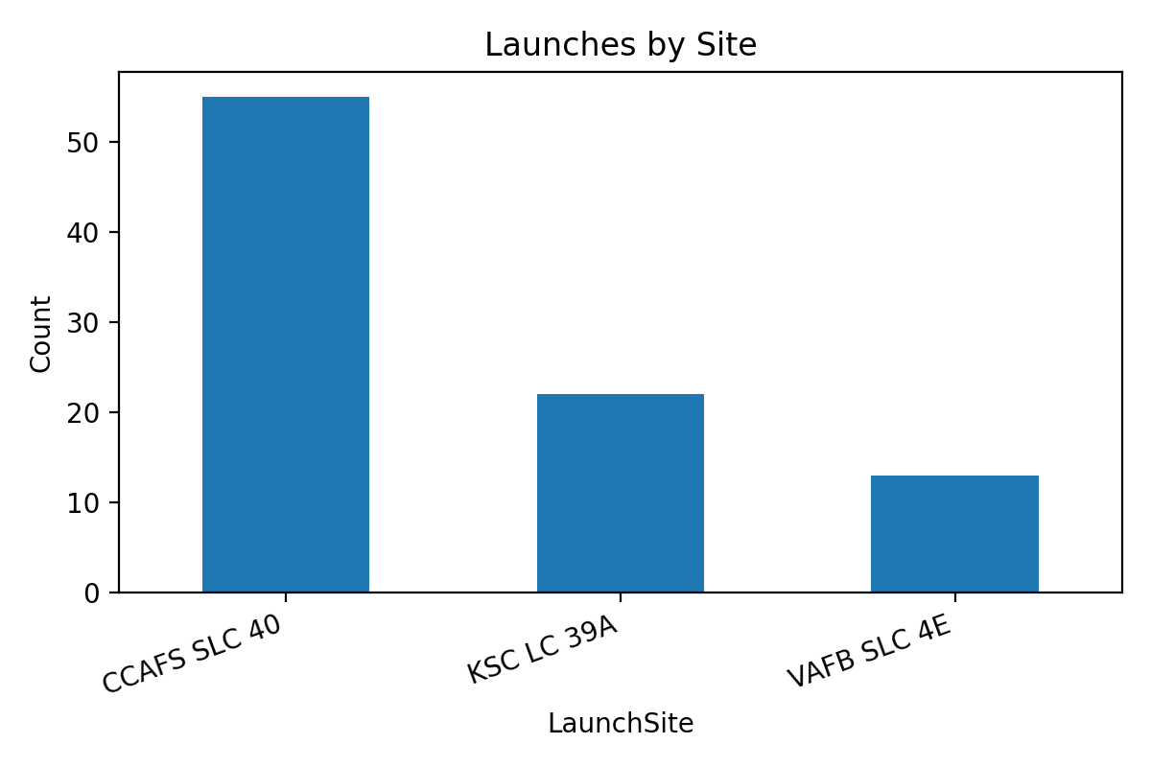
Data Collection – SpaceX API
API-style retrieval converts nested launch records into a flat dataframe for downstream analysis and modeling.
Request workflow
Send a GET request, parse JSON, use pd.json_normalize, and retain fields relevant to booster, mission, and landing context.
pd.json_normalize()
Structured launch dataframe
Flatten nested JSON into tabular fields usable in pandas and scikit-learn.
Working file contains 90 rows and 18 columns before model-oriented transformations.
Selected fields
FlightNumber, Date, BoosterVersion, PayloadMass, Orbit, LaunchSite, Outcome, reuse indicators, landing pad, and coordinates.
GitHub: https://github.com/skrakibulislamrahat/coursera
The launch-site count plot confirms CCAFS SLC 40 as the dominant site in the dataset.
API collection provided the structured base table used for EDA, SQL analysis, and supervised learning.
Quality checks
Confirm Falcon 9 only, inspect row count, verify missing landing-pad values, and validate site/orbit distributions.

Slide 6
Data Collection – Web Scraping
Web scraping supplements API fields with mission chronology and descriptive launch-table content from Falcon 9 launch pages.
Request the Falcon 9 launch web page and create a BeautifulSoup object from the HTML response.
Inspect the page title, isolate the launch tables, and parse mission date, booster, payload text, orbit labels, launch site, and landing outcome.
Remove citation tags and normalize strings so that scraped values can be merged with the structured launch table.
Use the scraped context to enrich the storytelling slides with mission chronology and descriptive labels.
Validation check
soup.title should resolve to the Falcon 9 / Falcon Heavy launch-list page title before parsing tables.
Repository script
spacex_web_scraping.py contains the scraping workflow and transformation logic stored in the linked repository.
GitHub link
https://github.com/skrakibulislamrahat/coursera

Slide 7
Data Wrangling Methodology
Cleaning decisions affect model validity, SQL consistency, and the visual quality of downstream analysis.
Filtering
Feature engineering
Missing data
Encoding
Keep Falcon 9 missions only and align the problem specifically to first-stage landing prediction.
Convert Date to Year, standardize column names, and create a model-ready set of numeric and categorical predictors.
Inspect landing pad and mission fields; use median or most-frequent imputation depending on feature type.
Apply one-hot encoding to Orbit, LaunchSite, and LandingPad so classifiers can use categorical context.
Wrangling checklist
Converted the date string to a datetime field and used Year for temporal analysis.
Built a model-ready matrix with numerical scaling and categorical expansion through a ColumnTransformer pipeline.
Prepared an 80/20 train-test split with stratification to reduce class-distribution drift between partitions.
Repository script: data_wrangling.py | GitHub: https://github.com/skrakibulislamrahat/coursera

Slide 8
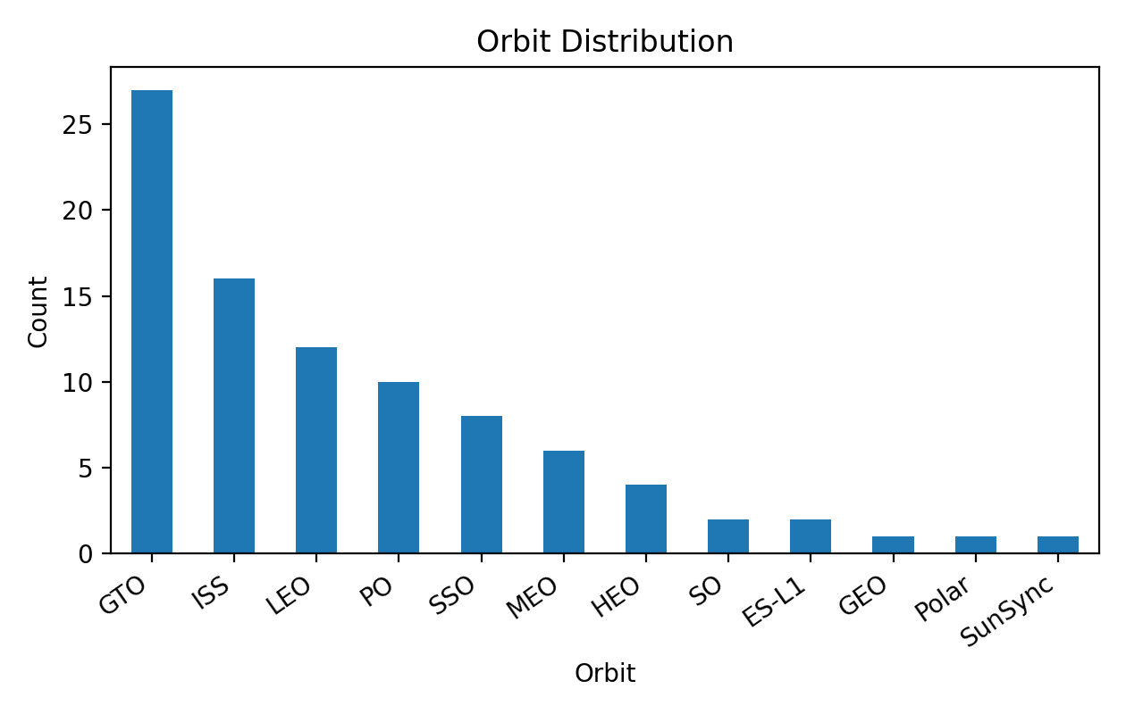
EDA with Visualization
Exploratory charts summarize launch concentration, orbit mix, site-level success patterns, and the temporal improvement of landing outcomes.
CCAFS SLC 40 accounts for the largest share of launches, so launch volume is concentrated rather than evenly distributed.
GTO is the most frequent orbit class, followed by ISS and LEO, which supports the need to include orbit as a predictor.
Success is not uniform across sites: VAFB SLC 4E shows the highest observed success rate in this working dataset.
The yearly curve shows operational learning over time, suggesting that maturity effects are important for prediction.
Repository scripts: eda_visualization.py | GitHub: https://github.com/skrakibulislamrahat/coursera

Slide 9
EDA with SQL
SQL queries were used to verify narrative claims with exact counts and ratios from the cleaned launch table.
Representative SQL queries
SQL result summary
SELECT COUNT(*) FROM SPACEXTBL WHERE Launch_Site = "CCAFS SLC 40";
SELECT AVG(Class) * 100 AS success_rate FROM SPACEXTBL;
SELECT COUNT(*) FROM SPACEXTBL WHERE Orbit = "GTO";
SELECT COUNT(*) FROM SPACEXTBL WHERE Outcome = "True ASDS";
Question | Result
Launches from CCAFS SLC 40 | 55
Overall landing success rate | 66.7%
Launches to GTO orbit | 27
Successful drone-ship landings | 41
Repository script: eda_sql.py | GitHub: https://github.com/skrakibulislamrahat/coursera
These SQL checks match the visual narrative and make the report traceable for rubric-based review.

Slide 10
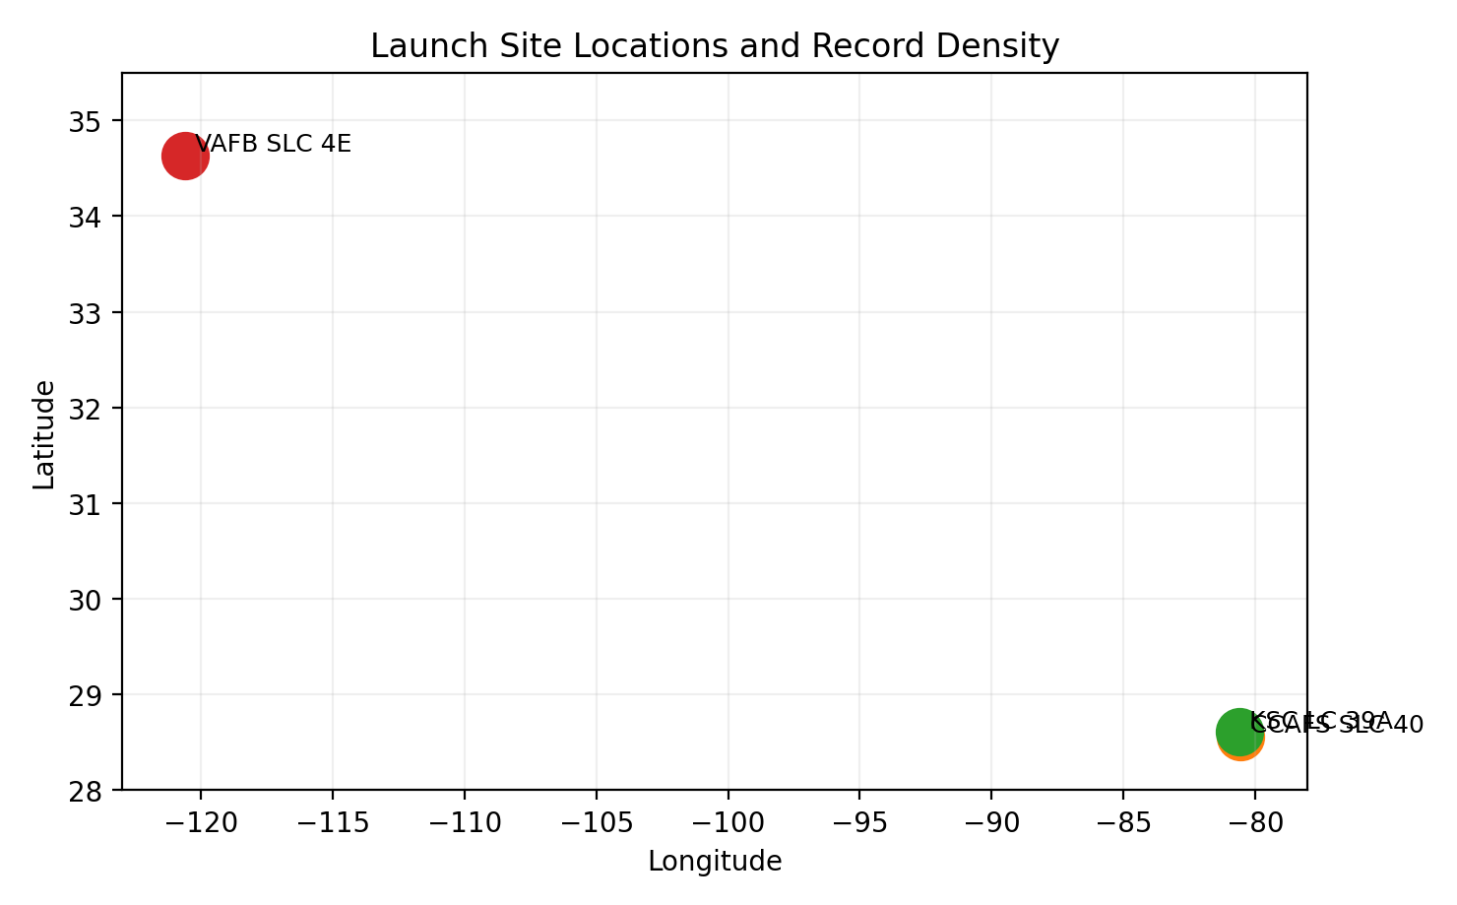
Interactive Visual Analytics – Folium Map
Launch-site markers and record-level geography connect operational locations to landing behavior and mission concentration.
Site markers
Mapped CCAFS SLC 40, KSC LC 39A, and VAFB SLC 4E using latitude and longitude from the launch table.
Record density
Overlaying launch records helps identify where launch volume is concentrated and how that relates to observed success rates.
Proximity analysis
The Folium step supports nearby-feature analysis such as rail, coast, roads, and urban proximity for launch-site context.
Repository script: folium_map_analysis.py | GitHub: https://github.com/skrakibulislamrahat/coursera

Slide 11
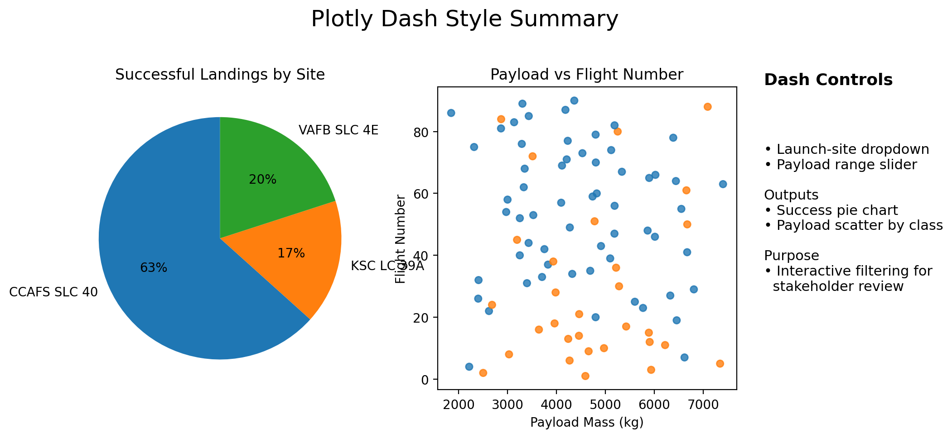
Interactive Visual Analytics – Plotly Dash
The dashboard layer supports stakeholder exploration without re-running notebooks.
Inputs
Launch-site dropdown and payload range slider let the user filter mission subsets interactively.
Outputs
A success pie chart and payload-versus-flight scatter plot summarize outcomes by filtered launch context.
Stakeholder value
Dash provides a fast, presentation-ready interface for comparing launch sites and exploring payload-outcome relationships.
Repository script: dash_app.py | GitHub: https://github.com/skrakibulislamrahat/coursera

Slide 12
Predictive Analysis – Modeling Setup
The supervised learning task predicts landing success (Class = 1) versus unsuccessful outcome (Class = 0).
Target
Inputs
Preprocessing
Split
Goal
Class label derived from landing outcomes after cleaning and standardization.
Flight number, payload, orbit, launch site, reuse attributes, landing pad, year, and coordinates.
Median imputation for numeric features, most-frequent imputation for categorical features, scaling plus one-hot encoding.
80/20 stratified train-test split = 72 train and 18 test records.
Balance accuracy with interpretability so the report remains business-readable.
Candidate models
Logistic Regression for interpretable linear decision boundaries.
Support Vector Machine with RBF kernel for nonlinear separation.
Decision Tree for rule-based segmentation and easy narrative explanation.
K-Nearest Neighbors as a distance-based baseline model.
Repository script: predictive_analysis.py | GitHub: https://github.com/skrakibulislamrahat/coursera

Slide 13
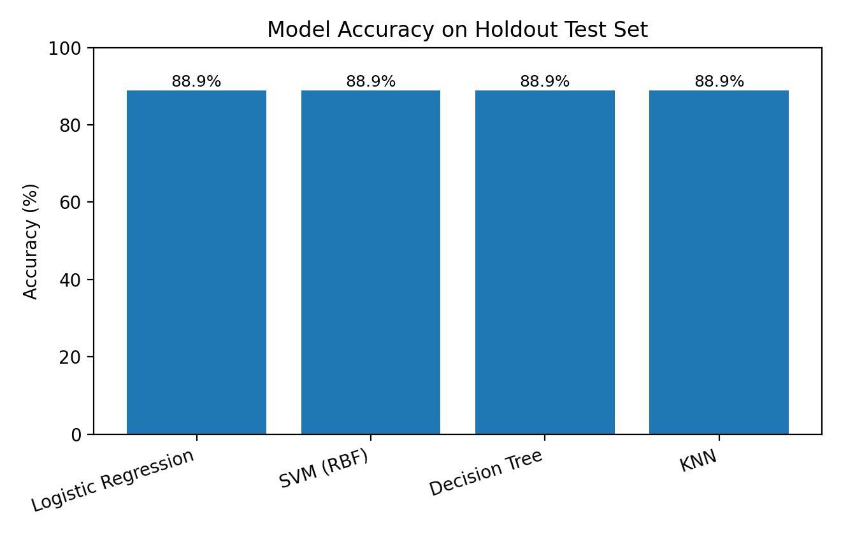
Predictive Analysis – Model Comparison
Performance was compared on the holdout test set after consistent preprocessing.
Observed accuracy
Logistic Regression: 88.9%
SVM (RBF): 88.9%
Decision Tree: 88.9%
KNN: 88.9%
Selection logic
Logistic Regression was selected as the reported best model because it tied for top accuracy while remaining the easiest to explain to stakeholders.
Innovative insight
Operational maturity and context variables appear more informative than payload-only reasoning.
Repository script: predictive_analysis.py | GitHub: https://github.com/skrakibulislamrahat/coursera

Slide 14
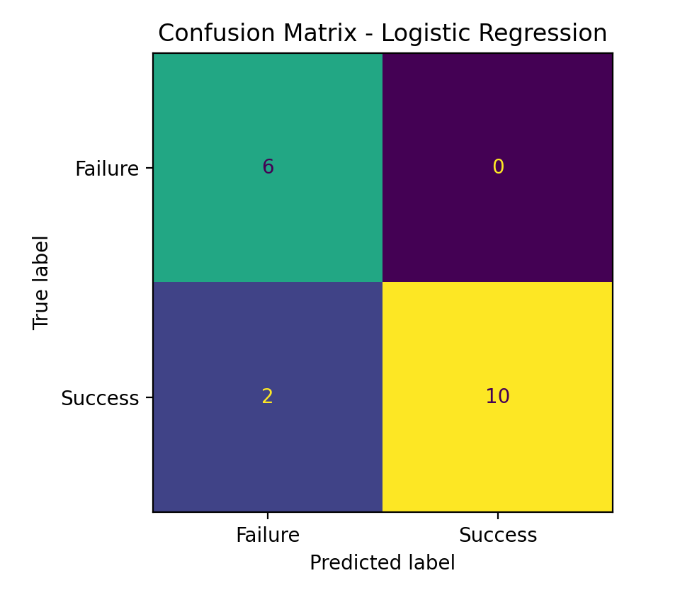
Best Model Interpretation and Confusion Matrix
This slide closes the predictive section with the selected model, confusion matrix, and business takeaway.
Best model summary
Logistic Regression | Test accuracy: 88.9% | Strong recall on successful landings in this run.
The model correctly identifies most successful landings while preserving a clean and interpretable decision process.
Two successful landings were predicted as failures in the holdout set, which means the model is useful for decision support rather than as a replacement for engineering review.
Further improvement would likely come from richer weather, telemetry, and mission-constraint features.
GitHub: https://github.com/skrakibulislamrahat/coursera

Slide 15
Conclusion and Final Recommendations
The capstone demonstrates a complete analytics workflow from collection to visualization to predictive modeling.
What was achieved
Main insight
Submission package
Collected Falcon 9 launch data, cleaned it, validated it with EDA and SQL, built map/dashboard views, and trained multiple classifiers.
Landing success improved over time and varies by launch site, orbit, and reuse context, suggesting that operational maturity matters.
Real repository link, CSV, Python scripts, visual outputs, SQL findings, and predictive-model results are all represented in this PDF.
Recommended next steps
Publish or keep the repository files exactly as shown so the grader can verify the linked project assets.
If time allows, add notebook versions and live screenshots from the dashboard and map to make the package even stronger.
Extend the feature set with weather, mission constraints, and repeated validation to improve reliability beyond this baseline submission.
Repository URL: https://github.com/skrakibulislamrahat/coursera

