Slide 1
Work with date. MomentJS.
By Nataliia Skrebets

Slide 2
Agenda
Constructor
Static methods
Instance methods
momentJS

Slide 3
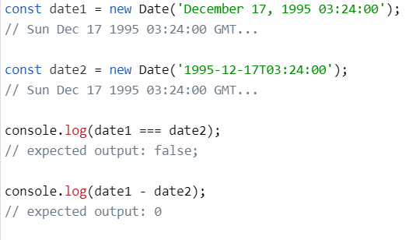
Constructor
Date() - Creates a new Date object.

Slide 4
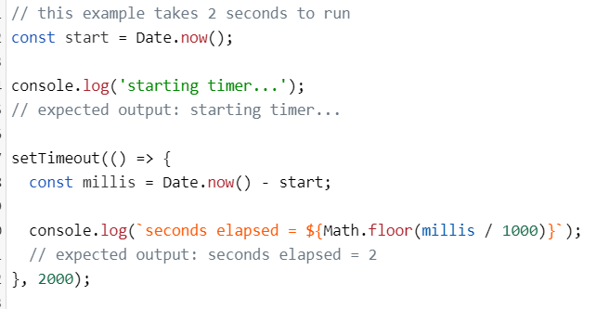
Static methods
Date.now() - Returns the numeric value corresponding to the current time—the number of milliseconds elapsed since January 1, 1970 00:00:00 UTC, with leap seconds ignored.

Slide 5
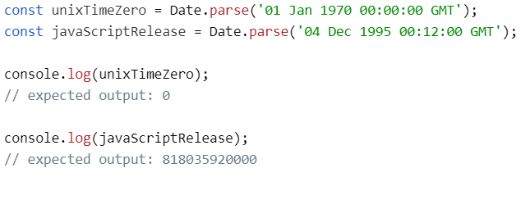
Date.parse() Parses a string representation of a date and returns the number of milliseconds since 1 January, 1970, 00:00:00 UTC, with leap seconds ignored.

Slide 6
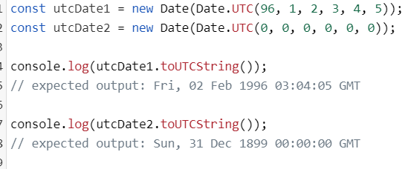
The Date.UTC() method accepts parameters similar to the Date constructor, but treats them as UTC. It returns the number of milliseconds since January 1, 1970, 00:00:00 UTC.

Slide 7
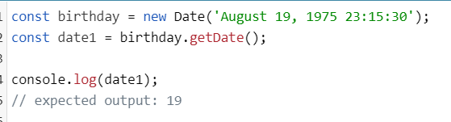
Instance methods
Date.prototype.getDate() - Returns the day of the month (1–31) for the specified date according to local time.

Slide 8
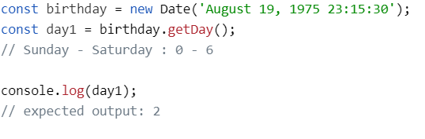
getDay() - method returns the day of the week for the specified date according to local time, where 0 represents Sunday.

Slide 9
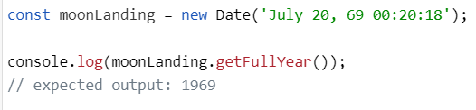
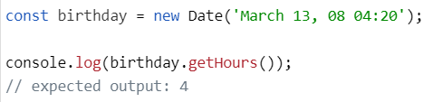
getFullYear() - method returns the year of the specified date according to local time.
getHours() - method returns the hour for the specified date, according to local time.

Slide 10
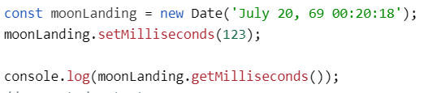
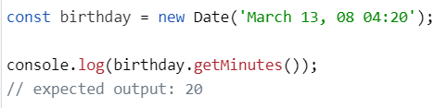
getMilliseconds() method returns the milliseconds in the specified date according to local time.
getMinutes() method returns the minutes in the specified date according to local time.

Slide 11
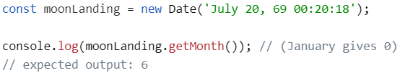

getMonth() method returns the month in the specified date according to local time, as a zero-based value (where zero indicates the first month of the year).
getSeconds() method returns the seconds in the specified date according to local time.

Slide 12
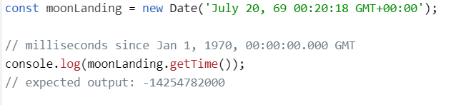
getTime() method returns the number of milliseconds* since the Unix Epoch.

Slide 13
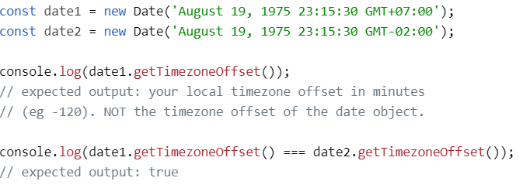
getTimezoneOffset() method returns the time zone difference, in minutes, from current locale (host system settings) to UTC.

Slide 14
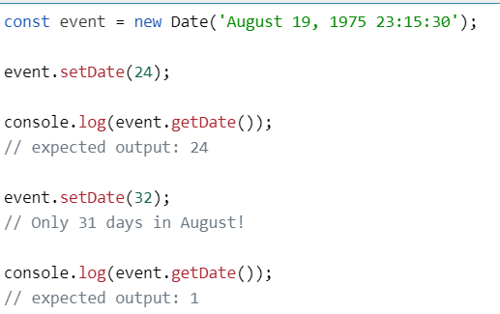
setDate() method sets the day of the Date object relative to the beginning of the currently set month.

Slide 15
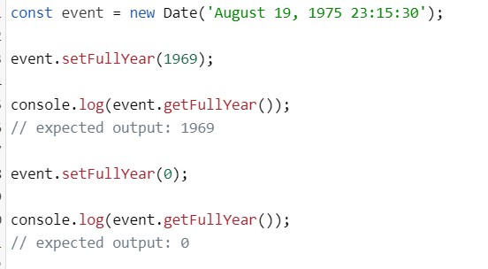
setFullYear() method sets the full year for a specified date according to local time. Returns new timestamp.

Slide 16
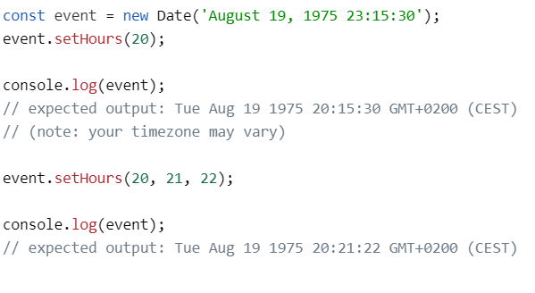
setHours() method sets the hours for a specified date according to local time, and returns the number of milliseconds since January 1, 1970 00:00:00 UTC until the time represented by the updated Date instance.

Slide 17
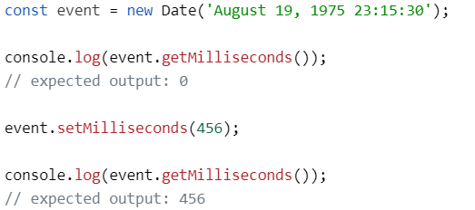
setMilliseconds() method sets the milliseconds for a specified date according to local time.

Slide 18
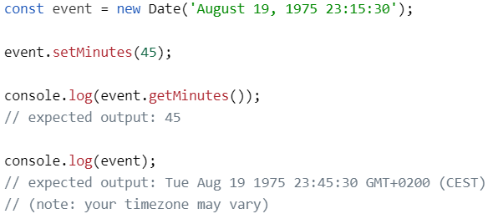
setMinutes() method sets the minutes for a specified date according to local time.

Slide 19
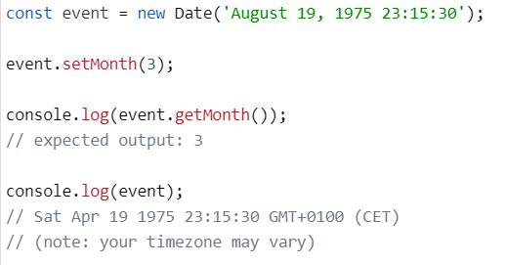
setMonth() method sets the month for a specified date according to the currently set year.

Slide 20
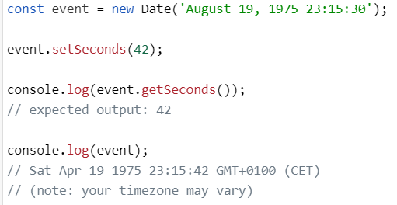
setSeconds() method sets the seconds for a specified date according to local time.

Slide 21
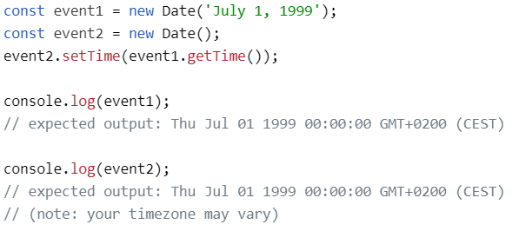
setTime() method sets the Date object to the time represented by a number of milliseconds since January 1, 1970, 00:00:00 UTC.

Slide 22
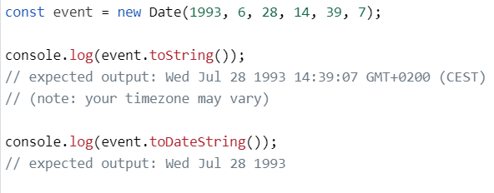
The toDateString() method returns the date portion of a Date object in English in the following format separated by spaces:
First three letters of the week day name
First three letters of the month name
Two digit day of the month, padded on the left a zero if necessary
Four digit year (at least), padded on the left with zeros if necessary

Slide 23
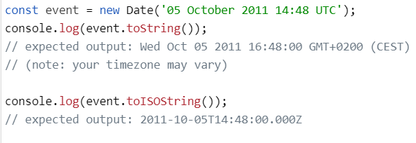
toISOString() method returns a string in simplified extended ISO format (ISO 8601), which is always 24 or 27 characters long (YYYY-MM-DDTHH:mm:ss.sssZ or ±YYYYYY-MM-DDTHH:mm:ss.sssZ, respectively). The timezone is always zero UTC offset, as denoted by the suffix "Z".

Slide 24
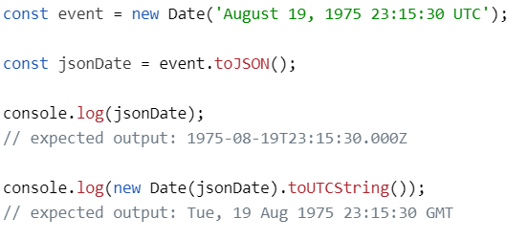
toJSON() method returns a string representation of the Date object.

Slide 25
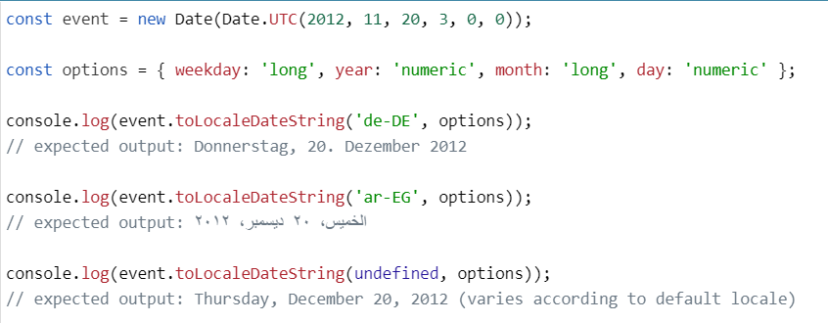
toLocaleDateString() method returns a string with a language sensitive representation of the date portion of this date.

Slide 26
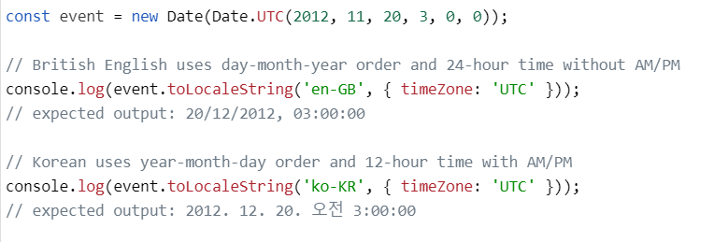
toLocaleString() method returns a string with a language sensitive representation of this date.

Slide 27
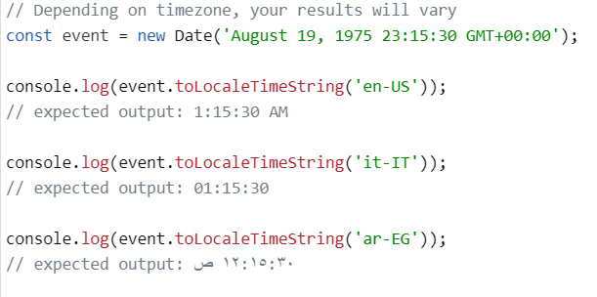
toLocaleTimeString() method returns a string with a language sensitive representation of the time portion of this date.

Slide 28
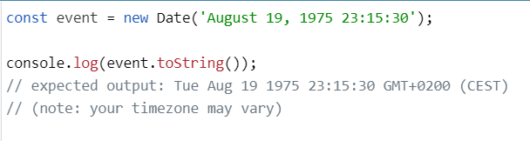
toString() method returns a string representing the specified Date object.

Slide 29
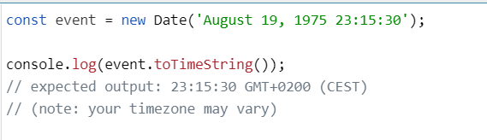
toTimeString() method returns the time portion of a Date object in human readable form in English.

Slide 30
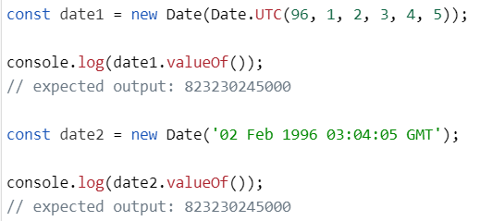
valueOf() method returns the primitive value of a Date object.

Slide 31
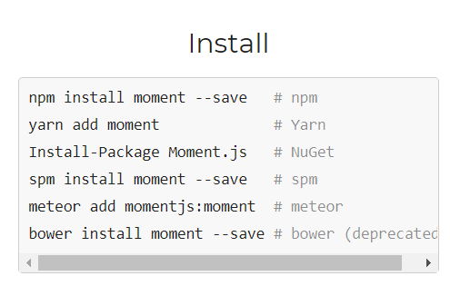
MomentJS - date library for parsing, validating, manipulating, and formatting dates.

Slide 32
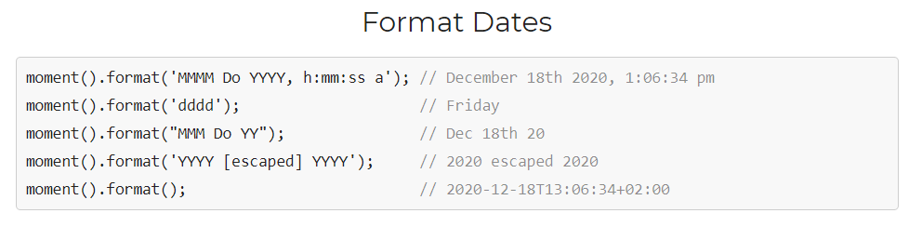

Slide 33
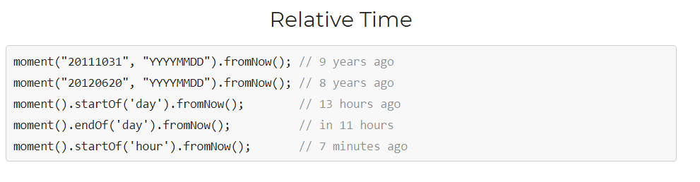

Slide 34
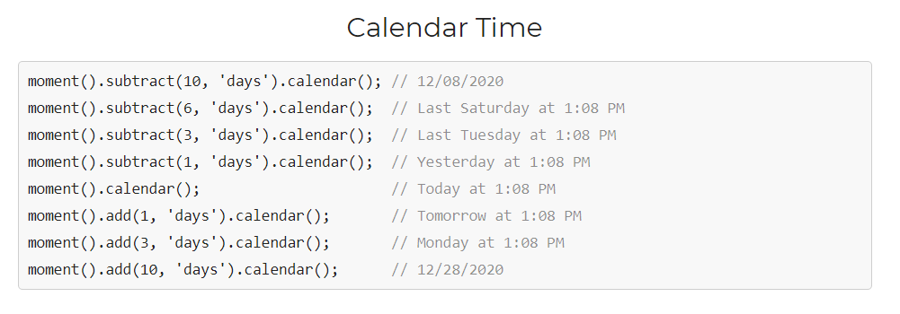

Slide 35
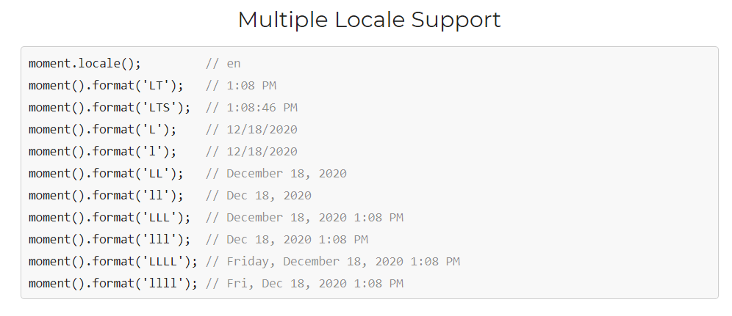

Slide 36
https://momentjs.com/
https://developer.mozilla.org/en-US/docs/Web/JavaScript/Reference/Global_Objects/Date

Slide 37


