Slide 1
Regular expressions
By Nataliia Skrebets

Slide 2
Regular expressions are patterns that provide a powerful way to search and replace in text.
In JavaScript, they are available via the RegExp object, as well as being integrated in methods of strings.

Slide 3

There are two syntaxes that can be used to create a regular expression object.
The “long” syntax:
And the “short” one, using slashes "/":
The main difference between these two syntaxes is that pattern using slashes /.../ does not allow for expressions to be inserted (like string template literals with ${...}). They are fully static.

Slide 4
Flags
Regular expressions may have flags that affect the search.
There are only 6 of them in JavaScript:
і -With this flag the search is case-insensitive: no difference between A and a
g - With this flag the search looks for all matches, without it – only the first match is returned.
m - Multiline mode (covered in the chapter Multiline mode of anchors ^ $, flag "m").
s - Enables “dotall” mode, that allows a dot . to match newline character \n (covered in the chapter Character classes).
u - Enables full unicode support. The flag enables correct processing of surrogate pairs. More about that in the chapter Unicode: flag "u" and class \p{...}.
y - “Sticky” mode: searching at the exact position in the text (covered in the chapter Sticky flag "y", searching at position)

Slide 5
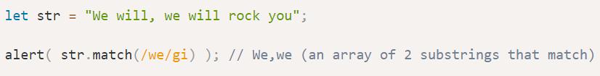
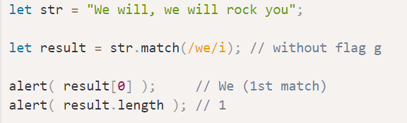
Searching: str.match
As mentioned previously, regular expressions are integrated with string methods.
The method str.match(regexp) finds all matches of regexp in the string str.
It has 3 working modes:
If the regular expression has flag g, it returns an array of all matches:
2) If there’s no such flag it returns only the first match in the form of an array, with the full match at index 0 and some additional details in properties:
3) if there are no matches, null is returned (doesn’t matter if there’s flag g or not).

Slide 6
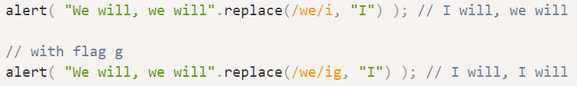
Replacing: str.replace
The method str.replace(regexp, replacement) replaces matches found using regexp in string str with replacement (all matches if there’s flag g, otherwise, only the first one).
The second argument is the replacement string. We can use special character combinations in it to insert fragments of the match:

Slide 7
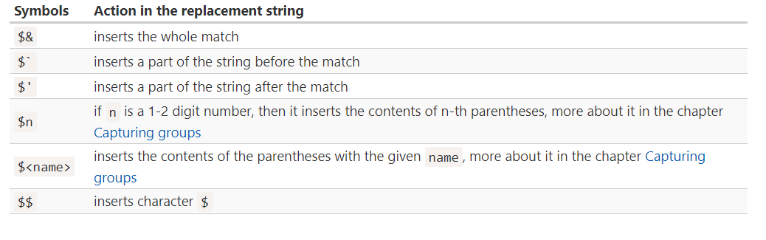

Slide 8
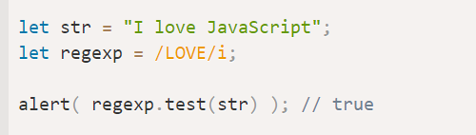
Testing: regexp.test
The method regexp.test(str) looks for at least one match, if found, returns true, otherwise false.

Slide 9
Character classes
A character class is a special notation that matches any symbol from a certain set.
There exist following character classes:
\d – digits.
\D – non-digits.
\s – space symbols, tabs, newlines.
\S – all but \s.
\w – Latin letters, digits, underscore '_'.
\W – all but \w.
. – any character if with the regexp 's' flag, otherwise any except a newline \n.

Slide 10
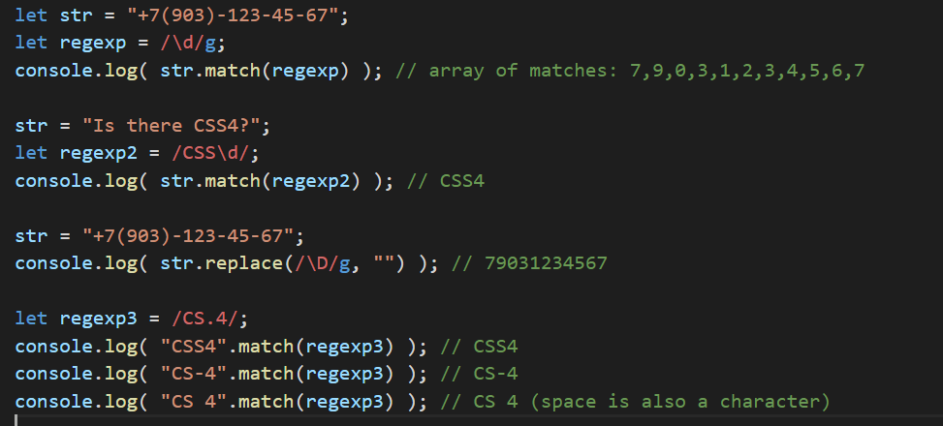

Slide 11
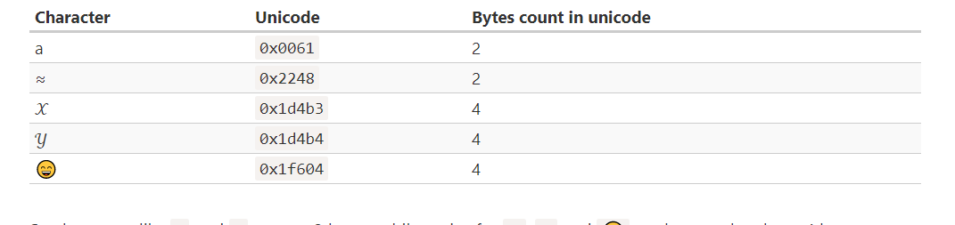
Unicode: flag "u" and class \p{...}
JavaScript uses Unicode encoding for strings. Most characters are encoded with 2 bytes, but that allows to represent at most 65536 characters.
That range is not big enough to encode all possible characters, that’s why some rare characters are encoded with 4 bytes, for instance like 𝒳 (mathematical X) or 😄 (a smile), some hieroglyphs and so on.
Here are the unicode values of some characters:

Slide 12
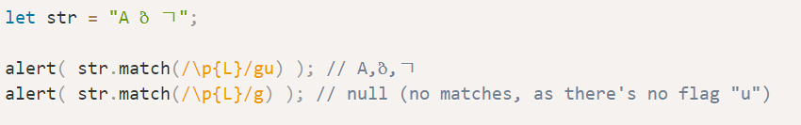
Unicode properties \p{…}
Every character in Unicode has a lot of properties. They describe what “category” the character belongs to, contain miscellaneous information about it.
For instance, if a character has Letter property, it means that the character belongs to an alphabet (of any language). And Number property means that it’s a digit: maybe Arabic or Chinese, and so on.
We can search for characters with a property, written as \p{…}. To use \p{…}, a regular expression must have flag u.
, \p{Letter} denotes a letter in any of language. We can also use \p{L}, as L is an alias of Letter.

Slide 13
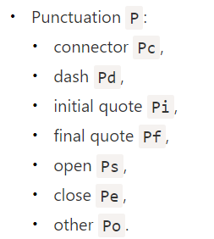
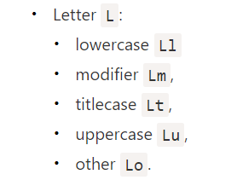
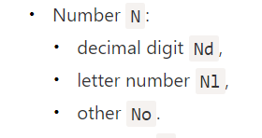
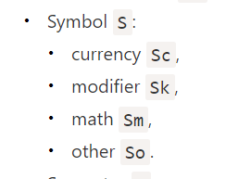
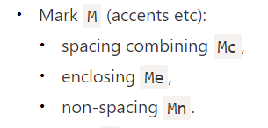
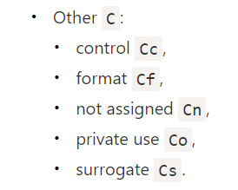
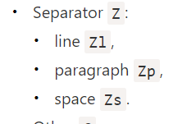

Slide 14
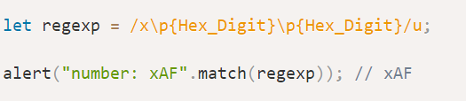
There are also other derived categories, like:
Alphabetic (Alpha), includes Letters L, plus letter numbers Nl (e.g. Ⅻ – a character for the roman number 12), plus some other symbols Other_Alphabetic (OAlpha).
Hex_Digit includes hexadecimal digits: 0-9, a-f.

Slide 15


Anchors: string start ^ and end $
The caret ^ and dollar $ characters have special meaning in a regexp. They are called “anchors”.
The caret ^ matches at the beginning of the text, and the dollar $ – at the end.
For instance, let’s test if the text starts with Mary:
Similar to this, we can test if the string ends with snow using snow$:

Slide 16
Word boundary: \b
A word boundary \b is a test, just like ^ and $.
When the regexp engine (program module that implements searching for regexps) comes across \b, it checks that the position in the string is a word boundary.
There are three different positions that qualify as word boundaries:
At string start, if the first string character is a word character \w.
Between two characters in the string, where one is a word character \w and the other is not.
At string end, if the last string character is a word character \w.

Slide 17

Escaping
Let’s say we want to find literally a dot. Not “any character”, but just a dot.
To use a special character as a regular one, prepend it with a backslash: \..
That’s also called “escaping a character”.
A slash
A slash symbol '/' is not a special character, but in JavaScript it is used to open and close the regexp: /...pattern.../, so we should escape it too.

Slide 18


Sets
For instance, [eao] means any of the 3 characters: 'a', 'e', or 'o'.
That’s called a set. Sets can be used in a regexp along with regular characters:

Slide 19
Ranges
Square brackets may also contain character ranges.
For instance, [a-z] is a character in range from a to z, and [0-5] is a digit from 0 to 5.
In the example below we’re searching for "x" followed by two digits or letters from A to F:

Slide 20

Besides normal ranges, there are “excluding” ranges that look like [^…].
They are denoted by a caret character ^ at the start and match any character except the given ones.
For instance:
[^aeyo] – any character except 'a', 'e', 'y' or 'o'.
[^0-9] – any character except a digit, the same as \D.
[^\s] – any non-space character, same as \S.

Slide 21
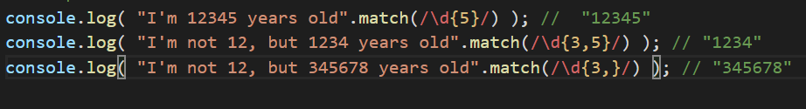
Quantity {n}
The simplest quantifier is a number in curly braces: {n}.
A quantifier is appended to a character (or a character class, or a [...] set etc) and specifies how many we need.
The exact count: {5}\d{5} denotes exactly 5 digits, the same as \d\d\d\d\d.
The range: {3,5}, match 3-5 times
Then a regexp \d{3,} looks for sequences of digits of length 3 or more

Slide 22
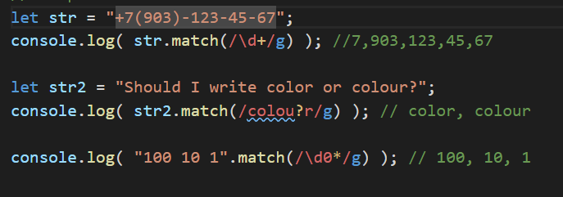
Shorthands
There are shorthands for most used quantifiers:
+ means “one or more”, the same as {1,}.
? means “zero or one”, the same as {0,1}. In other words, it makes the symbol optional.
* means “zero or more”, the same as {0,}. That is, the character may repeat any times or be absent.

Slide 23
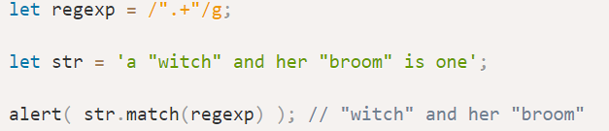
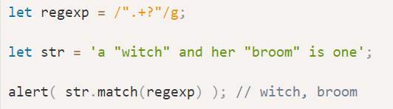
Greedy search
To find a match, the regular expression engine uses the following algorithm:
For every position in the string
Try to match the pattern at that position.
If there’s no match, go to the next position.
Lazy mode
The lazy mode of quantifiers is an opposite to the greedy mode. It means: “repeat minimal number of times”.
We can enable it by putting a question mark '?' after the quantifier, so that it becomes *? or +? or even ?? for '?'.

Slide 24
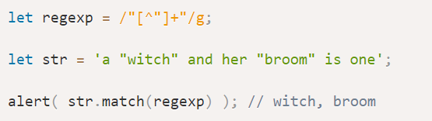
Alternative approach
With regexps, there’s often more than one way to do the same thing.
The regexp "[^"]+" gives correct results, because it looks for a quote '"' followed by one or more non-quotes [^"], and then the closing quote.
When the regexp engine looks for [^"]+ it stops the repetitions when it meets the closing quote, and we’re done.

Slide 25
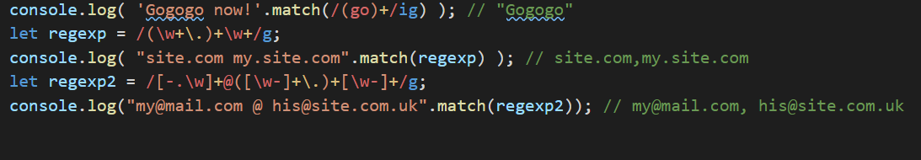
Capturing groups
A part of a pattern can be enclosed in parentheses (...). This is called a “capturing group”.
That has two effects:
It allows to get a part of the match as a separate item in the result array.
If we put a quantifier after the parentheses, it applies to the parentheses as a whole.

Slide 26
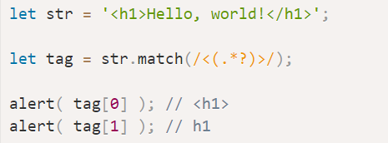
Parentheses contents in the match
Parentheses are numbered from left to right. The search engine memorizes the content matched by each of them and allows to get it in the result.
The method str.match(regexp), if regexp has no flag g, looks for the first match and returns it as an array:
At index 0: the full match.
At index 1: the contents of the first parentheses.
At index 2: the contents of the second parentheses.
…and so on…

Slide 27
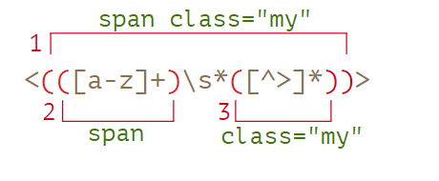
Nested groups
Parentheses can be nested. In this case the numbering also goes from left to right.
For instance, when searching a tag in <span class="my"> we may be interested in:
The tag content as a whole: span class="my".
The tag name: span.
The tag attributes: class="my".

Slide 28
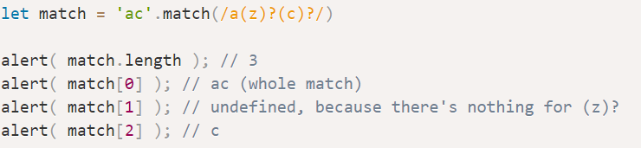
Optional groups
Even if a group is optional and doesn’t exist in the match (e.g. has the quantifier (...)?), the corresponding result array item is present and equals undefined.

Slide 29
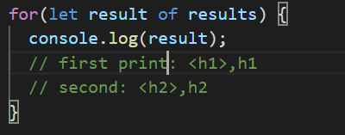
Searching for all matches with groups: matchAll
Just like match, it looks for matches, but there are 3 differences:
It returns not an array, but an iterable object.
When the flag g is present, it returns every match as an array with groups.
If there are no matches, it returns not null, but an empty iterable object.

Slide 30
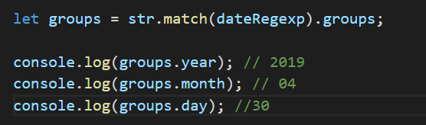
Named groups
Remembering groups by their numbers is hard. For simple patterns it’s doable, but for more complex ones counting parentheses is inconvenient. We have a much better option: give names to parentheses.
That’s done by putting ?<name> immediately after the opening paren.
For example, let’s look for a date in the format “year-month-day”:

Slide 31
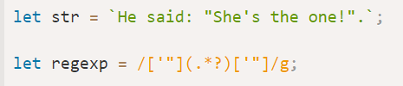
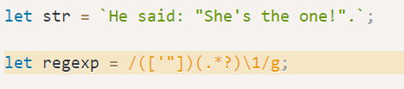
Backreference by number: \N
A group can be referenced in the pattern using \N, where N is the group number.
To make clear why that’s helpful, let’s consider a task.
We need to find quoted strings: either single-quoted '...' or a double-quoted "..." – both variants should match.
We can put both kinds of quotes in the square brackets: ['"](.*?)['"], but it would find strings with mixed quotes, like "...' and '...". That would lead to incorrect matches when one quote appears inside other ones, like in the string "She's the one!":

Slide 32
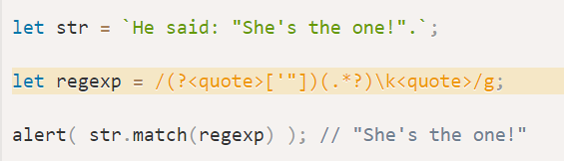
Backreference by name: \k<name>
If a regexp has many parentheses, it’s convenient to give them names.
To reference a named group we can use \k<name>.
In the example below the group with quotes is named ?<quote>, so the backreference is \k<quote>:

Slide 33
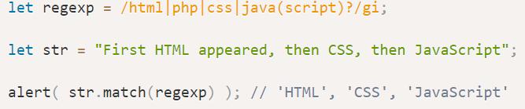
Alternation (OR) |
Alternation is the term in regular expression that is actually a simple “OR”.
In a regular expression it is denoted with a vertical line character |.
For instance, we need to find programming languages: HTML, PHP, Java or JavaScript.
The corresponding regexp: html|php|java(script)?.

Slide 34
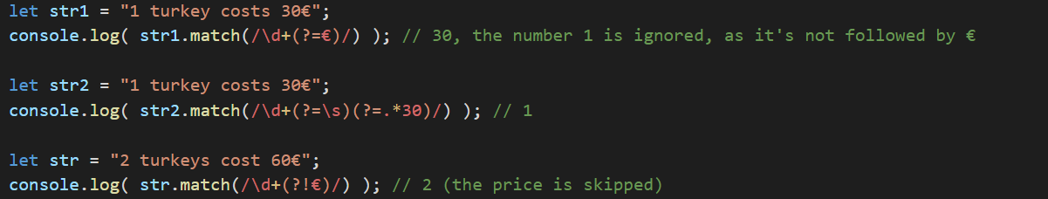
Lookahead
The syntax is: X(?=Y), it means "look for X, but match only if followed by Y". There may be any pattern instead of X and Y.
Negative lookahead
The syntax is: X(?!Y), it means "search X, but only if not followed by Y“

Slide 35
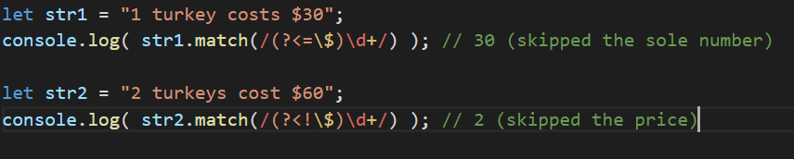
Lookbehind
Lookahead allows to add a condition for “what follows”.
Lookbehind is similar, but it looks behind. That is, it allows to match a pattern only if there’s something before it.
The syntax is:
Positive lookbehind: (?<=Y)X, matches X, but only if there’s Y before it.
Negative lookbehind: (?<!Y)X, matches X, but only if there’s no Y before it.

Slide 36
Methods of RegExp and String
str.match(regexp)
str.matchAll(regexp)
str.split(regexp|substr, limit)
str.search(regexp)
str.replace(str|regexp, str|func)
regexp.exec(str)
regexp.test(str)

Slide 37
str.match(regexp)
The method str.match(regexp) finds matches for regexp in the string str.
It has 3 modes:
If the regexp doesn’t have flag g, then it returns the first match as an array with capturing groups and properties index (position of the match), input (input string, equals str);
If the regexp has flag g, then it returns an array of all matches as strings, without capturing groups and other details;
If there are no matches, no matter if there’s flag g or not, null is returned.

Slide 38
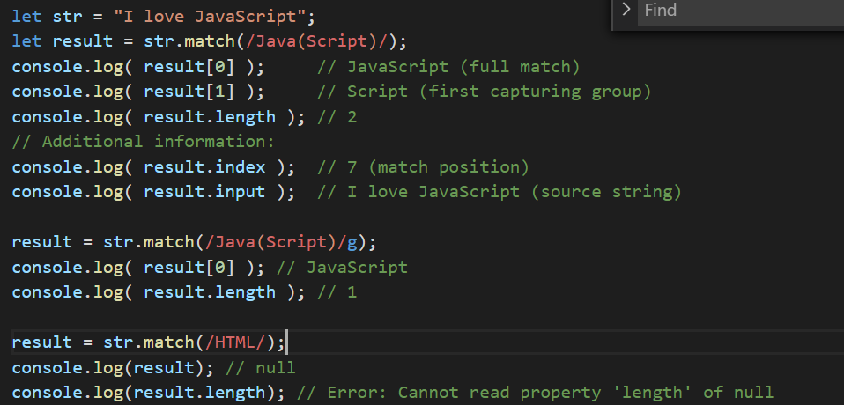

Slide 39
str.matchAll(regexp)
The method str.matchAll(regexp) is a “newer, improved” variant of str.match.
It’s used mainly to search for all matches with all groups.
There are 3 differences from match:
It returns an iterable object with matches instead of an array. We can make a regular array from it using Array.from.
Every match is returned as an array with capturing groups (the same format as str.match without flag g).
If there are no results, it returns not null, but an empty iterable object.

Slide 40
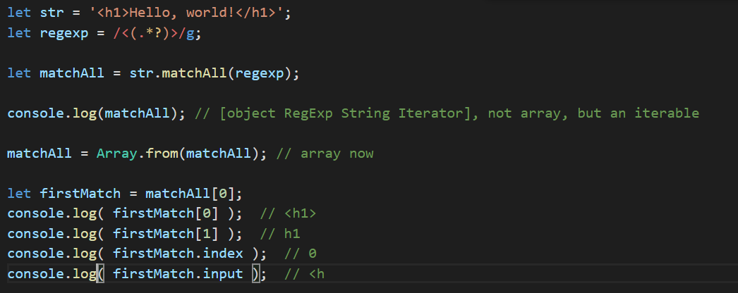

Slide 41

str.split(regexp|substr, limit)
Splits the string using the regexp (or a substring) as a delimiter.

Slide 42

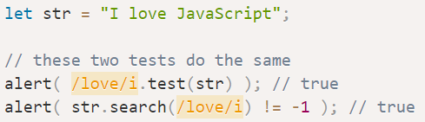
str.search(regexp)
The method str.search(regexp) returns the position of the first match or -1 if none found:
regexp.test(str)
The method regexp.test(str) looks for a match and returns true/false whether it exists.

Slide 43


str.replace(str|regexp, str|func)
This is a generic method for searching and replacing, one of most useful ones. The swiss army knife for searching and replacing.

Slide 44
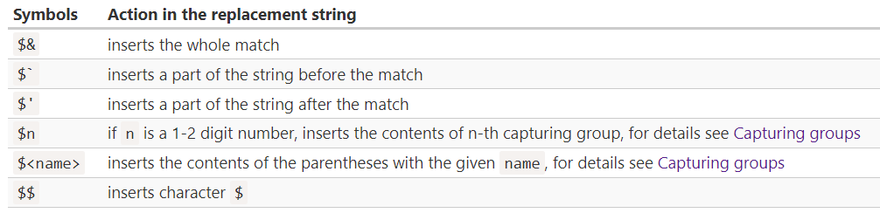
The second argument is a replacement string.
We can use special character in it:

Slide 45
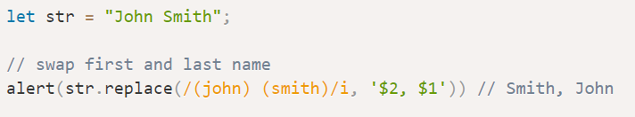

Slide 46
For situations that require “smart” replacements, the second argument can be a function.
It will be called for each match, and the returned value will be inserted as a replacement.
The function is called with arguments func(match, p1, p2, ..., pn, offset, input, groups):
match – the match,
p1, p2, ..., pn – contents of capturing groups (if there are any),
offset – position of the match,
input – the source string,
groups – an object with named groups.

Slide 47
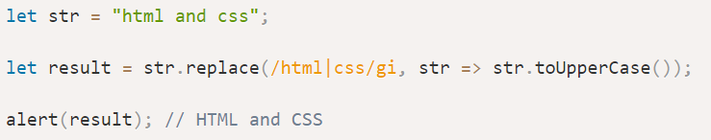
For example, let’s uppercase all matches:
Replace each match by its position in the string:

Slide 48
regexp.exec(str)
The method regexp.exec(str) method returns a match for regexp in the string str. Unlike previous methods, it’s called on a regexp, not on a string.
It behaves differently depending on whether the regexp has flag g.
If there’s no g, then regexp.exec(str) returns the first match exactly as str.match(regexp). This behavior doesn’t bring anything new.
But if there’s flag g, then:
A call to regexp.exec(str) returns the first match and saves the position immediately after it in the property regexp.lastIndex.
The next such call starts the search from position regexp.lastIndex, returns the next match and saves the position after it in regexp.lastIndex.
…And so on.
If there are no matches, regexp.exec returns null and resets regexp.lastIndex to 0.

Slide 49
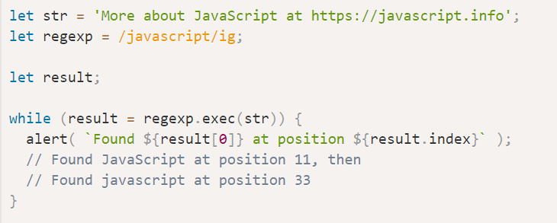
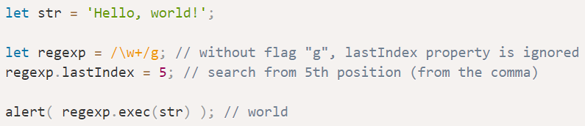

Slide 50


