Slide 1
jQuery
By Nataliia Skrebets

Slide 2
Agenda
JQUERY BASIC
JQUERY EFFECTS
JQUERY MANIPULATION
JQUERY TRAVERSING
JQUERY AJAX

Slide 3
jQuery is a fast, lightweight, and feature-rich JavaScript library that is based on the principle "write less, do more". It's easy-to-use APIs makes the things like HTML document traversal and manipulation, event handling, adding animation effects to a web page much simpler that works seamlessly across all the major browsers like Chrome, Firefox, Safari, Internet Explorer, etc.

Slide 4
To get started, first download a copy of jQuery and include it in your document. There are two versions of jQuery available for downloading — compressed and uncompressed.
You can download jQuery from here: https://jquery.com/download/
Once you've downloaded the jQuery file you can see it has .js extension, because the jQuery is just a JavaScript library, therefore you can include the jQuery file in your HTML document with the <script> element just like you include normal JavaScript files.
Always include the jQuery file before your custom scripts; otherwise, the jQuery APIs will not be available when your jQuery code attempts to access it.
Alternatively, you can include jQuery in your document through freely available CDN (Content Delivery Network) links, if you don't want to download and host jQuery yourself.

Slide 5
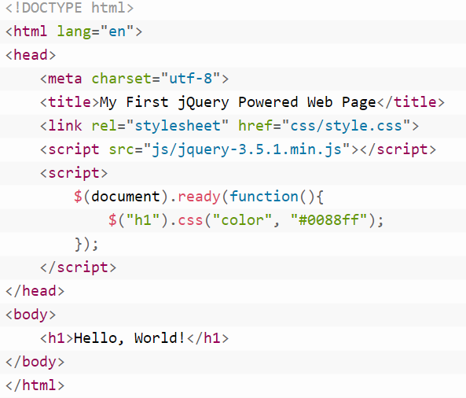

Slide 6
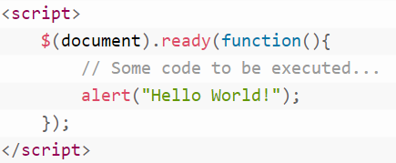
jQuery Syntax
A jQuery statement typically starts with the dollar sign ($) and ends with a semicolon (;).
In jQuery, the dollar sign ($) is just an alias for jQuery. Let's consider the following example code which demonstrates the most basic statement of the jQuery.

Slide 7
The .ready() method offers a way to run JavaScript code as soon as the page's Document Object Model (DOM) becomes safe to manipulate.
The $(document).ready(handler); — This statement is typically known as ready event. Where the handler is basically a function that is passed to the ready() method to be executed safely as soon as the document is ready to be manipulated i.e. when the DOM hierarchy has been fully constructed.
The jQuery ready() method is typically used with an anonymous function.

Slide 8


jQuery Selectors
Selecting Elements by ID select a single element with the unique ID on the page.
Selecting Elements by Class Name The class selector can be used to select the elements with a specific class.
Selecting Elements by Name - select elements based on the element name.
Selecting Elements by Attribute - selector to select an element by one of its HTML attributes, such as a link's target attribute or an input's type attribute, etc.

Slide 9
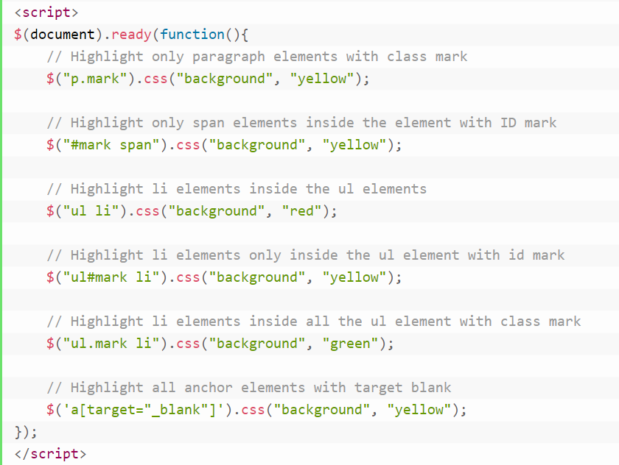
Selecting Elements by Compound CSS Selector

Slide 10
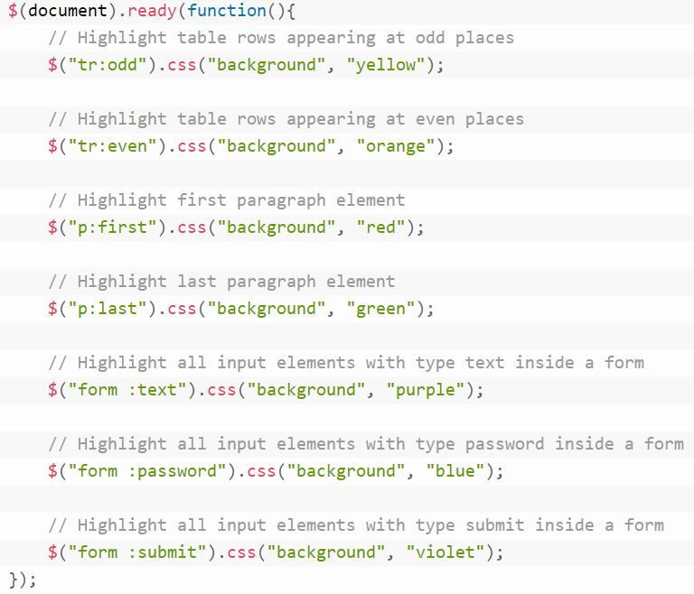
jQuery Custom Selector
In addition to the CSS defined selectors, jQuery provides its own custom selector to further enhancing the capabilities of selecting elements on a page.

Slide 11
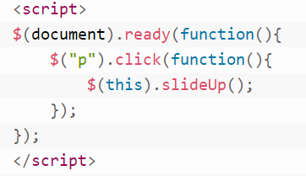
jQuery Events
Mouse Events
click() - is executed when the user clicks on that element.
dblclick() - user double-clicks on that element
hover() - mouse pointer enters and leaves the elements.
mouseenter() - when you place the cursor on it.
mouseleave() - when the mouse leaves an element.

Slide 12
Keyboard Events
keypress() - that is executed when the browser receives keyboard input from the user.
keydown() - that is executed when the user first presses a key on the keyboard.
keyup() - is executed when the user releases a key on the keyboard.
Form Events
change() - method attach an event handler function to the <input>, <textarea> and <select> elements that is executed when its value changes.
focus() - method attach an event handler function to the selected elements (typically form controls and links) that is executed when it gains focus.
blur() - method attach an event handler function to the form elements such as <input>, <textarea>, <select> that is executed when it loses focus.
submit() - method attach an event handler function to the <form> elements that is executed when the user is attempting to submit a form.

Slide 13
Document/Window Events
ready() method specify a function to execute when the DOM is fully loaded.
resize() method attach an event handler function to the window element that is executed when the size of the browser window changes.
scroll() method attach an event handler function to the window or scrollable iframes and elements that is executed whenever the element's scroll position changes.

Slide 14
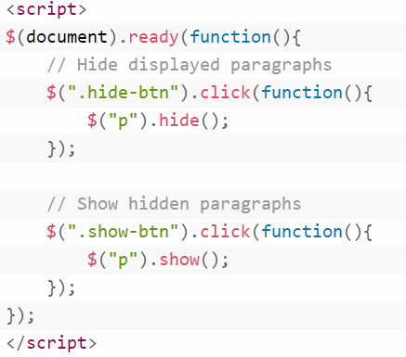
JQUERY EFFECTS
show() - method simply sets the inline style display: none for the selected elements.
hide() - method restores the display properties of the matched set of elements to whatever they initially were—typically block, inline, or inline-block—before the inline style display: none
toggle() - method to make it animated like the show() and hide() methods.

Slide 15
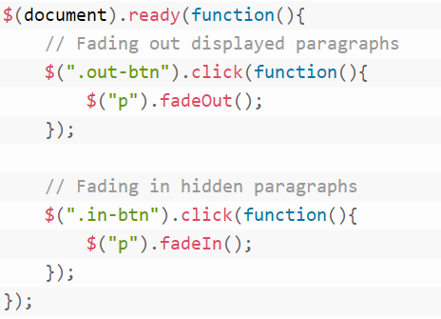
fadeIn() - methods to display the HTML elements by gradually increasing or decreasing their opacity.
fadeOut() - hide the HTML elements by gradually increasing or decreasing their opacity.
fadeToggle() method display or hide the selected elements by animating their opacity in such a way that if the element is initially displayed, it will be fade out; if hidden, it will be fade in

Slide 16
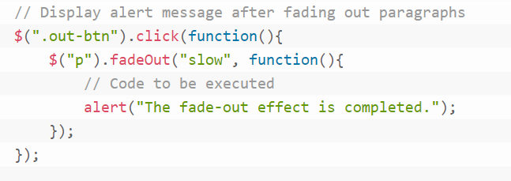
Durations can be specified either using one of the predefined string 'slow' or 'fast', or in a number of milliseconds; higher values indicate slower animations.
Callback function to be executed after the fadeIn() or fadeOut() method completes

Slide 17
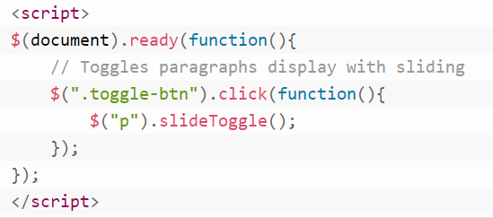
slideUp() methods is used to hide HTML elements by gradually increasing their height
slideDown() - methods is used to show the HTML elements by gradually increasing their height
slideToggle() - method show or hide the selected elements by animating their height in such a way that if the element is initially displayed, it will be slide up; if hidden, it will be slide down i.e. toggles between the slideUp() and slideDown() methods.

Slide 18
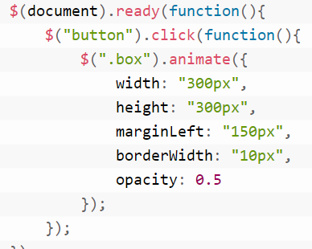
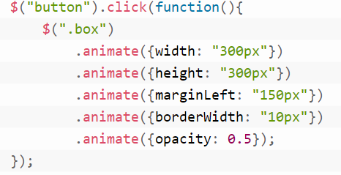
animate() - method is used to create custom animations.
The animate() method is typically used to animate numeric CSS properties, for example, width, height, margin, padding, opacity, top, left, etc. but the non-numeric properties such as color or background-color cannot be animated using the basic jQuery functionality.

Slide 19
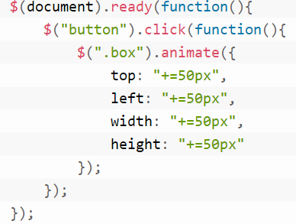
Animate Properties with Relative Values
If a value is specified with a leading += or -= prefix, then the target value is calculated by adding or subtracting the given number from the current value of the property.

Slide 20

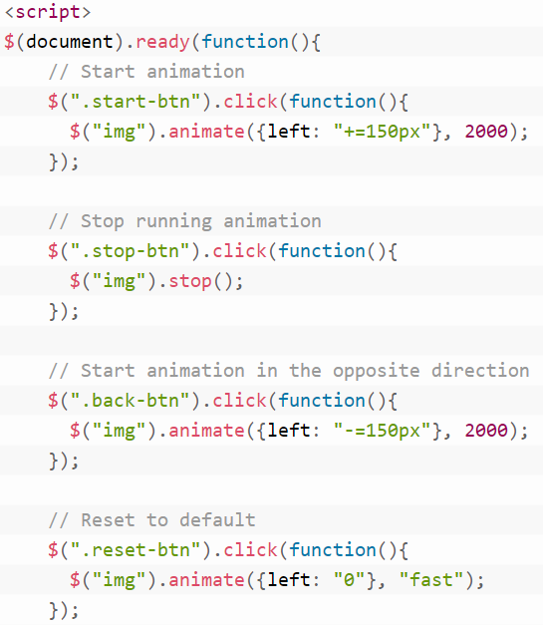
stop() - method is used to stop the jQuery animations or effects currently running on the selected elements before it completes.
The parameters in the above syntax have the following meanings:
The optional stopAll Boolean parameter specifies whether to remove queued animation or not. Default value is false, that means only the current animation will be stopped, rest of the animations in the queue will run afterwards.
The optional goToEnd Boolean parameter specifies whether to complete the current animation immediately. Default value is false.

Slide 21
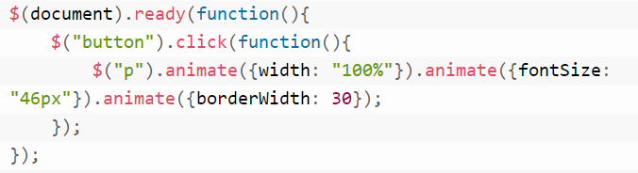
Method Chaining
The jQuery provides another robust feature called method chaining that allows us to perform multiple action on the same set of elements, all within a single line of code
This is possible because most of the jQuery methods return a jQuery object that can be further used to call another method

Slide 22
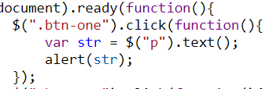
jQuery Getters & Setter
text() - method is either used to get the combined text contents of the selected elements, including their descendants, or set the text contents of the selected elements.
html() - method is used to get or set the HTML contents of the elements.
attr() - method to either get the value of an element's attribute or set one or more attributes for the selected element.
val() - method is mainly used to get or set the current value of the HTML form elements such as <input>, <select> and <textarea>

Slide 23
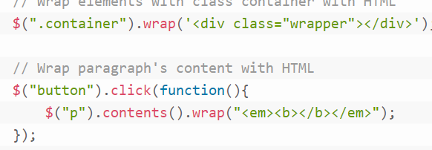
jQuery Insert New Content
jQuery provides several methods, like append(), prepend(), html(), text(), before(), after(), wrap() etc. that allows us to insert new content inside an existing element.
append() - method is used to insert content to the end of the selected elements.
prepend() - method is used to insert content to the beginning of the selected elements.
before() - method is used to insert content before the selected elements.
after() - method is used to insert content after the selected elements.
after() - method is used to insert content after the selected elements.

Slide 24
jQuery Remove Elements or Contents
jQuery provides handful of methods, such as empty(), remove(), unwrap() etc. to remove existing HTML elements or contents from the document.
empty() - method removes all child elements as well as other descendant elements and the text content within the selected elements from the DOM.
remove() - method removes the selected elements from the DOM as well as everything inside it.
unwrap() - method removes the parent elements of the selected elements from the DOM.
removeAttr() - method removes an attribute from the selected elements.

Slide 25
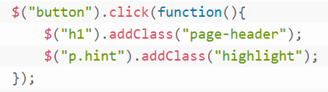
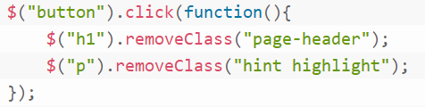

CSS Classes Manipulation
addClass() - method adds one or more classes to the selected elements.
removeClass() - method can remove a single class, multiple classes, or all classes at once from the selected elements.
toggleClass() - add or remove one or more classes from the selected elements in such a way that if the selected element already has the class, then it is removed; if an element does not have the class, then it is added i.e. toggle classes.

Slide 26

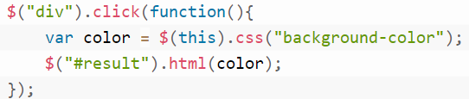

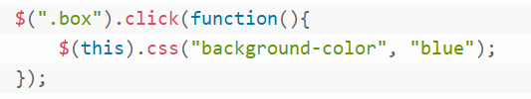
jQuery Get and Set CSS Properties
css() - method is used to get the computed value of a CSS property or set one or more CSS properties for the selected elements.
Get a css property
Set a css property

Slide 27
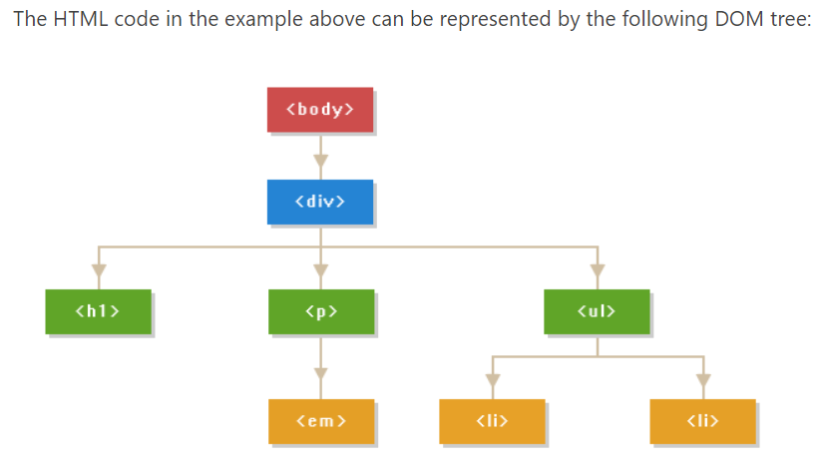
jQuery Traversing
DOM traversing is one of the prominent features of the jQuery. To make the most it you need to understand the relationships between the elements in a DOM tree.

Slide 28

Traversing Ancestors
parent() - method is used to get the direct parent of the selected element.
parents() - method is used to get the ancestors of the selected element.
parentsUntil() - method is used to get all the ancestors up to but not including the element matched by the selector.

Slide 29

Down the DOM Tree
jQuery provides the useful methods such as children() and find() that you can use to traverse down in the DOM tree either single or multiple levels to easily find or get the child or other descendants of an element in the hierarchy.
children() - method is used to get the direct children of the selected element
find() - method is used to get the descendant elements of the selected element.

Slide 30
Traversing Sideways in DOM Tree
siblings() - method is used to get the sibling elements of the selected element.
next() - method is used to get the immediately following sibling i.e. the next sibling element of the selected element.
nextAll() - method is used to get all following siblings of the selected element.
nextUntil() - method is used to get all the following siblings up to but not including the element matched by the selector.
prev() - method is used to get the immediately preceding sibling i.e. the previous sibling element of the selected element.
prevAll() - method is used to get all preceding siblings of the selected element.
prevUntil() - method is used to get all the preceding siblings up to but not including the element matched by the selector.

Slide 31

Filtering the Elements Selection
first() - method filters the set of matched elements and returns the first element from the set.
last() - method filters the set of matched elements and returns the last element from the set.
eq() - method filters the set of matched elements and returns only one element with a specified index number.

Slide 32
filter() - method can take the selector or a function as its argument to filters the set of matched elements based on a specific criteria.
has() - method filters the set of matched elements and returns only those elements that has the specified descendant element.
slice() - method filters the set of matched elements specified by a range of indices.
not() - method filters the set of matched elements and returns all elements that does not met the specified conditions. It can take the selector or a function as its argument.

Slide 33
jQuery Ajax
Different browsers implement the Ajax differently that means if you're adopting the typical JavaScript way to implement the Ajax you have to write the different code for different browsers to ensure that Ajax would work cross-browser.
It offers simple methods such as load(), $.get(), $.post(), etc. to implement the Ajax that works seamlessly across all the browsers.

Slide 34
load() - method loads data from the server and place the returned HTML into the selected element. This method provides a simple way to load data asynchronous from a web server.
The parameters of the load() method has the following meaning:
The required URL parameter specifies the URL of the file you want to load.
The optional data parameter specifies a set of query string (i.e. key/value pairs) that is sent to the web server along with the request.
The optional complete parameter is basically a callback function that is executed when the request completes. The callback is fired once for each selected element.

Slide 35
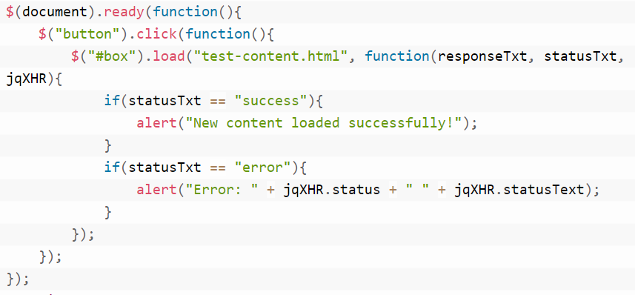
callback function can have three different parameters:
responseTxt — Contains the resulting content if the request succeeds.
statusTxt — Contains the status of the request such as success or error.
jqXHR — Contains the XMLHttpRequest object.

Slide 36
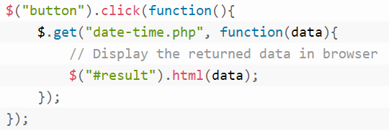
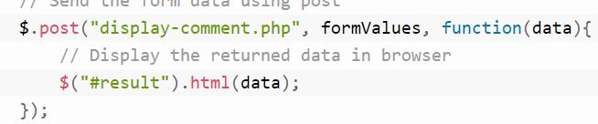
jQuery Ajax GET and POST Requests
The jQuery's $.get() and $.post() methods provide simple tools to send and retrieve data asynchronously from a web server. Both the methods are pretty much identical, apart from one major difference — the $.get() makes Ajax requests using the HTTP GET method, whereas the $.post() makes Ajax requests using the HTTP POST method.

Slide 37
Links:
https://www.freecodecamp.org/learn/front-end-libraries/jquery/
https://www.tutorialrepublic.com/jquery-examples.php
https://jquery.com/download/

Slide 38


