Slide 1
Conditional statements. Loops
By Nataliia Skrebets

Slide 2
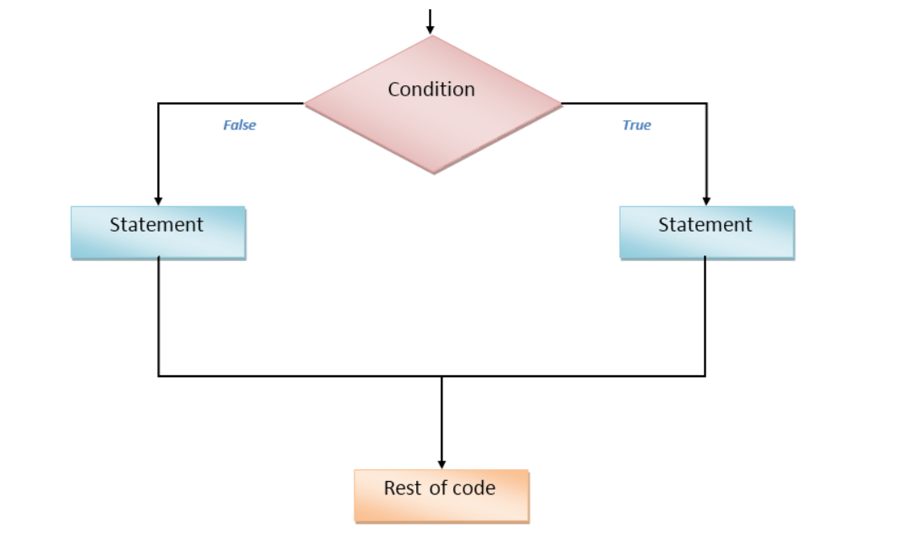
Conditional statements are used to decide the flow of execution based on different conditions. If a condition is true, you can perform one action and if the condition is false, you can perform another action.

Slide 3

Different Types of Conditional Statements
There are mainly three types of conditional statements in JavaScript.
If statement
If…Else statement
If…Else If…Else statement
if statement
The if statement is the fundamental control statement that allows JavaScript to make decisions and execute statements conditionally.
Syntax
The syntax for a basic if statement is as follows −

Slide 4
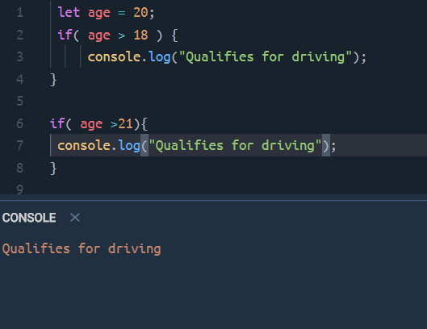

Slide 5
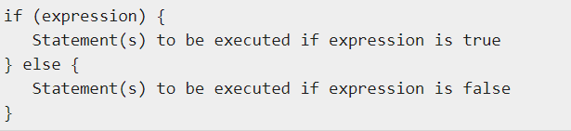
if...else statement
The 'if...else' statement is the next form of control statement that allows JavaScript to execute statements in a more controlled way.
Syntax:

Slide 6
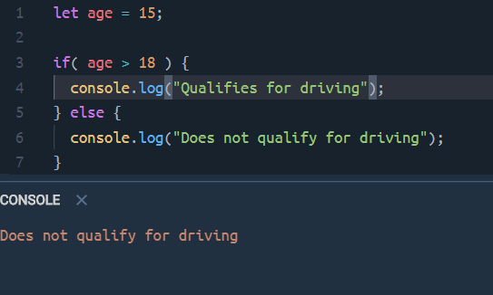

Slide 7
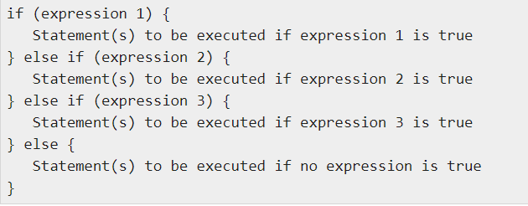
if...else if... Statement
The if...else if... statement is an advanced form of if…else that allows JavaScript to make a correct decision out of several conditions.
Syntax

Slide 8
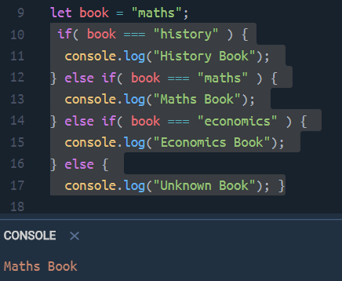

Slide 9

Ternary operator
The ternary operator is a substitute for an if statement in which both the if and else clauses assign different values to the same field.
The ternary operator shortens this if/else statement into a single statement.

Slide 10
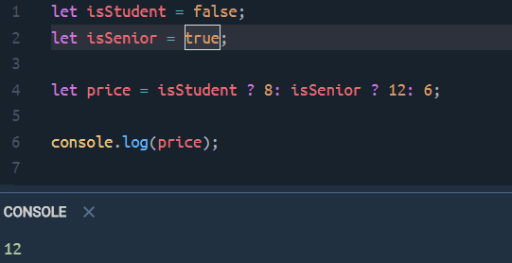

Slide 11
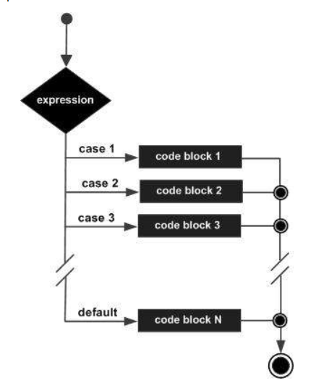
Switch Statement
Use the switch statement to select one of many code blocks to be executed.

Slide 12
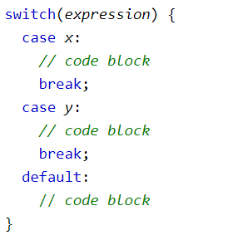
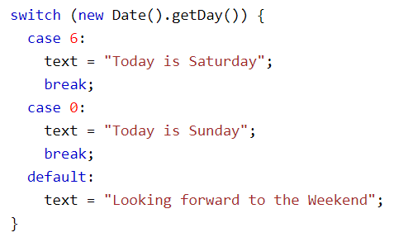

Slide 13
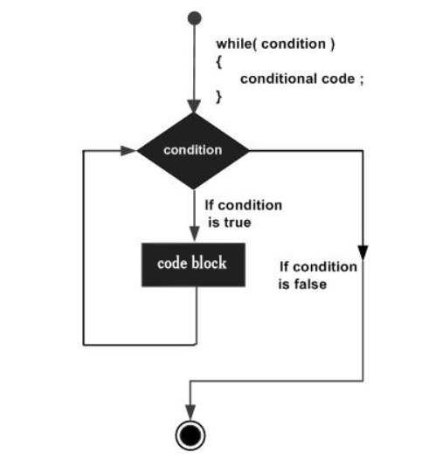
The while Loop
The most basic loop in JavaScript is the while loop which would be discussed in this chapter. The purpose of a while loop is to execute a statement or code block repeatedly as long as an expression is true. Once the expression becomes false, the loop terminates.

Slide 14

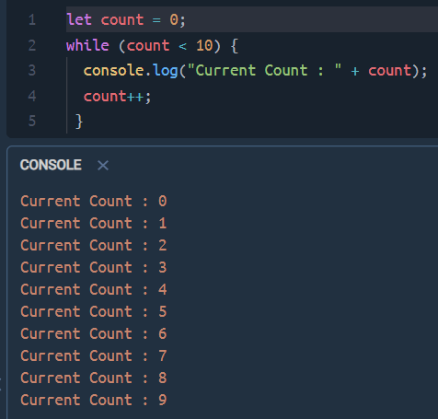
Syntax

Slide 15
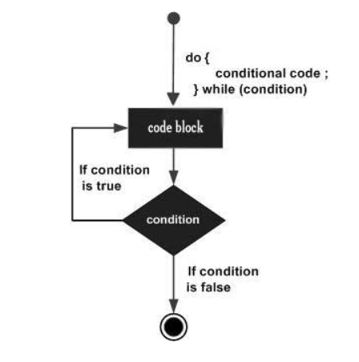
The do...while Loop
The do...while loop is similar to the while loop except that the condition check happens at the end of the loop. This means that the loop will always be executed at least once, even if the condition is false.

Slide 16
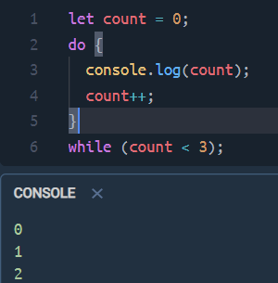

Syntax

Slide 17
For Loop
The 'for' loop is the most compact form of looping. It includes the following three important parts −
The loop initialization where we initialize our counter to a starting value. The initialization statement is executed before the loop begins.
The test statement which will test if a given condition is true or not. If the condition is true, then the code given inside the loop will be executed, otherwise the control will come out of the loop.
The iteration statement where you can increase or decrease your counter.

Slide 18
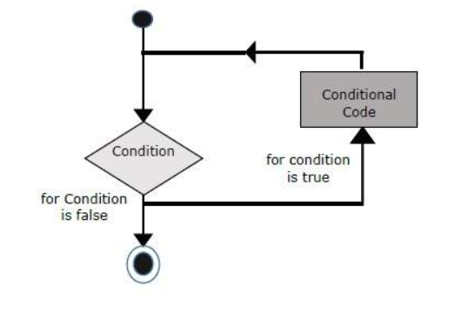

Slide 19

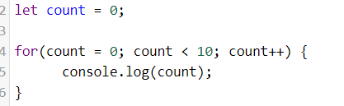
Syntax

Slide 20

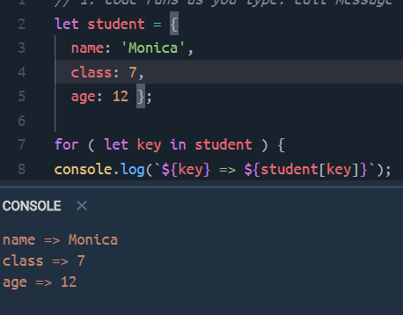
for...in
The for...in loop is used to loop through an object's properties.

Slide 21

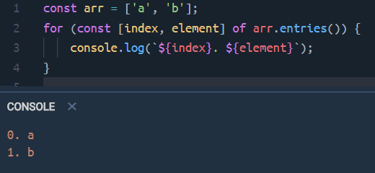
For of
Use it to loop over iterable objects (Arrays, strings, Maps, Sets, etc.; see Chap. “Iterables and iterators”)

Slide 22
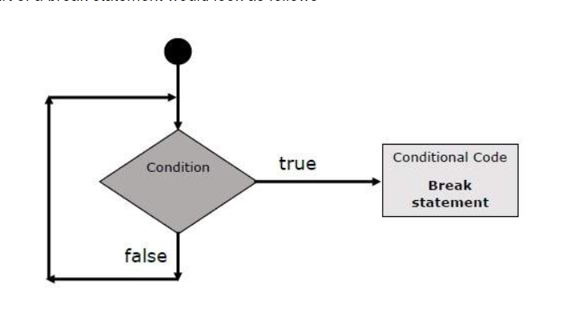
The break Statement
The break statement, which was briefly introduced with the switch statement, is used to exit a loop early, breaking out of the enclosing curly braces.

Slide 23
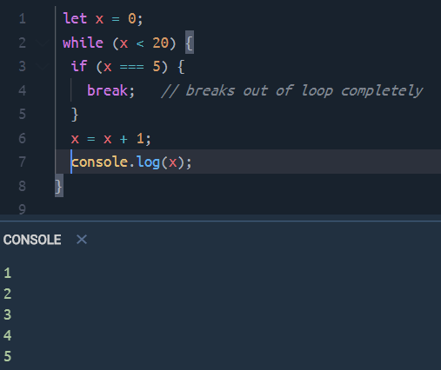

Slide 24
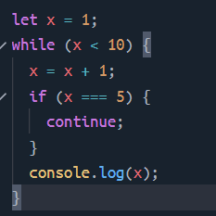
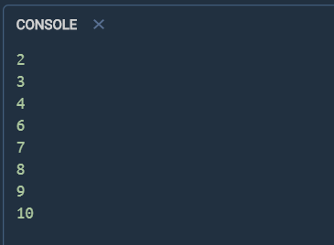
The continue Statement
The continue statement tells the interpreter to immediately start the next iteration of the loop and skip the remaining code block. When a continue statement is encountered, the program flow moves to the loop check expression immediately and if the condition remains true, then it starts the next iteration, otherwise the control comes out of the loop.

Slide 25
Using Labels to Control the Flow
Starting from JavaScript 1.2, a label can be used with break and continue to control the flow more precisely. A label is simply an identifier followed by a colon (:) that is applied to a statement or a block of code.
Note − Line breaks are not allowed between the ‘continue’ or ‘break’ statement and its label name. Also, there should not be any other statement in between a label name and associated loop.

Slide 26
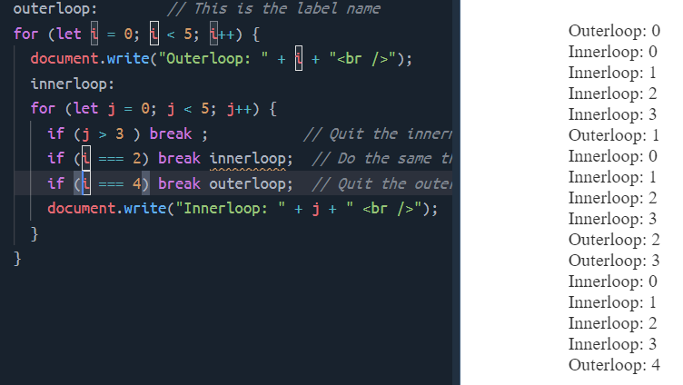

Slide 27
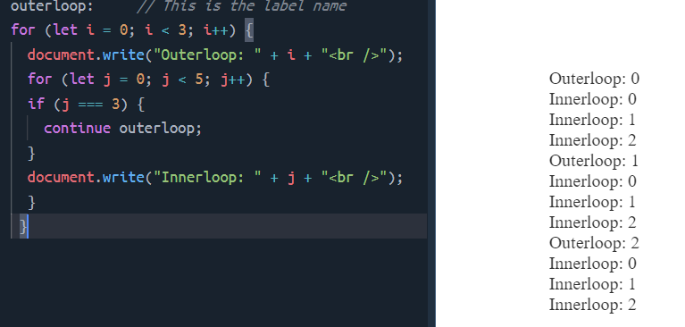

Slide 28


