Slide 1
Object class. Object methods
By Nataliia Skrebets

Slide 2
Agenda
Object constructor
Static methods
Instance properties
Instance methods

Slide 3
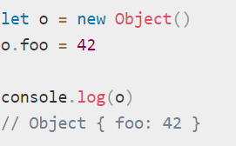
Objects are variables. But objects can contain many values.
Constructor Object() - Creates a new Object object. It is a wrapper for the given value.
The Object constructor creates an object wrapper for the given value.
If the value is null or undefined, it will create and return an empty object.
Otherwise, it will return an object of a Type that corresponds to the given value.
If the value is an object already, it will return the value.
When called in a non-constructor context, Object behaves identically to new Object().

Slide 4
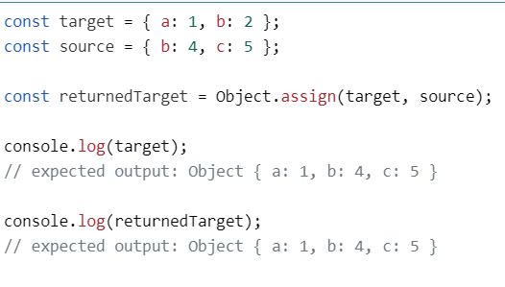
Static methods
Object.assign() - Copies the values of all enumerable own properties from one or more source objects to a target object.

Slide 5
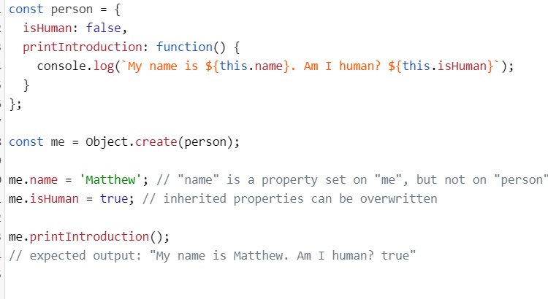
Object.create()-Creates a new object with the specified prototype object and properties.

Slide 6
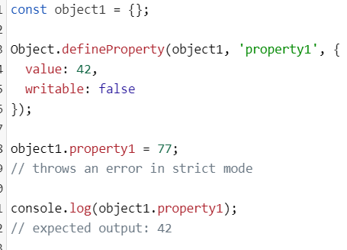
Object.defineProperty() Adds the named property described by a given descriptor to an object.

Slide 7
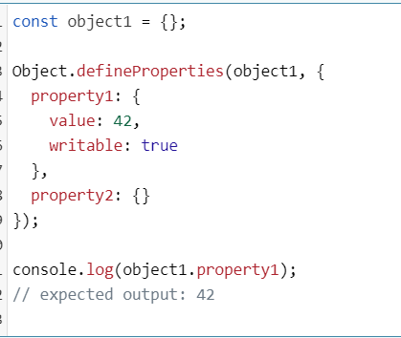
Object.defineProperties() - Adds the named properties described by the given descriptors to an object.

Slide 8
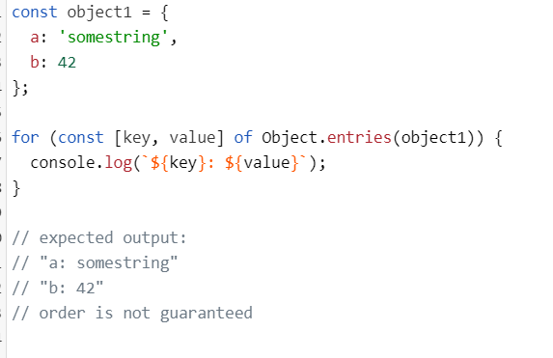
The Object.entries() method returns an array of a given object's own enumerable string-keyed property [key, value] pairs, in the same order as that provided by a for...in loop.

Slide 9
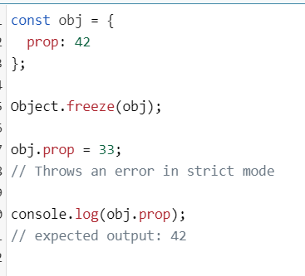
Object.freeze() - Freezes an object. Other code cannot delete or change its properties.

Slide 10
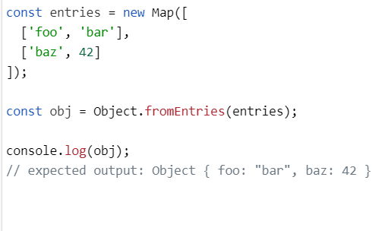
Object.fromEntries() - Returns a new object from an iterable of [key, value] pairs. (This is the reverse of Object.entries.)

Slide 11
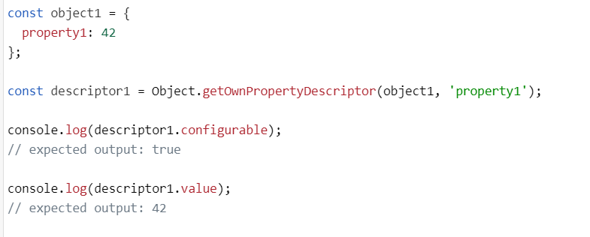
Object.getOwnPropertyDescriptor() - returns a property descriptor for a named property on an object.

Slide 12
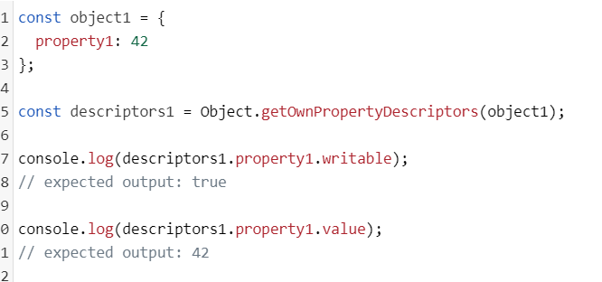
Object.getOwnPropertyDescriptors() - Returns an object containing all own property descriptors for an object.

Slide 13
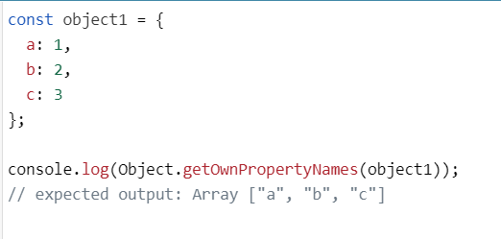
Object.getOwnPropertyNames() - Returns an array containing the names of all of the given object's own enumerable and non-enumerable properties.

Slide 14
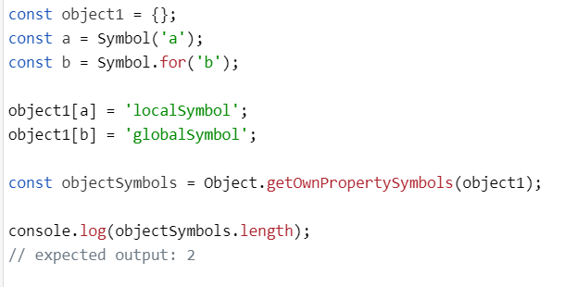
Object.getOwnPropertySymbols() - Returns an array of all symbol properties found directly upon a given object.

Slide 15
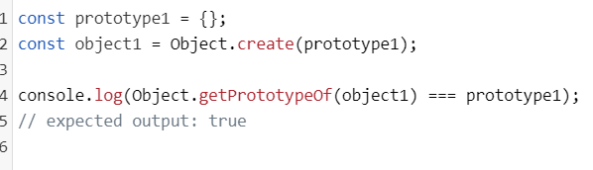
Object.getPrototypeOf() - returns the prototype (internal [[Prototype]] property) of the specified object.

Slide 16
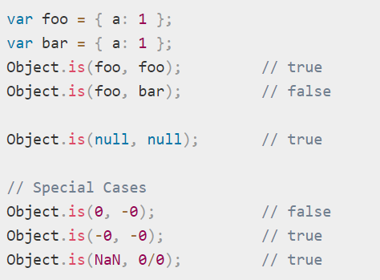
Object.is() Compares if two values are the same value. Equates all NaN values (which differs from both Abstract Equality Comparison and Strict Equality Comparison).

Slide 17
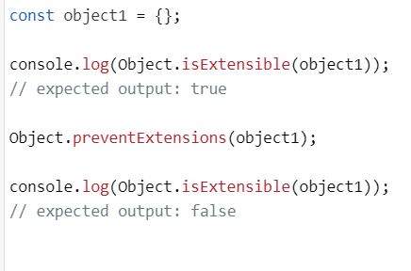
Object.isExtensible() method determines if an object is extensible (whether it can have new properties added to it).

Slide 18
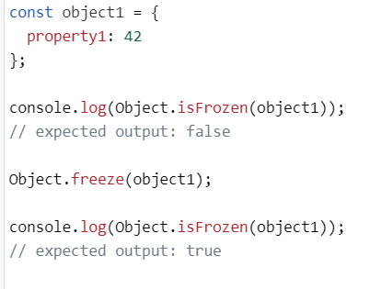
Object.isFrozen() Determines if an object was frozen.

Slide 19
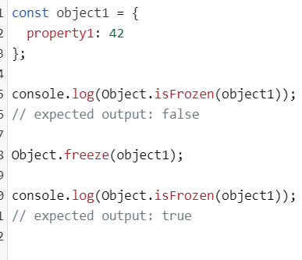
Object.isFrozen() - Determines if an object was frozen.

Slide 20
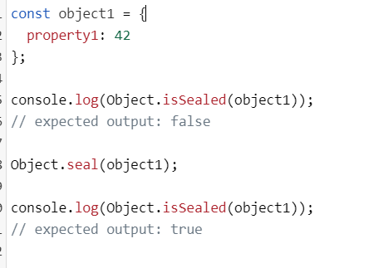
Object.isSealed() - Determines if an object is sealed.

Slide 21
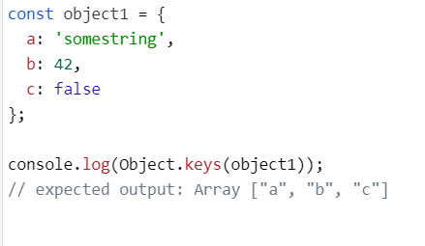
Object.keys() - Returns an array containing the names of all of the given object's own enumerable string properties.

Slide 22
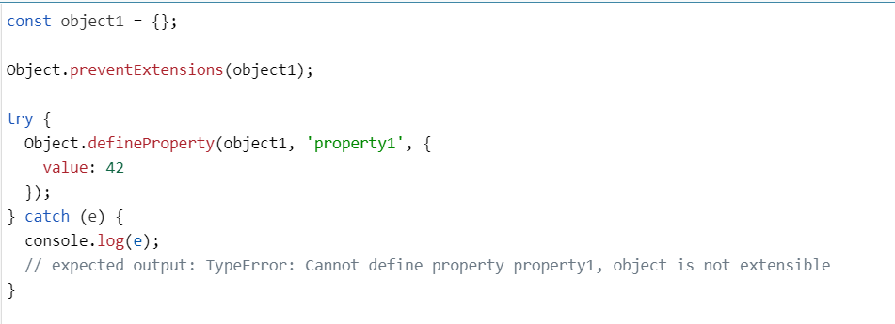
Object.preventExtensions() Prevents any extensions of an object.

Slide 23
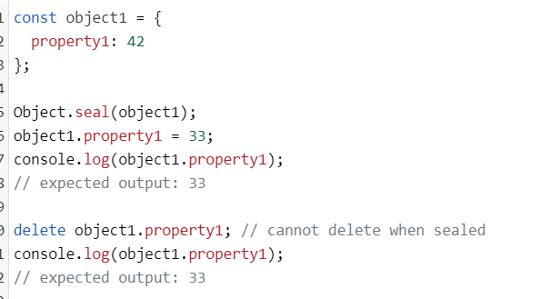
Object.seal() - Prevents other code from deleting properties of an object.

Slide 24
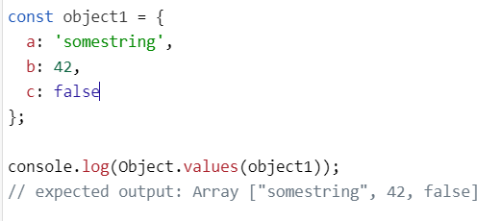
Object.values() method returns an array of a given object's own enumerable property values, in the same order as that provided by a for...in loop. (The only difference is that a for...in loop enumerates properties in the prototype chain as well.)

Slide 25
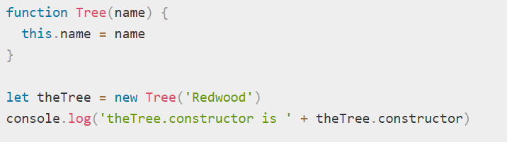
Instance properties
Object.prototype.constructor - Specifies the function that creates an object's prototype.

Slide 26
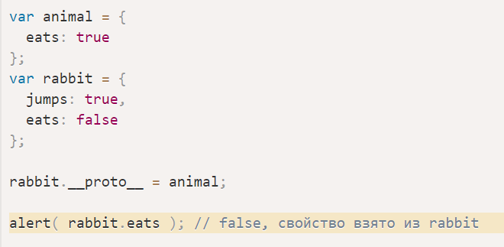
Object.prototype.__proto__ Points to the object which was used as prototype when the object was instantiated.

Slide 27
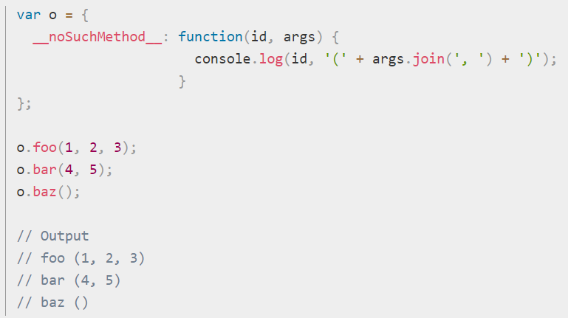
Object.prototype.__noSuchMethod__ Allows a function to be defined that will be executed when an undefined object member is called as a method.

Slide 28
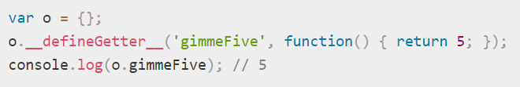
Instance methods
Object.prototype.__defineGetter__() Associates a function with a property that, when accessed, executes that function and returns its return value.

Slide 29
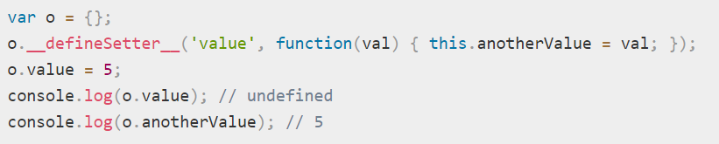
Object.prototype.__defineSetter__() Associates a function with a property that, when set, executes that function which modifies the property.

Slide 30
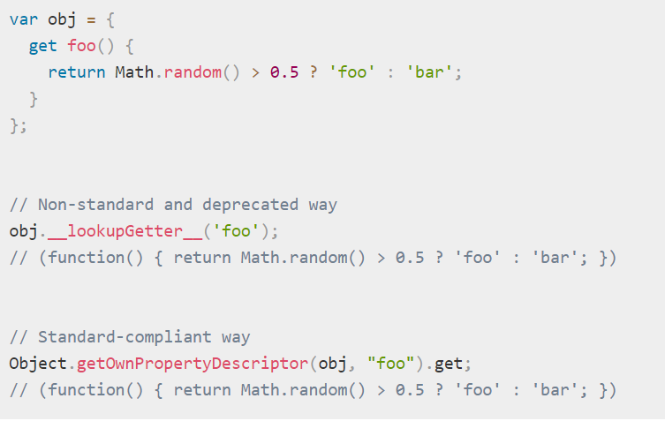
Object.prototype.__lookupGetter__() Returns the function associated with the specified property by the __defineGetter__() method.

Slide 31
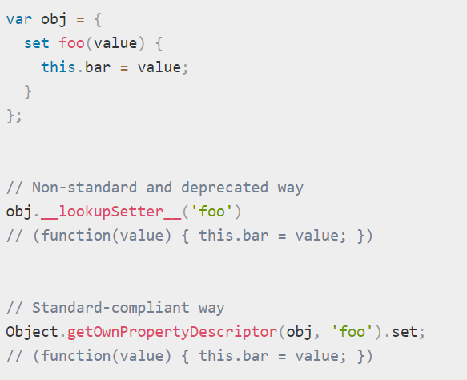
Object.prototype.__lookupSetter__() Returns the function associated with the specified property by the __defineSetter__() method.

Slide 32
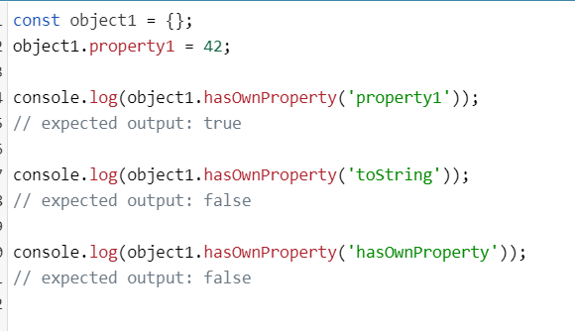
Object.prototype.hasOwnProperty() - Returns a boolean indicating whether an object contains the specified property as a direct property of that object and not inherited through the prototype chain.

Slide 33
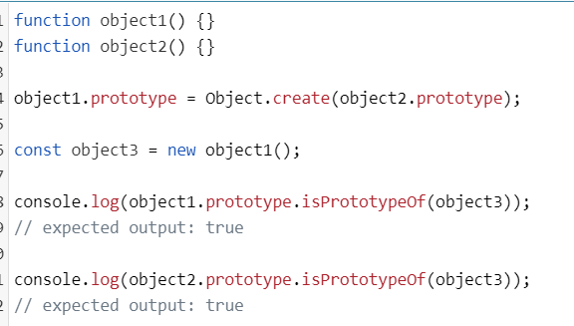
Object.prototype.isPrototypeOf() Returns a boolean indicating whether the object this method is called upon is in the prototype chain of the specified object.

Slide 34
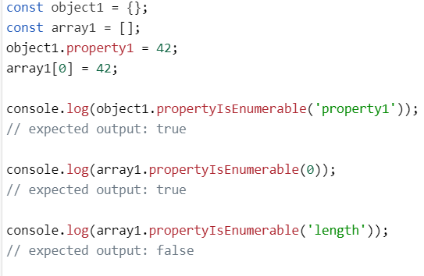
Object.prototype.propertyIsEnumerable() Returns a boolean indicating if the internal ECMAScript [[Enumerable]] attribute is set.

Slide 35
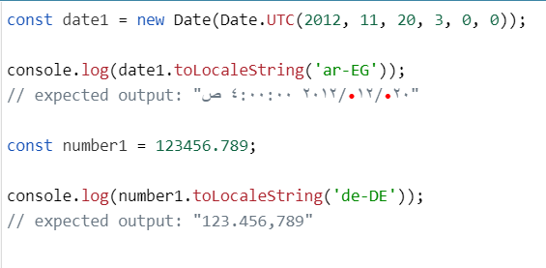
Object.prototype.toLocaleString() - Calls toString().

Slide 36
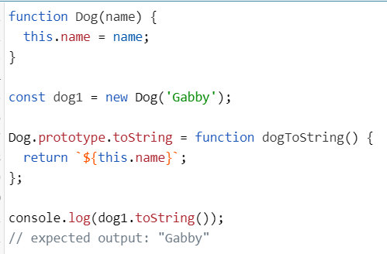
Object.prototype.toString() Returns a string representation of the object.

Slide 37
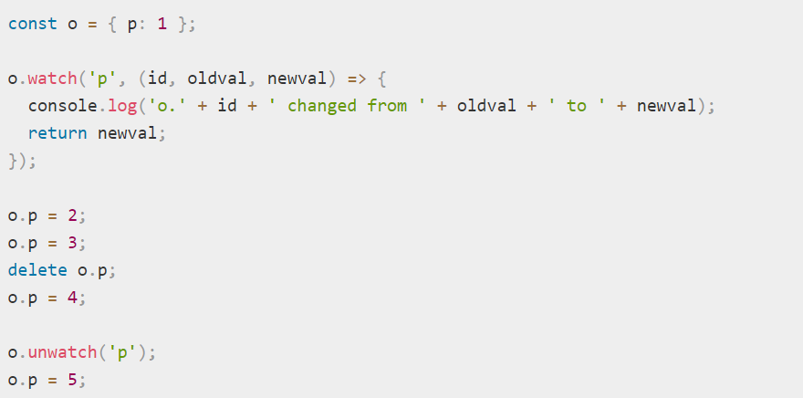
Object.prototype.unwatch() Removes a watchpoint from a property of the object.
Object.prototype.watch() Adds a watchpoint to a property of the object.

Slide 38
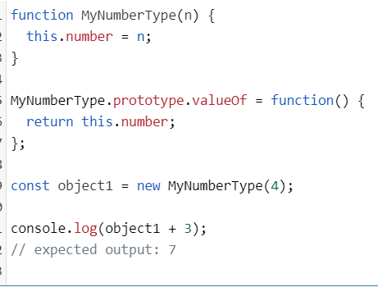
Object.prototype.valueOf() Returns the primitive value of the specified object.

Slide 39


