Slide 1
Accelerated DATABASE RECOVERY
The Future of the Transaction Log
SQL Saturday Indianapolis – August 17, 2019

Slide 2
About Me
Frank Gill
Senior Data Engineer with Concurrency
20 years in IT
12 as a SQL Guy
@skreebydba
skreebydba@gmail.com
skreebydba.com

Slide 3
What We Will Cover
Transactions
Transaction log
Transaction log architecture
Current crash recovery process
Accelerated Database Recovery (ADR)
ADR crash recovery process

Slide 4
Transactions
Unit of work in the database
All transactions begin
Transactions can commit or rollback
Default behavior is auto-commit

Slide 5
Transaction Log
Records all changes to the database
On commit transaction log records are written to disk
CHECKPOINT process writes active log records to disk
Data pages associated with transactions can remain in memory

Slide 6
Transaction Log Architecture
Transaction log contains logical units called Virtual Log Files (VLF)
VLFs can be active or free
VLFs containing log records that may be needed must be active
In FULL recovery, log records are retained until LOG backup
Log records are also needed for rollback and high availability
In SIMPLE recovery, VLFs freed by CHECKPOINT operation
In FULL recovery, VLFs freed by LOG backup

Slide 7
Virtual Log Files
VLF1
VLF2
VLF3
VLF4
Active
Free
Free
Free

Slide 8
Transaction 1 Commits
Tran1
VLF1
VLF2
VLF3
VLF4
Active
Active
Free
Free

Slide 9
Transaction 2 Commits
Tran1
Tran2
VLF1
VLF2
VLF3
VLF4
Active
Active
Active
Free

Slide 10
Transaction 3 Begins
Tran1
Tran2
Tran3
VLF1
VLF2
VLF3
VLF4
Active
Active
Active
Active

Slide 11
Log Backup or Checkpoint
Tran3
VLF1
VLF2
VLF3
VLF4
Free
Free
Active
Active

Slide 12
Transaction 3 Continues
Tran1
Tran2
Tran3
VLF1
VLF2
VLF3
VLF4
Active
Active
Active
Active

Slide 13
Transaction Log Growth
Tran1
Tran2
Tran3
VLF1
VLF2
VLF3
VLF4
VLF5
Active
Active
Active
Active
Active

Slide 14
Current Crash Recovery Process
3 phases
Analysis – Scans log from last checkpoint
Transaction committed but not hardened to disk
Transactions not committed
Redo
Committed transactions hardened to disk
Undo
Uncommitted transactions rolled back

Slide 15
Crash Recovery
Oldest Uncommitted Transaction
Oldest Checkpoint
VLF1
VLF2
VLF3
VLF4
Active
Free
Free
Free

Slide 16
Analysis
Oldest Uncommitted Transaction
Oldest Checkpoint
Analysis
VLF1
VLF2
VLF3
VLF4
Active
Free
Free
Free

Slide 17
Redo
Oldest Uncommitted Transaction
Oldest Checkpoint
Analysis
Redo
VLF1
VLF2
VLF3
VLF4
Active
Free
Free
Free

Slide 18
Undo
Oldest Uncommitted Transaction
Oldest Checkpoint
Undo
Analysis
Redo
VLF1
VLF2
VLF3
VLF4
Active
Free
Free
Free

Slide 19
What It Looks Like in the Error Log

Slide 20
And Now…The Future

Slide 21
What You’ve All Been Waiting For!!!The Future

Slide 22

The Future!!!

Slide 23
ACCELERATE DATABASE RECOVERY (ADR)
New feature in SQL Server 2019
Enable with ALTER DATABASE…SET ACCELERATED_DATABASE_RECOVERY = ON
Currently available in SQL Server 2019 CTP 3.2
Rumor has it this will be enterprise-only feature

Slide 24
Accelerated Database Recovery – New Concepts
Persisted Version Store (PVS) – contains previous versions of modified rows, stored in the user database
Logical revert – On rollback, running transactions pull row version from the PVS
sLog – In-memory log stream that stores non-versioned activity (locks for DDL, metadata cache invalidation, and bulk activity)
Cleaner – periodic process that cleans up unneeded row versions

Slide 25
ADR Analysis
Oldest Uncommitted Transaction
Oldest Checkpoint
Analysis
VLF1
VLF2
VLF3
VLF4
Active
Free
Free
Free

Slide 26
Redo From sLog
Oldest Uncommitted Transaction
Oldest Checkpoint
Analysis
Redo from sLog
VLF1
VLF2
VLF3
VLF4
Active
Free
Free
Free

Slide 27
Redo From tLog
Oldest Uncommitted Transaction
Oldest Checkpoint
Analysis
Redo from sLog
Redo from tLog
VLF1
VLF2
VLF3
VLF4
Active
Free
Free
Free

Slide 28

Redo From TLog
Oldest Uncommitted Transaction
Oldest Checkpoint
Undo from sLog
Analysis
Redo from sLog
Redo from tLog
VLF1
VLF2
VLF3
VLF4
Active
Free
Free
Free

Slide 29
What It Looks Like in the Error Log

Slide 30
Benefits of ADR
Faster crash recovery
Faster AG failover
Faster rollback
Fast log truncation means smaller logs

Slide 31
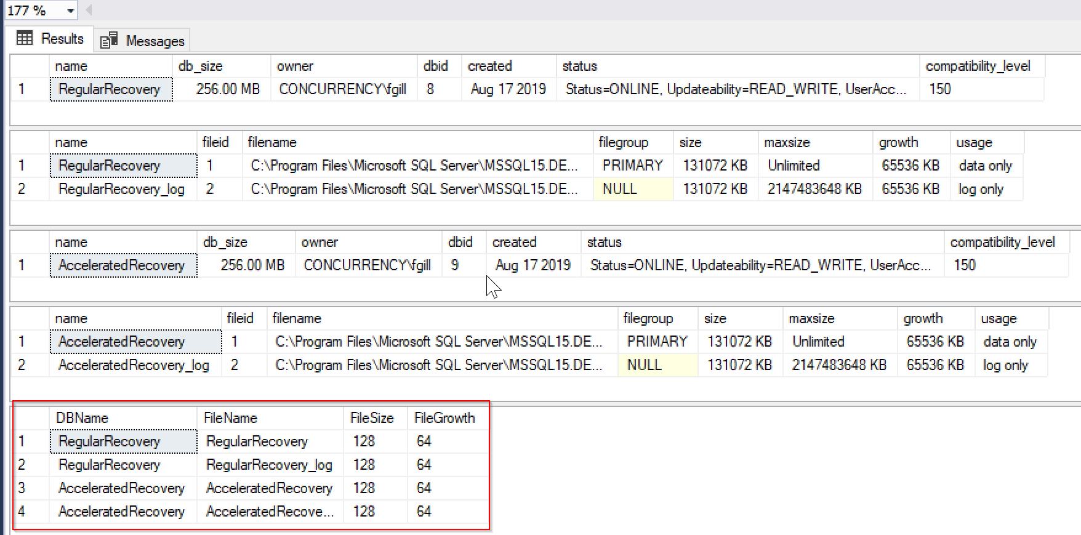
Crash Recovery Demo

Slide 32
Crash Recovery Demo
DECLARE @waitfor DATETIME;
SELECT @waitfor = CAST(DATEADD(SECOND, 10, CURRENT_TIMESTAMP) AS TIME);
WAITFOR TIME @waitfor;
BEGIN TRANSACTION
DROP TABLE IF EXISTS dbo.fl1, dbo.fl2, dbo.fl3;
SELECT s2.* INTO dbo.fl1 FROM sys.all_columns AS s1 CROSS JOIN sys.all_objects AS s2;
SELECT s2.* INTO dbo.fl2 FROM sys.all_columns AS s1 CROSS JOIN sys.all_objects AS s2;
SELECT s2.* INTO dbo.fl3 FROM sys.all_columns AS s1 CROSS JOIN sys.all_objects AS s2;

Slide 33
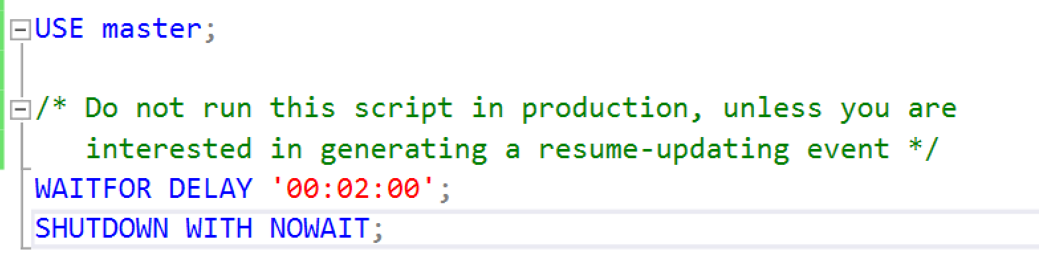
Shutdown SQL Server Instance

Slide 34

Crash Recovery Results

Slide 35
AG Failover Demo
DECLARE @waitfor DATETIME;
SELECT @waitfor = CAST(DATEADD(SECOND, 10, CURRENT_TIMESTAMP) AS TIME);
WAITFOR TIME @waitfor;
BEGIN TRANSACTION
DROP TABLE IF EXISTS dbo.fl1, dbo.fl2, dbo.fl3;
SELECT s2.* INTO dbo.fl1 FROM sys.all_columns AS s1 CROSS JOIN sys.all_objects AS s2;
SELECT s2.* INTO dbo.fl2 FROM sys.all_columns AS s1 CROSS JOIN sys.all_objects AS s2;
SELECT s2.* INTO dbo.fl3 FROM sys.all_columns AS s1 CROSS JOIN sys.all_objects AS s2;

Slide 36
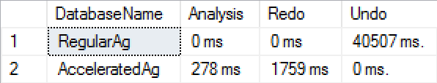
AG Failover Results

Slide 37
What We Have Covered
Transactions
Transaction log
Transaction log architecture
Current crash recovery process
Accelerated Database Recovery (ADR)
ADR crash recovery process

Slide 38
Resources
Accelerated Database Recovery Overview - https://docs.microsoft.com/en-us/azure/sql-database/sql-database-accelerated-database-recovery
Aaron Bertrand on ADR (source for the queries used) - https://www.mssqltips.com/sqlservertip/5971/accelerated-database-recovery-in-sql-server-2019/
The Future of the Future, Hyperscale - https://docs.microsoft.com/en-us/azure/sql-database/sql-database-service-tier-hyperscale
Link to slides and scripts - https://github.com/skreebydba/AcceleratedDatabaseRecovery/tree/master/AcceleratedDatabaseRecovery

