Slide 1
iFree
PDA-Based MP3 Player for the Blind
Phase III
CPSC 544 - Fall 2006
Andrew Kaufman
Arsham Skrenes
Alfred Pang

Slide 2
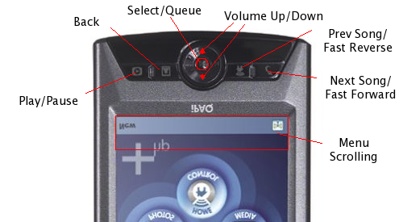
Physical Layout

Slide 3
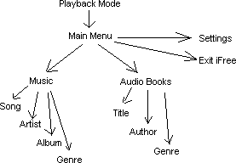
Menu Layout

Slide 4
Queuing
Running queue of songs to play
Add songs to end of queue
Queue single song or entire folder
Also can play immediately
  Interrupts queue

Slide 5
User Study
11 participants
  9 totally blind
  2 partially
Prelim survey
Tutorial
Directed tasks
Free play
Satisfaction survey

Slide 6
Directed Tasks
3 play immediate
  Start from main menu
  Find song
  Play it
3 queuing
  Start from current location
  Find song (or album)
    While music is playing
  Queue it

Slide 7
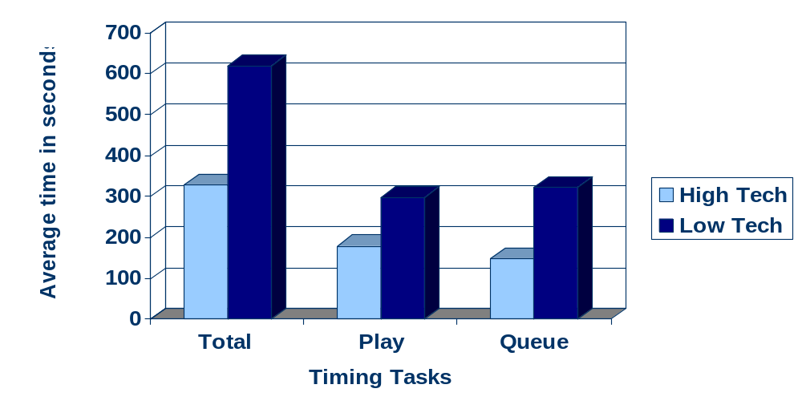
Differences in Task Time
High-Tech vs. Low-Tech Skilled Individuals

Slide 8
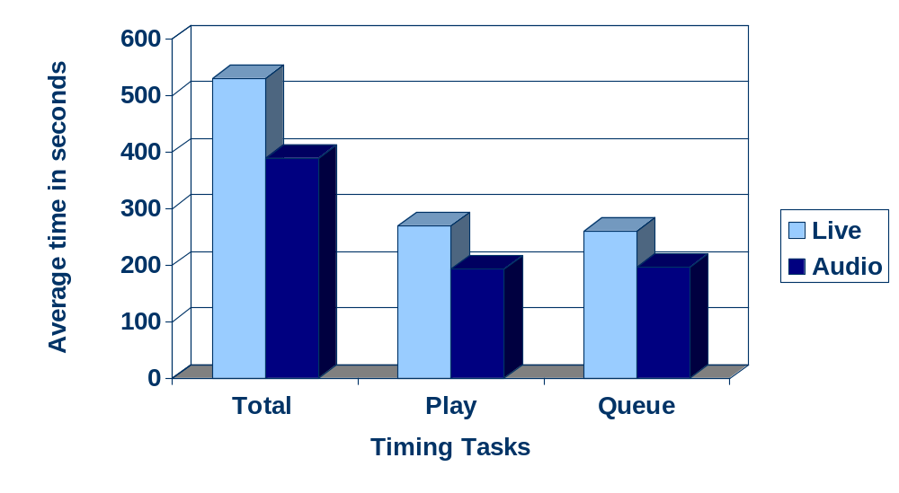
Differences in Task Time
Audio Instructions vs. Live Tutorial

Slide 9
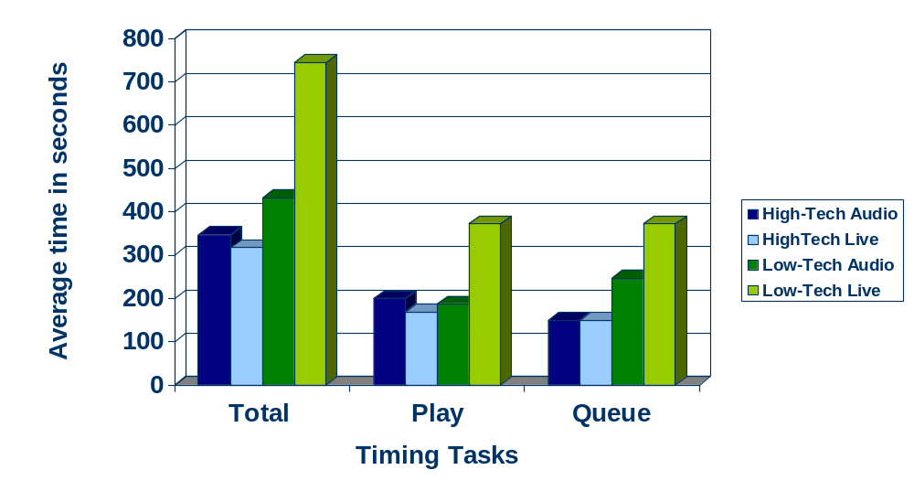
Differences in Task Time
Instructions within Tech Level

Slide 10
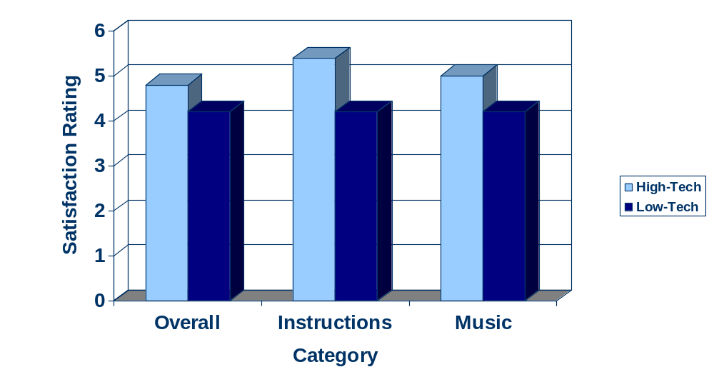
Differences in Satisfaction
High-Tech vs. Low-Tech Skilled Individuals

Slide 11
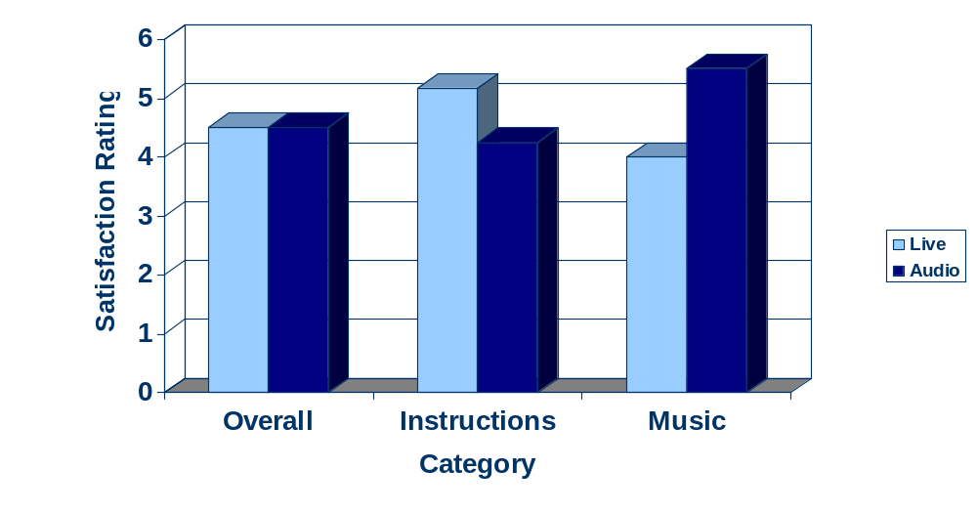
Differences in Satisfaction
Audio Instructions vs. Live Tutorial

Slide 12
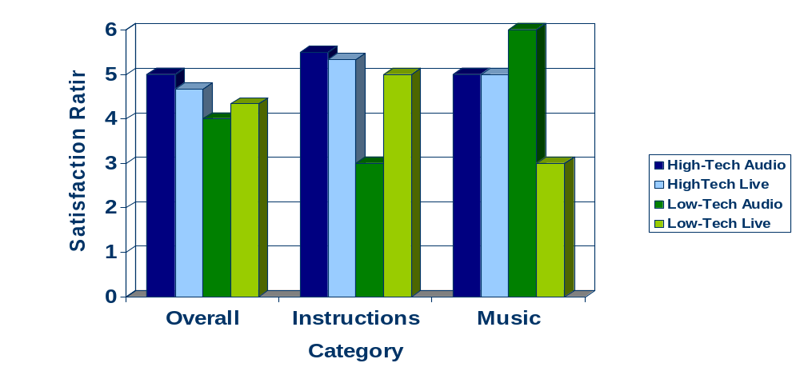
Differences in Satisfaction within Tech Level

Slide 13
User Experience
Hated touch screen
  Didn’t understand scrolling
  Suggested adding tactile pad over screen
Buttons too small
Liked menu structure
Liked queue and ability to search with music playing
Some offers to buy iFree

Slide 14
Questions
And comments

