Slide 1
Automated Medical Image Boundary Detection
Course: Computer Vision Techniques
Name: Sarathkumar Venkatesan
Instructor: Dr Meenakshi
Institution: SRM Institute of Science & Technology

Slide 2
Problem Statement
A hospital aims to assist doctors in accurately identifying tumor boundaries in MRI images. The objective is to develop an automated system that can detect object boundaries and highlight regions of interest, enabling faster and more reliable medical diagnosis.

Slide 3
Objectives
Develop an automated system to detect tumor boundaries in MRI images and highlight regions of interest.
Active Contours, Level Set, Mean Shift, and Split & Merge.
Perform boundary detection visualisation to identify abnormal regions clearly.
Compare segmentation methods and evaluate their accuracy using sample MRI images with performance metrics

Slide 4
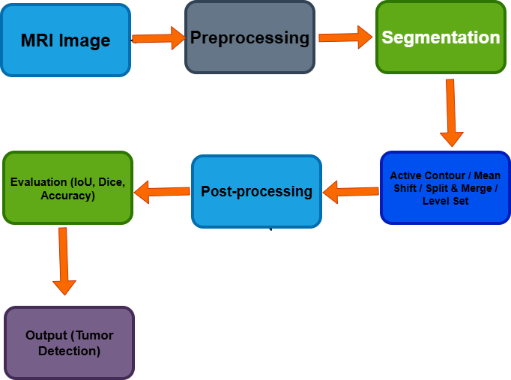
System Overview

Slide 5
Methodology
Image acquisition & preprocessing
Apply multiple segmentation methods
Generate binary masks
Evaluate using IoU, Dice, and accuracy
Compare results to find the best method

Slide 6
Techniques Used
Active Contour (Snakes): Detects object boundaries by evolving a curve towards the tumor edges.
Level Set Method: Captures complex and irregular tumor shapes using contour evolution.
Mean Shift Segmentation: Groups pixels based on intensity similarity to identify regions.
Split and Merge Segmentation: Divides the image into regions and merges similar areas based on homogeneity.

Slide 7
Algorithm Details
Preprocessing: Apply smoothing (Gaussian filter) and dynamic range normalization to improve image quality.
Active Contour (Snakes): Initializes a contour and iteratively moves it to fit the tumor boundary.
Level Set Method: Evolves contours to detect complex and irregular shapes.
Mean Shift Segmentation: Clusters pixels based on intensity (image resized for efficient processing).
Split & Merge: Divides the image into regions and merges similar areas based on uniformity.

Slide 8
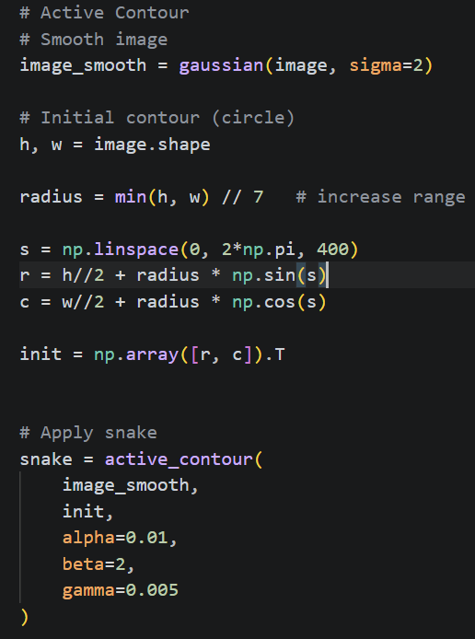
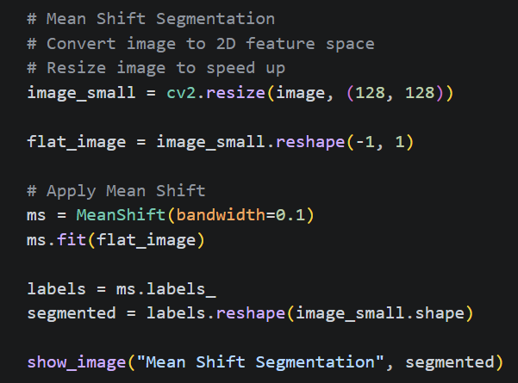
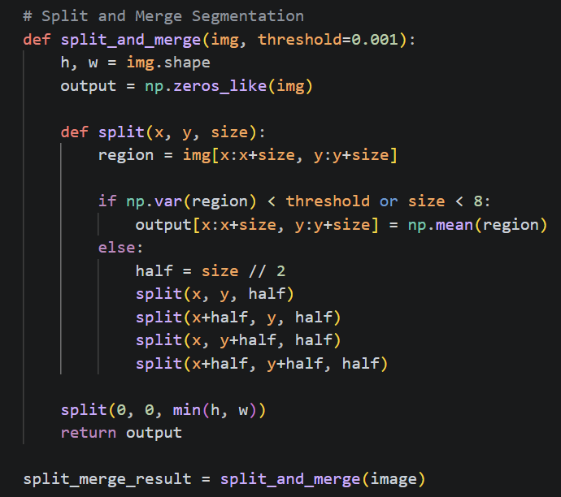
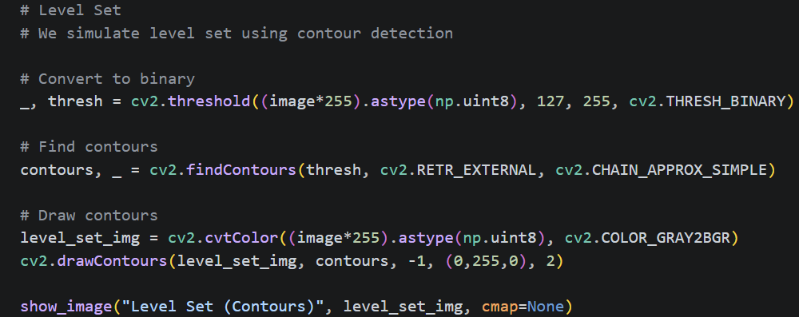
Implementation

Slide 9
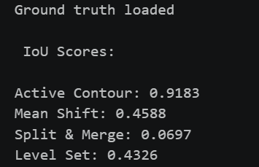
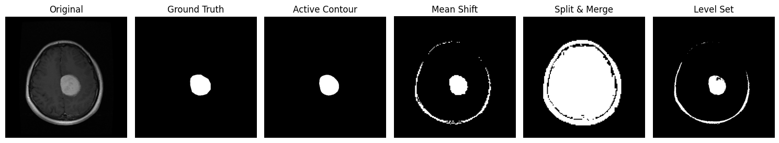
Results

Slide 10
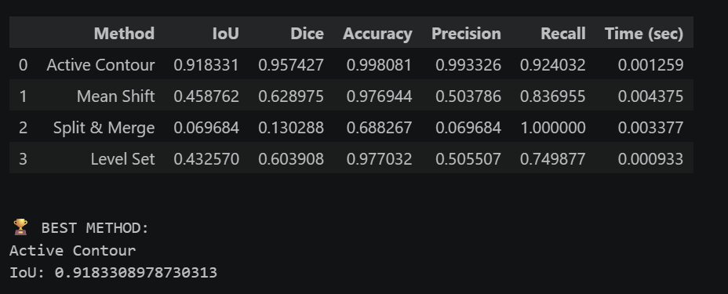
Performance Analysis

Slide 11
Advantages
Automated detection
Improved accuracy
Better visualization
Comparative analysis
Efficient processing
Supports medical diagnosis

Slide 12
Limitations
Sensitive to noise and contrast
Requires parameter tuning
Computationally expensive (Mean Shift)
Initialization issues (Snakes)
May struggle with complex boundaries

Slide 13
Conclusion
Developed an automated tumor detection system
Compared multiple segmentation methods
Evaluated using standard metrics
Identified best performing technique

Slide 14
Thank you

