Slide 1

DESIGN OF AN INTERACTIVE GAME IN A RECONFIGURABLE PLATFORM
Skrimponis panagiotis

Slide 2
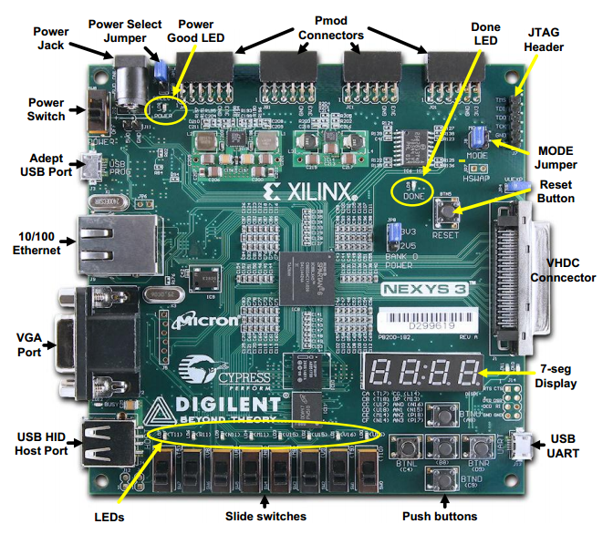
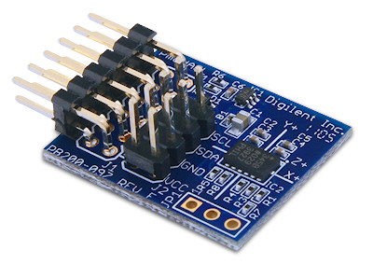
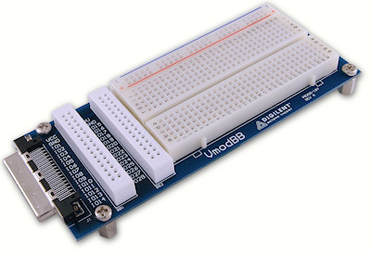
FPGA Kit
The Nexys3 circuit board is a complete, ready-to-use digital circuit development platform based on a Xilinx Spartan 6
The PmodACL is a 3-axis digital accelerometer module. It uses a standard 12-pin Pmod connector and can communicate via SPI
BreadBoard offers a ready-made solution for prototyping breadboarded circuits

Slide 3
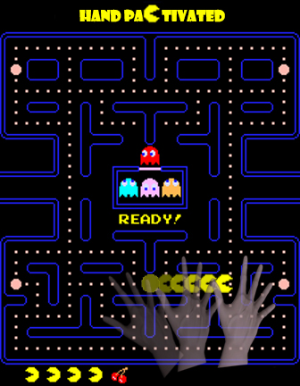
Pac-Man
The game control, data processing, audio and graphics are implemented in Verilog HDL Language.
The user move Pac-Man using an accelerometer connected via SPI interface to the board.

Slide 4
References
[1]: Nexys 3 Reference Manual http://www.digilentinc.com/Data/Products/NEXYS3/Nexys3_rm.pdf
[2]: The Pac-Man Dossier http://home.comcast.net/~jpittman2/pacman/pacmandossier.html
[3]: Accelerometer Reference Manual http://www.digilentinc.com/Data/Products/PMOD-ACL/PmodACL_rm.pdf
[4]: Embedded Systems Lab http://inf-server.inf.uth.gr/courses/CE435

