Slide 1


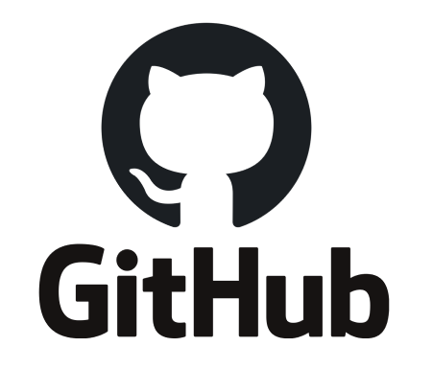
GIT – GitHub
Pull Request - CONFLICT

Slide 2
Creating a GitHub Repository
Creating a GitHub repository
Go to https://github.com/
Login with your account
Create a new repository with a proper name
Link this repository with your existing project on your local BUT
Cloning a GitHub repository
Go to an existing repository URL
Copy the SSH repository URL
Go to Terminal and navigate to folder that you want to clone the repository
Run the command git clone <url>
Instead of Terminal, you could use your Code Editor as well.

Slide 3
Collaborators
Go to your repository on GitHub
Select “Settings”
Select “Collaborators”
Select “Add People”
Search for person you want to add as a collaborator and send them an invitation

Slide 4
Pull Request
A pull request – also referred to as a merge request – is known as a contributor/developer is ready to begin the process of merging new code changes with the main project repository.
It is basically after you are done with your changes on your own branch, you request your changes to be merged with main remote branch.
Steps to create a Pull Request
Do your changes in a repository with your own branch
Push your code to your remote branch
Go to hosting website
Create a pull request from your branch to main branch (add reviewers if required as a policy)
After PR is created, your reviewer (if you add any) or yourself can merge the code to main branch (master).

Slide 5
Merge Conflict
This is a common issue when multiple people work on the same project.
It occurs when multiple people make changes on the same file.
We need to resolve the conflict before merging it to main branch (master).

