Slide 1


JavaScript Data Types
PRIMITIVES – REFERENCE TYPES

Slide 2
Data Types in JavaScript
Primitive Data Types
There are 7 primitives: String, Number, Bigint, Boolean, Undefined, Null, Symbol
Reference Data Types (non-primitives) - Objects
The object data type can contain arrays, objects, functions, collections, etc.

Slide 3

String
A String is a sequence of characters like "John Doe".
Strings are written with quotes. You can use single or double quotes.

Slide 4
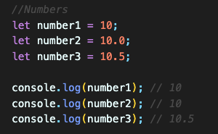
Number
All JS numbers are stored as decimal numbers (floating point).
Numbers can be written with, or without decimals.

Slide 5

BigInt
All JS numbers are stored in a a 64-bit floating-point format.
JavaScript BigInt is a new datatype (2020) that can be used to store integer values that are too big to be represented by a normal JavaScript Number.

Slide 6
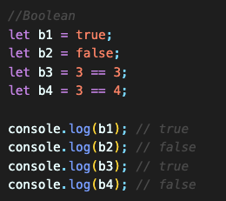
Boolean
Boolean can only have two values: true or false.
It is used often with conditional statements.

Slide 7
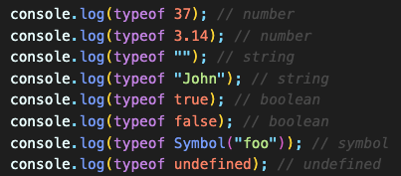
The typeof Operator
JS typeof operator helps finding the type of a variable.
The typeof operator returns the type of a variable or an expression.

Slide 8
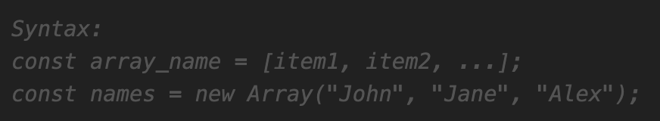
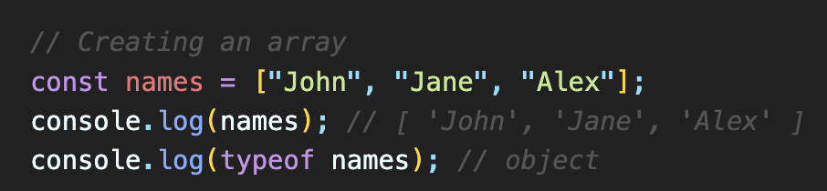
Arrays in JavaScript
JS Arrays are used to store multiple values in a single variable, instead of declaring separate variables for each value.
JS Array can be created using an array literal.
The two examples given do exactly the same but there is no need to use new Array().
For simplicity, readability and execution speed, use the array literal method.
Arrays are a special type of objects. The typeof operator in JavaScript returns "object" for arrays.

Slide 9
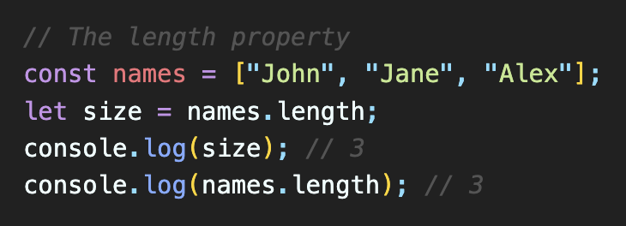
The length of an Array
length property - returns the length (size) of an array.
It returns the total number of elements stored in the array.

Slide 10
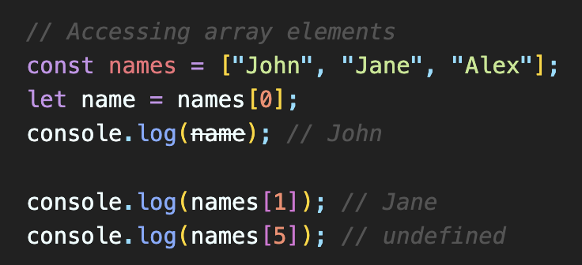
Accessing Array Elements
You can access an array element by referring to the index of the item.
Note: Array indexes start with 0.

Slide 11
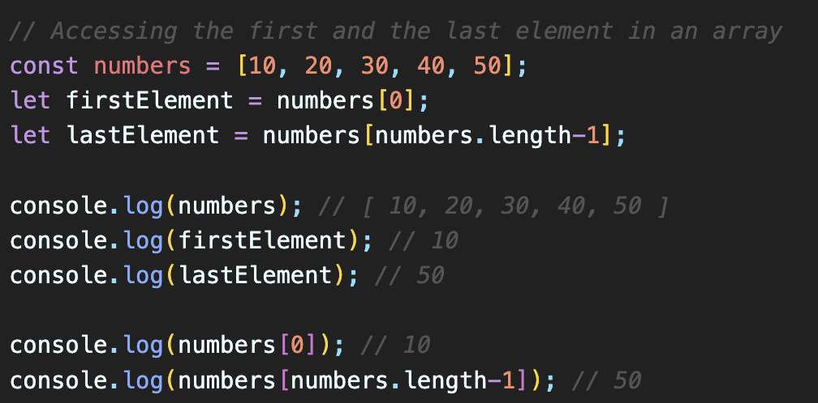
Accessing the First and Last Array Elements
You can access to first and last elements in an array using the indexes and length property.
Note: Array indexes start with 0.

Slide 12
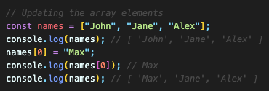
Updating Array Elements
You can access an array element by referring to the index of the item and reassign a value to the specified index.
Note: Array indexes start with 0.

Slide 13
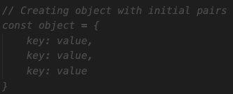
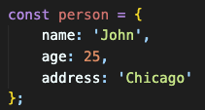
JS Objects
JS Objects are collections of properties. They are also variables at the same time.
Property: key-value pair
* All keys are converted to strings (except symbols).
We can access the data using custom keys not the indexes.
We can create an object using object literals {} or object constructor as below
const obj1 = {}; // empty object
const obj2 = new Object();
NOTE: It is a common practice to declare objects with the const keyword.

Slide 14
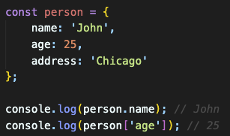
JS Object – Accessing properties
We can use object.key syntax to access to the value of the specified key. (dot notation)
We can also use object['key'] if the key is not a valid identifier. (bracket notation)
object.key
or
object['key']

Slide 15
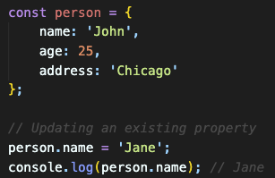
JS Object – Updating properties
We can access and update any property values of an object as below;
object.key = newValue;
or
object['key'] = newValue;

Slide 16
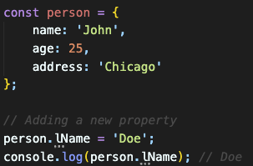
JS Object – Adding properties
We can add new property to an object as below;
object.newKey = newValue;
or
object[‘newKey'] = newValue;

Slide 17
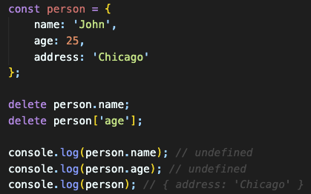
JS Object – Removing properties
We can remove a property of an object using delete keyword as below;
delete object.newKey;
or
delete object[‘newKey'];

