Slide 1


JavaScript Operators
Special Symbols

Slide 2
Operators in JavaScript
JavaScript has a wide range of operators that allow you to perform various operations on data.
Operators in JavaScript can be categorized into different types based on their functionality.
Here are some of the main types of operators in JavaScript:
Assignment Operators: Used to assign values to variables.
Arithmetic Operators: Used for basic arithmetic calculations.
Comparison Operators: Used to compare values.
Logical Operators: Used to perform logical operations.

Slide 3
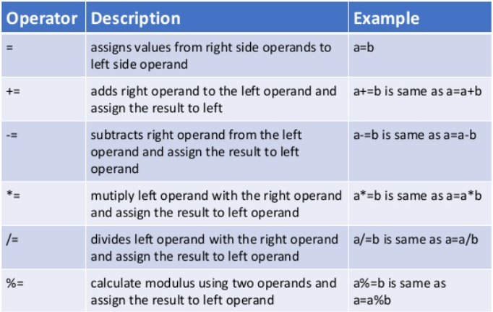
Assignment Operators
= is used to assign a value to a variable
+= addition assignment
-= subtraction assignment
*= multiplication assignment
**= exponentiation assignment
%= remainder assignment

Slide 4
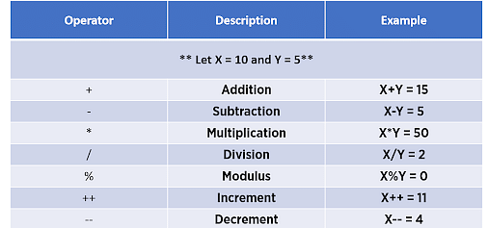
Arithmetic Operators
+ addition
- subtraction
* multiplication
** exponentiation
/ division
% modulus
++ increment
-- decrement

Slide 5
Practice
Create 2 variables and assign them numbers. Then, find the sum, subtraction, multiplication, division and remainder of these 2 numbers.
Use given numbers below
let num1 = 6;
let num2 = 4;

Slide 6
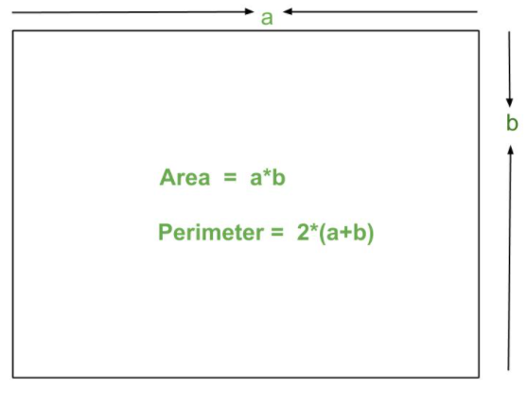
Practice
Write a program that calculates and outputs the area and perimeter of a rectangle. Interview Question!
NOTE: Same question could be asked for square, triangle etc.
Use formulas below to find area and perimeter of a rectangle

Slide 7
Practice
An annual average salary for an SDET in the Unites States is 120k. Write a program that calculates and prints the monthly and bi-weekly and weekly average amount that an SDET makes in the United States.
Annual average salary = $120,000.00
1 year = 12 months
1 year = 52 weeks
Biweekly = every other week

Slide 8
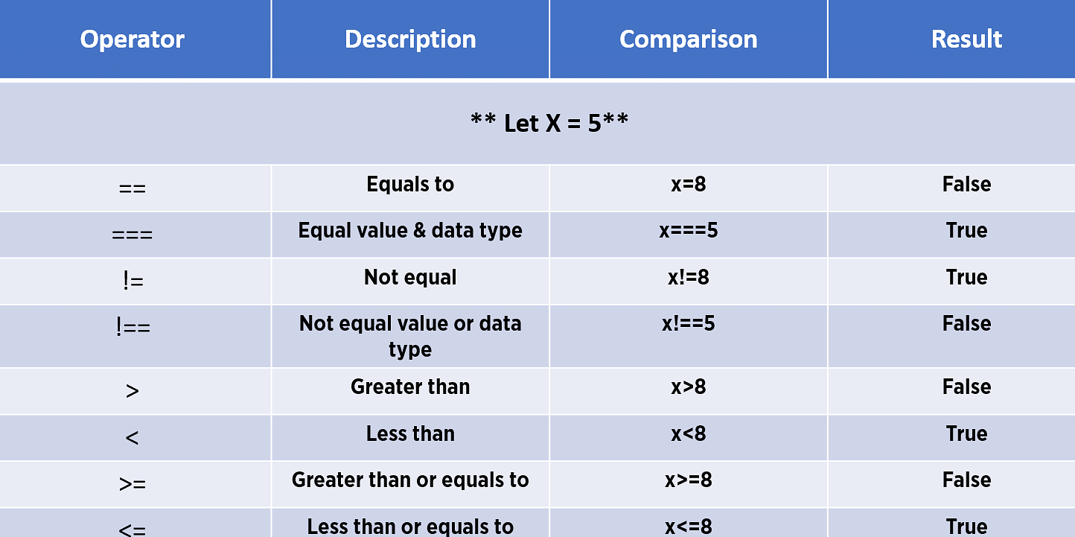
Comparison Operators
== equal to
=== equal value and equal type
!= not equal
!== not equal value or not equal type
> greater than
< less than
>= greater than or equal to
<= less than or equal to

Slide 9
Practice
Find if the following statements are true or false
let x = 10, y = 20, z = “10”;
x == z;
x === z;
y < z;
x <= y;
x >= z;
y > x;
x >= y;
(x >= z) < y;

Slide 10
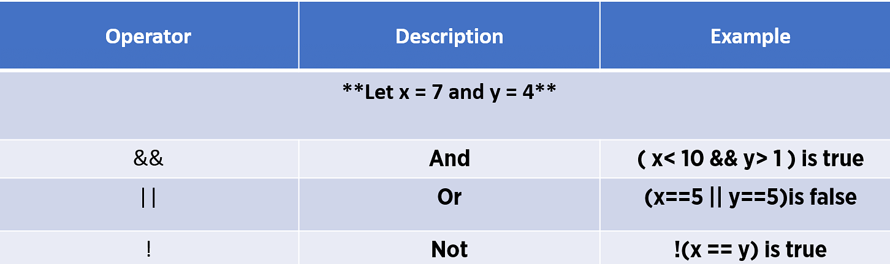
Logical Operators
&& logical and
|| logical or
! logical not

Slide 11
Logical AND (&&) Operators
AND operator syntax: condition1 && condition2
Expected results
false && false - returns false
false && true - returns false
true && false - returns false
true && true - returns true
It will return true only if both conditions are true
It will return false if one or both conditions are false

Slide 12
Logical OR (||) Operators
OR operator syntax: condition1 || condition2
Expected results
false || false - returns false
false || true - returns true
true || false - returns true
true || true - returns true
It will return false only if both conditions are false
It will return true if one or both conditions are true

Slide 13
Logical NOT (!) Operators
NOT operator syntax: !condition
Expected results
!false - returns true
!true - returns false

Slide 14
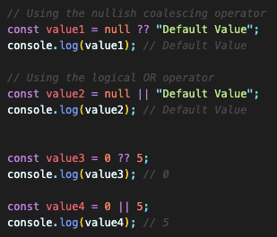
nullish coalescing operator (??)
The nullish coalescing operator (??) is a relatively new addition to JavaScript, introduced in ECMAScript 2020 (ES11).
It provides a concise way to handle default values for variables or expressions when dealing with null or undefined values.
NOTE: The key distinction between the nullish coalescing operator (??) and the logical OR operator (||) is in how they handle "falsy" values other than null and undefined.
The || operator evaluates to the right-hand value if the left-hand value is falsy (e.g., false, 0, an empty string, NaN, or null).
The ?? operator only checks for null or undefined.

